Slide 1

Rules You Wrote Against Weights Somebody Fitted

Slide 2

Why did it say that
Your program said hardware
The ticket was about a password
Somebody has to answer why
One of these systems can
MCCTC | AI Automation & Software Development
Notes:
Here is a help request about being locked out of an account. Two systems labelled it. One said account and one said hardware. In a minute I am going to ask each of them why, and only one of them is going to be able to tell me. That difference is the whole competency for today and it is the most likely thing from this module to show up on your exam.

Slide 3
Rules a person wrote
if "locked out" in text.lower():
return "account"
if "wifi" in text.lower():
return "network"
return "other"
MCCTC | AI Automation & Software Development
Notes:
Three lines. A person wrote every one of them and a person chose the order. You can read it. You can put a print statement above any branch. When it gives a wrong answer, there is a line to change. Hold on to those three facts because in two slides all three of them go away.

Slide 4
The reason is a line you can point at
account
branch account (getting in) fired on the phrase 'locked out'
MCCTC | AI Automation & Software Development
Notes:
That second line came out of the program itself. It is not a guess about what happened. The function that produced the label produced the reason at the same time, from the same branch. Nothing else in this course is going to be able to do that, so look at it while you can.

Slide 5

Weights fitted to data
A very large pile of numbers
Nudged until outputs matched examples
Nobody wrote a rule
Nobody can read one
MCCTC | AI Automation & Software Development
Notes:
A neural network is numbers. They were adjusted automatically, over and over, in whatever direction made the system's answers closer to a huge collection of examples. When it finishes, the numbers are the whole system. There is no list of rules inside it, no comments, and no line to point at.

Slide 6
The trade, both directions
Readable and brittle
Flexible and opaque
Trees are readable and brittle
Networks are flexible and opaque
Neither column is the good one
You are choosing what to give up
MCCTC | AI Automation & Software Development
Notes:
Write this down because it is the sentence people get wrong. A model is not a better if statement. You are giving up the readable reason in order to get coverage of cases nobody wrote a rule for. That is a trade, and which side you want depends on whether you would rather explain a wrong answer or have fewer of them.

Slide 7
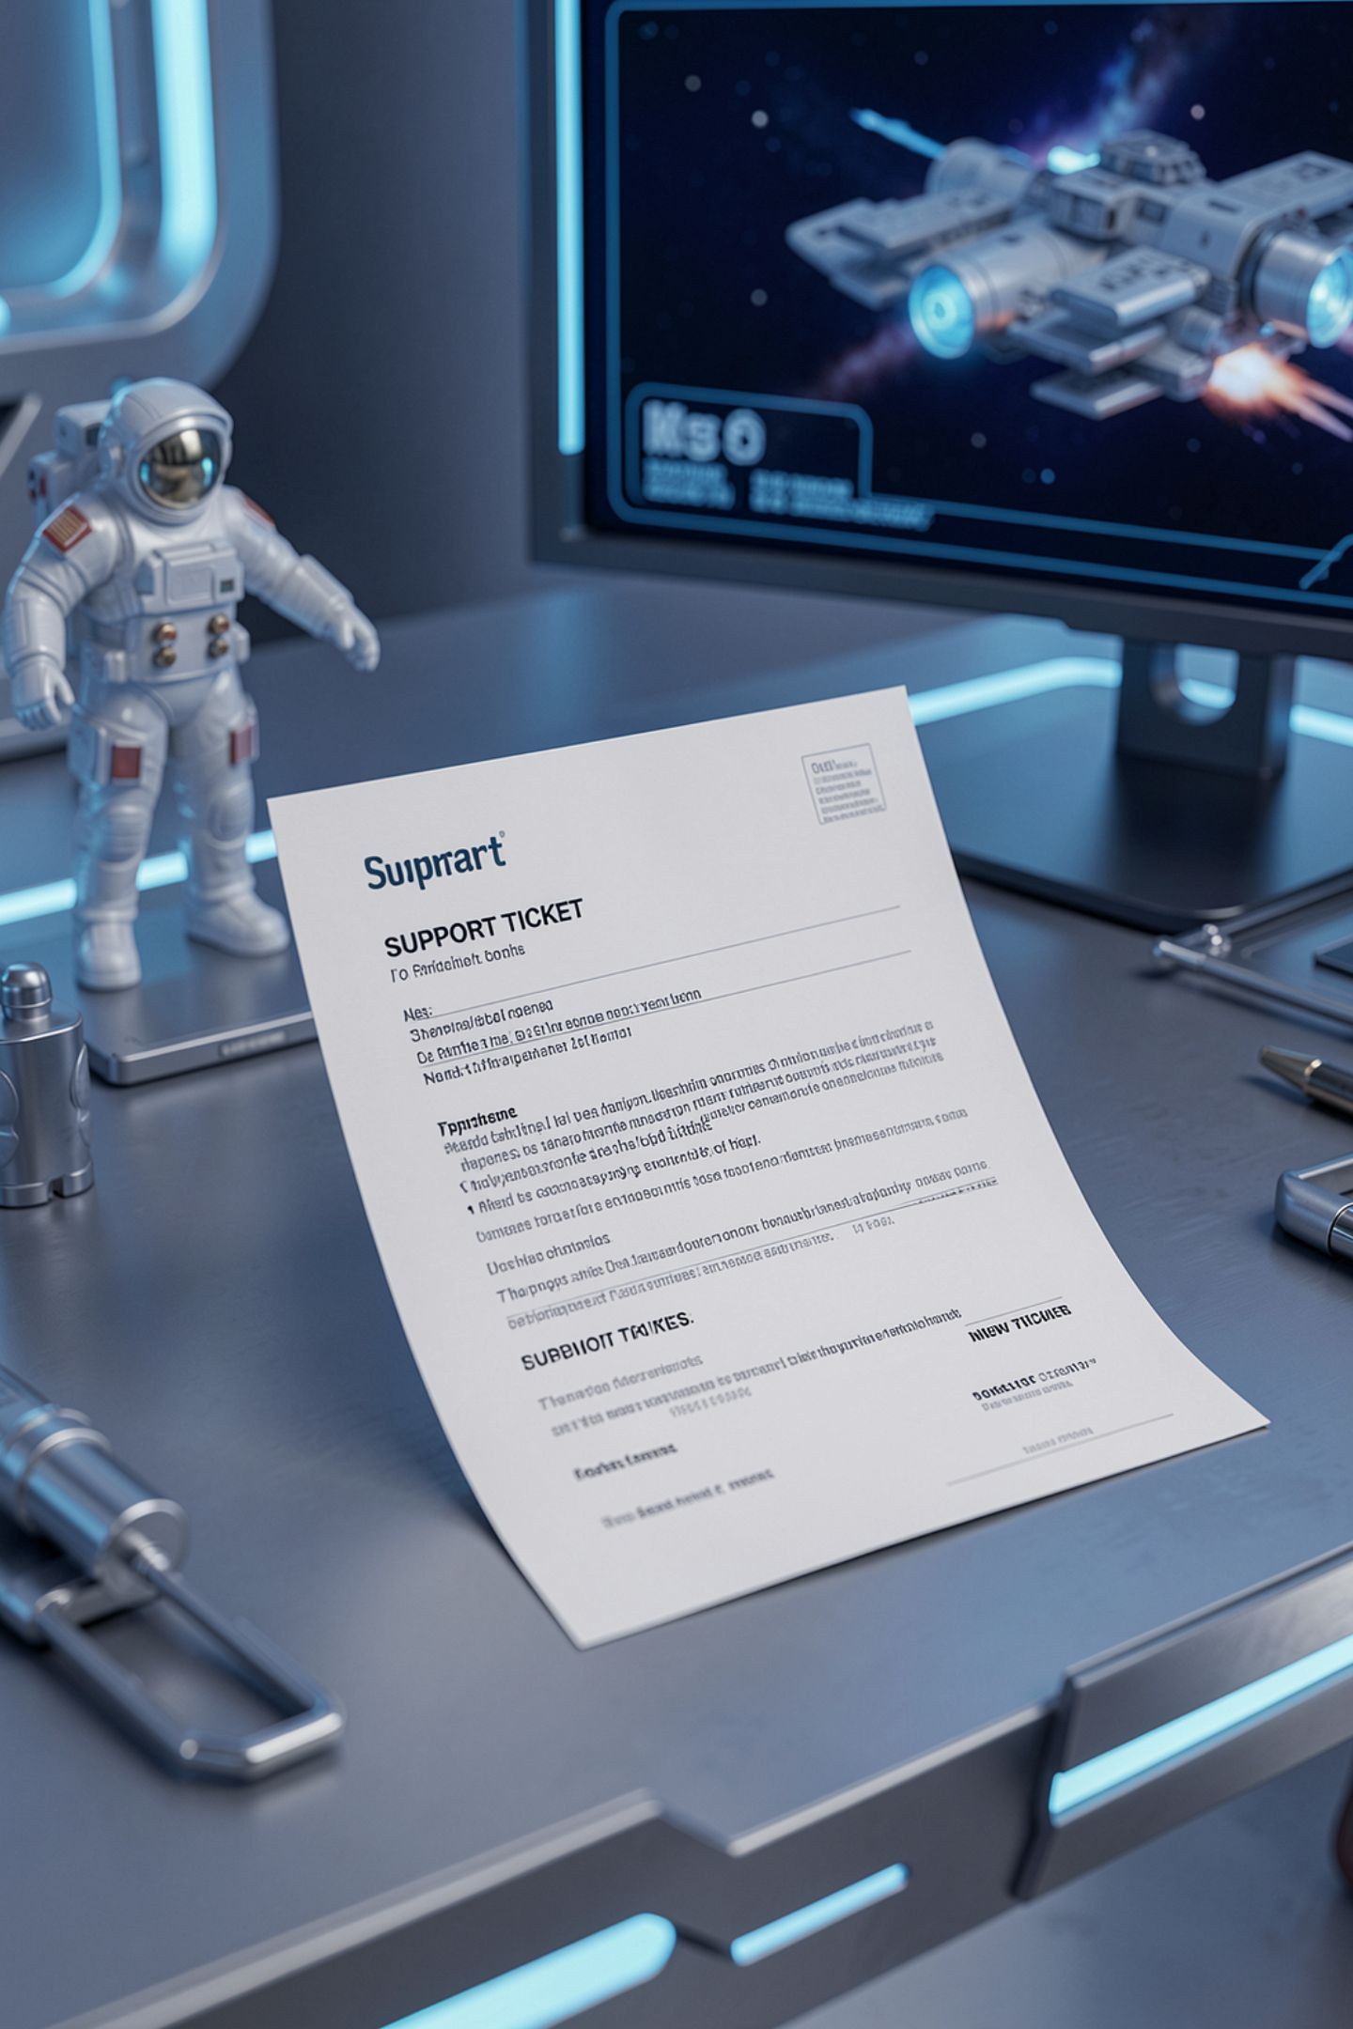
Watch what happens to one ticket
MT-2004 is about a password
The sentence contains the word screen
Your tree asks about getting in first
The other system matched screen
MCCTC | AI Automation & Software Development
Notes:
Here is the ticket. I am locked out of my account after changing my password, and the login screen accepts it on my phone. Three words in there could trigger three different branches. What the system answers depends entirely on which question somebody decided to ask first.

Slide 8
The real comparison
ticket staff your rules service source agree
------------------------------------------------------------
MT-2004 account account hardware model rules
MT-2008 software software hardware model rules
MCCTC | AI Automation & Software Development
Notes:
This is a real run from the lab you are about to do. Two tickets where the hand written rules agreed with the makerspace staff and the other side did not. Before anybody celebrates, look at the column headed source, because there is a problem with it and it is the most useful thing on this slide.

Slide 9

The wrong way to say it
We used AI instead of if statements
Because AI is more accurate
More accurate at what, than what
Measured how, on which examples
MCCTC | AI Automation & Software Development
Notes:
This sentence turns up in project write ups every single year. Accuracy is not a property a technology has. It is a number a specific system got on a specific test. And notice what the sentence quietly threw away: the tree could tell you which branch fired, and whatever replaced it cannot. That cost is real and the sentence does not mention it.

Slide 10
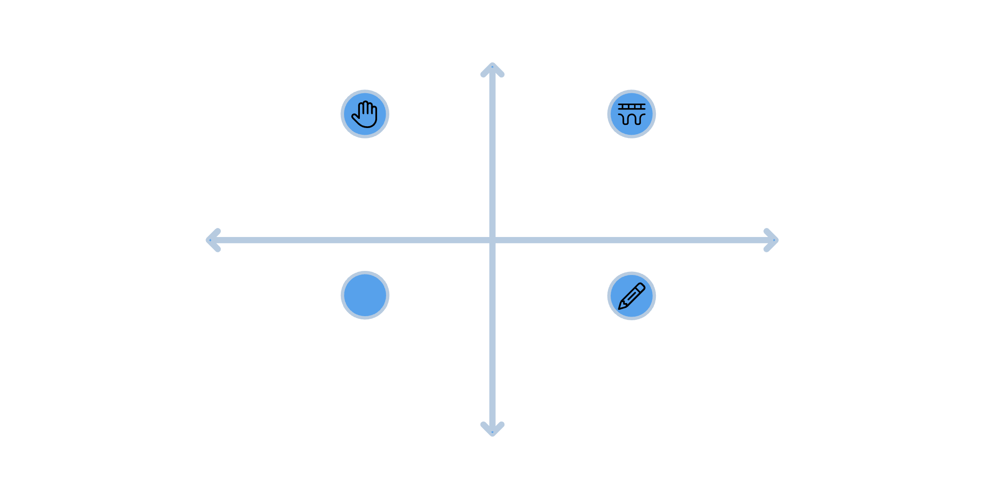
Where the clean story breaks
High Interpretability
Manual Rules - Expert-crafted paths
Hybrid Models - Expert rules plus data
Some trees are built from data
An algorithm picks each branch
That is machine learning, with a tree
The exam means hand written trees
Low Automation
High Automation
Algorithmic Trees - Learned from data
Exam-style Trees - Handwritten for tests
Low Interpretability
MCCTC | AI Automation & Software Development
Notes:
I am telling you this because somebody in here will find it and I would rather you hear it from me. The neat sentence, trees are written and networks are learned, is a starting point and not the whole truth. The property that actually divides them is whether a human authored the boundaries and whether you can read the result.

Slide 11
A tree fails visibly, a model fails fluently
Tree failure
Model failure
Nothing works, says ticket MT-2012
The tree falls through and says so
A model produces a label anyway
With a confident sentence explaining it
MCCTC | AI Automation & Software Development
Notes:
This is the difference that matters when a person is going to read the output. The tree has a no branch matched state and it reports it. A model has no such state. Asked for a label, it produces the tokens that look like a label, and it will explain its reasoning in a sentence that reads perfectly well and describes reasoning that never happened.

Slide 12

What you are about to build
Your own triage tree, nine tickets
Then the same tickets through the service
One table, every disagreement
And an argument about three of them
MCCTC | AI Automation & Software Development
Notes:
Build one is your decision tree in triage rules dot py, and check rules dot py tells you when the nine settled tickets pass. Build two runs both systems on the same twelve tickets and writes a comparison file. Three of those tickets have no agreed answer on purpose, and what you write about those three is the part I am going to read first.

