Slide 1

Tokens and the Context Window

Slide 2

It remembers me
You have felt this
The assistant knows your name
It picks up where you left off
Nothing is stored anywhere
MCCTC | AI Automation & Software Development
Notes:
Everybody in this room has had the experience of a chat assistant seeming to remember something about them. That experience is real and the explanation everybody carries for it is wrong. By the end of this period you will know exactly what is happening instead, and it is more useful than the thing you believed.

Slide 3
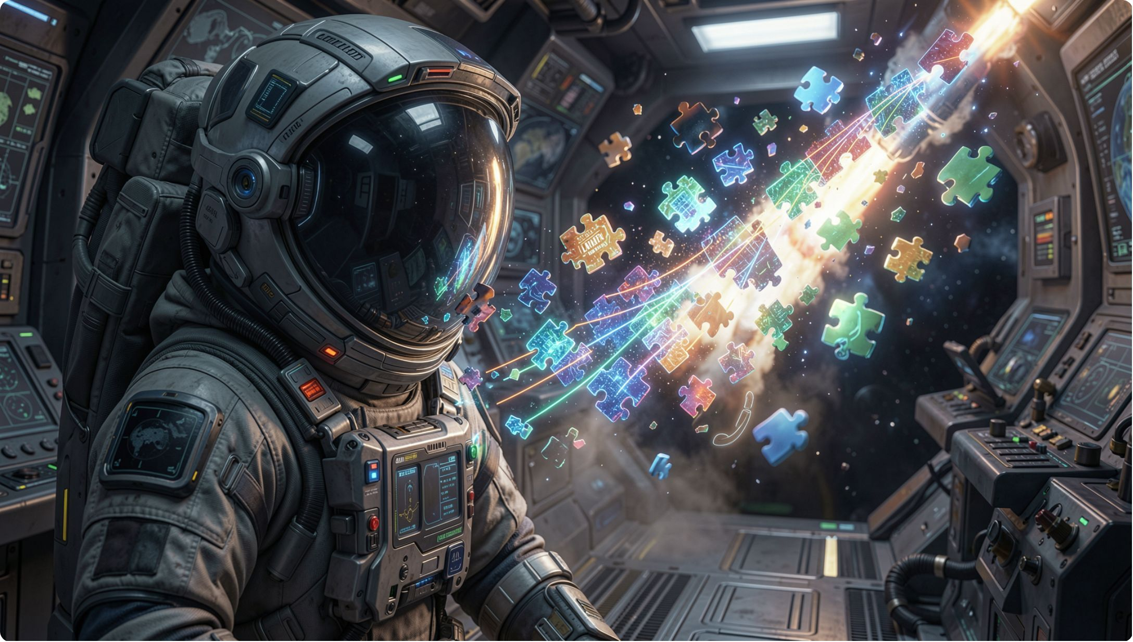
The model does not read words
It reads tokens
A common word is usually one
A name or a typo is several
Pieces, not words, not characters
MCCTC | AI Automation & Software Development
Notes:
This is the first of the two words. A model needs a fixed, finite list of things it can see, and there are far too many words in the world once you include names, typos, code, and every language. Pieces smaller than words give a fixed list that can still spell out anything, including a word the model has never encountered.

Slide 4

Three things that follow immediately
Limits are in tokens
Unusual text costs more
Not characters
Rare words split into many tokens
Spelling questions are strange to it
Tokens are not letters
MCCTC | AI Automation & Software Development
Notes:
An eight thousand token limit is not eight thousand words. A paragraph of code uses more tokens than a paragraph of plain English the same length. And asking a model how many letters are in a word is asking it about something it does not directly see, which is why it gets those wrong far more often than you would expect from something that writes so well.

Slide 5


Do not repeat the conversion rate
People say four characters per token
That is a rule of thumb
It varies by tokenizer and by text
Ask the tokenizer you are using
MCCTC | AI Automation & Software Development
Notes:
You will hear a number for how many characters are in a token and somebody will state it as though it were measured. It is a rough average for one kind of text in one tokenizer. When you need the real number, run your text through the tokenizer of the model you are actually running. Your Week 3 benchmark prints its assumption at the top of every report for exactly this reason.

Slide 6

The window is a size limit
Not memory, a maximum per request
Your instruction is in there
Whatever you pasted is in there
Whatever the program added is too
MCCTC | AI Automation & Software Development
Notes:
Here is the second word and the one people get wrong. The context window is how much the model can take into account at once, for this one request. Nothing survives to the next request on its own. Everything that feels like continuity is a program putting the earlier text back in and paying for it again.

Slide 7
One character over
HTTP 400
{"ok":false,"task":"summarize","result":null,"source":"none","elapsed_ms":0,
"error":{"kind":"prompt_too_long","message":"the prompt is 4001 characters.
The limit is 4000."}}
MCCTC | AI Automation & Software Development
Notes:
Four thousand and one characters. Three things to notice. Source says none, so the model was never asked. Elapsed is zero, so nothing was spent. And the message says the actual number, so nobody has to guess how far over they were. Every system with a model in it has a limit like this and the interesting question is what it does when you cross it.

Slide 8




Three things a system can do at the limit
Refuse
Truncate
And say the number
And usually not say
Summarise
And lose detail quietly
MCCTC | AI Automation & Software Development
Notes:
Ours refuses. Most chat products truncate or summarise, silently. Truncating silently is the one to watch for, because the output looks completely normal. You asked about a ten page document, four pages were sent, and the answer is confident and complete about four pages. Nothing on the screen tells you.

Slide 9
Proving there is no memory
send({"task": "classify", "prompt": "Remember that my favourite label is account."})
send({"task": "classify", "prompt": "What is my favourite label?"})
MCCTC | AI Automation & Software Development
Notes:
Two requests, one after the other, same session. The second cannot be influenced by the first, and not because the model forgot. The service keeps no session, no history, and no copy of any prompt. Its own documentation says it in one line: each request is answered and forgotten.

Slide 10

So why does it feel continuous
The product re-sends your earlier turns
Every single time
And pays for them every time
Past the window, something gets dropped
MCCTC | AI Automation & Software Development
Notes:
That is the whole explanation. The feeling of memory is your own earlier words being mailed back in with every new question. It also explains something you have noticed: long conversations start losing the beginning. That is not the assistant getting tired. That is the oldest text being dropped to make room.

Slide 11

Why this is a privacy lesson too
Later you will build the re-sending
You decide what is kept
For how long, and for whom
Make that decision on purpose
MCCTC | AI Automation & Software Development
Notes:
When you build something that feels like a conversation, you will do it by putting earlier turns back into the prompt yourself. At that moment the decision about what gets kept is yours, and it is worth making deliberately instead of inheriting it from whatever tutorial you copied. Module 3 spends three weeks on what that decision costs.

Slide 12

What you are about to build
Send a prompt that is one over
Read the refusal, all six fields
Then send one that is one under
Write what your program should do instead
MCCTC | AI Automation & Software Development
Notes:
Build one is finding the limit by crossing it and reading the exact message. Build two is the design question, and it is the part I am grading: your program has a document larger than the window, and you write down which of the three options you would pick, and what you would tell the person either way. There is no right answer and there are several wrong ones.

