Slide 1

Training and Inference

Slide 2

You corrected it and it worked
So you taught it, right
Next session, same mistake
Nothing you said stuck
Here is what actually happened
MCCTC | AI Automation & Software Development
Notes:
You have corrected a model mid conversation and watched the next answer get better. That is real. And then you came back the next day and it made exactly the same mistake, and that is real too. Both of those follow from one idea and by the end of the period you will be able to explain it to your parents.

Slide 3


Two completely different activities
Press Enter
Weights Set
Training set the weights
One happened once, elsewhere
Inference uses them
Training
Inference
One happens when you press enter
Use Weights
MCCTC | AI Automation & Software Development
Notes:
Almost every wrong belief about these systems comes from blending these two words together. Training is the process that produced the numbers. Inference is what happens on our lab machine. They are not two phases of one thing you are part of. One of them finished before you ever opened the program.

Slide 4

What training actually did
01
Showed it an enormous amount of text
02
Asked it to predict the next piece
03
Compared the guess to what followed
04
Nudged the numbers, an unimaginable number of times
MCCTC | AI Automation & Software Development
Notes:
That is the loop. Predict, compare, adjust, repeat. Months of specialised hardware. You will not do this in this class and nobody expects you to. What you need from it is the last fact: when it finishes, the result is a file full of numbers, and that file is the model.

Slide 5


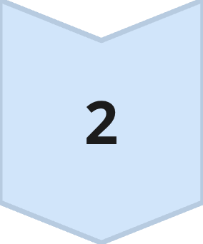
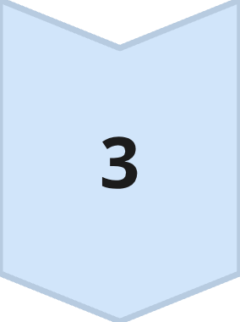
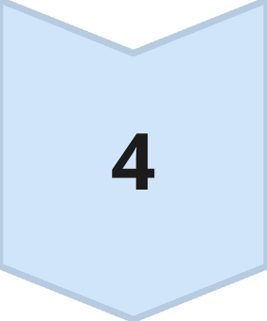
What inference does
Tokenize your text
Run it through fixed weights
Get a probability for every next token
Choose one, append, run again
MCCTC | AI Automation & Software Development
Notes:
That is the entire mechanism. There is no other step. Notice what is missing: there is no lookup, no checking, and no stage where it decides whether the answer is true. Correct output is output whose most likely continuation happened to match reality, and that is why there is never a warning when it does not.

Slide 6

The weights do not change
Not during your request
Not because you corrected it
The file on disk is the same file
Nothing is learned while you use it
MCCTC | AI Automation & Software Development
Notes:
Write this down. During inference nothing is learned. The improvement you saw inside a conversation was your own correction sitting in the input, being re-read from scratch every single turn. Take it out of the input and the behaviour disappears, which is exactly what happened the next day.

Slide 7
What the cost actually looks like
prompt median total median ttft tokens tokens/sec
p1_short 1335.7 ms 318.3 ms 40.0 39.3
MCCTC | AI Automation & Software Development
Notes:
Read that as a story. A third of a second passed before any text existed at all. Then tokens arrived at about forty a second for a second. Total wait, one and a third seconds, for forty tokens. On real hardware the numbers differ and the shape does not: a pause, then a stream. The pause is the first token. The stream is the same thing happening again and again.

Slide 8
Three things people mean by trained on our data
"I trained it by talking to it" -> earlier text re-sent in the prompt
"We gave it our documents" -> documents searched, parts put in the prompt
"We fine-tuned it" -> more training, producing a new weights file
MCCTC | AI Automation & Software Development
Notes:
Only the third one changes any weights, and it produces a different file rather than editing the one you have. The middle one is retrieval and it is what Module 4 builds. For most practical problems it is the right answer: cheaper, updated the second a document changes, and you can show which document the answer came from.

Slide 9

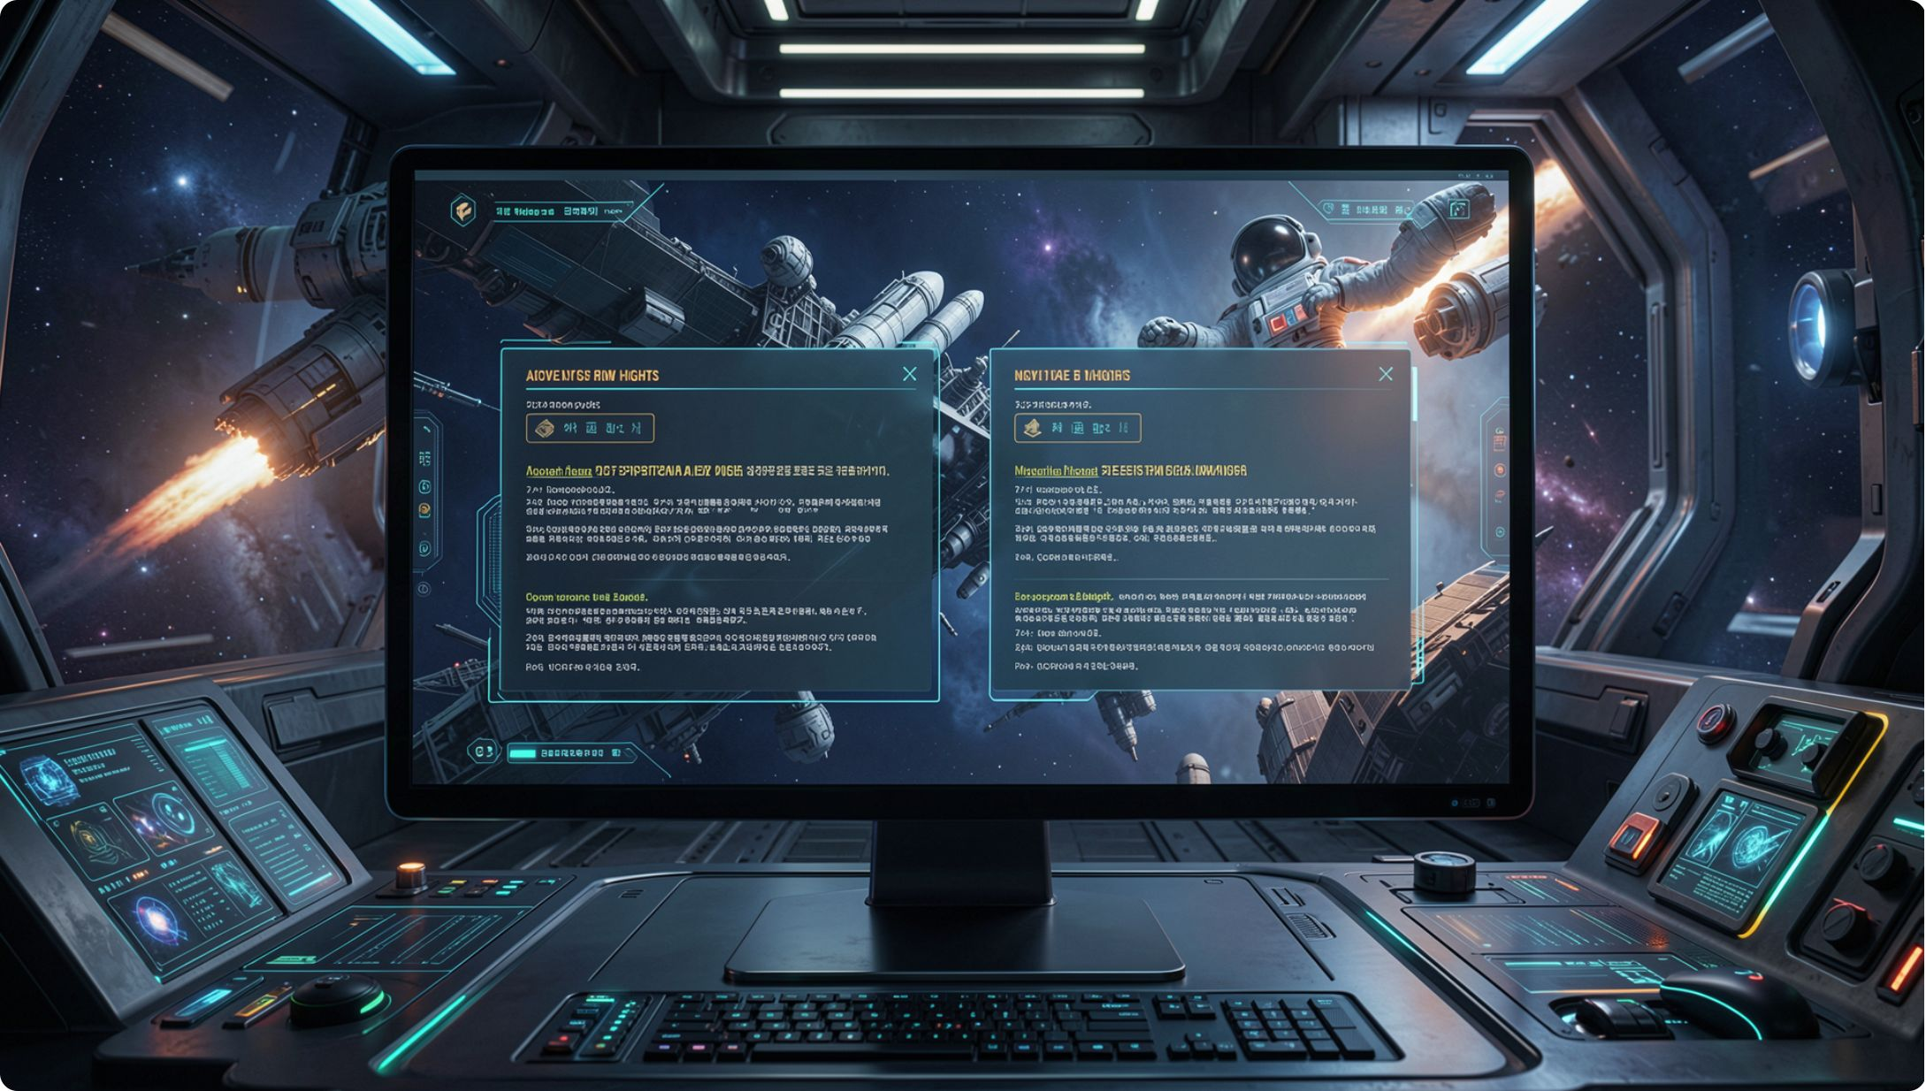
The same prompt twice
Our stub gives the same answer
A real model often does not
It samples with some randomness
Turn that off and it repeats
MCCTC | AI Automation & Software Development
Notes:
Our stub is a rule system so it is perfectly repeatable. A real model usually chooses the next token with some randomness rather than always taking the likeliest, so two identical prompts can produce two different answers. That matters for your own testing and it is why the service validates the shape of an answer instead of its exact text.

Slide 10

The belief this kills
Every time you use it, it learns
False during inference
Products do improve, at the company
Conversations improve, from the input
MCCTC | AI Automation & Software Development
Notes:
This is the most widely believed false thing about these systems, and the two reasons people believe it are both partly right. Products genuinely do get better over time, on the company's schedule. Conversations genuinely do get more relevant as they go. Neither of those is the model learning from you while you use it.

Slide 11
The sentence for a non-technical adult
01
02
A huge set of numbers
Adjusted once until it guessed well
03
04
Now it guesses the next piece
Adds it on, guesses again
MCCTC | AI Automation & Software Development
Notes:
That is the exit criterion for this module and you will write a full version of it in Week 3. Say it out loud now while it is fresh. And notice the clause I always add on the end: everything it produces is produced that way, including the parts that are true.

Slide 12

What you are about to build
Send an identical prompt twice
Record whether the answers match
Design an experiment that would prove learning
Then say why ours cannot run it
MCCTC | AI Automation & Software Development
Notes:
Build one is the repeat test and it takes ten minutes. Build two is the interesting half. You design an experiment that would show a model learned from you, and then you find out that our stub cannot settle it, because a stub is not a model. Naming a question your instrument cannot answer is a result, and it is Week 3 arriving four days early.

