Slide 1
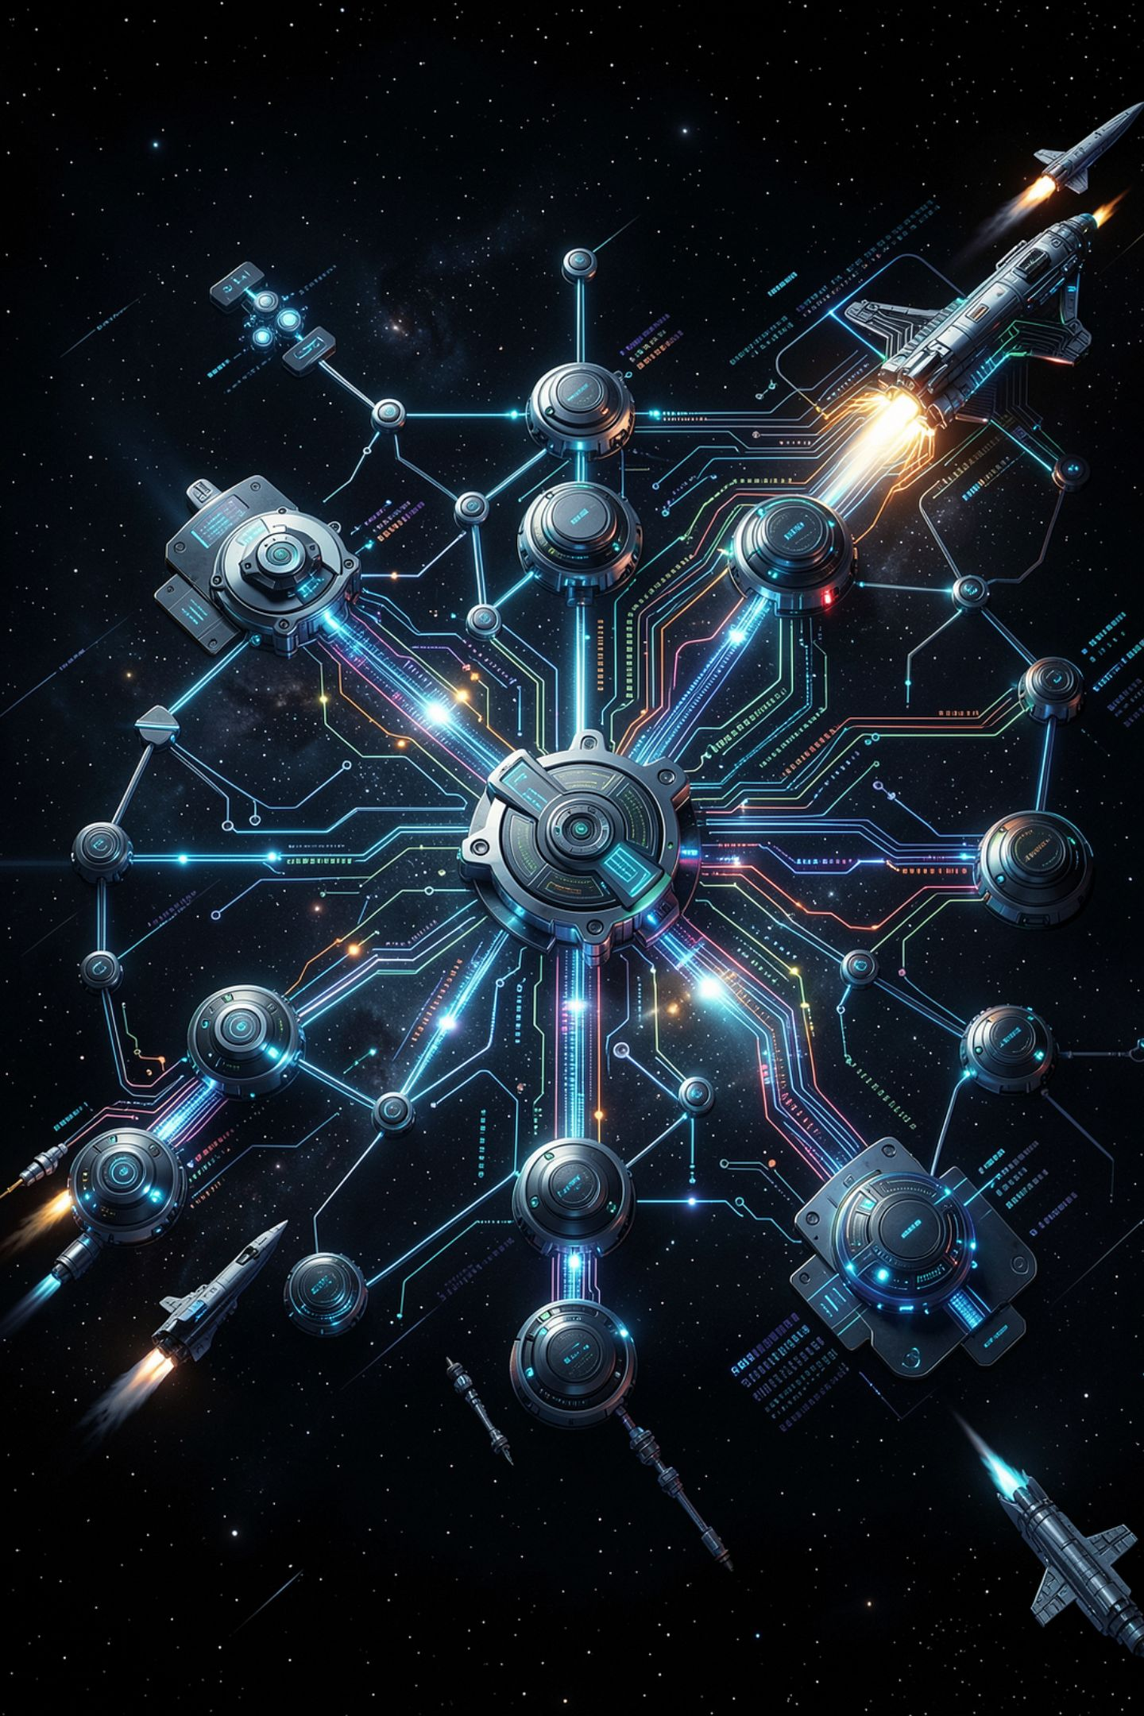
The Emerging Technology Map

Slide 2

Nine technologies, one question
A vendor sells your school something
Somebody has to make it work
With systems built before it existed
That somebody is the job
MCCTC | AI Automation & Software Development
Notes:
Today looks like a vocabulary day and it is not. The exam names nine technologies so we will name them. But the thing worth carrying out of here is that every one of them arrives the same way: somebody buys it and then somebody else has to connect it to a system nobody designed with it in mind.

Slide 3

The four models and machines
Large language models
Machine learning
Text one token at a time
Behaviour fitted to data
Artificial intelligence
Watch that third one carefully
The umbrella term
AI contains the others
MCCTC | AI Automation & Software Development
Notes:
Language models are one branch of machine learning, which is any system whose behaviour was fitted to data rather than written. Artificial intelligence is the umbrella and it is also a marketing term. When somebody says a product has AI in it, your follow up is always the same: what does it do that a rule could not.

Slide 4
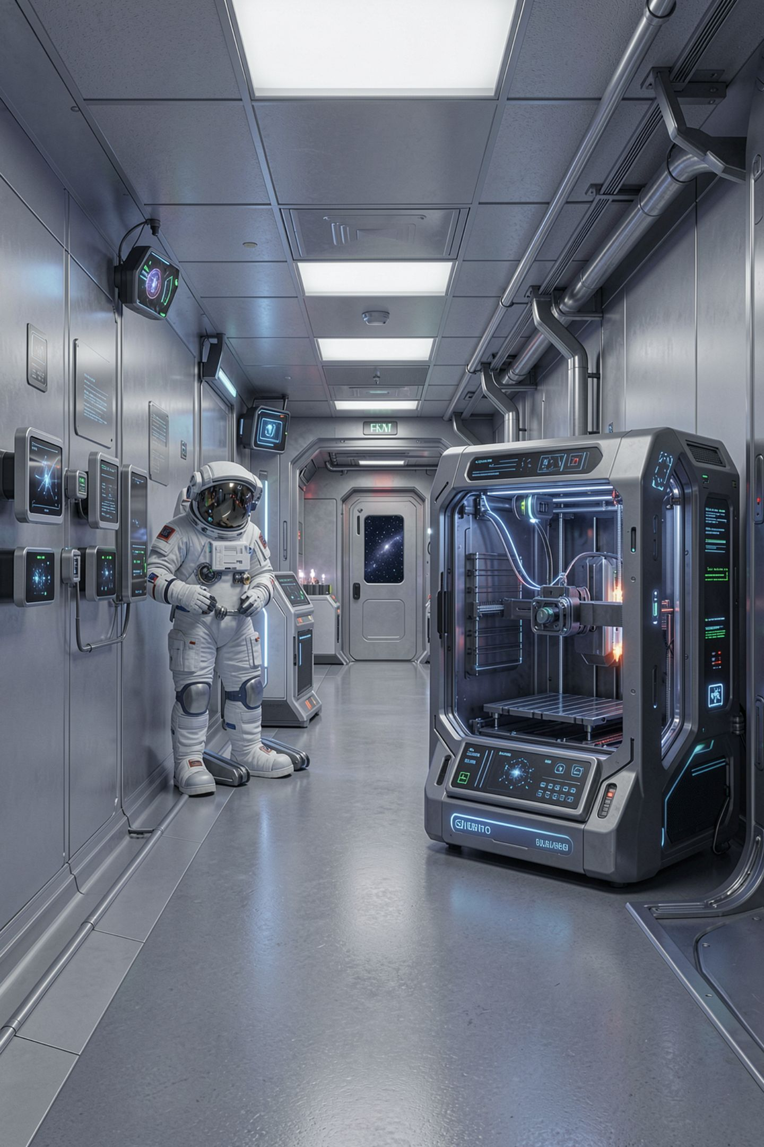
The four in the building
Internet of Things, objects that report
SMART devices, the consumer version
BYOD, a policy in a technology costume
Additive manufacturing, the file is the part
MCCTC | AI Automation & Software Development
Notes:
These four are all within a hundred feet of you. Sensors reporting somewhere, phones doing school work, and a 3D printer whose queued files are now the actual product. That last one is worth a pause: version control and intellectual property questions that used to apply to drawings now apply to something you can hold.

Slide 5

The two that hold everything up
Services virtualization
Shared hardware. No fixed machine, no fixed address.
Mixed reality
Content in your space. Needs a live feed from real systems.
MCCTC | AI Automation & Software Development
Notes:
Virtualization is why cloud services exist, and the integration problem is that anything which assumed a fixed machine has to be rebuilt. Mixed reality is the one people demo and rarely ship, and the reason is the second bullet. A headset showing the wrong torque spec is worse than a piece of paper showing the right one.

Slide 6
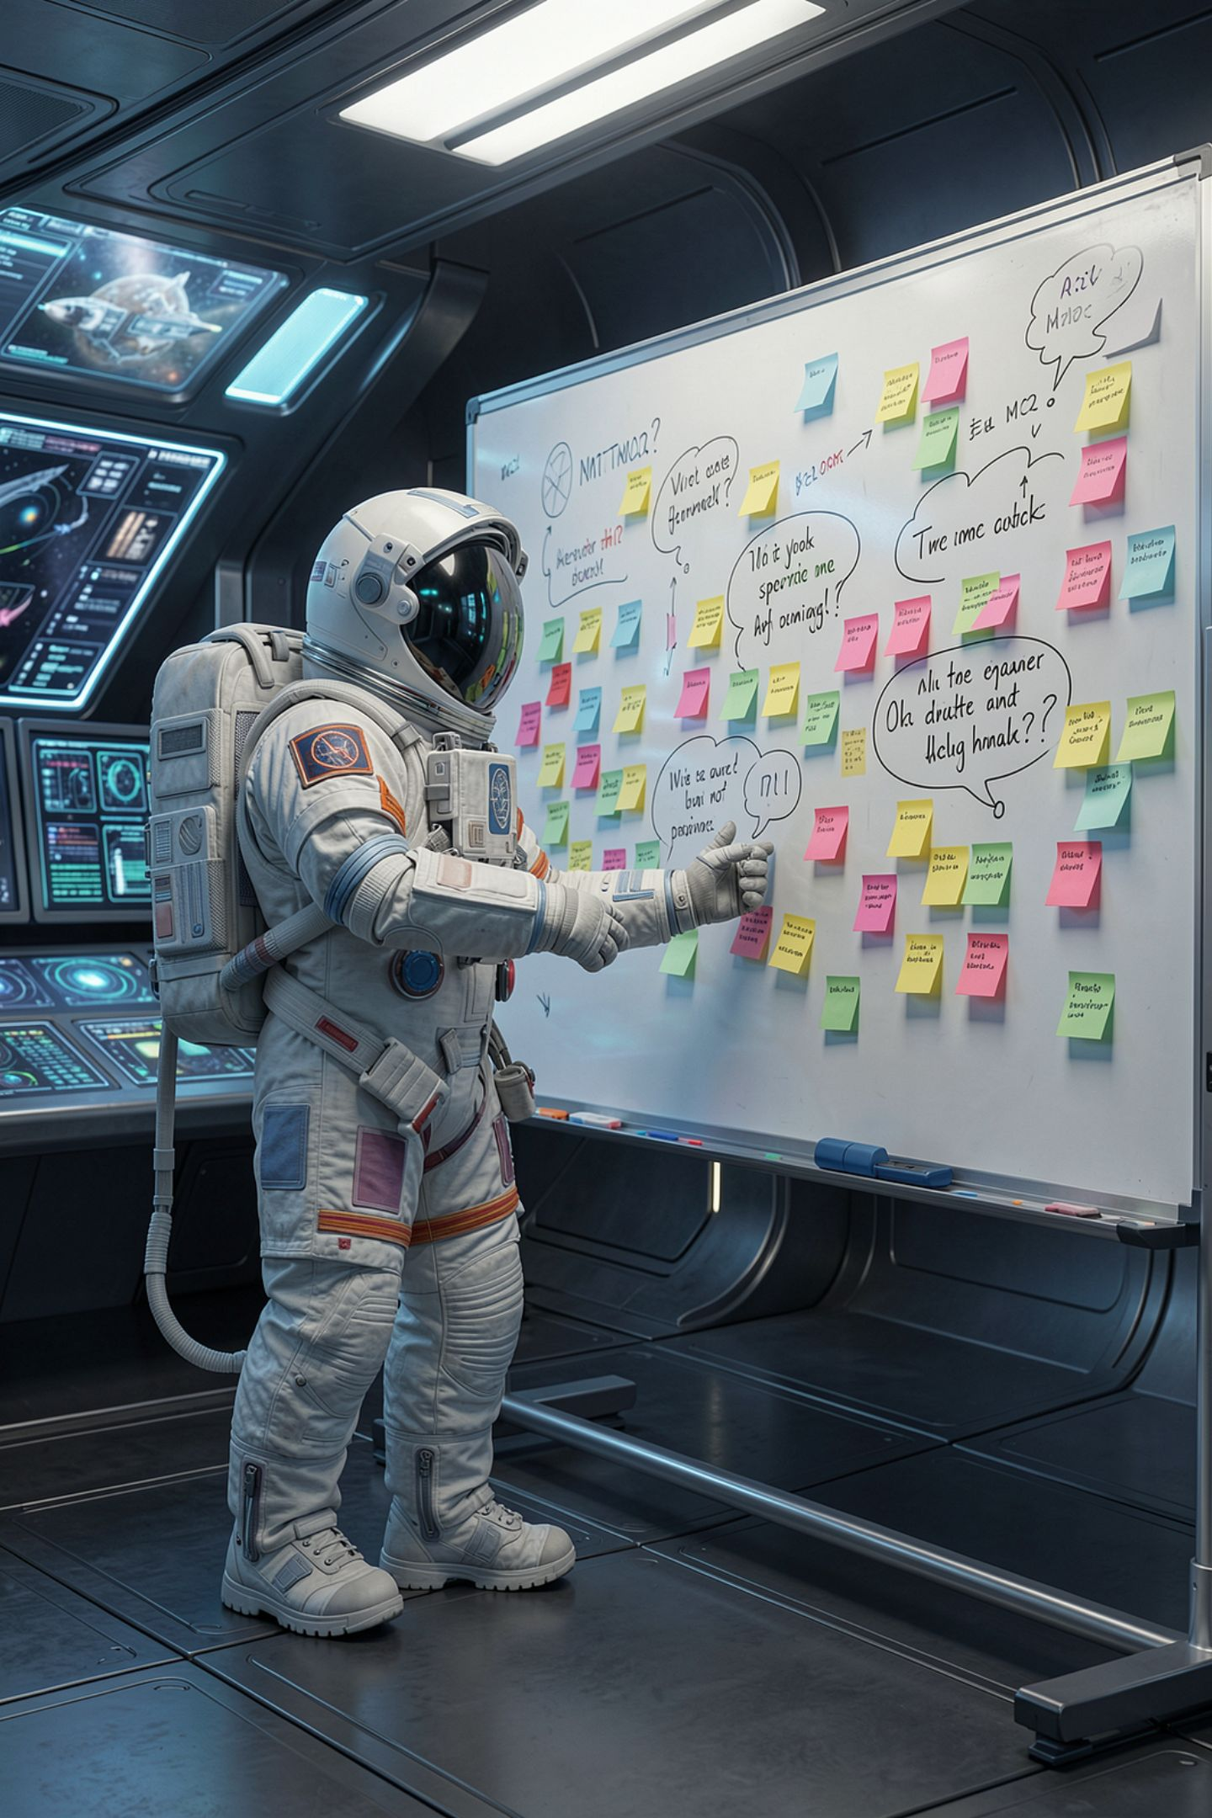
Four questions that beat a definition
1
What does it do the old thing could not
2
What does it have to connect to
3
Who carries the cost when it is wrong
4
What does it look like when it fails
MCCTC | AI Automation & Software Development
Notes:
This is the method and it is worth more than the list. Anyone can describe a technology. A person who can answer these four about it can talk about it in an interview. And notice question one accepts nothing but faster as an answer, because that is frequently the true one.

Slide 7
Where a language model is the wrong tool
add up a column of numbers -> arithmetic in your code
decide who may open a door -> a rule and an access list
find every ticket saying wifi -> a search
compute a student's grade -> the gradebook formula
MCCTC | AI Automation & Software Development
Notes:
This is the slide employers care about. Every row on the left is something people try to hand a model, and every one of them needs an exact, identical, defensible answer. A model produces likely text, and a likely number is not a correct number. Knowing where not to use it is most of what makes you useful.

Slide 8
Where it earns its place
summarise 200 open tickets into themes -> a language model
MCCTC | AI Automation & Software Development
Notes:
One row, and look at what is different. No rule states what a theme is. The input is language. And a person is going to read the output and can catch a mistake. Those three conditions together are the test. Take away any one of them and you are back on the previous slide.

Slide 9

The sentence that says nothing
Emerging technologies are transforming every industry
No technology named
No industry named
Nothing that could be false
MCCTC | AI Automation & Software Development
Notes:
Every word is defensible and the sentence carries no information. You could have written it in any year of the last forty. It is also exactly what a model produces when you ask it about emerging technology, and that is not a coincidence: the most likely continuation of a vague question is a vague answer.

Slide 10

So ask what would change it
A sentence that cannot be wrong is decoration
Ask what evidence would change it
If there is none, cut it
You will meet this again Friday
MCCTC | AI Automation & Software Development
Notes:
Write this one down because it is the most transferable thing in the module. A claim is a statement that could turn out to be false. If nothing could show your sentence wrong, it is not a claim, and it is taking up space where a claim should be. Friday I am going to hand you a page full of these.

Slide 11

What you are about to build
Walk the building, find four
One IoT, one printer, one BYOD, one virtualized
For each, name what it connects to
A category with nothing in it counts
MCCTC | AI Automation & Software Development
Notes:
Build one is a walk with a clipboard and it is not a scavenger hunt. For every technology you find, you write one sentence: this had to be connected to blank, which was built before it existed. Build two turns that into the four questions from slide five for the one you found most interesting. An empty category is a finding, so write it down rather than inventing something.

