Slide 1

Extract Valid Information and Cite the Source

Slide 2

According to the Halloran Institute
Eighty four percent of mid-sized firms
Now run a model on their own hardware
Plausible name, plausible number
The institute does not exist
MCCTC | AI Automation & Software Development
Notes:
I made that organisation up for this slide. Nobody in the room blinked, and that is the lesson. It has a plausible name, a plausible subject, and a precise number, and it reads exactly like every real citation you have ever seen. That shape is what a fabricated source actually looks like.

Slide 3

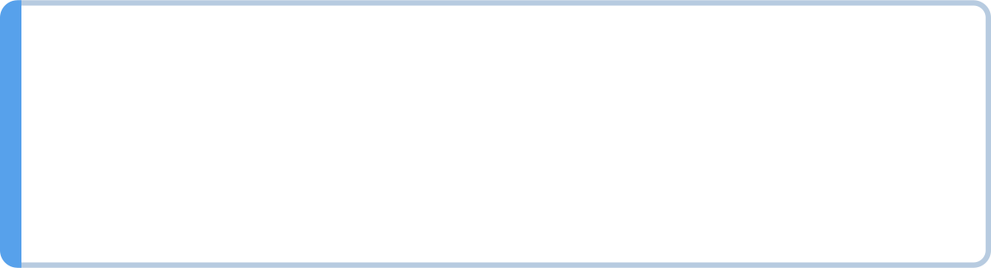

Precision is a style, not evidence
A number reads as research
It is boring, so nobody checks
Checking costs effort
Accepting costs none
MCCTC | AI Automation & Software Development
Notes:
Three reasons a fake statistic gets through, and none of them is that people are careless. It is specific, and specificity reads as research. It is dull, so nobody has an emotional reason to argue with it. And checking takes real work while believing takes none. Assume this is happening to you constantly.

Slide 4

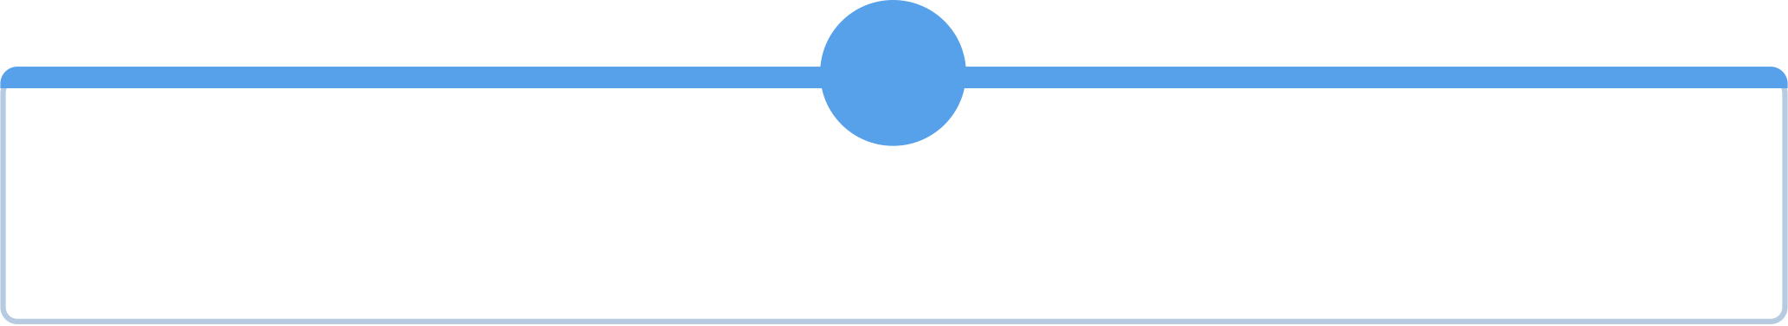
Traceable means three things
1
The claim is specific enough to be wrong
2
The support is named precisely enough to find
3
The support actually says that
4
All three, or it does not count
MCCTC | AI Automation & Software Development
Notes:
Write these down. The third one is the one people skip and it is where most real errors live. Somebody cites a real document that says something narrower than the claim they attached to it. Go and read the sentence you are citing, every time.

Slide 5
The four kinds of support, ranked
A model's answer
1
Not support at all
A secondary source
2
Weaker
A primary source
3
Strong
A run you did
4
Strongest
MCCTC | AI Automation & Software Development
Notes:
The bottom row is the one to internalise. A model's output is a thing to check, never a thing to cite. If a model tells you something useful, your job is to go and find where it is actually written and cite that. If you cannot find it, you have learned something important about the claim.

Slide 6

Untraceable
"Local AI models are much slower than cloud models,
often by a factor of ten."
No source named. No measurement cited. No way to verify.
MCCTC | AI Automation & Software Development
Notes:
Nothing here can be checked by anybody. Which models. On what hardware. Measuring what, total latency or tokens per second. Ten times which number. This sentence came out of a real student draft and the student was not lying. They had watched something slow and written it up.

Slide 7

Traceable
On the build machine, with a stand-in server set to 40 tokens at
25 ms each, bench.py reported a median total latency of 1335.7 ms
and 39.3 tokens/sec for p1_short. Raw run: runs/bench-a.json.
No real model was available, so this measures the instrument.
Specific machine. Specific file. Specific caveat. Findable.
MCCTC | AI Automation & Software Development
Notes:
Longer, and anybody with the folder can repeat it. Look at the last sentence in particular. Saying what you did not measure is part of the report. A reader who finds out later that a number came from a stand-in, when the report did not say so, stops trusting everything else in it, and they are right to.

Slide 8


When there is no command to run
Say what would settle it
Find the primary source
Read the part that matters
Write down the search that failed
MCCTC | AI Automation & Software Development
Notes:
Some claims have no terminal command. The method is these four steps in order. Step one is the filter: if you cannot finish the sentence this would be settled by blank, the claim is not about the world and no amount of searching will help.

Slide 9
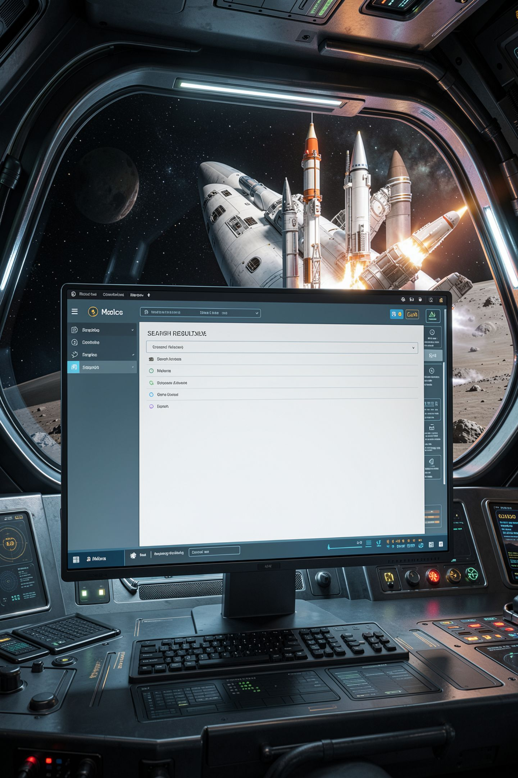
A failed search is a result
I looked in X and Y
I did not find the origin
That sentence belongs in your report
It is stronger than studies show
MCCTC | AI Automation & Software Development
Notes:
This is the part students resist because it feels like admitting defeat. It is the opposite. An honest failed search tells a reader something real and repeatable. Studies show tells them nothing at all. Leaving out the failed search to keep a paragraph tidy is the actual failure.

Slide 10

Three questions before the sentence ends
01
What exactly am I asserting
02
What would show it
03
Where is that thing
MCCTC | AI Automation & Software Development
Notes:
This is the habit. Ask these three before you finish writing the claim, not after. If the third has no answer you have two honest choices: weaken the claim until it matches what you know, or go and get the evidence. There is no third choice and everyone knows is not one.

Slide 11
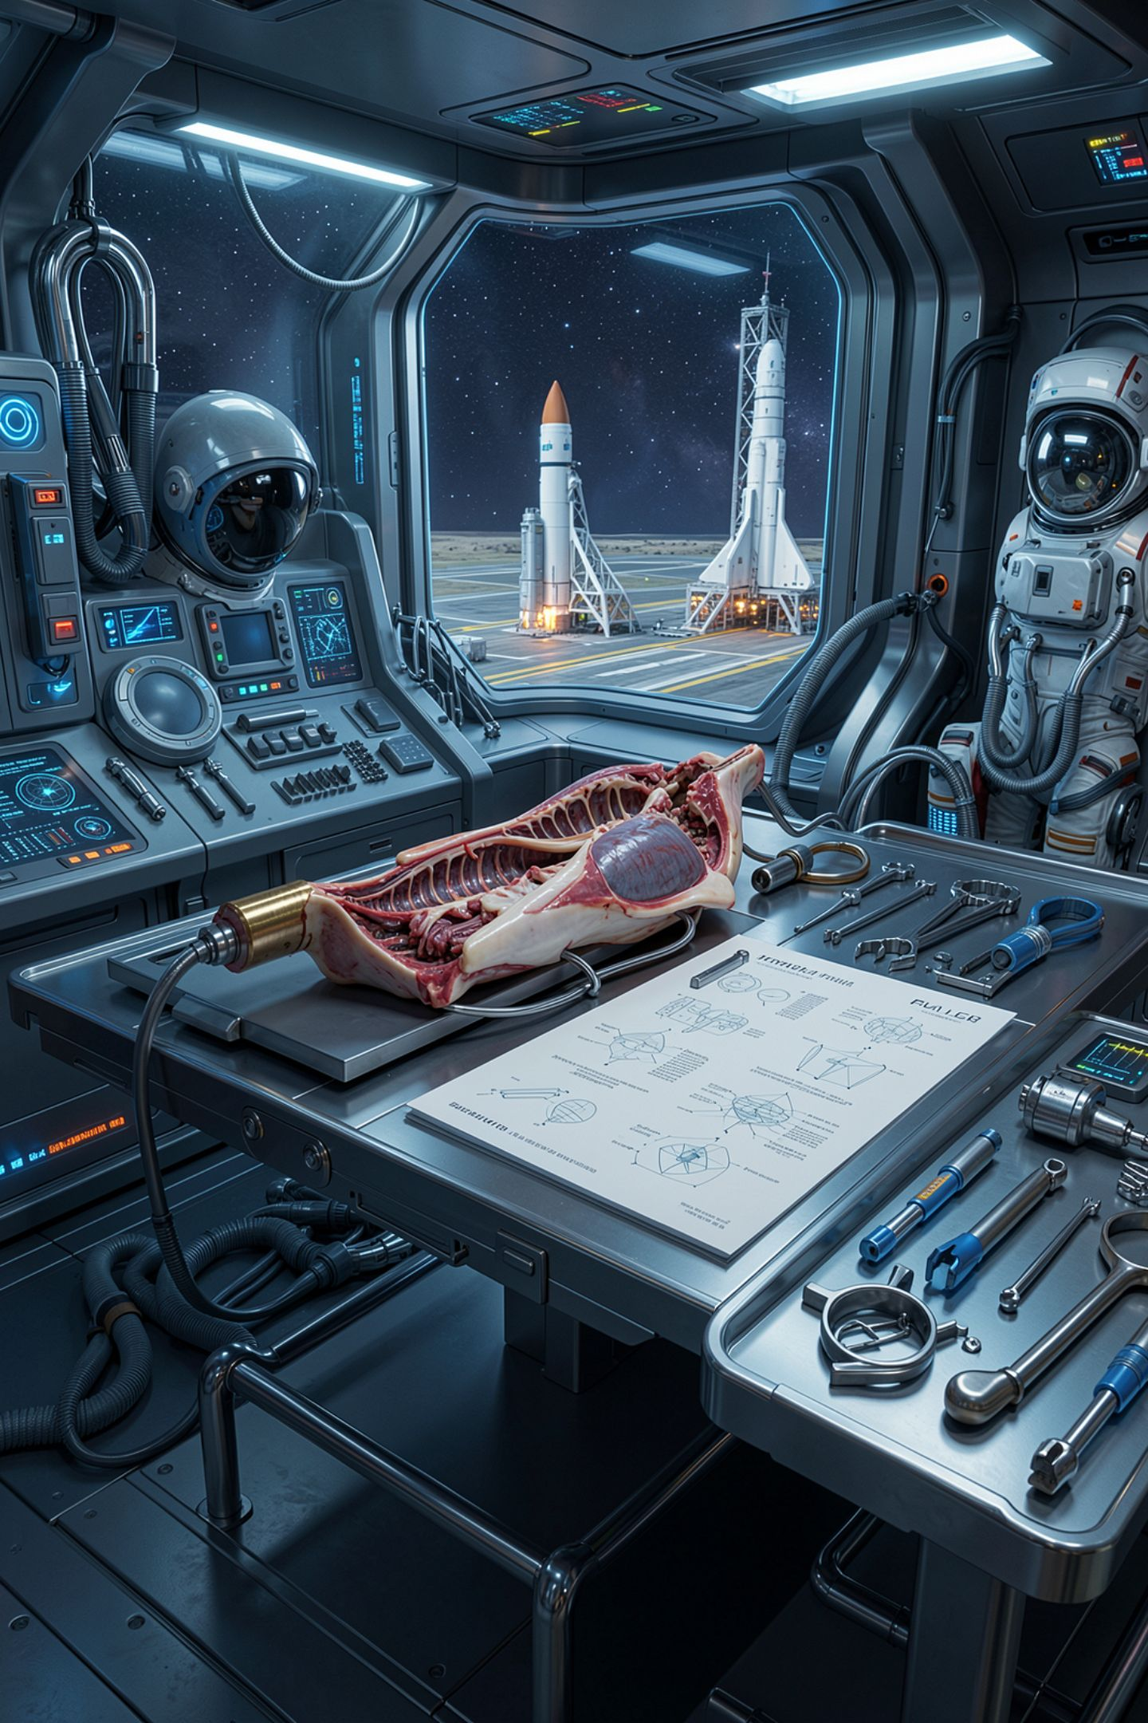
What you are about to build
The Infographic Autopsy starts now
A page about how a language model works
Constructed for this class, and it says so
One of its problems is genuinely arguable
MCCTC | AI Automation & Software Development
Notes:
Build two is the autopsy and it runs into tomorrow. You did one of these as juniors on a Python cheat sheet where a terminal settled everything in eight seconds. This one is harder, it is about material you learned last week, and at least one thing on it is a real argument rather than a mistake. Finding that one and arguing it is worth more than finding three obvious ones.

