Slide 1

A Measurement Nobody Can Repeat

Slide 2

Mine was faster than Diego's
One run each
No prompts recorded
No warm-up mentioned
Conclusion: my machine is better for AI
MCCTC | AI Automation & Software Development
Notes:
This sentence is going to be written in this room today and it might even be true. The problem is that nobody can tell, including the person who wrote it, and in two weeks somebody buys hardware because of it. Today is about the difference between a number and a comparison.

Slide 3

Seven things that are the method
The exact prompts, and the repeat count
Whether a warm-up was thrown away
Streaming or not
How tokens were counted
What else the machine was doing
MCCTC | AI Automation & Software Development
Notes:
Miss any one of these and your number is still a number. It is no longer a comparison. And the last one is the one nobody writes down: a video call in another window is part of your measurement whether you recorded it or not.

Slide 4
A comparison the program refuses
These two runs cannot be compared.
different repeat counts: 3 against 5. A median of three and a
median of ten are not the same kind of number.
Agree on a method, run again, and come back.
MCCTC | AI Automation & Software Development
Notes:
That refusal is the feature, not an inconvenience. Those two runs were on the same machine against the same server, so the difference between their numbers is pure method. A program that printed the table anyway would have handed you a difference and invited you to explain it in terms of hardware.

Slide 5
A comparison it allows, with warnings
warning: tokens counted differently: server_counter vs character_estimate
warning: one run streamed and the other did not
warning: different models: streaming-stub against llama3.2
p1_short 1335.7 ms 15.0 ms 1320.7 ms faster
MCCTC | AI Automation & Software Development
Notes:
The table prints because the prompts and repeats match. Three warnings sit above it and any one of them makes that difference a sentence about two servers rather than two machines. Both of those runs were on the same computer. A reader who skips the warnings walks away believing one machine is eighty nine times faster.

Slide 6

Refuse or warn, and why the difference
Refuse when nothing survives
Warn when something still holds
Repeat counts ruin everything
Token sources leave the timings fine
MCCTC | AI Automation & Software Development
Notes:
This is a design decision you will make in your own programs. Different repeat counts make every summary number incomparable, so there is nothing worth printing. Different token counting ruins the token figures and leaves the timings perfectly good, so print what holds and warn about what does not.

Slide 7
The comparison that actually works
bench-a 40 tokens/sec configured -> 39.3 measured, ttft 318 ms
bench-b 25 tokens/sec configured -> 24.7 measured, ttft 713 ms
MCCTC | AI Automation & Software Development
Notes:
Same method, same machine, two stand-in servers set to different rates. Both measurements within two percent and the ratio between them is right. What it still cannot tell you is anything about a model, because neither server is one, and your report has to say that in those words.

Slide 8
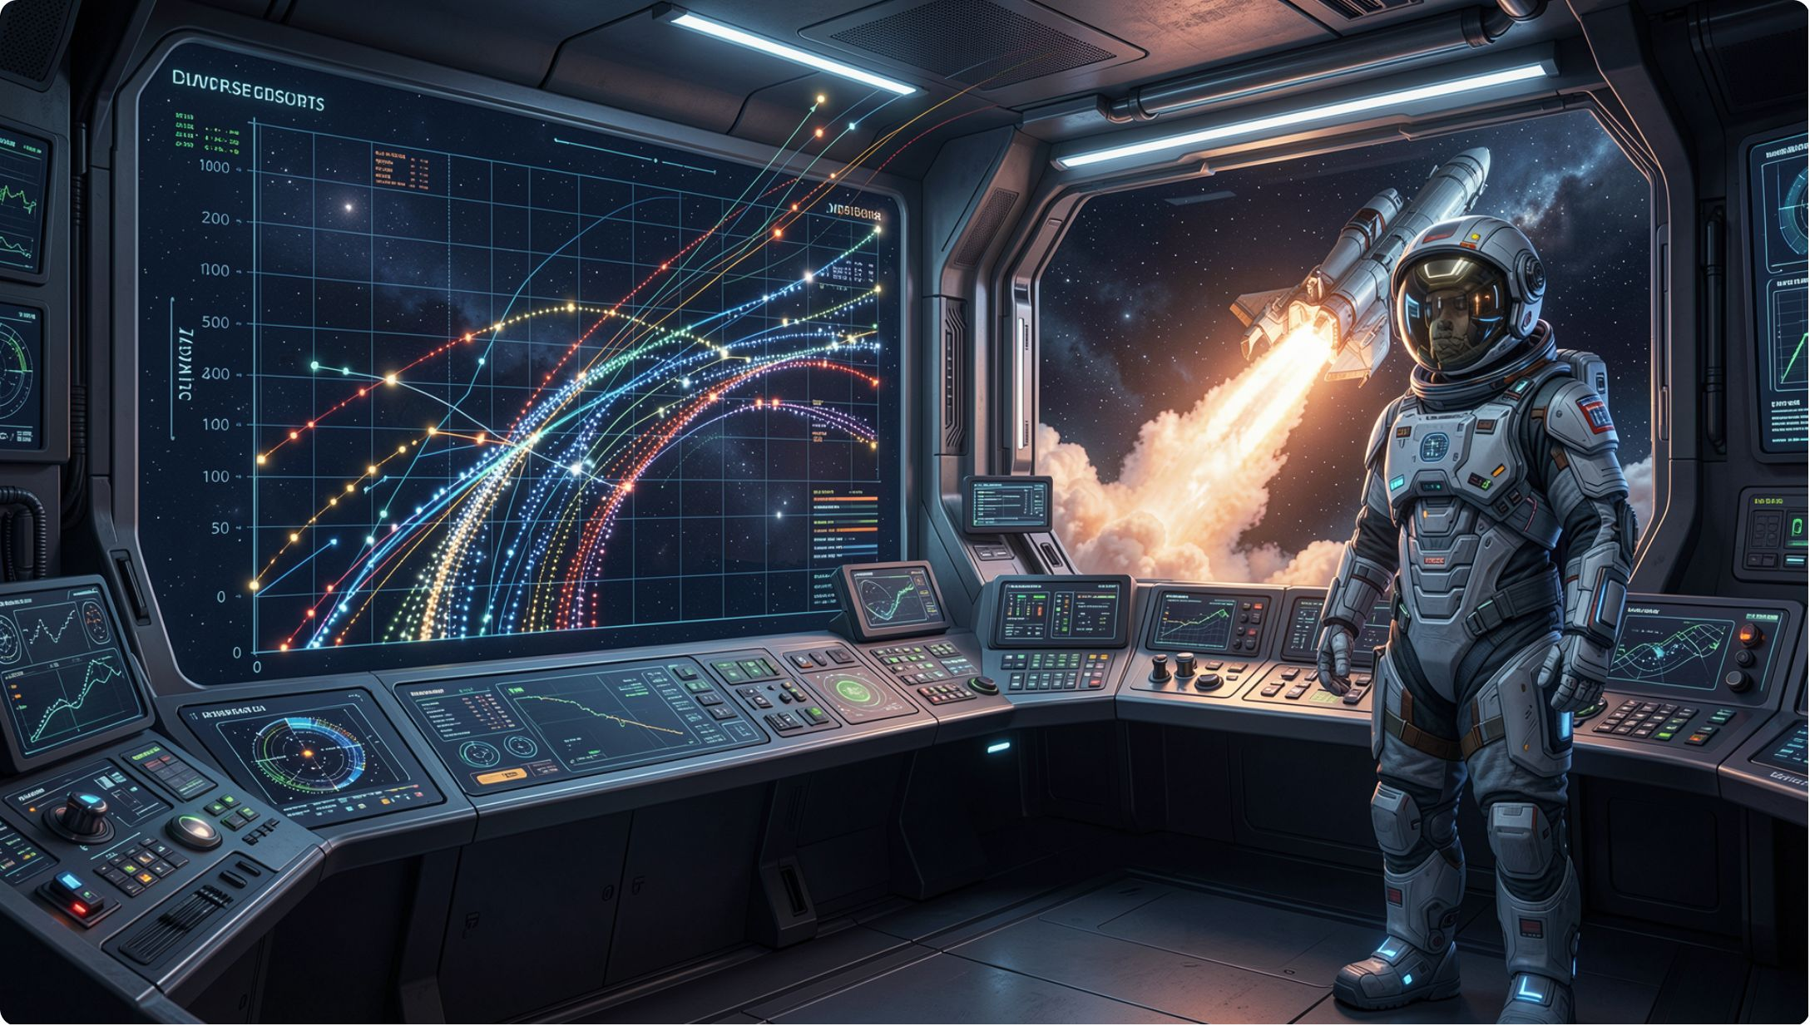
One run is not a measurement
bench.py prints the spread
Widest gap: 8.0 ms on medians of 1330
Under one percent, so they agree
Six hundred would be a different story
MCCTC | AI Automation & Software Development
Notes:
Report the spread next to the median, always. A median with no spread beside it hides exactly the information a reader needs in order to decide whether to believe it. If your three repeats disagree by half a second, the median is a confident summary of a mess.

Slide 9
Why median and not average
2.2s
1.3s
The average
The median
No run actually took 2.2 seconds
One run did take 1.3 seconds
Three runs: 1.3, 1.3, and 4.1 seconds
The average is 2.2
No run took 2.2 seconds
The median is 1.3, which one did
MCCTC | AI Automation & Software Development
Notes:
One slow run drags an average somewhere no run actually was. The median is what a typical run cost, and the four point one still shows up in the spread line, where it belongs as a question to investigate rather than as a number smeared into your headline.

Slide 10
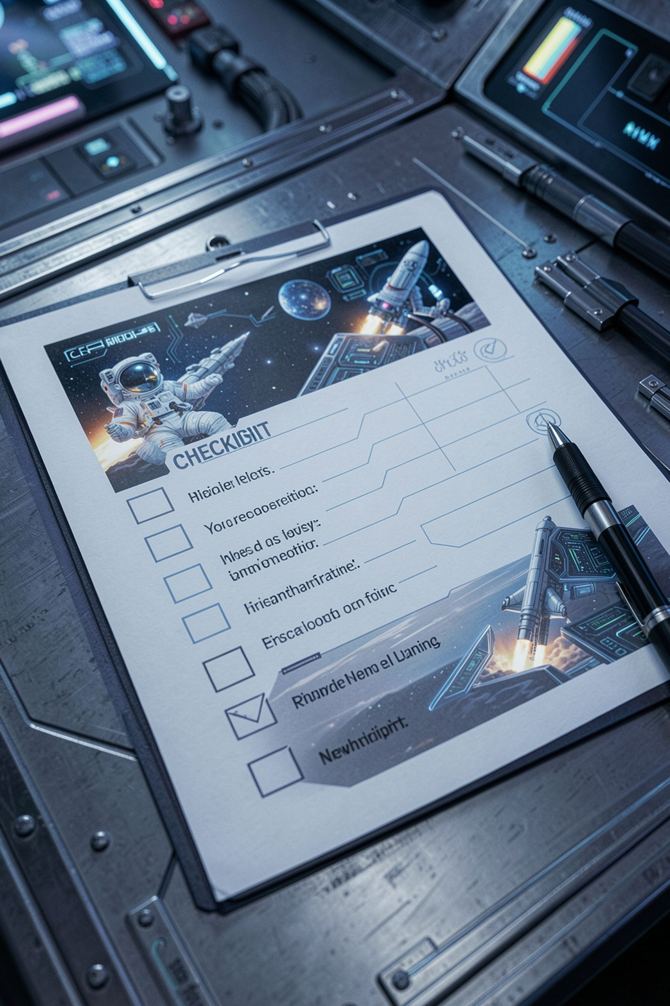
Before you write the word faster
Name one thing that differed
Other than the hardware
There is always at least one
The program asks you this
MCCTC | AI Automation & Software Development
Notes:
Compare machines prints that prompt at the bottom of every comparison, on purpose. The pull toward a clean conclusion is strongest exactly when the numbers are new, and this is the thirty seconds that stops you. If you genuinely cannot name one, you have not read the method fields in both saved runs.

Slide 11
What you are about to build
01
02
Agree a method with a partner first
Then both run it
03
04
Then compare, and read the warnings
Write the sentence about what differed
MCCTC | AI Automation & Software Development
Notes:
Build one is the negotiation, and it comes before either of you runs anything: same prompts, same repeats, same warm-up, same token source. Build two is the run and the comparison. If the program refuses you, that is the lab working, and fixing it is the assignment rather than a setback.

