Slide 1

Three Numbers Worth Measuring

Slide 2


Our model runs at 42 tokens per second
One number, no method
Which prompt, how many runs
Median, average, or best
Was the warm-up counted
MCCTC | AI Automation & Software Development
Notes:
You will read a sentence like this about once a week for the rest of your career. Without the method it is not a measurement, it is a number somebody typed, and you cannot use it for anything including comparing it against your own. By Friday you will be able to say exactly what a benchmark does and does not establish.

Slide 3
Three numbers, three different people
Total latency
Time to first token
Tokens per second
Anyone waiting
Anyone watching it type
Whoever bought the hardware
MCCTC | AI Automation & Software Development
Notes:
These measure different things and different people care about each one. Two systems with identical total latency can feel completely different: one shows nothing for four seconds then the whole answer, the other shows a word after half a second. Same wait. Only one of them gets called fast.

Slide 4
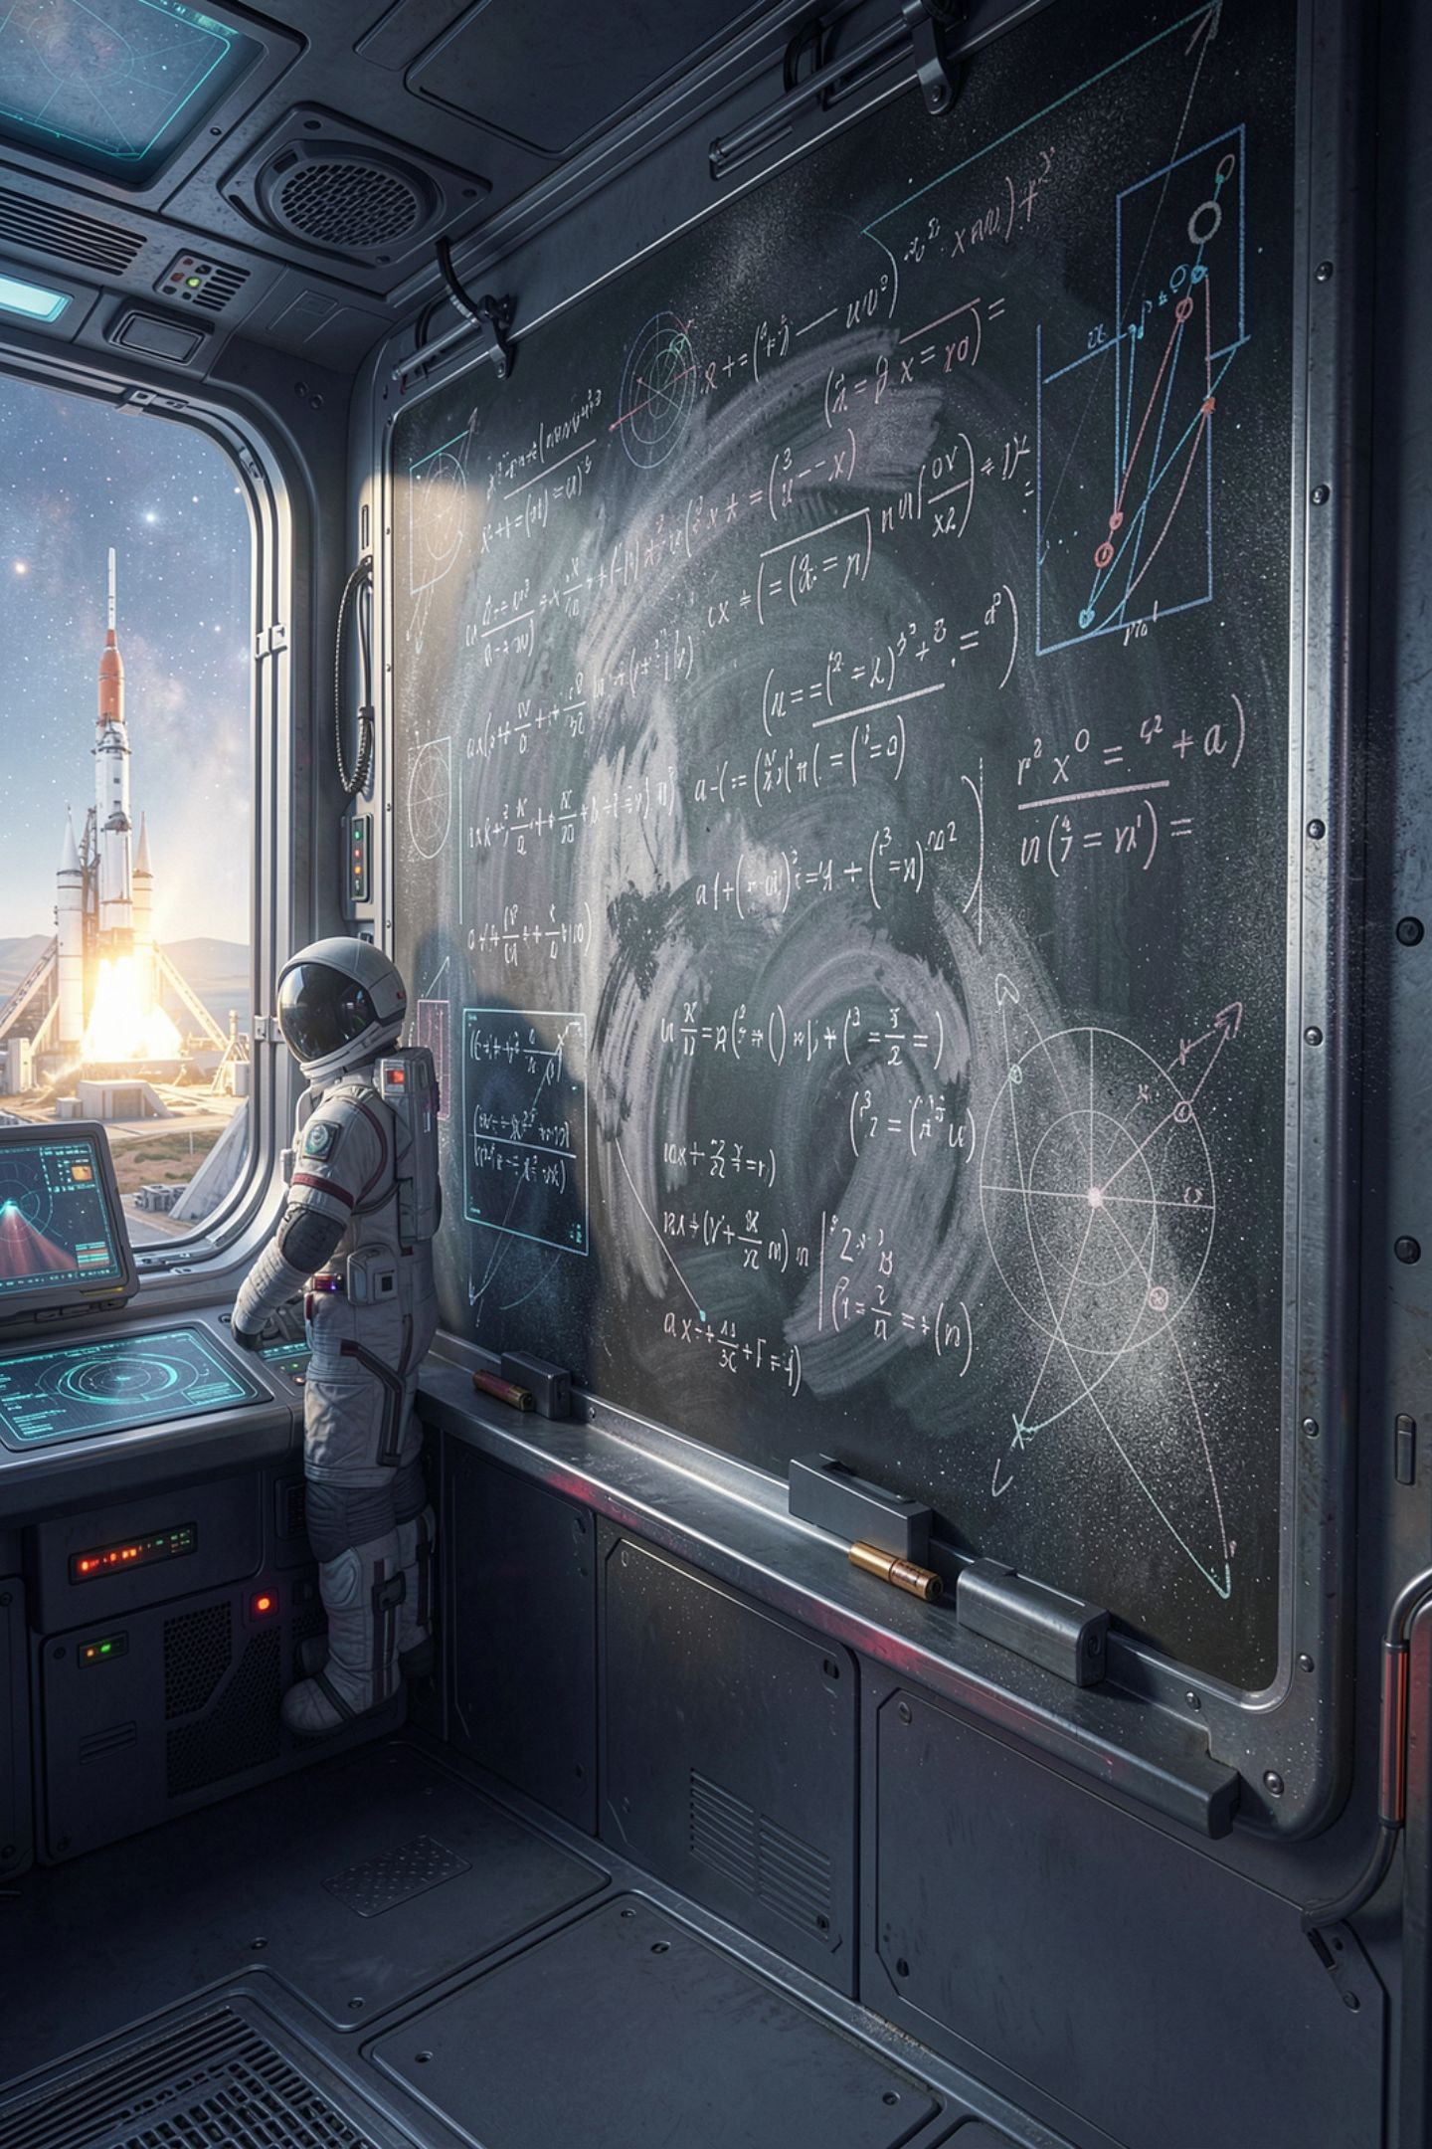
The arithmetic everybody gets wrong
tokens_per_second = tokens / total_latency WRONG
tokens_per_second = tokens / generation_time RIGHT
generation_time = total_latency - time_to_first_token
MCCTC | AI Automation & Software Development
Notes:
No tokens were produced during the wait before the first one. Dividing by total latency spreads the tokens over time the model spent doing something else and reports a rate it never ran at. This is the most common error in amateur benchmarks and it is on your exam.

Slide 5

The error always goes one way
The divisor is always too big
So the number is always too low
It never overstates a model
It understates slow-starting ones most
MCCTC | AI Automation & Software Development
Notes:
This is worth a second. A bug that is sometimes high and sometimes low gets noticed, because the numbers jump around. A bug that is always low looks like a consistent, slightly disappointing result, and nobody investigates a consistent result. Systematic errors hide better than random ones.

Slide 6
Do it both ways, with real numbers
p1_short median total 1335.7 ms ttft 318.3 ms tokens 40
wrong: 40 / 1.3357 = 29.9 tokens/sec
right: 40 / (1.3357 - 0.3183) = 40 / 1.0174 = 39.3 tokens/sec
MCCTC | AI Automation & Software Development
Notes:
Same run, two answers, and a quarter of a difference between them. Now here is the part that makes this worth a whole period rather than a slide.

Slide 7

We already knew the answer
The server was a stand-in
Started at 40 tokens, 25 ms each
Its true rate is 40 per second
The right method reported 39.3
MCCTC | AI Automation & Software Development
Notes:
The server producing those numbers was not a model. It was a stand-in we started ourselves with the rate on the command line, so we knew the truth before we measured. The correct method landed within two percent. The wrong one was a quarter low. That is how anybody ever comes to trust an instrument: you point it at something whose size you already know.

Slide 8
When a number cannot be known
note: this server does not stream, so time to first token and
tokens per second are not measurable here
p1_short 15.0 ms n/a 48.0 n/a character_estimate
MCCTC | AI Automation & Software Development
Notes:
Point the same program at the anchor stub and two columns say not applicable. The program had every chance to fill them. It could have divided by total latency and printed three thousand tokens per second. It refuses, and the note says why.

Slide 9

The rule, written into the code
When you cannot know a number, return None
Never return a guess
A gap is a fact about your method
A guess is a lie with a decimal point
MCCTC | AI Automation & Software Development
Notes:
That rule lives in three functions in measure dot py and it is the part of today's lab you write. It is also the sentence I want in your benchmark report. A reader can work with a gap. A reader cannot work with a number that looks exactly like the real ones and was invented.

Slide 10
The token count is a measurement too
1
Server counter
2
Stream chunks
3
Character estimate
Best available
Good if one piece is one token
Weak, and we print the assumption
MCCTC | AI Automation & Software Development
Notes:
Look at the source column in every run. These three are not equally trustworthy, and the benchmark records which one it used for every single number. That is why compare machines refuses to compare a server counter against a character estimate: those are not two measurements of the same thing.

Slide 11

What you are about to build
Three functions in measure.py
check_measure.py has thirteen cases
Every expected value worked out by hand
Then point bench.py at a known rate
MCCTC | AI Automation & Software Development
Notes:
Build one is median, generation time, and tokens per second, and the self check will not pass until the None cases are right. Build two starts the streaming stand-in at a rate you choose and confirms your benchmark reports it. If your number is a quarter low, you know exactly which line to look at.

