Slide 1
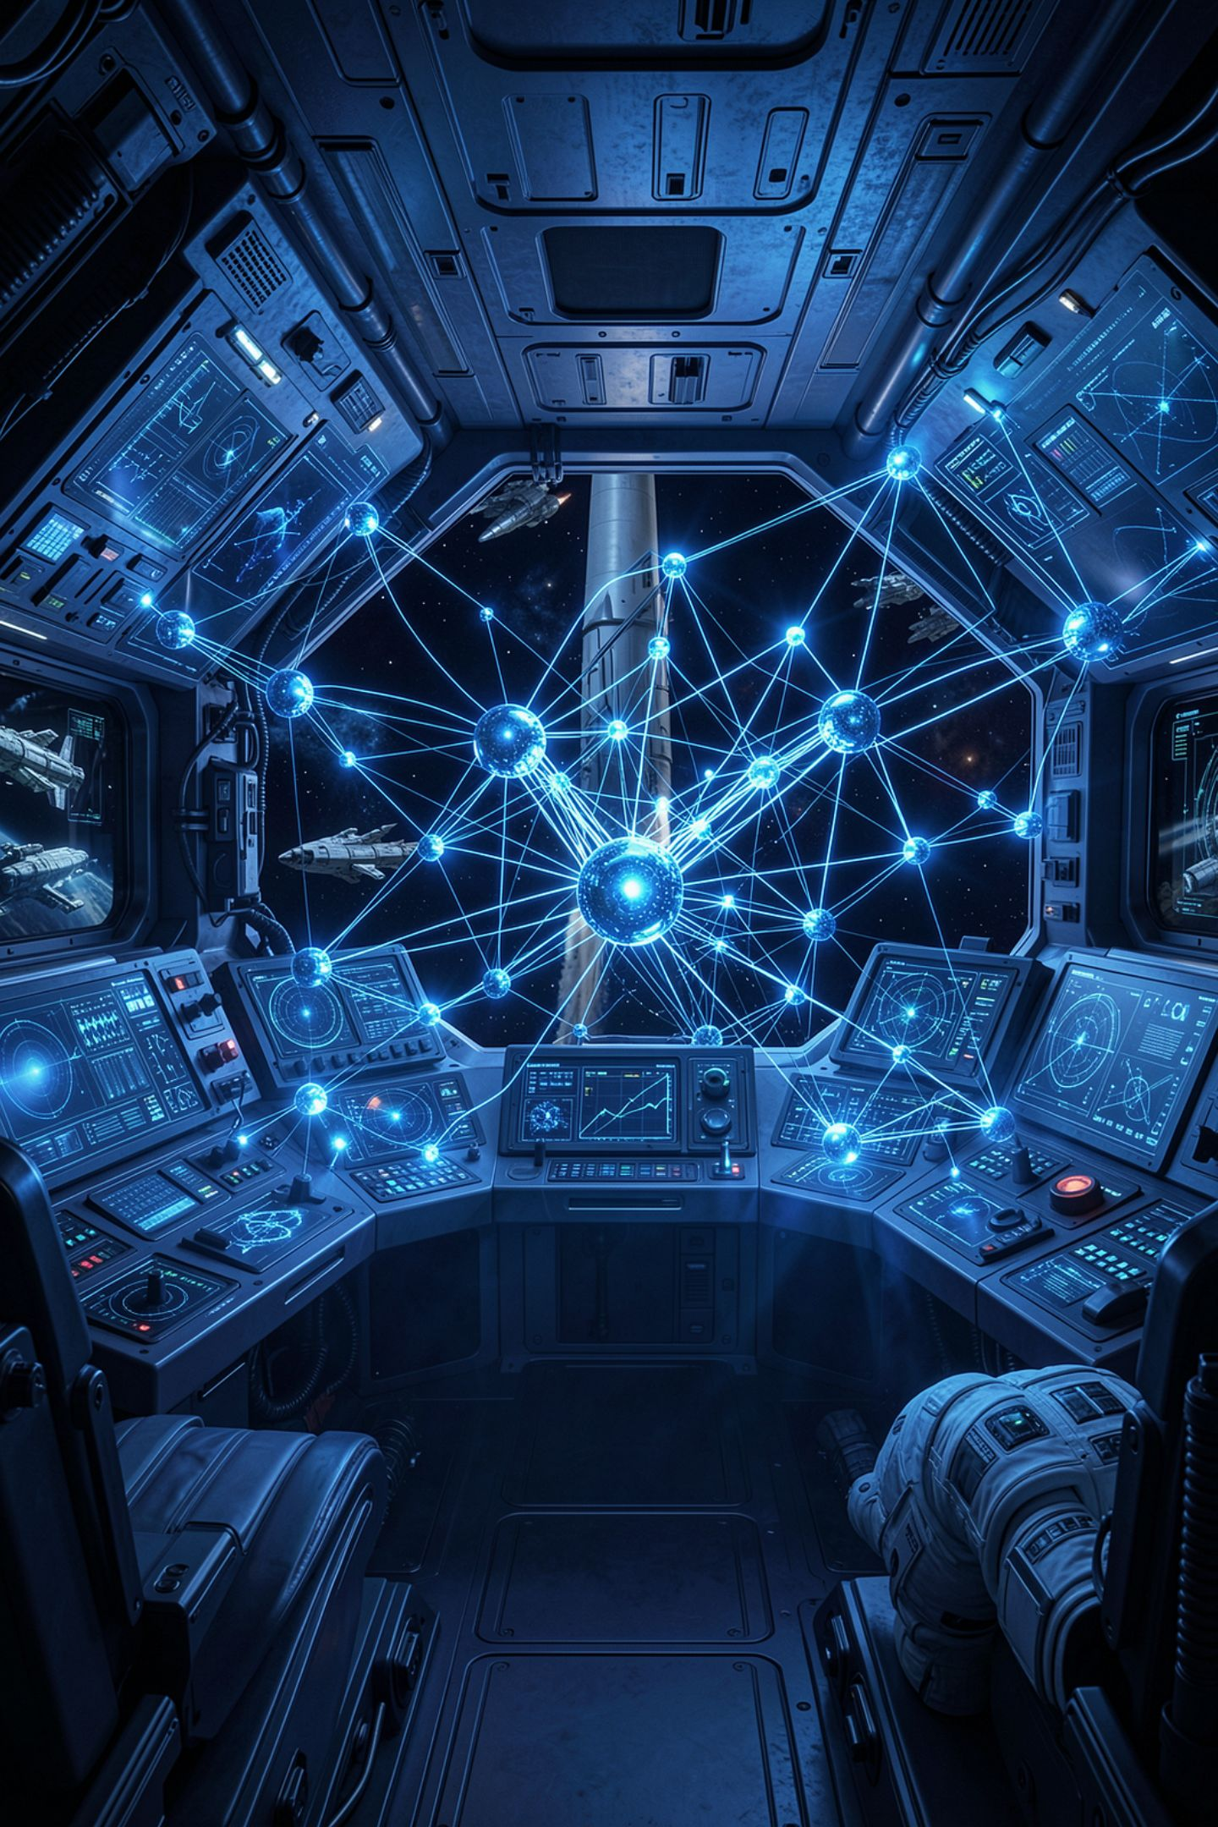
Three Things a Language Model Cannot Do

Slide 2
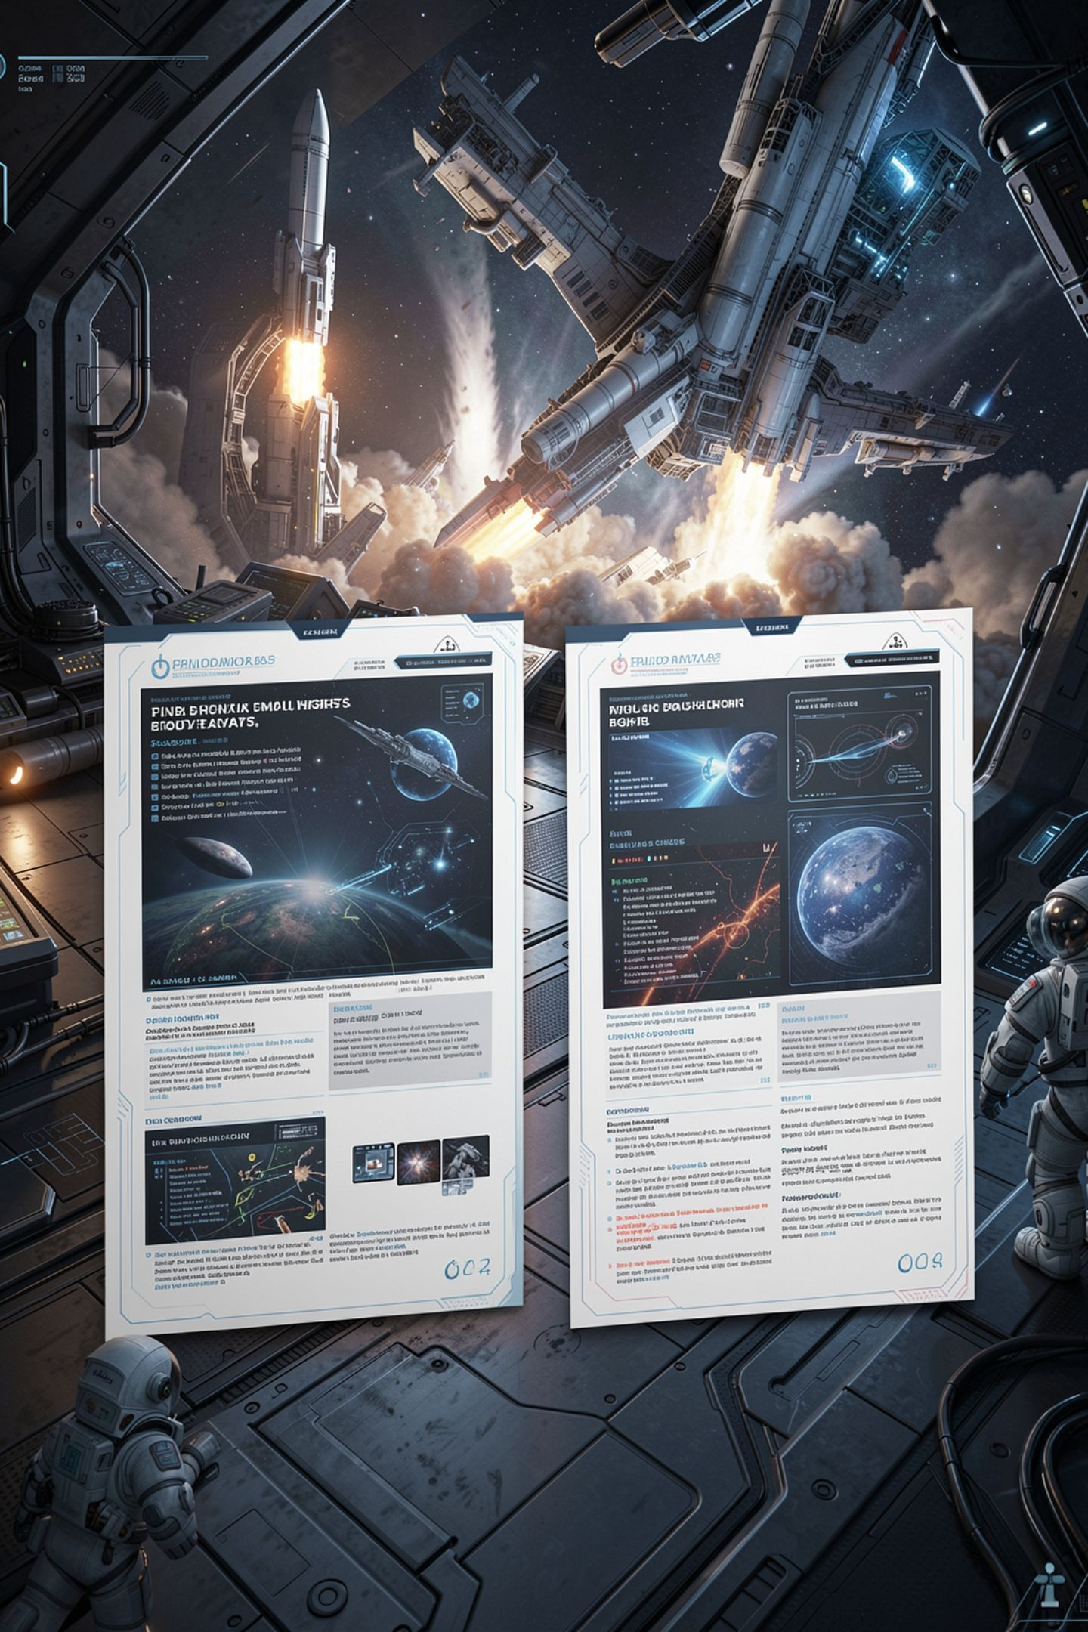
One request, two failures, uniform tone
A fluent summary of the themes
A total of 41.5 hours
A quoted shop standard
All three sound identical
MCCTC | AI Automation & Software Development
Notes:
Here is one answer about a spreadsheet of print jobs. The summary is good. The total is text that looks like a total. The quoted standard does not exist. Nothing in the tone changes between the part that is fine and the part that is invented, and that uniformity is the actual hazard.

Slide 3

One, it cannot say where an answer came from
There is no lookup step
So there is no source record
A citation is produced like any sentence
As likely text
MCCTC | AI Automation & Software Development
Notes:
This follows from the mechanism rather than from a gap in the technology. Output is tokens chosen for likelihood. A reference to a real paper and a reference to one that does not exist look identical from the inside, because both are plausible continuations of a sentence heading toward a citation.

Slide 4

What partly fixes it
Retrieval
Context
Search your own documents
Put the relevant passages in the prompt
Attribution
Provenance
Report which document each came from
The provenance comes from your search
MCCTC | AI Automation & Software Development
Notes:
Notice where the honesty comes from in that design. Your search has a record. The model still has none. Module 4 builds this and it is the right answer for most practical problems, because it updates the moment a document changes and you can point at the page.

Slide 5
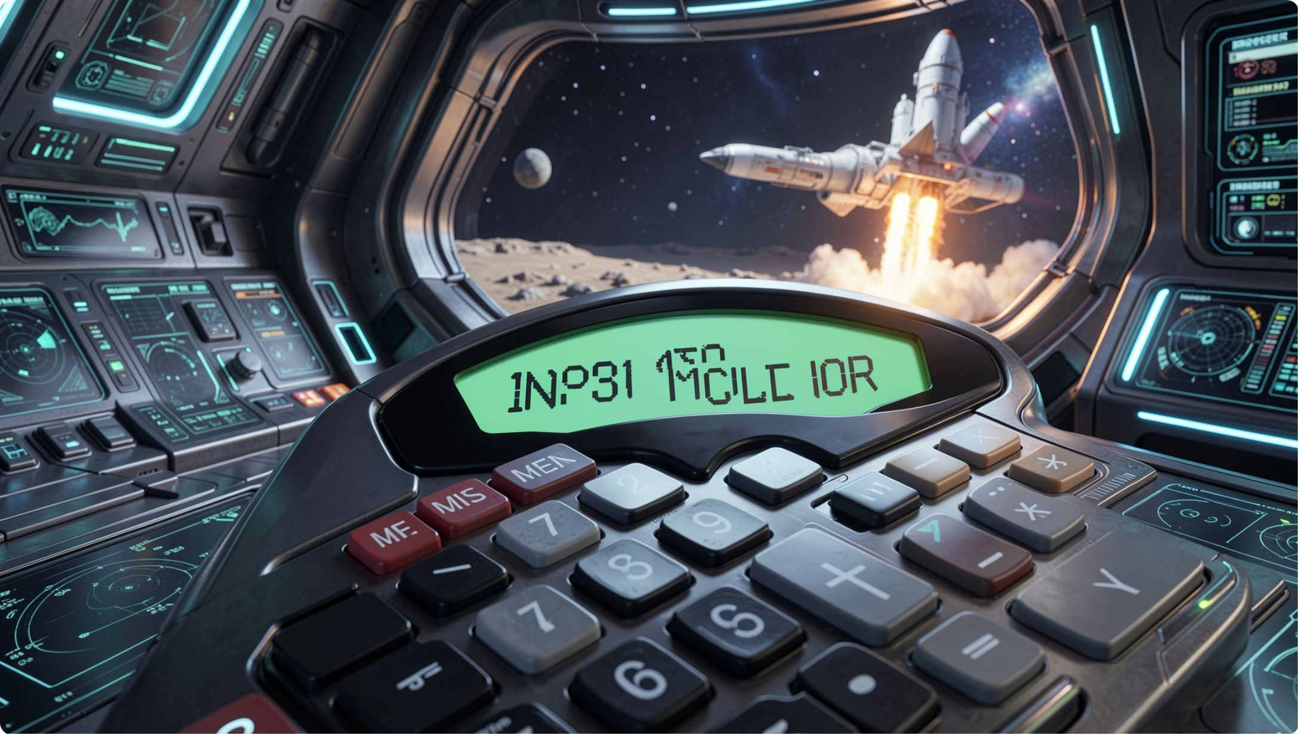
Two, it cannot be relied on to be exact
Arithmetic, counting, precise lookups
Anything where close is wrong
Likely and correct are different properties
Nothing in the process prefers correct
MCCTC | AI Automation & Software Development
Notes:
For a multiplication it has never encountered, the most likely tokens are the ones that look like an answer to that kind of question. This is not about model size. A larger model gets more of them right, which is a completely different claim from being reliable, and there is still no signal telling you which ones to check.

Slide 6
The design that fixes it
model -> work out what was being asked, pull out the amounts
code -> validate each amount, then add them up
MCCTC | AI Automation & Software Development
Notes:
Two lines and this is the shape of your Module 5 application. The model handles language. Your code handles anything that has to be exact. Never let a model do the arithmetic in your program, and be specific about that rule: it means the number must be computed by code even when the model offered you one.

Slide 7
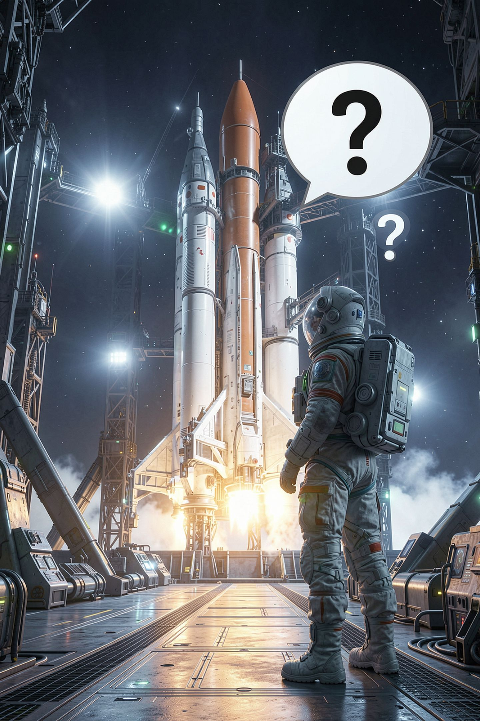
Three, and this one is an argument
"A language model does not understand what it is saying."
MCCTC | AI Automation & Software Development
Notes:
You will see this stated as settled fact constantly, including on the page you scored last week. It is not settled. I am going to give you the strongest version of each side and then you are going to have to hold a position, which is what Friday's Gate 2 asks for.

Slide 8
The case that it does not
The mechanism contains nothing like meaning
Nothing in it refers to the world
It contradicts itself without discomfort
It invents citations with equal confidence
MCCTC | AI Automation & Software Development
Notes:
Tokens in, distribution out, sample, repeat. The system has never seen a 3D printer, waited for a bus, or been wrong about something and noticed. And it fails in ways understanding would prevent: nothing is tracking consistency, so it asserts a fact and contradicts it two paragraphs later.

Slide 9
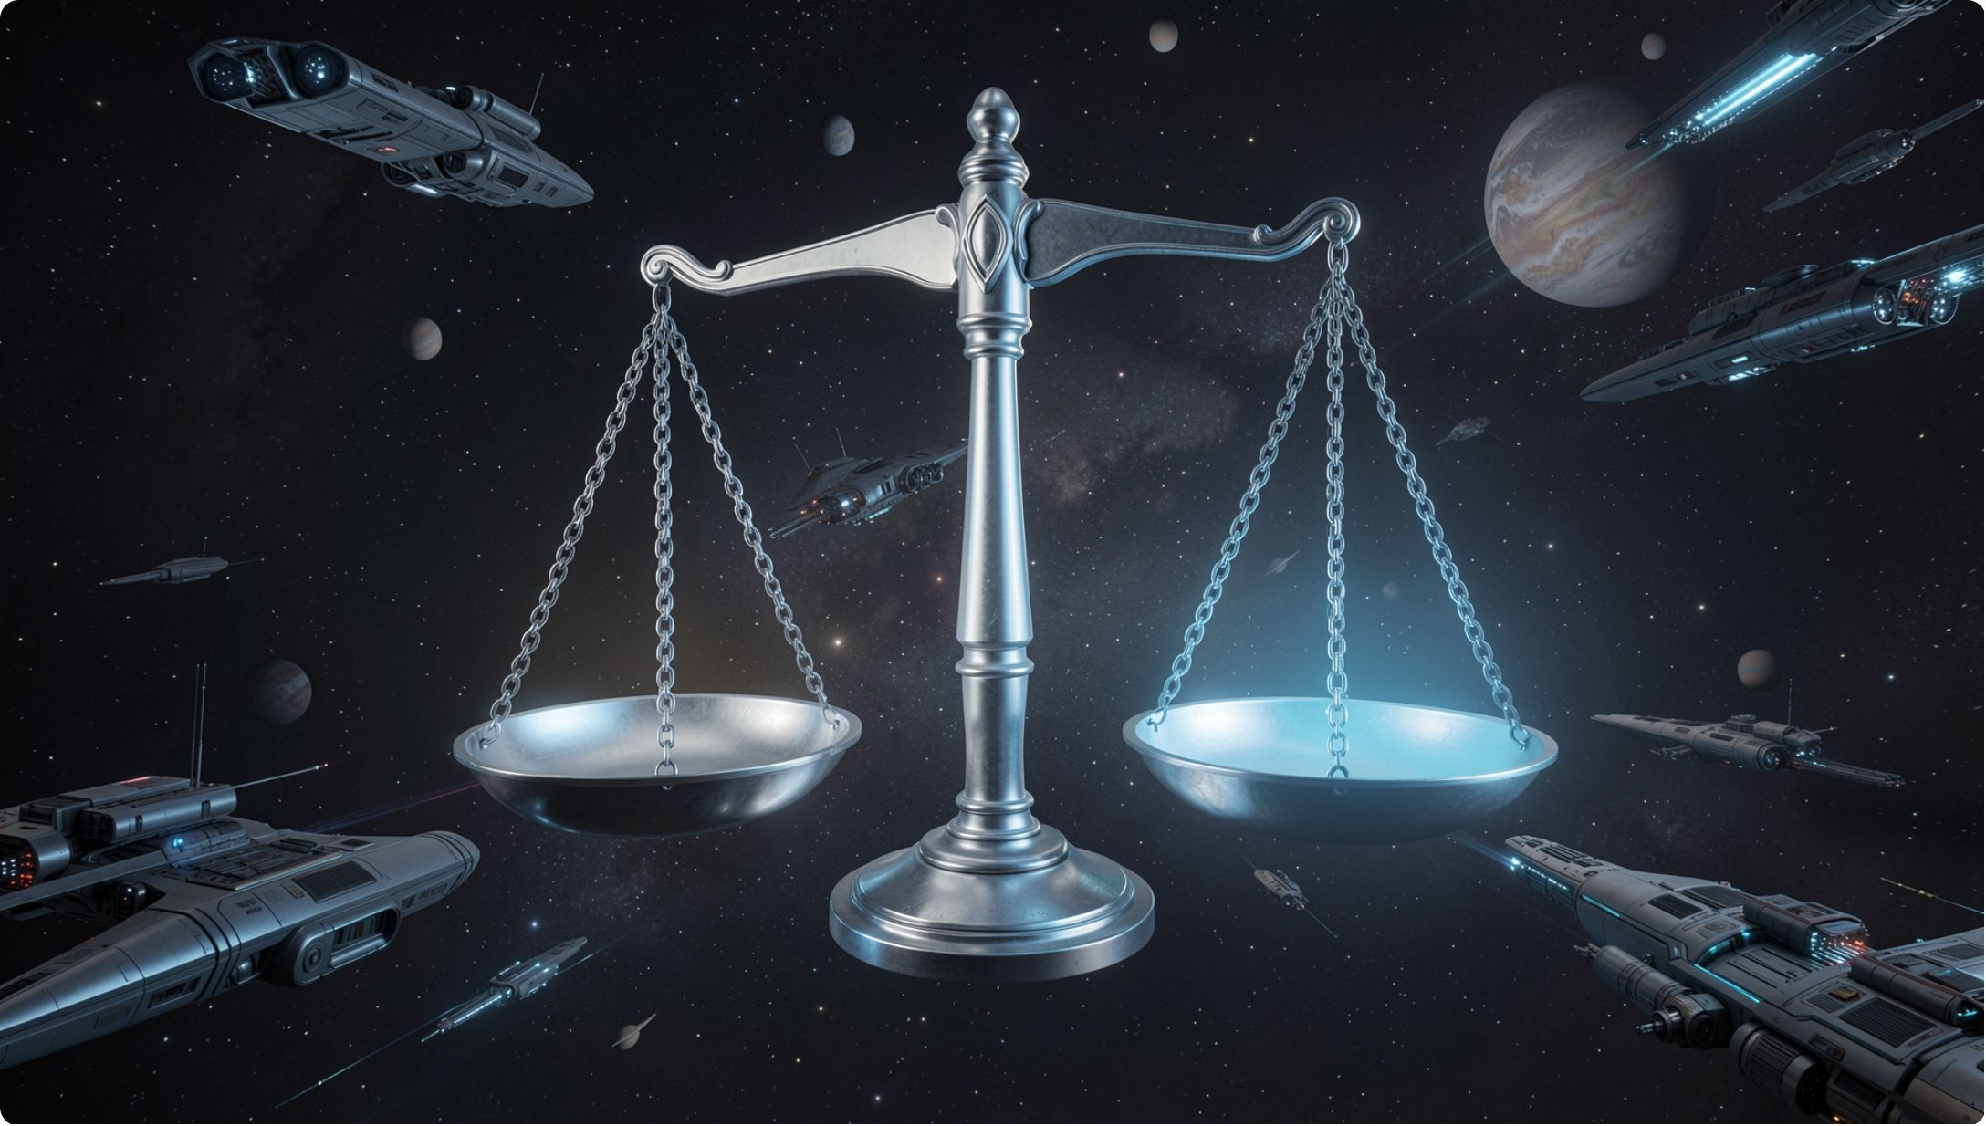
The case that the question is open
Understand has never been defined testably
The argument assumes simple parts cannot suffice
Brains are also simple parts
That is only pattern matching keeps being revised
MCCTC | AI Automation & Software Development
Notes:
This is the side students have usually never heard argued well, so listen to it properly. Saying it is only pattern matching is a claim about what pattern matching cannot achieve, and that claim has been revised downward repeatedly over the last decade by people who were not expecting to revise it.

Slide 10
So write what is settled
Settled
Settled
The mechanism, no learning during use
Confidence carries no information
Settled
Not settled
It fabricates sources
Whether that is understanding
MCCTC | AI Automation & Software Development
Notes:
In your own documents, describe what it does and what it fails at, and stay out of the word. It produces fluent text and fabricates citations with equal confidence is checkable. It does not understand anything is a position in an open argument, and stating it as fact to beginners is the defect you were asked to find last week.

Slide 11
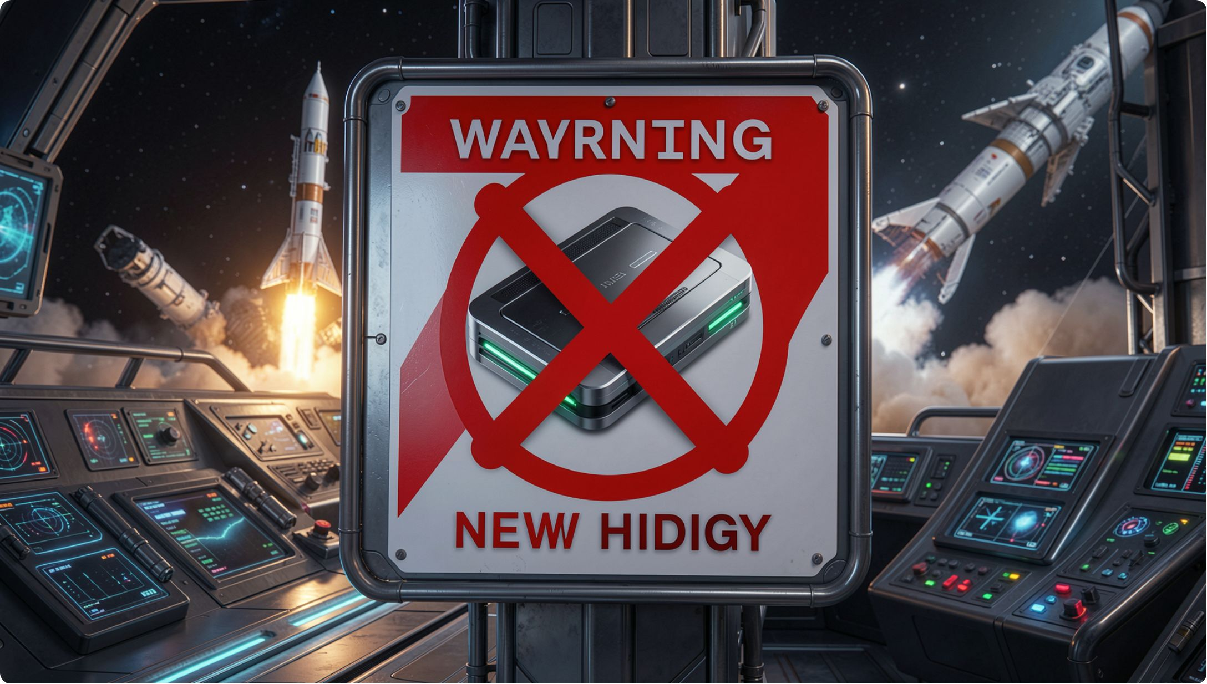
The wrong lesson to take
AI cannot be trusted, so avoid it
Treats trust as a property of the technology
The question is per task
What happens when this answer is wrong
MCCTC | AI Automation & Software Development
Notes:
This sounds cautious and it is a way of avoiding the actual work, which is deciding task by task where a mistake is recoverable. Draft an email and a person reads it before sending: recoverable. Compute a grade and nobody checks: not recoverable. The difference is whether a human who could catch it stands between the output and the consequence.

Slide 12

What you are about to build
The pretest first, then this
Three failures, one from your own work
Name the design that contains each
One has to be the contested one
MCCTC | AI Automation & Software Development
Notes:
The pretest runs in Build 1 and it is not graded, it tells me where to spend Module 2. Build 2 is three failures with the design that contains each, and one of them has to be the argument from slide six, where you take a side and give the other side its strongest form before you disagree with it.

