Slide 1

Modeling the Solution Before You Build It

Slide 2

Two people. One design. Written down nowhere.
You split the build on Monday
You agreed out loud on "return the summary"
You connect the halves on Thursday
They do not fit
MCCTC | AI Automation & Software Development
Notes:
Here is how this week goes wrong, and it goes wrong the same way every year. Two of you split the build. You agree out loud on what the service will return. Nobody writes it down, because you both understand it. On Thursday you connect the two halves and find out that you understood two different things. Today costs forty minutes and it is the cheapest forty minutes in this module.

Slide 3

Five tools, five different questions
1
2
IPO chart
Dataflow diagram
What goes in, happens, comes out
What moves between layers
3
4
Decision table
Pseudocode
Every combination, what happens
The exact logic, no language
MCCTC | AI Automation & Software Development
Notes:
These are not interchangeable and picking the wrong one is how design documents end up unread. The IPO chart is always first and always one page. The dataflow diagram is for when there is more than one program. The decision table is for three or more conditions that combine. Pseudocode is the step right before you write the function.

Slide 4
The row everybody leaves off
Input From Allowed Untrusted
command the person four words yes
text the person 1 to 4000 chars yes
model answer the model any text at all YES
MCCTC | AI Automation & Software Development
Notes:
Look at the last row. The model's answer is an input to your system. It arrives from outside, you do not control it, and it is the input most likely to be shaped in a way you did not plan for. If it is not on your input list, your design has a hole in it and the hole is exactly where the refusals go.

Slide 5
A decision table finds the row you would never write
# HTTP source error What the program does
1 200 model null print it, say it came from the model
2 200 fallback set print it, say it came from the fallback
3 400 none set do not print, name the kind
4 200 missing any not the envelope, name the port
MCCTC | AI Automation & Software Development
Notes:
Row two is the point of this whole slide. Row two is a success that carries an error, and nobody writes row two by accident. You write it because you filled in the table and saw an empty cell staring at you. Rows five, six and seven are the wire failures, which is Week fourteen.

Slide 6
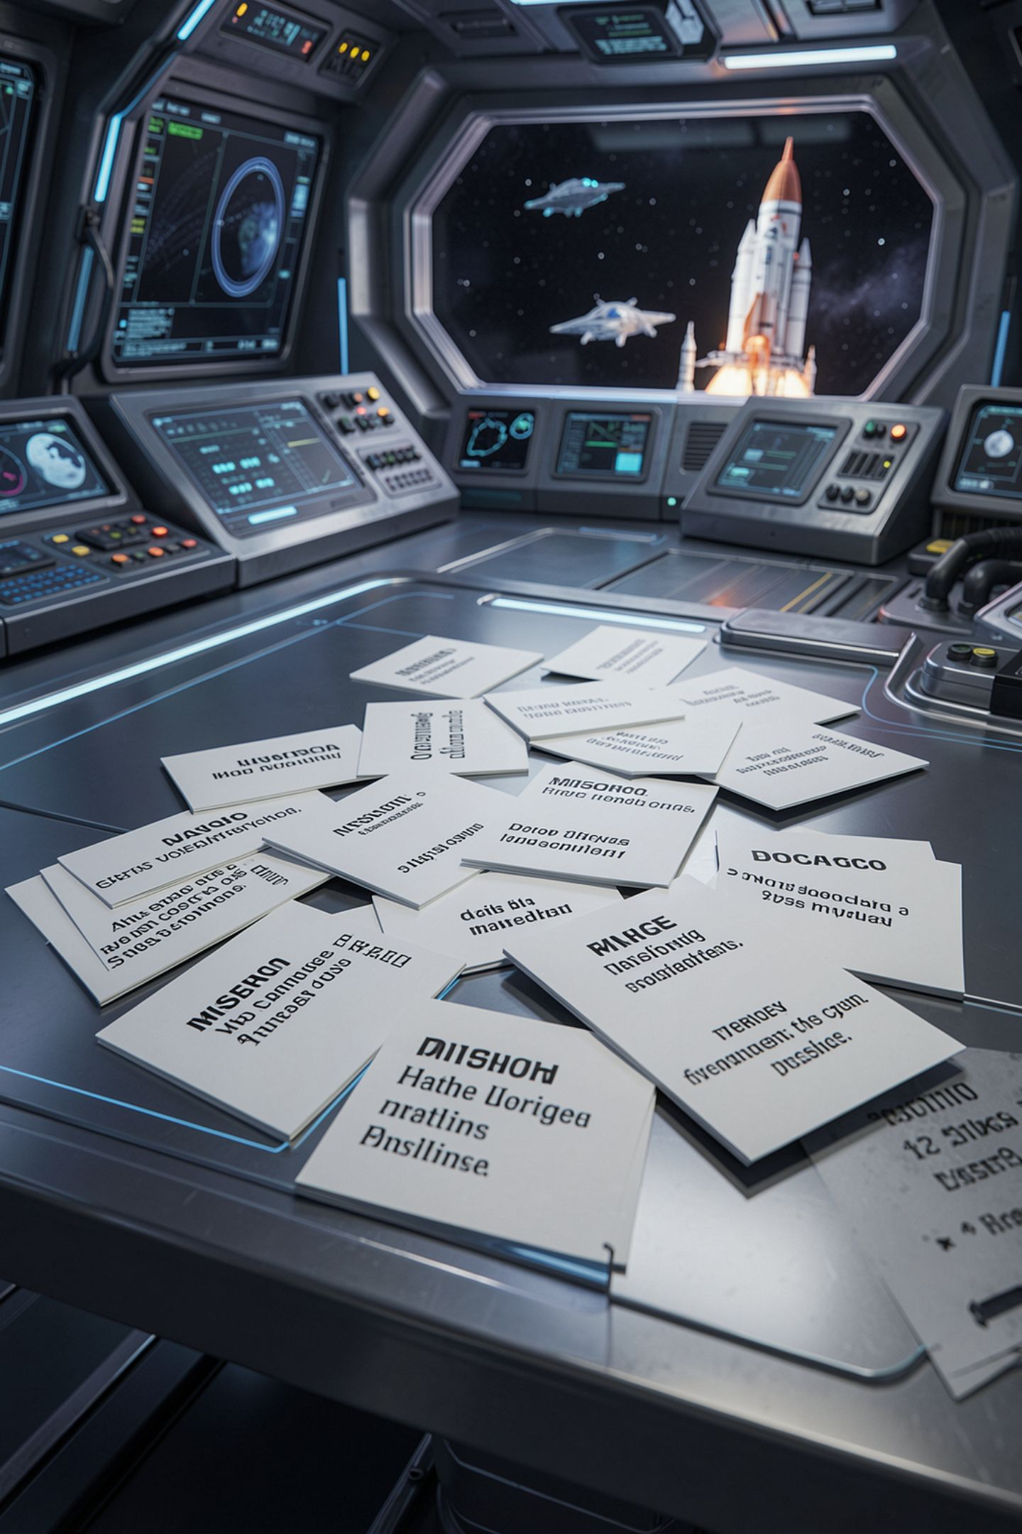
Count the messages
Seven rows in that table
At least five different messages
One word for all of them throws the answer away
Each one has a different fix
MCCTC | AI Automation & Software Development
Notes:
Count how many different messages a program needs to serve those seven rows. At least five. A program that prints the word Error for rows three through seven has thrown away the one thing the person actually needed, which is which of the five happened. You met this last year with 404 and timeout and rate limit. Same idea, new shapes.

Slide 7
Pseudocode is not code with the syntax removed
run_task(task, prompt):
try:
answer = ask the model, with a timeout, retrying only what can change
result = parse the answer into this task's shape
reason = check the result against this task's rules
if reason is nothing: return envelope(source: "model")
error = ("task_validation_failed", reason)
catch a model failure as e:
error = (e.kind, e.message)
return envelope(source: "fallback", fallback result, error)
MCCTC | AI Automation & Software Development
Notes:
Ten lines, and every decision the real service makes is in them. No imports, no syntax to get wrong, no language. The real function is twenty lines of Python and does exactly this. Here is the test of pseudocode. Hand it to your partner and ask them what happens when the model answers with something the parser cannot use. If they can answer from this alone, it is finished.

Slide 8

You may use a model to help you model
Draft a diagram or a decision table with it
Check every line against your own code
Record what you changed, in the decision log
Submit nothing you cannot defend
MCCTC | AI Automation & Software Development
Notes:
The competency names artificial intelligence alongside the graphic tools, which means using a model to help you model. That is allowed and it has one rule attached. Every draft you take from a model goes in your decision log with what you changed and why, and you defend it line by line. The only way to fail outright in this program is submitting work you cannot explain.

Slide 9
What the design you did not write down produces
service returns: {"summary": "...", "bullets": [...]}
client expects: {"result": {"text": "...", "points": [...]}}
summary:
MCCTC | AI Automation & Software Development
Notes:
Neither of them is wrong. They never agreed. The C sharp program runs, deserialises without complaining, and prints one empty line, because System dot Text dot Json sets a missing field to its default rather than telling you. That is two days of work that do not fit together, found on Thursday, in a three week module.

Slide 10
Why the tables feel like a waste of time
Monday
Monday
Monday mistake
Thursday mistake
Code gives you something on screen
Tables give you nothing you can run
Costs a conversation
Costs a rewrite
MCCTC | AI Automation & Software Development
Notes:
Be honest about why people skip this. You can see code working and you cannot see a design working. Forty minutes of tables produces nothing on a screen. The cost is not paid evenly. A design mistake found on Monday costs you a conversation. The same mistake found Thursday costs both of you a rewrite, and Thursday of Week thirteen is the last day I am in the room before the competition week.

Slide 11

What you are about to build
Lab M05-02 starts Thursday, design today
Your IPO chart, one page, both of you
Your result shape, in JSON, pasted into both files
Your decision table, every row, including the empty ones
MCCTC | AI Automation & Software Development
Notes:
Build one is your own IPO chart, on paper, both of you at one table. Build two is the result shape and the decision table. The rule for the result shape is that you do not describe it, you write it, in JSON, and both of you paste the same block into your own file. Not a description. The shape.

