Slide 1
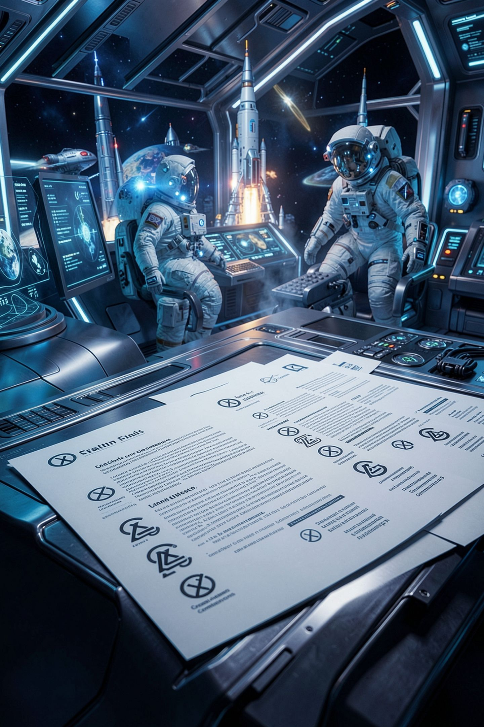
Creative Commons, Media, and the Attribution You Owe

Slide 2
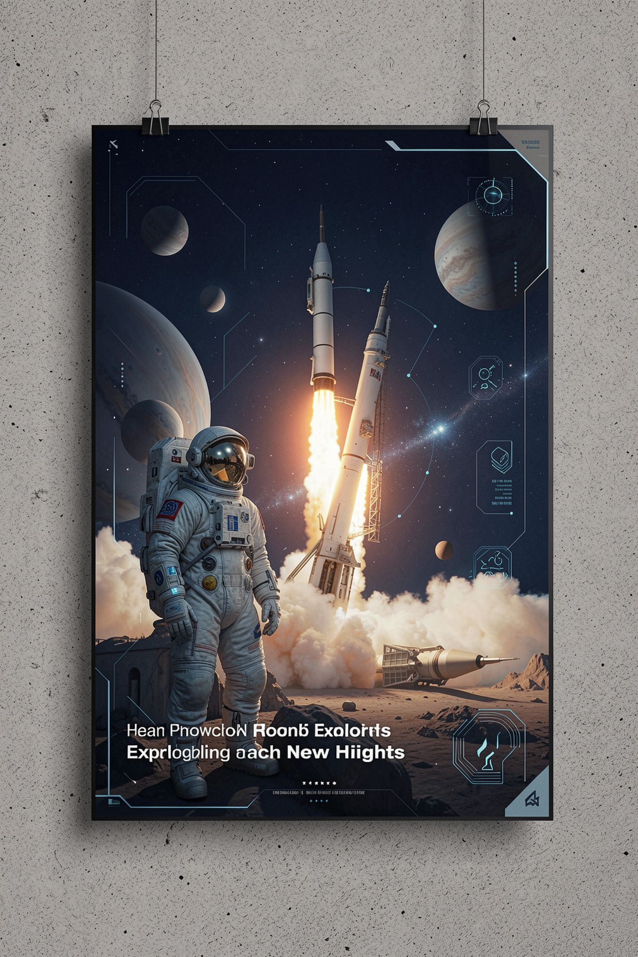

Nobody looks at your dependency tree
Everybody looks at your poster
The font, the icons, the sound, the image
None of those are things you made
All of them arrived without terms attached
MCCTC | AI Automation & Software Development
Notes:
Your code is usually the part you wrote. Your media almost never is. And the media is the part standing behind you at the showcase, two feet tall, in front of a judge. Today is about the four components most likely to be unlicensed in any project any of you ship.

Slide 3
Four elements, mixed into six licenses
BY
SA
Credit the creator, in the stated form
Adapted versions you share carry the same license
NC
ND
Not primarily for commercial advantage
Share the work, not adapted versions
MCCTC | AI Automation & Software Development
Notes:
Read the abbreviation and you know most of what you need before you open anything. Every current Creative Commons license includes BY. Combine BY with the other three and you get the six. CC zero is separate and is not a license in the same sense.

Slide 4
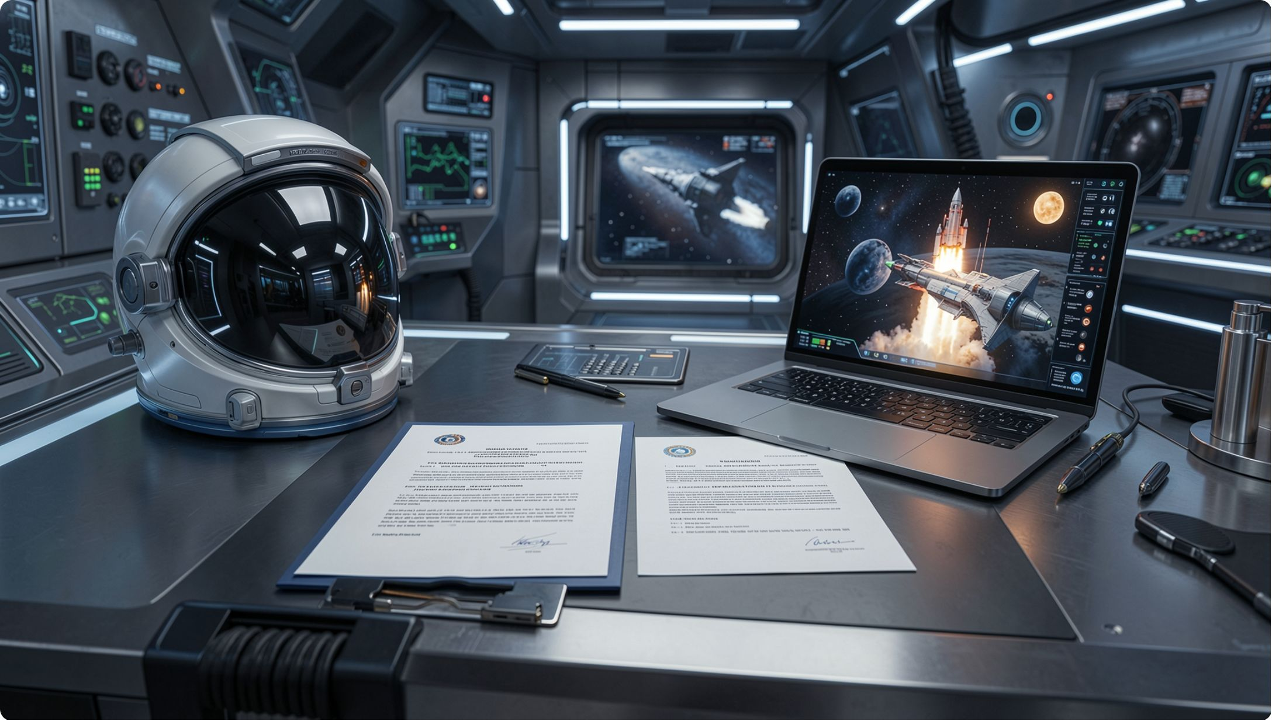
The deed is a summary. The legal code is the license
Every CC license ships two documents
The deed is short and human readable
The legal code is linked from it
Only one of them governs
MCCTC | AI Automation & Software Development
Notes:
This is the best lesson on summaries you will ever get, because the difference is built into the product. Creative Commons publishes a summary and the license side by side and tells you which one is which. Read the legal code. Then notice how often you were about to stop at the deed.

Slide 5
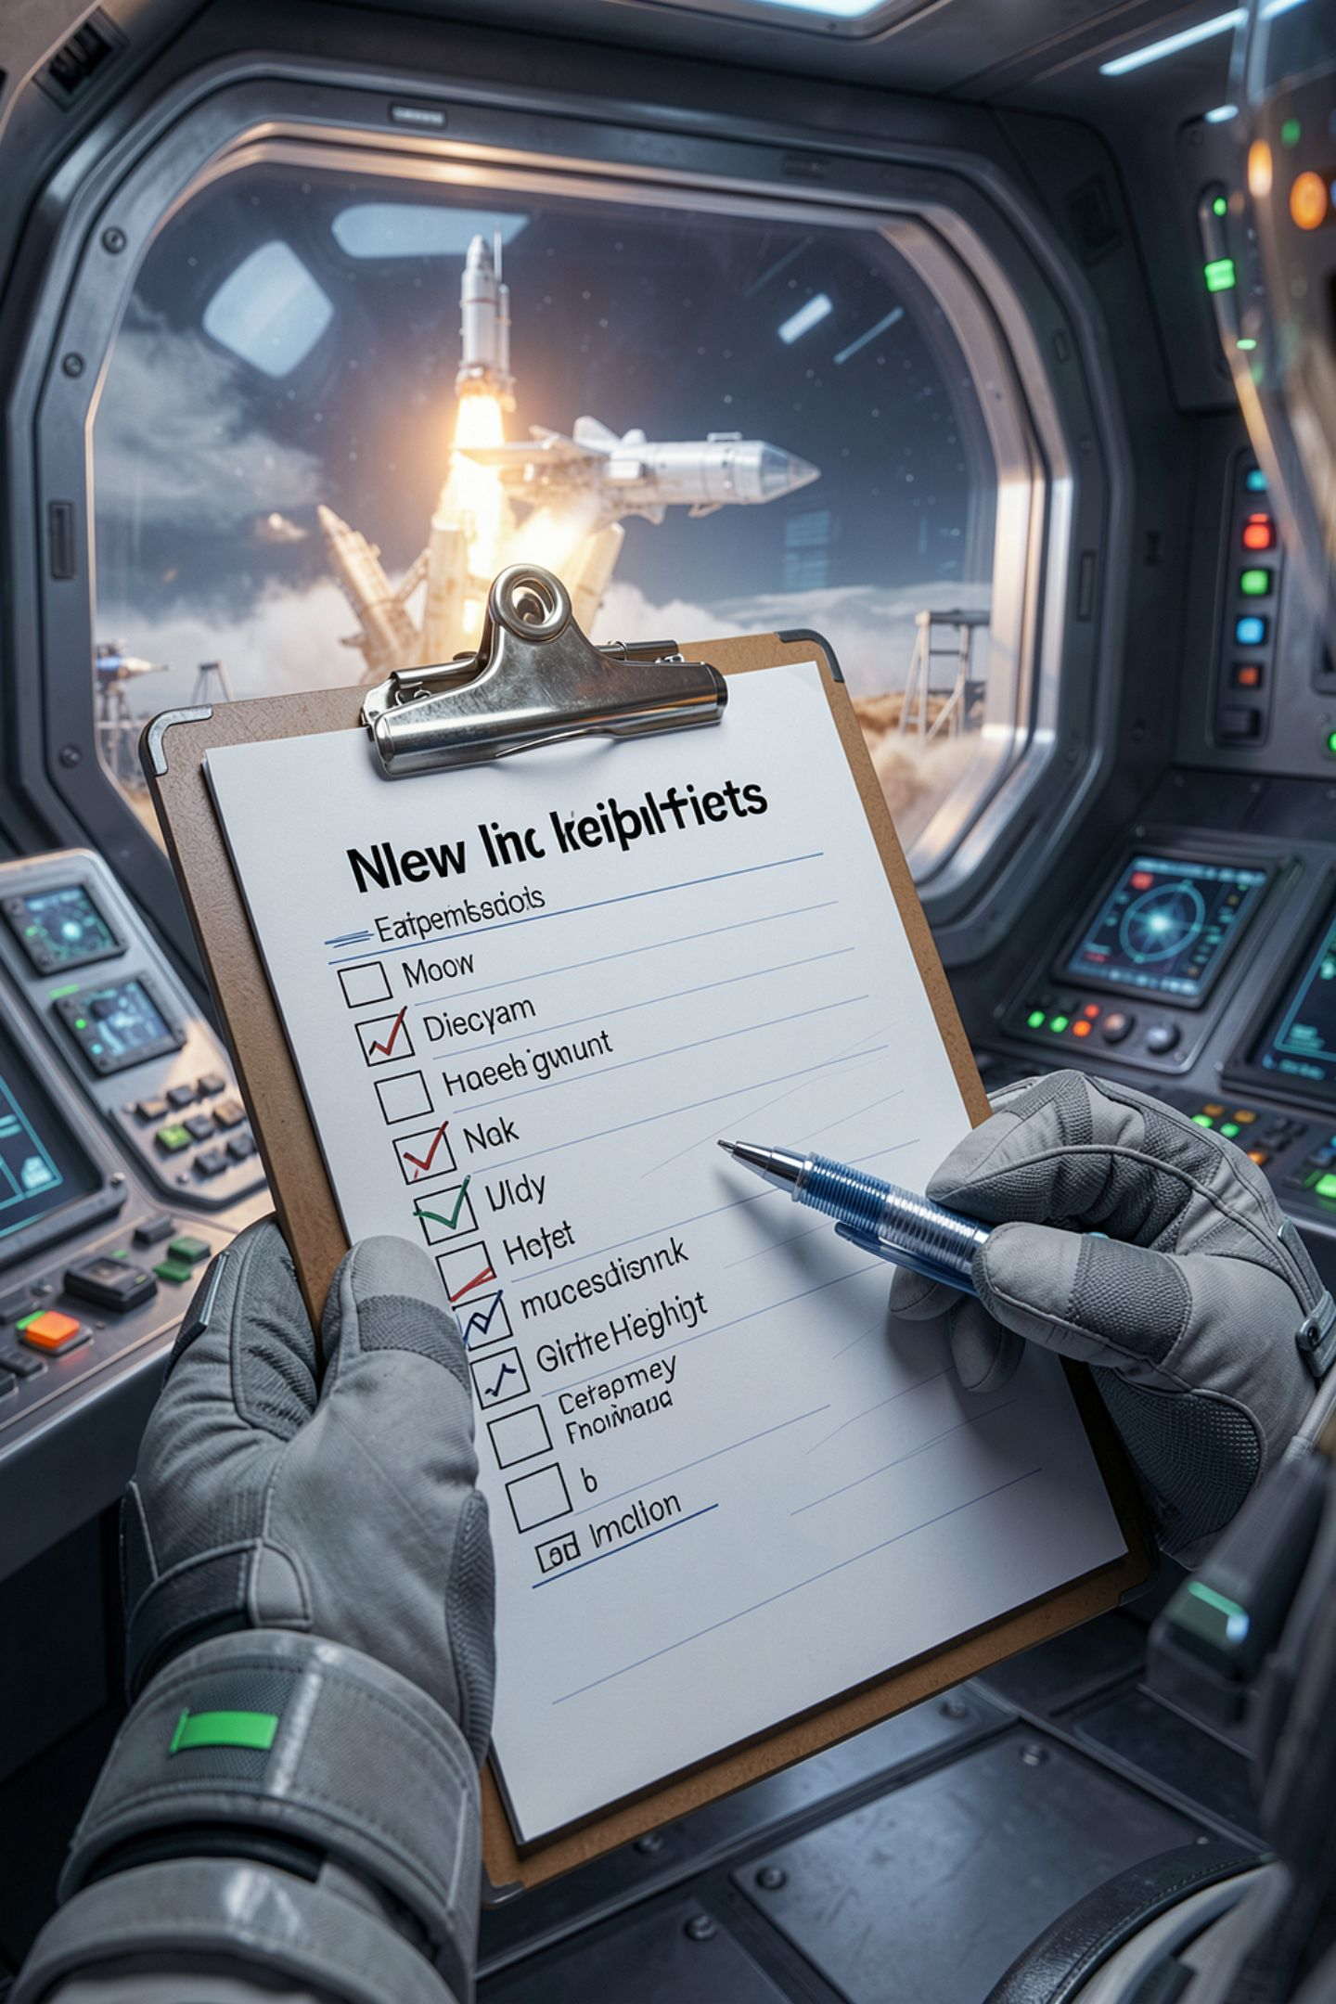
Attribution is a list, not a vibe
Creator name, copyright notice, license notice
Disclaimer notice, link to the material
Link to the license
An indication that you changed it
MCCTC | AI Automation & Software Development
Notes:
Section three of the license sets out what you keep or supply. That is the list, and almost nobody produces it. Your README probably says thanks to someone, and thanks is not on the list.

Slide 6
What your credit line is actually missing
Study Buddy README, as written
Icons by the Lantern Icon Project.
MISSING creator name
MISSING title of the work
MISSING link to the material
MISSING license named
MISSING link to the license
MISSING modified stated
MCCTC | AI Automation & Software Development
Notes:
Six for six. It names the project rather than the creators, and carries none of the other five items. It reads like credit and satisfies nothing. Two of those icons were recolored, which makes the last line a condition rather than a nicety.

Slide 7
One sentence longer, and it holds
"Study 24" by A. Nkemdirim and R. Bautista, at
https://example.invalid/study24, licensed CC BY 4.0,
https://creativecommons.org/licenses/by/4.0/ ,
modified: two icons recolored.
MCCTC | AI Automation & Software Development
Notes:
That is the whole cost of getting this right. One sentence. Which is why there is no excuse for getting it wrong, and why your audit asks you to write this line out rather than tick a box saying attribution done.

Slide 8
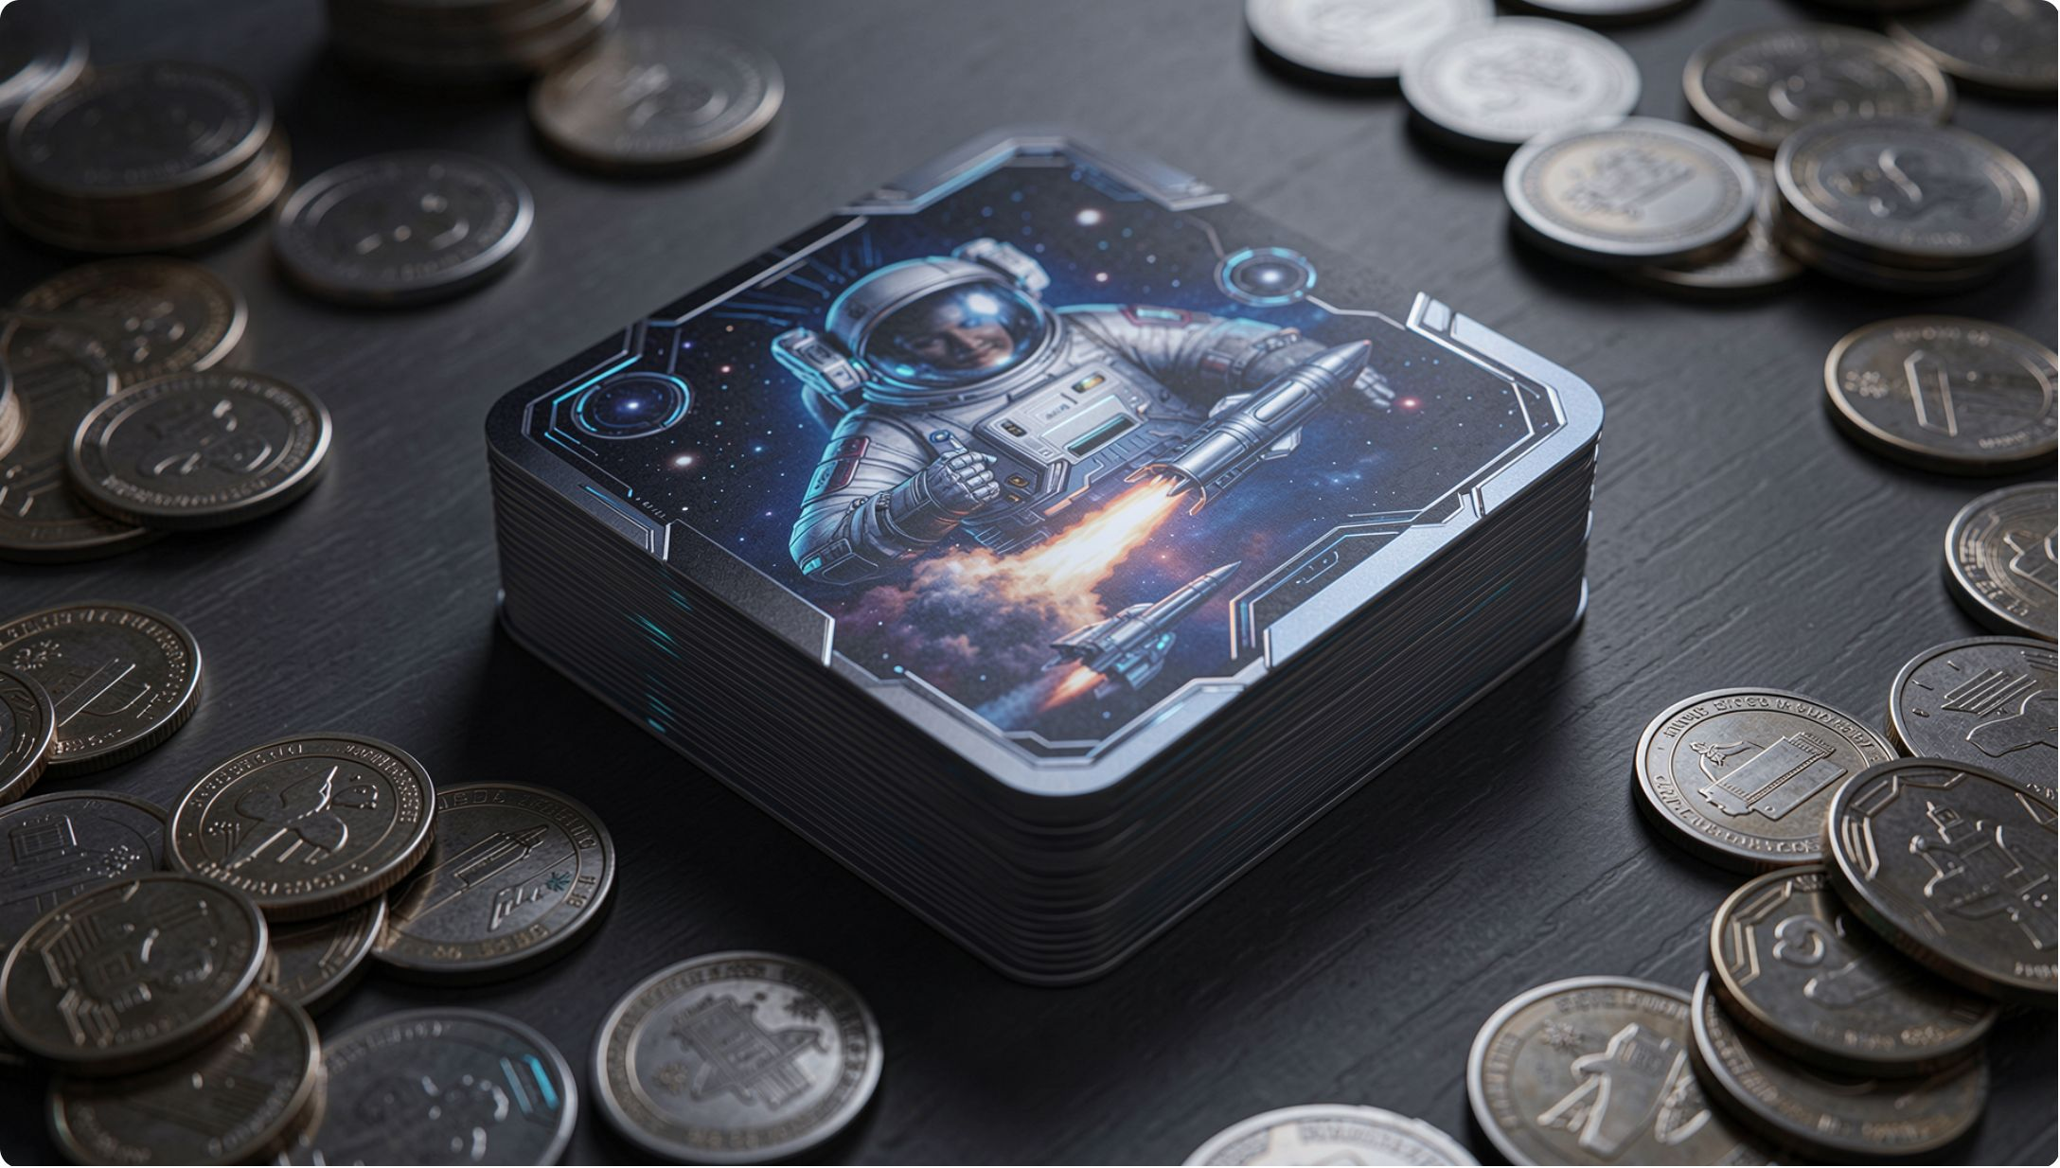
NonCommercial, and a question with two real sides
The chime in your fixture is CC BY-NC
The team plans to sell printed decks
One side: money is changing hands for a product
Other side: the chime is not in the printed decks
MCCTC | AI Automation & Software Development
Notes:
This is a genuine argument and both halves are real. Your job as an auditor is not to win it. Write down the facts the answer depends on, write down that swapping the sound is the cheap fix, and escalate it. We are a school club is not a legal analysis and this course will not let you use it as one.

Slide 9
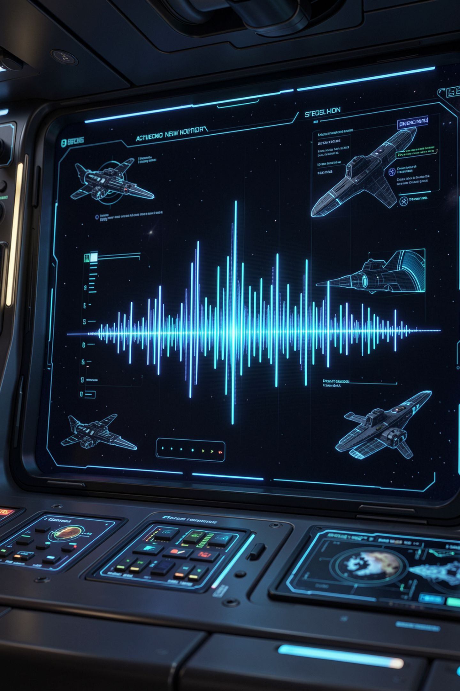

Media has its own traps
Fonts
Fonts have embedding and redistribution terms
Recorded music
Recorded music usually has two separate copyrights
Royalty-free
Royalty-free means no per-use royalty, not free
Logos
A logo in your interface implies endorsement
MCCTC | AI Automation & Software Development
Notes:
A font you may install is not automatically a font you may ship. A song you bought is not a song you may put in a video. Royalty-free is a pricing model. And a logo is a trademark question, which is about suggesting a relationship rather than about copying an image.

Slide 10
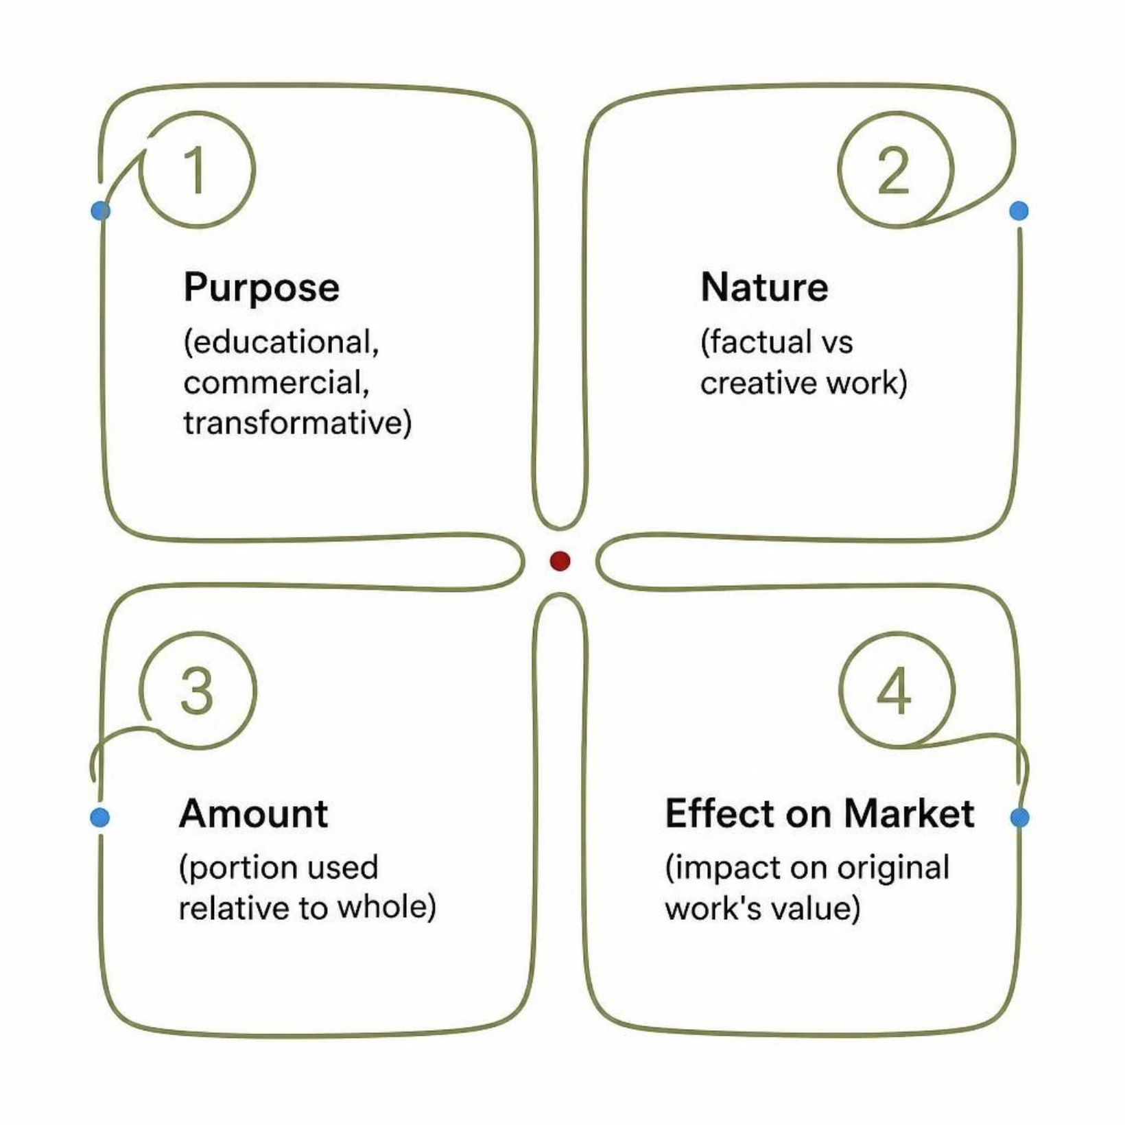
Fair use, honestly
Four factors, weighed by a court, case by case
Purpose, nature, amount, effect on the market
Educational purpose is part of one factor
A defense, never a permission slip
MCCTC | AI Automation & Software Development
Notes:
Teams reach for fair use after they have already done the thing and want a reason it was fine. That is backwards. It is a reason to ask a lawyer and never a reason to ship. If your defence of an asset starts with the words it is educational, you have not got a defence yet.

Slide 11
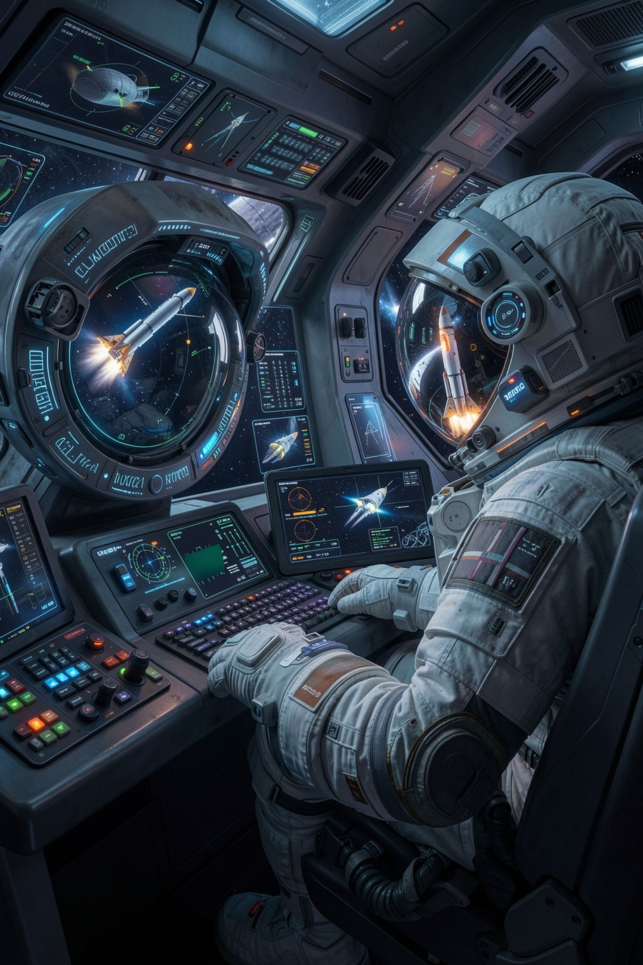
The fastest finding in your fixture
01
assets/images/hero.png has no license file
02
Recorded source: found it in image search
03
There is nothing to read, and that is the finding
04
Remove it before the poster is printed
MCCTC | AI Automation & Software Development
Notes:
The absence of a license is not a gap in your audit. It is the result of your audit, and it gets written down in exactly those words. No license found, no permission identified, remove. This one takes ten minutes to fix today and takes your poster down on Friday.

Slide 12
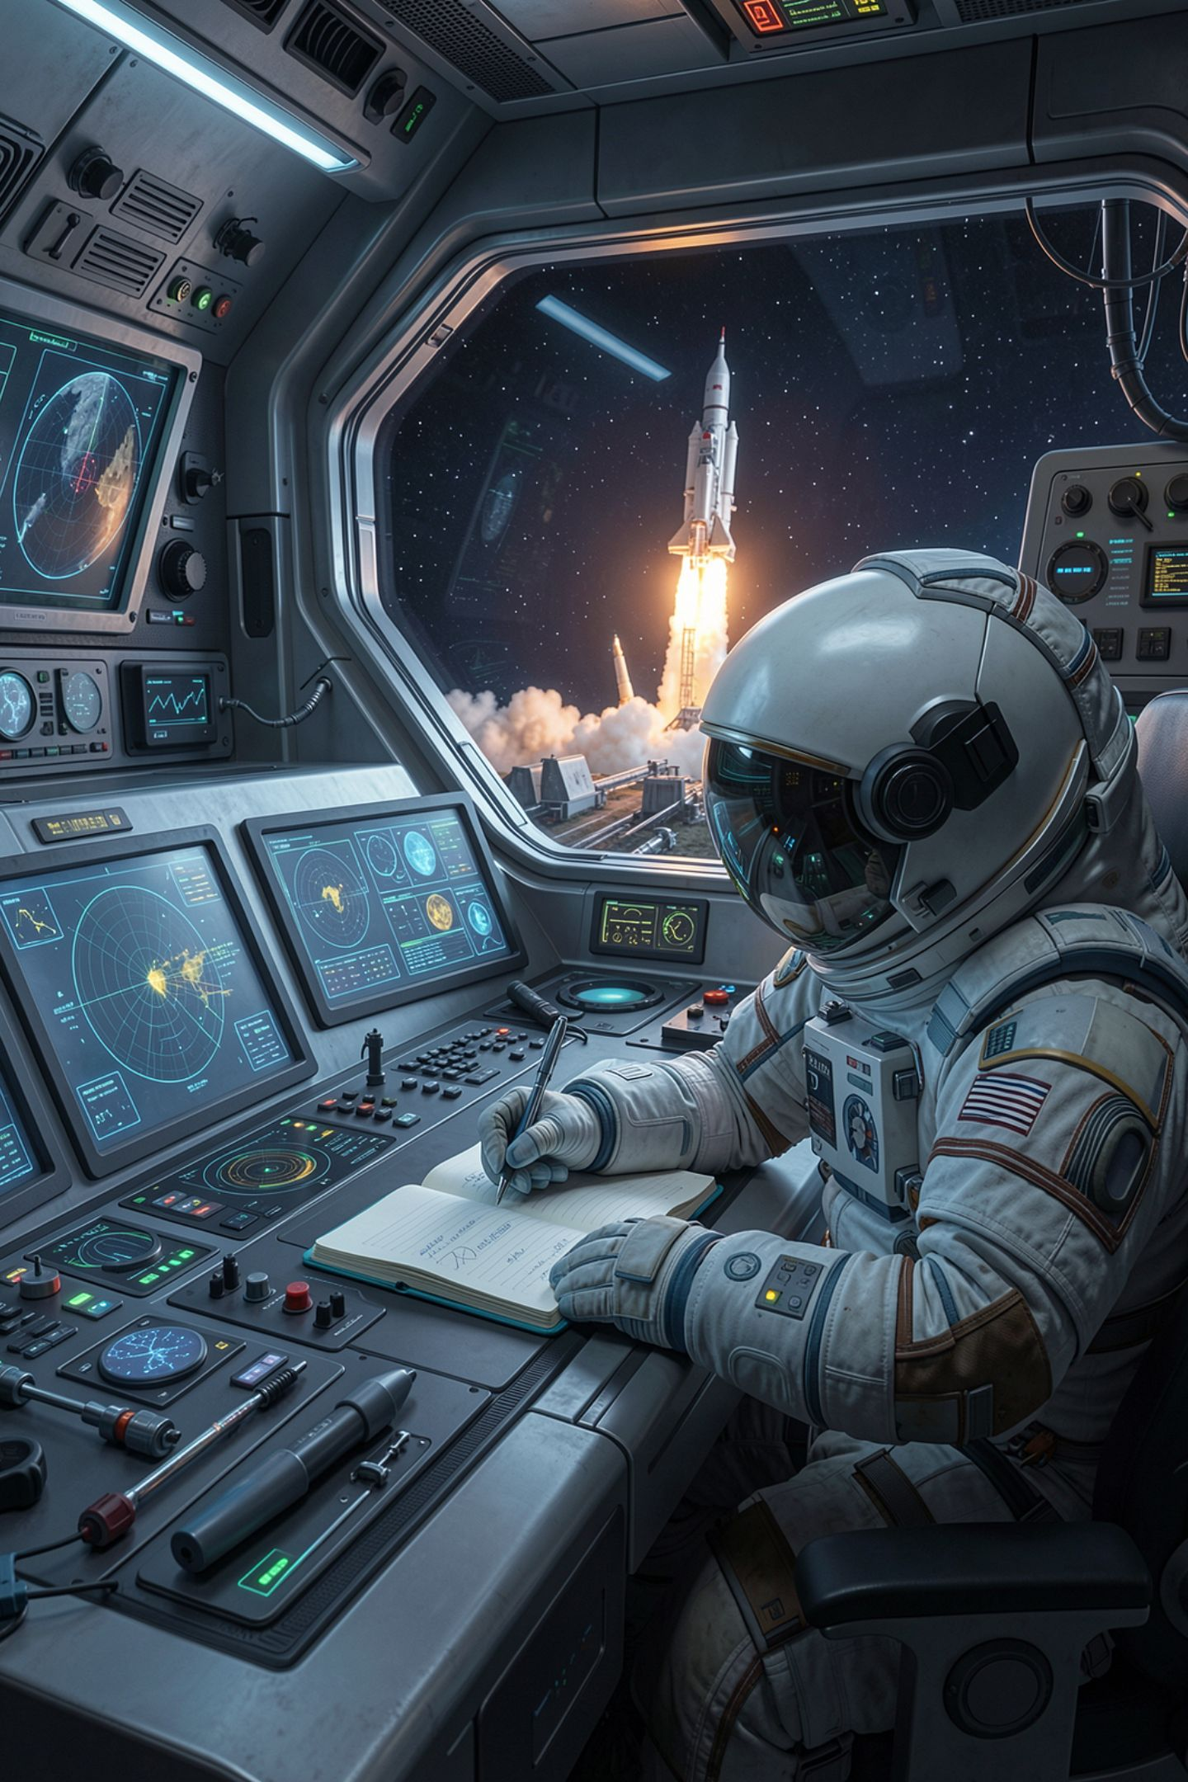
What you are about to build
1
Write the attribution line for the icons
2
Answer the NonCommercial question with facts, not a verdict
3
Write the audit entry for the ShareAlike dataset
4
Say what would trigger the condition that is not triggered
MCCTC | AI Automation & Software Development
Notes:
Build one finishes the media rows of your manifest. Build two is the three hardest entries: the icons, the chime, and the dataset. Not triggered today, and here is what would trigger it, is a complete entry. The letters N slash A are not.

