Slide 1

Reading a License Instead of Reading About One

Slide 2

You have had this argument already
Somebody says MIT means you must open source
Somebody says GPL means you cannot sell it
Both are false and both get repeated
The file that settles it is on your disk
MCCTC | AI Automation & Software Development
Notes:
You have heard both of those claims in this building. Working developers repeat them too. Today you settle arguments like that in under a minute, by opening a file instead of asking anybody, and the file turns out to be shorter than the argument.

Slide 3

Three questions, always in this order
1
2
PERMIT
REQUIRE
What does it PERMIT that you could not do before
What does it REQUIRE from you in exchange
3
4
FORBID
TRIGGERS
What does it FORBID no matter what
What TRIGGERS the requirements
MCCTC | AI Automation & Software Development
Notes:
Every license answers these. Write the answers in these words because your licensing audit asks for exactly them. The fourth one is the question nobody asks and it decides whether any of the rest is live today.

Slide 4
The whole MIT obligation, found in eight seconds
text = open("vendor/pocketgrid/LICENSE", encoding="utf-8").read()
print(len(text.split()), "words")
for paragraph in text.split("\n\n"):
if "shall be included" in paragraph:
print(paragraph.strip())
MCCTC | AI Automation & Software Development
Notes:
Watch how fast this settles. I am reading the license file itself and pulling out the one paragraph that states a condition. No summary, no search, no model. The file on my disk.

Slide 5

One hundred sixty nine words, one condition
169 words
The above copyright notice and this permission notice shall be included in all
copies or substantial portions of the Software.
MCCTC | AI Automation & Software Development
Notes:
That is the entire obligation of the MIT license. Not open source your project. Not credit us on the About screen. Include the notice. Next time somebody tells you what MIT requires, do this instead of arguing.

Slide 6
Three families, one bargain each
Permissive
Copyleft
Restricted Use
Do nearly anything, keep the notices
What you convey stays under the same terms
A list of things you may not do
Model licenses are usually the third kind
MCCTC | AI Automation & Software Development
Notes:
Three families. The third one is where most model licenses live, and it is the one students have never met. Open the model license in your fixture and you find a list of forbidden uses and an automatic termination clause. That is not an open source license and the difference matters on Thursday.

Slide 7
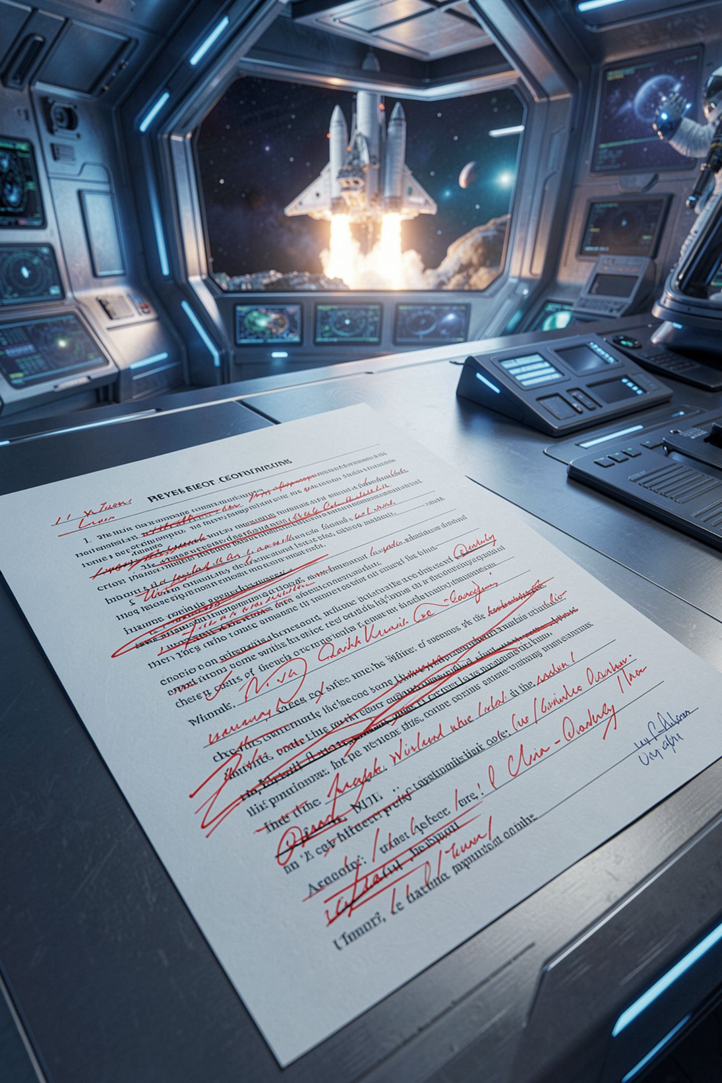
Two corrections worth saying out loud
The GPL permits commercial use and charging money
Its conditions are about conveying, not about using
Apache 2.0 adds a patent grant. MIT has none
Apache section four is a checklist. Read it
MCCTC | AI Automation & Software Development
Notes:
Both GPL corrections get said wrong in this room every year. The GPL is not an anti-money license. It is a same-terms-travel-with-it license. And Apache adds a patent grant that MIT is completely silent on, which is the reason a lot of companies prefer it.

Slide 8
Which obligations are awake right now
Plan: running it on your own laptop
Nothing is conveyed to anybody else.
Plan: putting the repository on GitHub
MIT ship the copyright notice and the permission notice
Apache-2.0 ship the license, the NOTICE contents, and mark changed files
GPL-3.0-or-later ship the license and the corresponding source, under the GPL
CC-BY-4.0 give attribution in the form section 3 sets out
You changed something, so every 'state your changes' clause applies.
MCCTC | AI Automation & Software Development
Notes:
Look at the second plan. Every one of you moved from the first plan to the second in week one of this program and nobody stopped to notice. Pushing to a public repository is conveying. That is the day the obligations wake up.

Slide 9
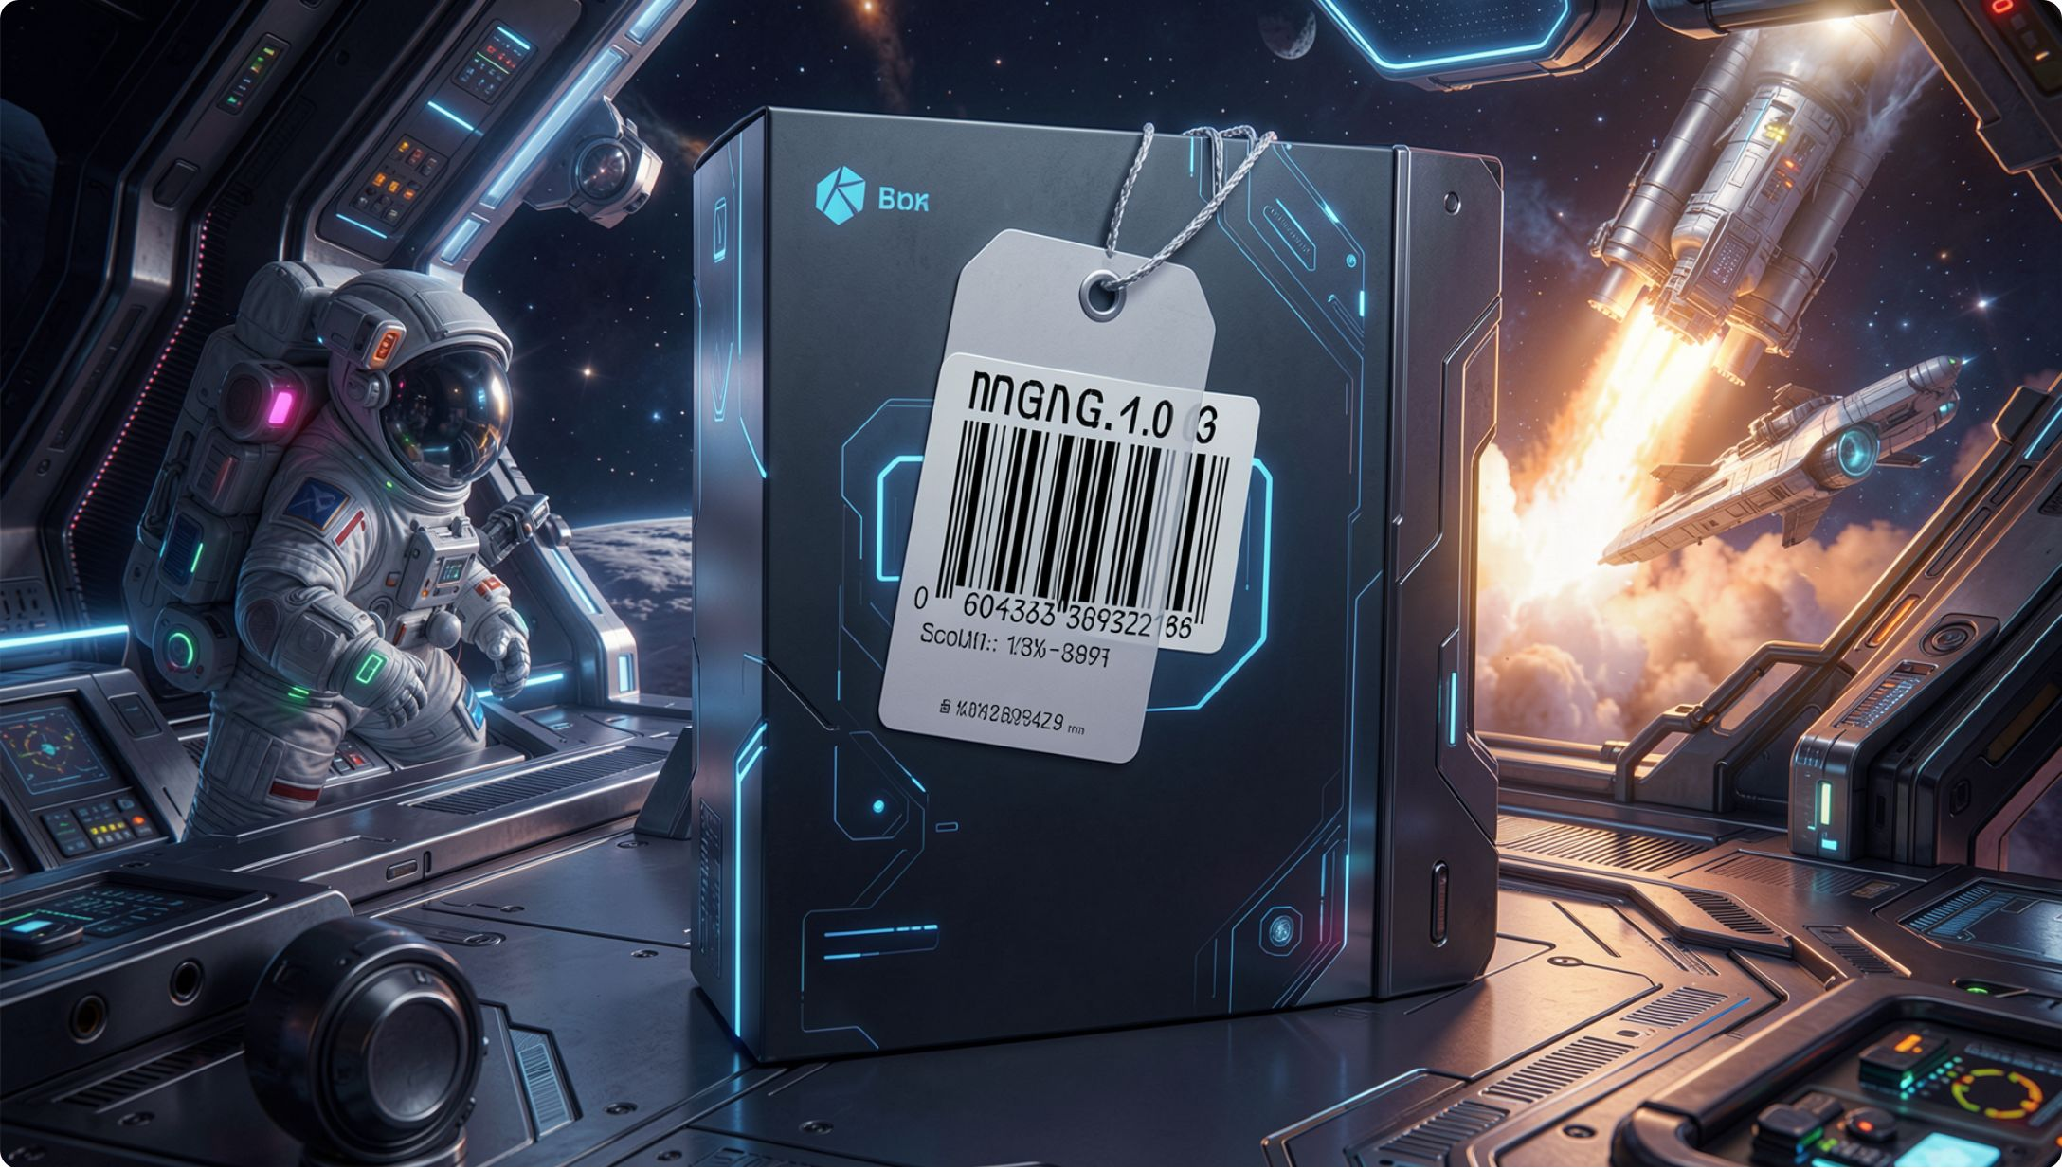
The identifier is a convenience, not the license
Four of ten components carry an SPDX tag
Pocketgrid has a full MIT license and no tag
Sortwell has a clear GPL header and no tag
No identifier is a signal to go read
MCCTC | AI Automation & Software Development
Notes:
If you had written a tool that treats a missing tag as a missing license, you would have flagged the two cleanest components in the tree and missed nothing that was actually wrong. A missing tag is never a finding. A finding is something you read, or a documented absence of anything to read.

Slide 10

The conflict sitting in your fixture
The project LICENSE says MIT
vendor/sortwell says GPL version 3 or later
There is no copy of the GPL in the tree
Auditors surface conflicts. They do not settle them
MCCTC | AI Automation & Software Development
Notes:
What counts as one combined work is a genuine long-running argument and you are not going to settle it this period. What is not arguable is that the front of the project says one thing, the tree contains another, nobody has written anything down, and the license that was supposed to travel with that code is missing. That is your finding.

Slide 11
The wrong version, with three false cells
License | Commercial use | Must credit | Must open source your code
MIT | Yes | No | Yes
Apache-2.0 | Yes | Yes | No
GPL-3.0 | No | Yes | Yes
CC-BY-4.0 | Yes | Yes | No
MCCTC | AI Automation & Software Development
Notes:
A model writes this in two seconds. Three cells are wrong and you have the files open to prove it. Notice what it got right, because that is what makes it dangerous. Apache and CC BY pass a glance, and three correct rows buy the wrong ones their credibility.

Slide 12
What you are about to build
1
Open every license in the Study Buddy tree
2
Write permits, requires, forbids, triggers for each
3
Find the one component with no license file
4
Escalate the conflict. Do not settle it
MCCTC | AI Automation & Software Development
Notes:
Build one is Lab M03-01, and the requirement is that every cell in your table traces to something you read, not something you were told. Build two is the first pass of your licensing audit manifest. Where a component has nothing, write nothing found. That is a result, not a gap.

