Slide 1

What Intellectual Property Actually Protects

Slide 2

Your poster goes up in front of strangers
The competition deadline is next week
Your project leaves the room
Somebody asks: is all of this yours to use
You have never been asked that before
MCCTC | AI Automation & Software Development
Notes:
Next week your work goes somewhere a stranger can see it. And the question that has never mattered in twelve years of school suddenly matters. Not did it work. Not did anybody notice. Is every piece of this yours to use. Today you get the four systems that answer that question, and you find out that the project on your screen right now already fails it.

Slide 3
Four systems, not one
Copyright
Trademark
Protects expression, automatically, on fixation
Protects the badge on the product
Patent
Trade Secret
Protects an invention, only if granted
Protects what you keep secret
MCCTC | AI Automation & Software Development
Notes:
These are four separate systems. Different things, different starting moments, different lengths. Mixing them up is the most common error in this whole area, including in every AI-written summary you will read this week. Learn the four rows and you can catch most of those errors on sight.

Slide 4

Copyright starts the moment you save
No notice required. No registration required
The commit you pushed this morning is protected
So is the photo a stranger posted
Registration is a separate step with separate benefits
MCCTC | AI Automation & Software Development
Notes:
Protection is automatic on fixation. That is worth saying twice because it cuts both ways. Your work is protected without you doing anything, and so is everybody else's, including the person whose image came up in your search. There is no step where somebody had to claim it.

Slide 5

The line the whole system runs on
Copyright covers expression, not the idea
Not procedures, processes, systems, or methods
Read the blog post, close the tab, write your own
Copy and paste is a different act
MCCTC | AI Automation & Software Development
Notes:
The statute says this directly. Copyright does not extend to any idea, procedure, process, system, or method of operation. So the idea of a flashcard app is not protected and the particular code somebody wrote for theirs is. That distinction is not a technicality, it is the thing that lets you learn from anybody.

Slide 6
How most people look for licenses
import os
for folder, subfolders, filenames in os.walk("study-buddy"):
if "LICENSE" in filenames:
print("licensed:", folder)
print("Scan complete. Everything above is licensed.")
MCCTC | AI Automation & Software Development
Notes:
Here is how a project gets checked in practice. Walk the tree, look for a file called LICENSE, print what you find. I am going to run it on the Study Buddy project. Predict how many lines come out before I press enter.

Slide 7
Three clean lines
licensed: study-buddy
licensed: study-buddy\vendor\lanternparse
licensed: study-buddy\vendor\pocketgrid
Scan complete. Everything above is licensed.
MCCTC | AI Automation & Software Development
Notes:
Three components. No errors. A confident closing sentence. This is the output a team pastes into a competition submission when a judge asks about licensing. Everything on this screen is true and the conclusion a reader draws from it is false.

Slide 8
The same project, looked at properly
vendor/pocketgrid file: LICENSE
vendor/lanternparse file: LICENSE
vendor/sortwell header in sortwell.py
snippets/shuffle_from_blog.py NOTHING FOUND
assets/fonts NOTHING FOUND
assets/icons file: LICENSE.txt
assets/images NOTHING FOUND
assets/sounds file: LICENSE.txt
model file: LICENSE.txt
data/flashcard_seed file: LICENSE.txt
MCCTC | AI Automation & Software Development
Notes:
Ten components. Three with nothing at all. One whose license lives in a source header the first scan never opened. The difference between the two programs is not cleverness. The second one starts by naming what has to be accounted for, then goes looking. The first one looks, then reports what it happened to find.

Slide 9

Public is not public domain
Publicly available means you can see it
Public domain means nobody holds a copyright
A file you can download is not a file you can use
Study Buddy's poster image is exactly this mistake
MCCTC | AI Automation & Software Development
Notes:
These two phrases share a word and share nothing else. This is the single most expensive misunderstanding in the module and it is sitting in your fixture right now, in a file whose recorded source is found it in image search, looked good.

Slide 10
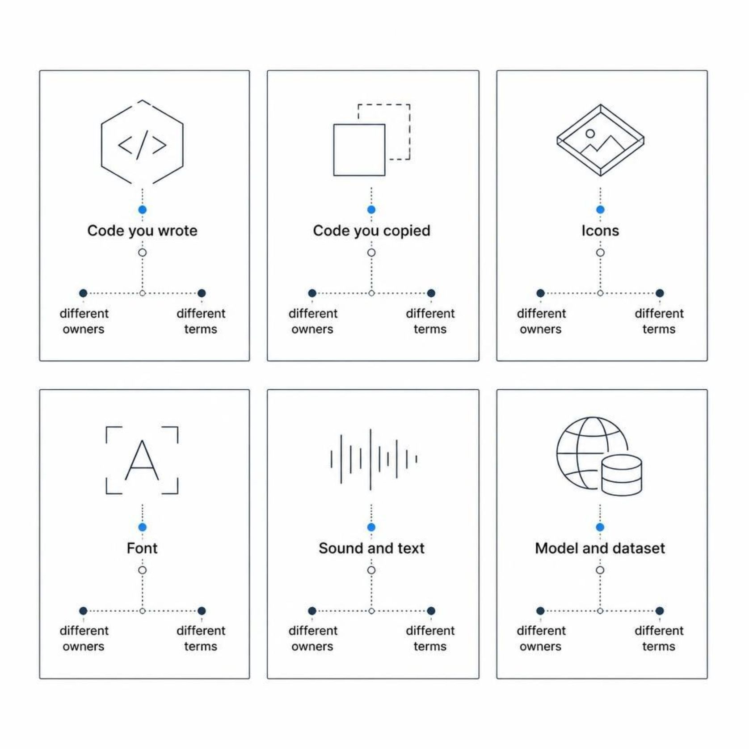
Your app is not one work
Code you wrote, code you copied, icons, font
Sound, text, the name, the model, the dataset
Different owners, different terms, one window
Each can be fine and still not ship together
MCCTC | AI Automation & Software Development
Notes:
An app is a stack of works owned by different people under terms that do not automatically agree with each other. This is what makes interactive media its own competency. Count the layers in your own project tonight and write the number down.

Slide 11

The pattern has repeated for a century
Player pianos, photocopiers, cassettes, the web
A copying technology arrives, rules get rewritten
1976 Act, Berne in 1989, the DMCA in 1998
You are living inside the next turn
MCCTC | AI Automation & Software Development
Notes:
The useful history is not a list of dates, it is one pattern. A copying technology arrives, does something the rules did not anticipate, courts and legislatures fight, the rules get rewritten, it becomes ordinary. Generative models are the current turn, and the rules are being written right now while you sit here. That is Thursday.

Slide 12
What you are about to build
1
Run both scans against the Study Buddy tree
2
Write down all ten components and what you found
3
Three of them have nothing. Name them
4
That list becomes your licensing audit
MCCTC | AI Automation & Software Development
Notes:
Build one is both scans, with the output pasted into your notes. Build two starts the manifest that becomes your licensing audit, and the requirement that matters is that you list the components first and then go looking. Start from the tree, not from the files you happen to find.

