Slide 1
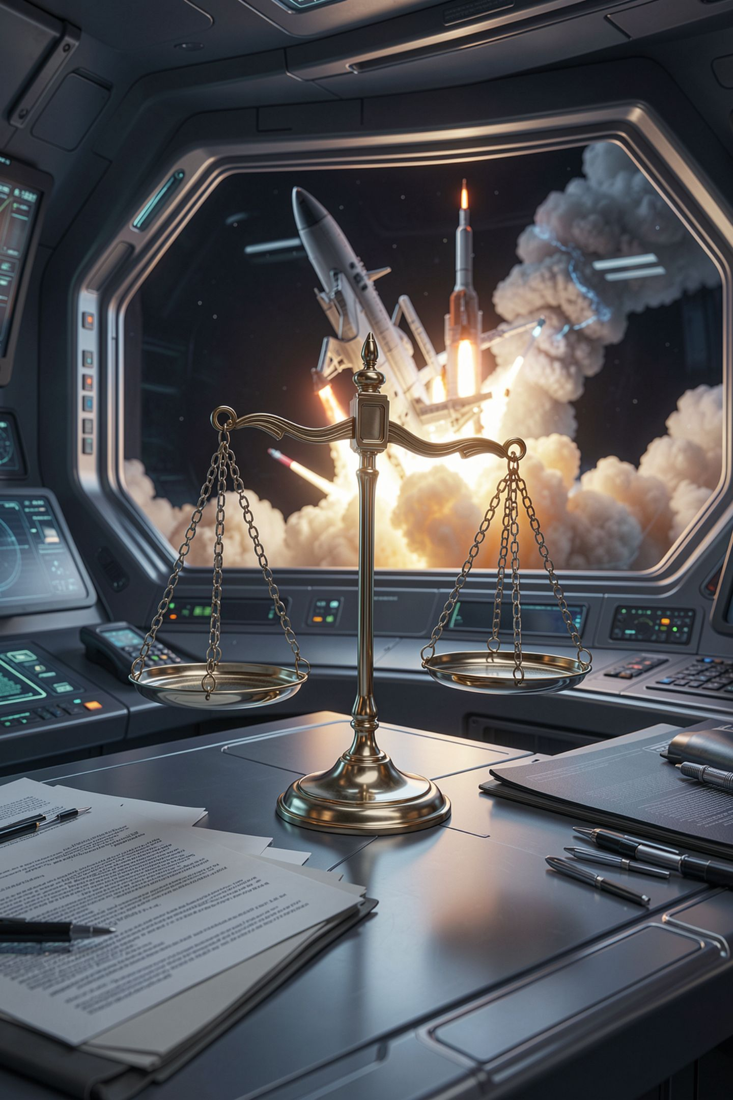
Who Owns the Output, and Why the Answer Is Unsettled

Slide 2
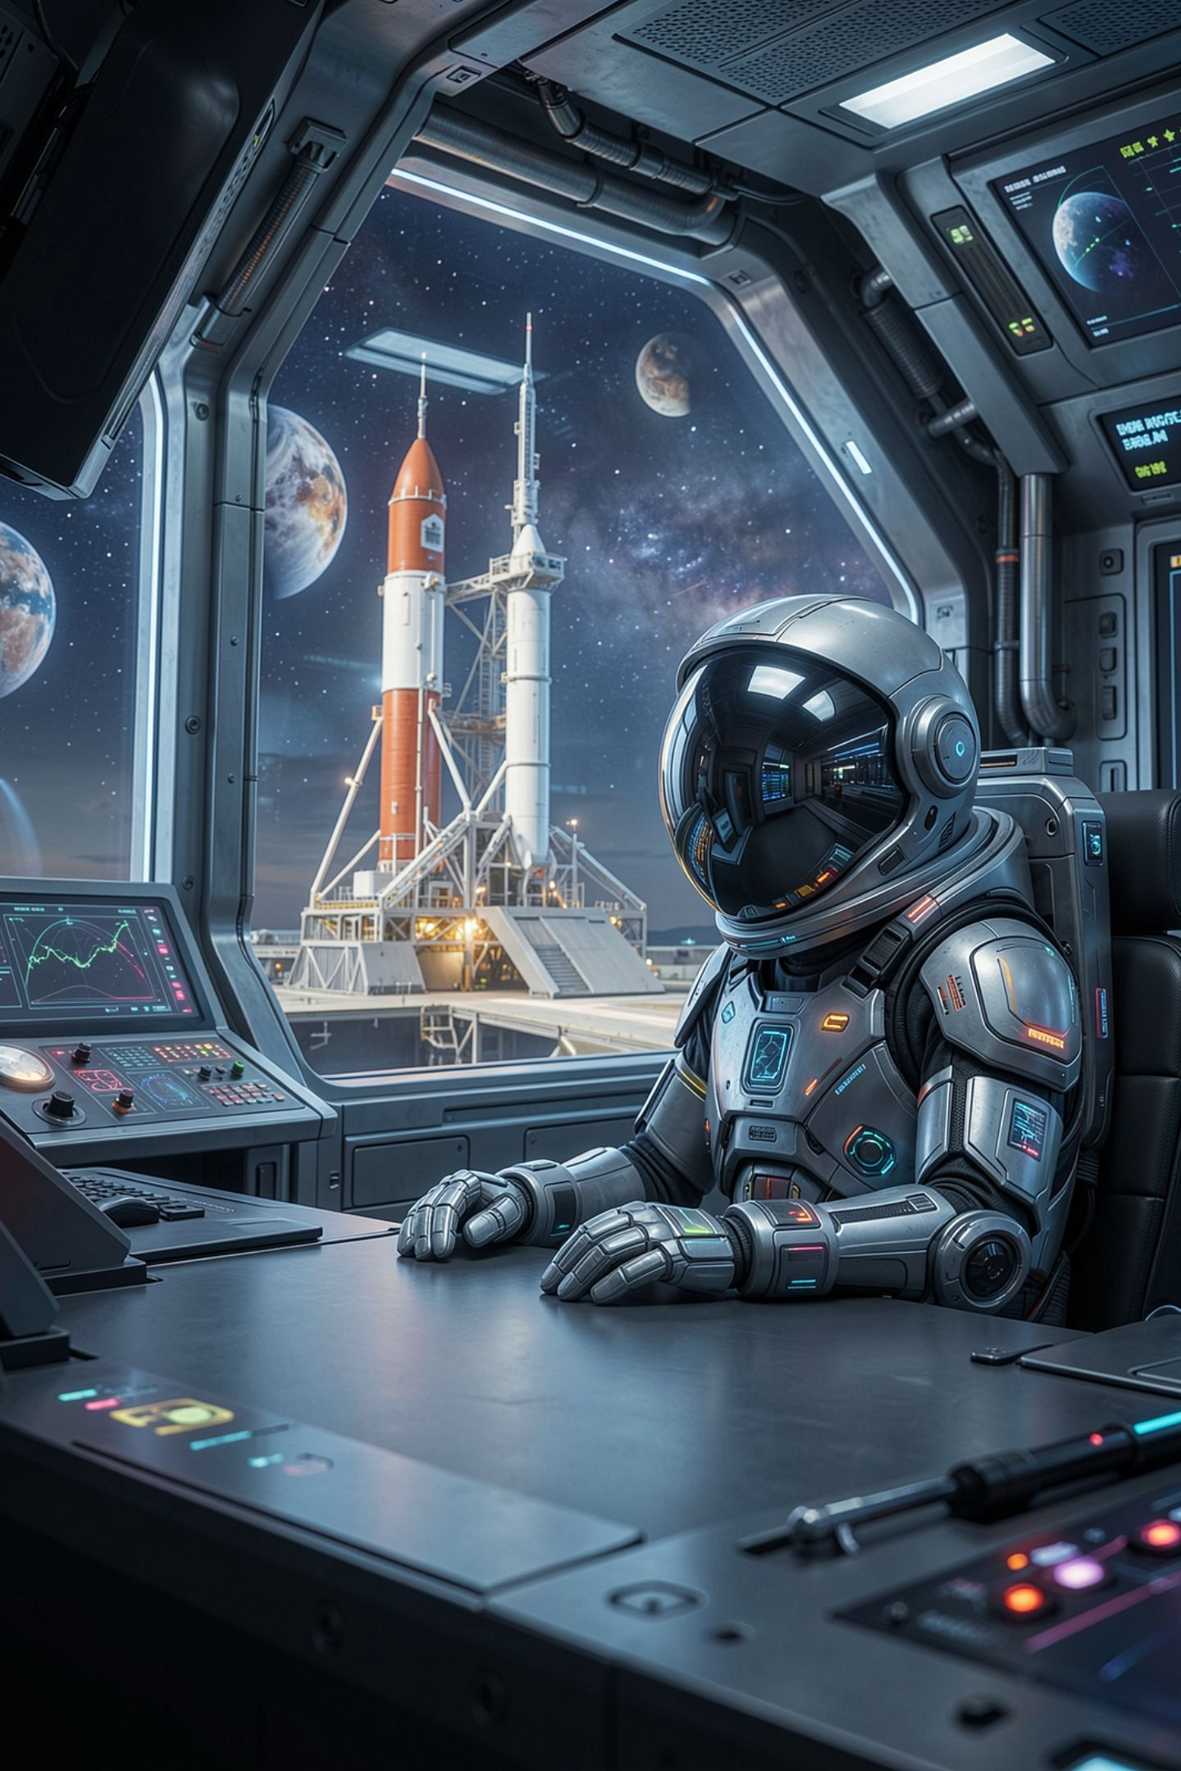
Somebody is going to ask you this
A judge, a client, an employer, a form
Who owns the thing the model made
Every confident one-sentence answer is wrong
Today ends without an answer, on purpose
MCCTC | AI Automation & Software Development
Notes:
This is the lesson with no conclusion at the bottom. That is not a gap. Anybody who gives you a confident one-sentence answer to today's question is either simplifying on purpose or does not know the state of the field. Watch for that from a model, from a teacher, and from me.

Slide 3
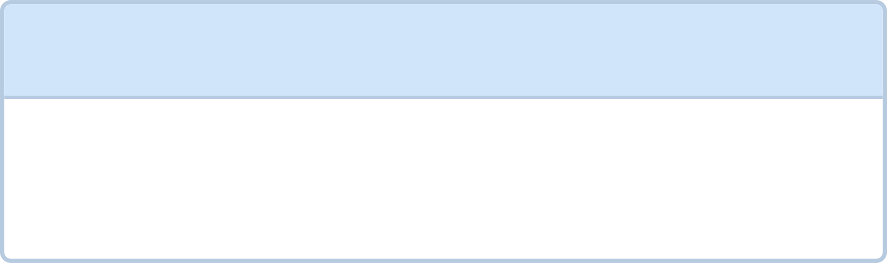
Four questions, not one
1
2
Is the output protected by copyright, and whose
Does the output infringe somebody else's work
3
4
Was the training on other people's work lawful
What does the model license let you do
MCCTC | AI Automation & Software Development
Notes:
Every argument you will hear about AI and copyright is one of these four wearing the others as a disguise. Two of them are settled enough to answer today. One is fact-specific. One is genuinely unsettled and being litigated right now.

Slide 4
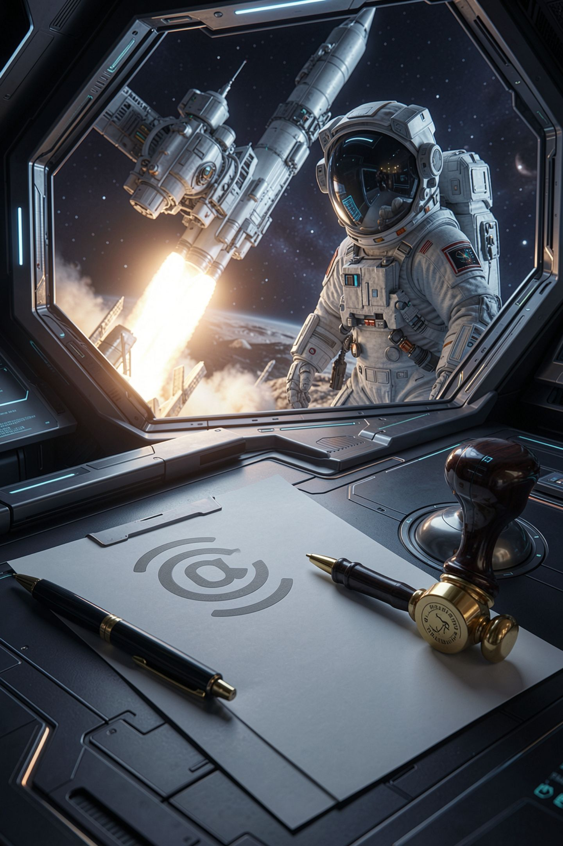
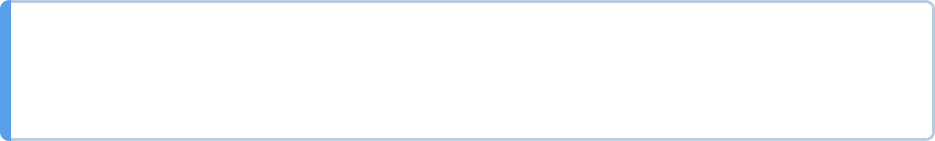
Question one, the human authorship point
The Copyright Office protects human authorship
Machine-generated material without it is not registrable
Mixed works: the human part registers, the rest is disclaimed
Other countries have taken different approaches
MCCTC | AI Automation & Software Development
Notes:
That is the Copyright Office's stated position and you should read their registration guidance rather than my summary of it. The boundary between typing a prompt and genuinely authoring something is not a number and nobody should hand you one.

Slide 5
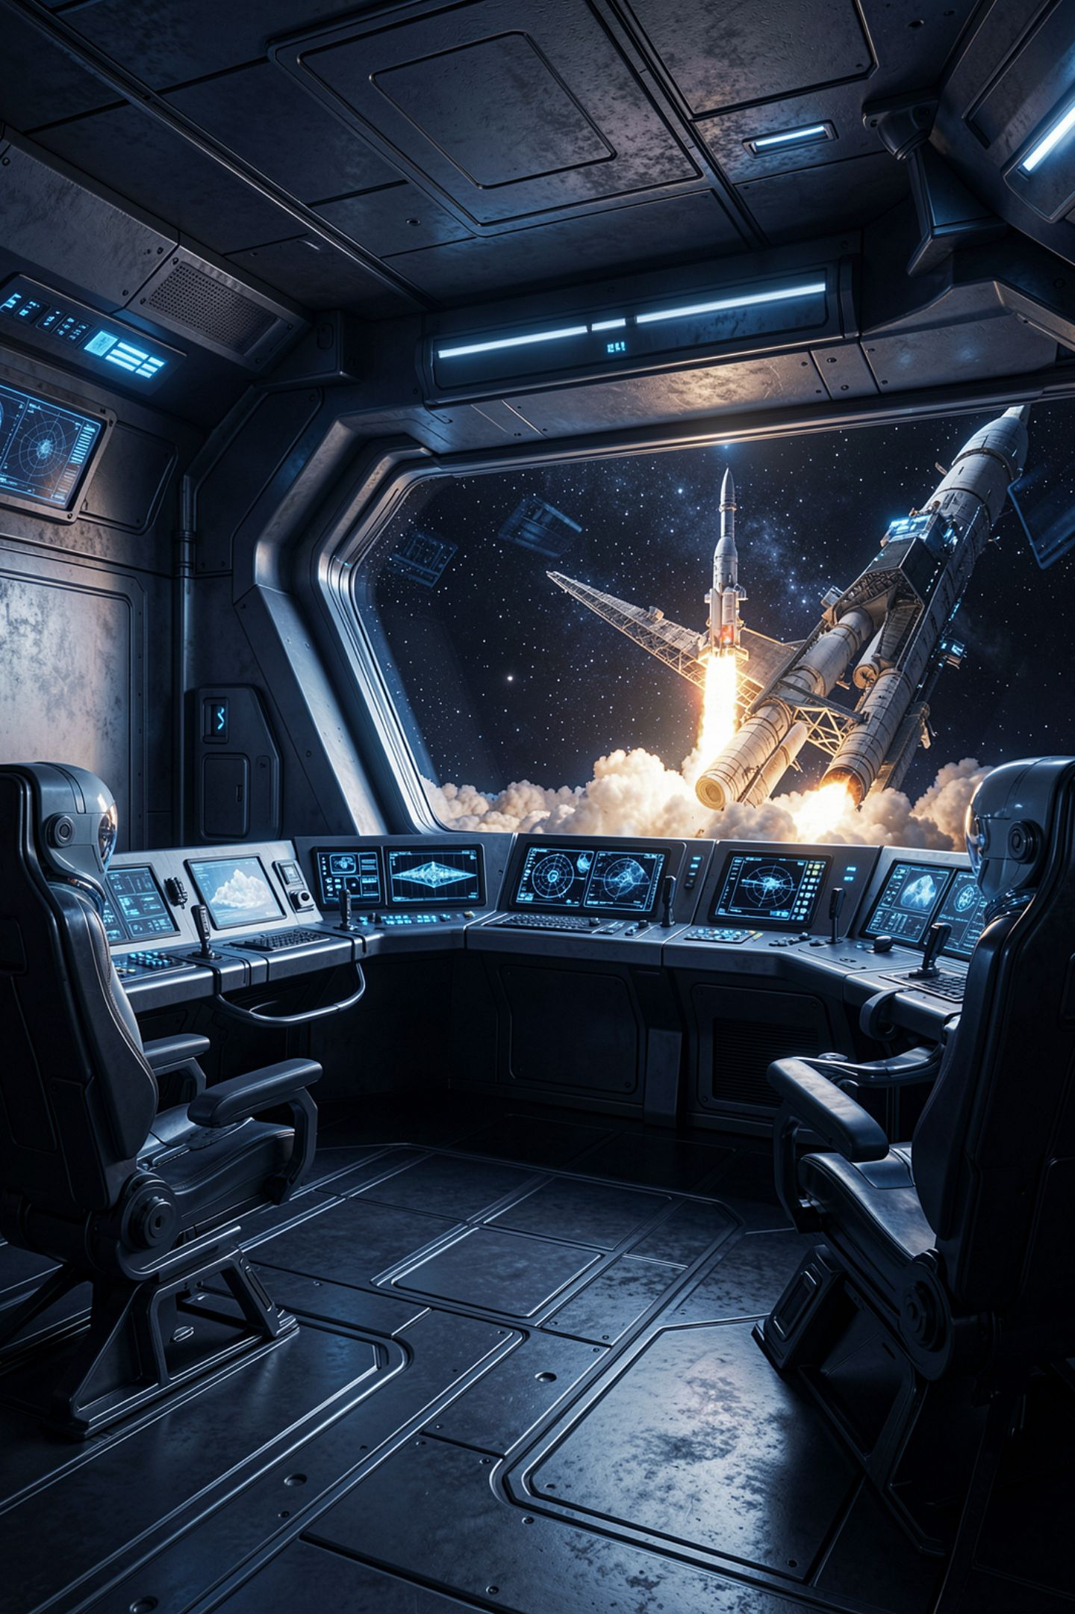
Question three is the unsettled one
Is training on protected works fair use
Being litigated right now, in more than one case
Different courts, different facts, different countries
I will not name a case or an outcome here
MCCTC | AI Automation & Software Development
Notes:
A case on appeal when I write this could be decided the other way by the time you read it, and a wrong citation in a lesson is worse than no citation. So you get the two strongest arguments instead, and you get them stated the way their own supporters would state them.

Slide 6
Both sides, at full strength
For
Against
Statistical process, new purpose, no stored copies
Licensing everything leaves only the largest players
A real market, and direct competition with creators
Taken at a scale nobody could consent to
MCCTC | AI Automation & Software Development
Notes:
Read both of those again tonight. If one of them looks clearly weaker to you, you have not understood it yet, and your position paper next week is going to be thin. Your job is to write the side you disagree with well enough that somebody who holds it would sign your paragraph.

Slide 7
Question four takes four minutes
7. OUTPUT. Lantern Research Collective claims no ownership in material you
generate with the Model Weights. This Section is a statement about what
Lantern Research Collective will and will not claim under this contract. It
is not a statement about whether any law gives you or anyone else a copyright
in that material.
MCCTC | AI Automation & Software Development
Notes:
That is section seven of the model license in your fixture. The second half is written out loud because the real ones usually leave it implied and readers fill it in wrongly. Read that clause twice.

Slide 8
Two claims in one clause
We will not assert ownership: a contract promise
You hold a copyright: a statement about the law
The license makes the first and not the second
No contract can create a copyright the law withholds
MCCTC | AI Automation & Software Development
Notes:
This is the most common confusion in the whole subject. A promise not to sue you is not a grant of copyright. When terms of service say you own the output, they are telling you what the company will do. Whether anybody holds a copyright is question one, and the terms do not decide it.

Slide 9
You cannot compute ownership. You can record authorship
human 860 words 58.8%
human_edit_of_model 280 words 19.2%
model 322 words 22.0%
Total words: 1462
Sections whose first draft came from a model: 3
MCCTC | AI Automation & Software Development
Notes:
Real percentages from a real provenance record. Look at the row with zero words that is not on this screen: the data flow diagram, human work this program cannot count because it counts words. A metric that cannot see part of the work always understates that part.

Slide 10
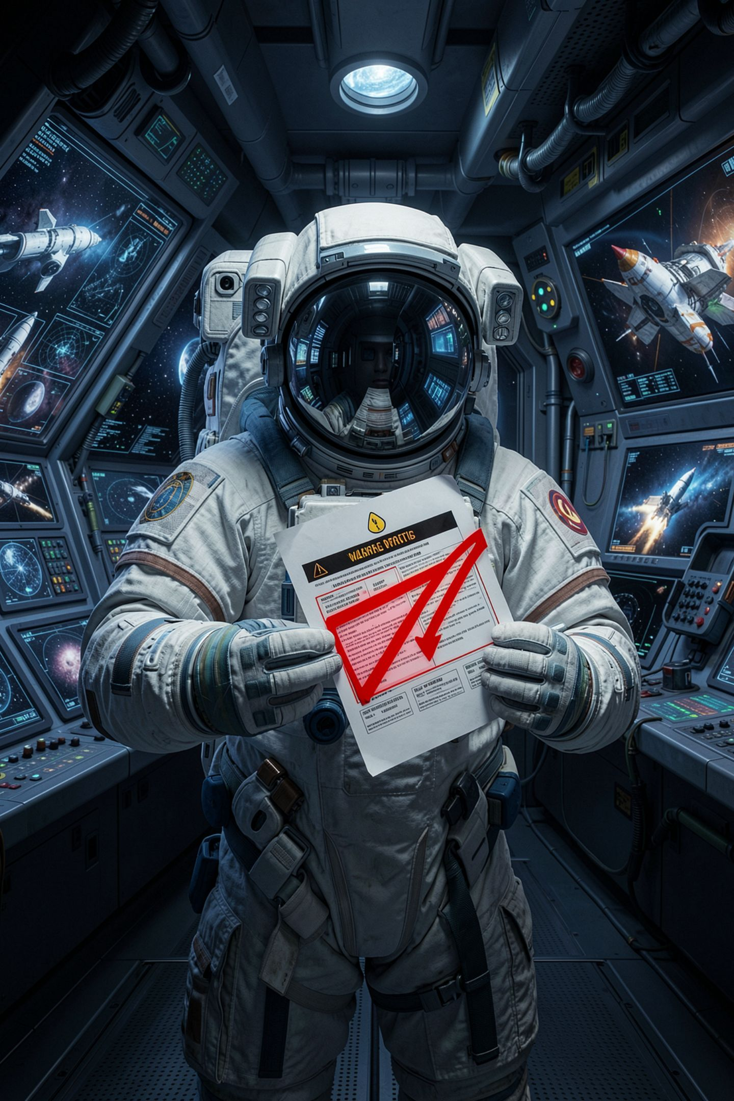

The wrong version, written by a model
All assets are original. The images were AI generated
Which means nobody else holds copyright
So we own them outright
Our submission is fully original work
MCCTC | AI Automation & Software Development
Notes:
Four mistakes in three sentences, and a judge is going to read it. Original is doing two different jobs. Not copyrighted by anybody else does not follow from generated with AI. So we own it does not follow from either. And fully original hides the disclosure inside a sentence that concludes there is nothing to disclose.

Slide 11
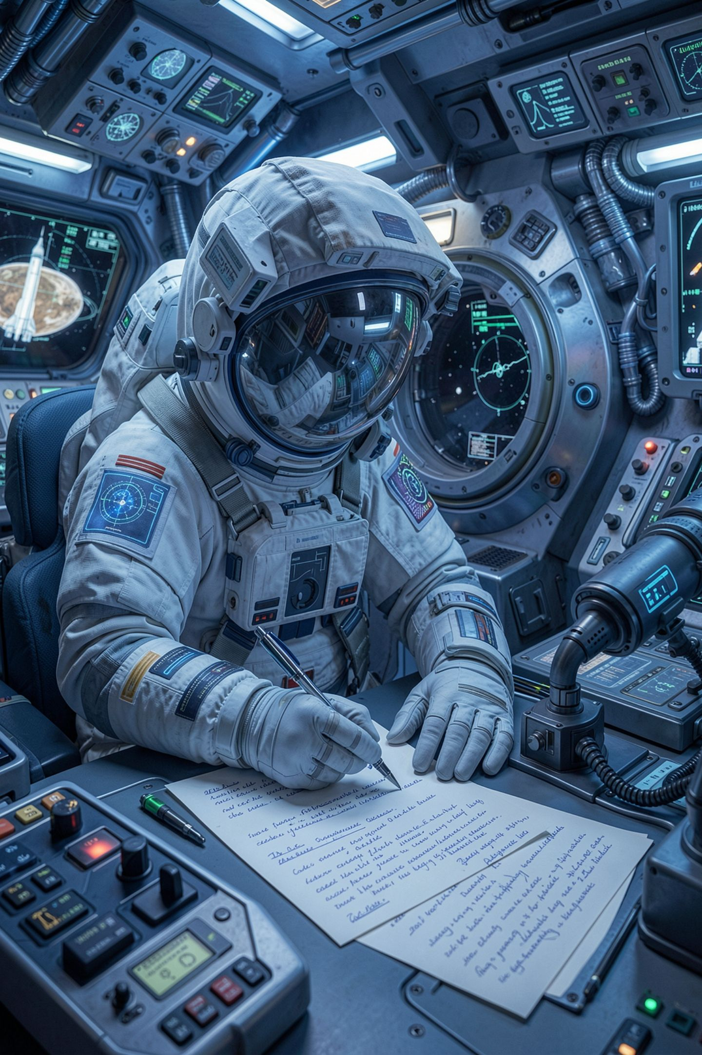


The honest version is shorter and stronger
Drafted with a local model, then edited by us
Our provenance record lists which sections
We are not claiming copyright in the unedited output
Third-party components are listed with their licenses
MCCTC | AI Automation & Software Development
Notes:
Saying this is unsettled, here are the facts it turns on, here is what we did about it, is the strongest answer available in this course and in any professional setting. A confident wrong answer is the weak one. Next week you will be graded on telling those two apart.

Slide 12
What you are about to build
01
02
Open the model license and answer the four questions
Write the model row of your licensing manifest
03
04
Write your project's disclosure paragraph, three sentences
Start a provenance record you will keep all semester
MCCTC | AI Automation & Software Development
Notes:
Build one is the model and dataset rows of the manifest, which are the two hardest rows in the audit. Build two is the disclosure paragraph for your own competition submission, due next week, and the provenance record that backs it. Three sentences. Honest ones.

