Slide 1

Conflicts of Interest, and the Three Rulebooks You Live Under

Slide 2

Somebody is about to ask you which tool
A teacher asks what the class should use
A club asks which vendor to go with
A manager asks which library we standardize on
You have a reason they cannot see
MCCTC | AI Automation & Software Development
Notes:
You are going to be asked for a recommendation sooner than you expect. The failure here is almost never corruption. It is a person with a real preference, a real relationship, and no place in the process where the relationship gets written down.

Slide 3

What a conflict actually is
A personal interest that could influence a decision
Made on somebody else's behalf
Could influence, not did influence
Or could reasonably appear to
MCCTC | AI Automation & Software Development
Notes:
Three parts of that sentence do the work. Could, not did: having one is not an accusation, it is a fact about a situation. Appear to: the value being protected is not your integrity, it is the decision's. And on somebody else's behalf: choosing a laptop for yourself cannot be a conflict.

Slide 4



Three rulebooks, all at once
Personal
Your values, family, community
Organizational
Policy, contract, purchasing rules
Professional
The ACM and IEEE codes, the field
They collide, and the collisions are real
MCCTC | AI Automation & Software Development
Notes:
Your personal standard says be loyal to your friend. Your professional standard says report the defect in their code. Both are real obligations. When they collide, the professional standard is the one written down by people who are not in the room, and that is what makes it the one that protects you.

Slide 5

The shapes it takes
Personal gain, project bidding, gifts, outside work
Using access you were given for a job
Benchmarking or grading your own work
Writing the criteria after seeing the products
MCCTC | AI Automation & Software Development
Notes:
The last one is the quiet one. If the requirements list is written after somebody has already fallen in love with a tool, those requirements will describe that tool. The fix is to write the criteria first and date the file.

Slide 6
Nine scores, two relationships
Chen NorthPath Learning 91 <-- CONFLICT: parent is employed there
Chen Kettle Ridge AI 62
Chen Open Tutor Co-op 70
Delgado NorthPath Learning 74
Delgado Kettle Ridge AI 79
Delgado Open Tutor Co-op 81
Ferris NorthPath Learning 88 <-- CONFLICT: accepted a paid conference trip
Ferris Kettle Ridge AI 66
Ferris Open Tutor Co-op 64
MCCTC | AI Automation & Software Development
Notes:
A composite. Invented district, invented vendors, invented evaluators. Two relationships were declared, which already puts this committee ahead of most. Watch what happens when they try to fix it.

Slide 7
Three rankings, one set of numbers
Every score: NorthPath 253, Open Tutor 215, Kettle Ridge 207
Conflicts dropped: Open Tutor 215, Kettle Ridge 207, NorthPath 74
Average of what is left: NorthPath 74.0, Open Tutor 71.7, Kettle Ridge 69.0
MCCTC | AI Automation & Software Development
Notes:
Three different first places from one set of numbers. Dropping the conflicted scores compares a sum of three against a sum of one, which is meaningless, and the program printed it anyway. Averaging puts NorthPath back on top on a single score from a single person.

Slide 8
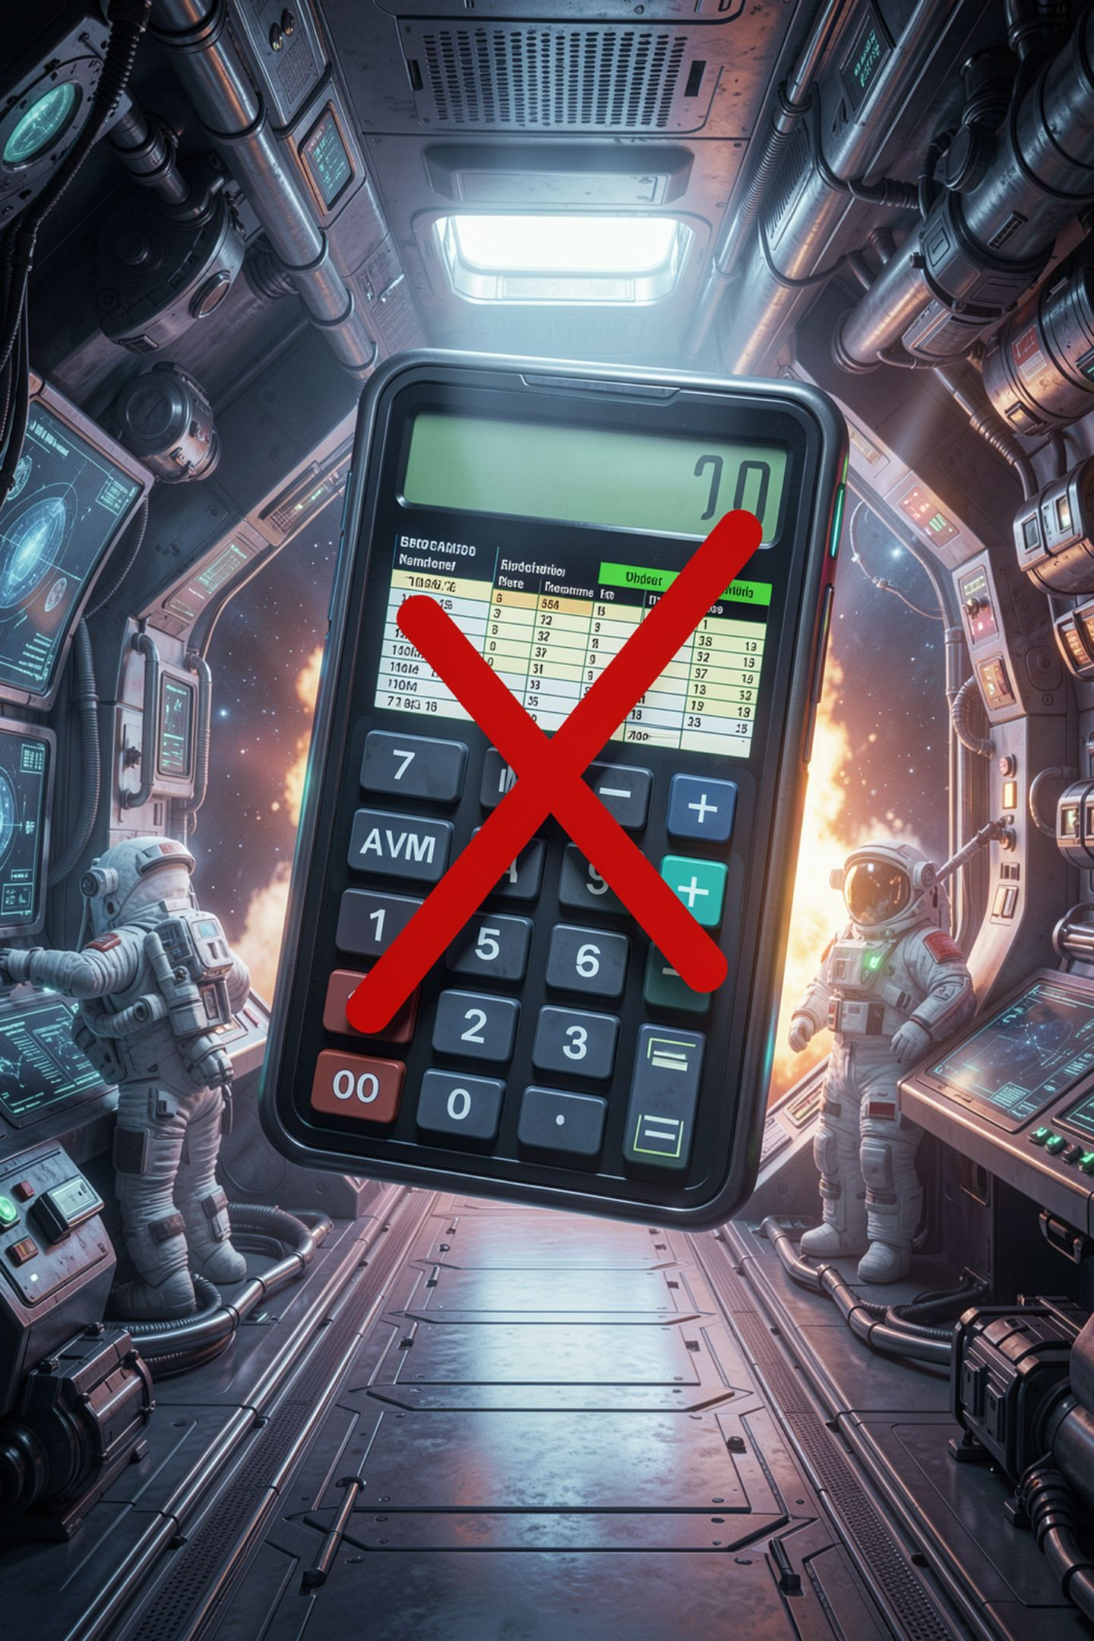

Arithmetic cannot remove a conflict
Once it is in the data, no formula gets it out
A committee that finds out afterwards has only bad options
Disclosures before scoring means two replacements
And nine clean scores instead of nine unusable ones
MCCTC | AI Automation & Software Development
Notes:
This is the lesson. Not that one ranking is right. That none of them are, and that the fix had to happen weeks earlier. Chen scored NorthPath twenty one points above the next vendor, the biggest gap in the table. That is not proof of anything, and the point is that nobody can tell any more, including Chen.

Slide 9




Four moves, and doing nothing is not one
Disclose
Recuse
Write it down, before the decision
Step out of that one decision
Divest
Decline
Get rid of the interest
Turn down the role entirely
MCCTC | AI Automation & Software Development
Notes:
Disclosure is the first move in every case and often the only one needed. Notice the mechanism in all four: you hand the decision to somebody else. That is what makes the decision survivable when somebody finds out later.

Slide 10

What a real disclosure sounds like
01
Name the relationship and how close it is
02
Offer options
03
Hand the decision to the person who owns it
04
Before the decision, in writing
MCCTC | AI Automation & Software Development
Notes:
My mother has worked at NorthPath for six years in an unrelated department. I am happy to score the other two and step out for NorthPath, or step out entirely, whichever the committee prefers. That is it. Four sentences and the decision is now trustworthy.

Slide 11



The three sentences that keep people quiet
"It would not change my scoring"
"Everybody knows my mom works there"
"It is only a conference trip, not a bribe"
MCCTC | AI Automation & Software Development
Notes:
The first is probably true and beside the point. The second confuses known informally with disclosed. The third is correct, and reciprocity does not require a bribe, which is exactly why gift policies have low thresholds. And notice: the thing that ends a career is almost never the conflict. It is the nondisclosure.

Slide 12

What you are about to build
1
Write the evaluation criteria first, and date the file
2
Collect disclosures before anybody sees a product
3
Score, then compute the ranking three ways
4
Write your own disclosure for the competition judge
MCCTC | AI Automation & Software Development
Notes:
Build one runs the bid exercise in the right order, criteria first, disclosures second, scores third. Build two is personal: write the disclosure you would actually send about a judge, a sponsor, or a family connection in your own competition entry. If you genuinely have none, write the one you would send if you did.

