Slide 1
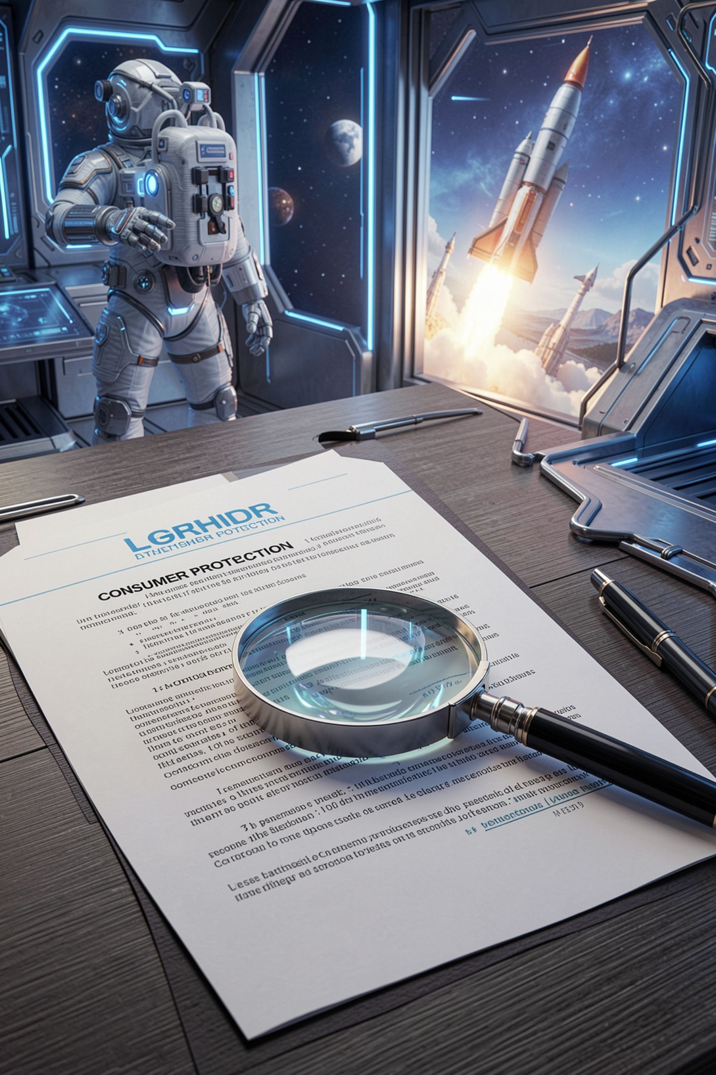
Consumer Protection, and the Claims on Your Own Poster

Slide 2
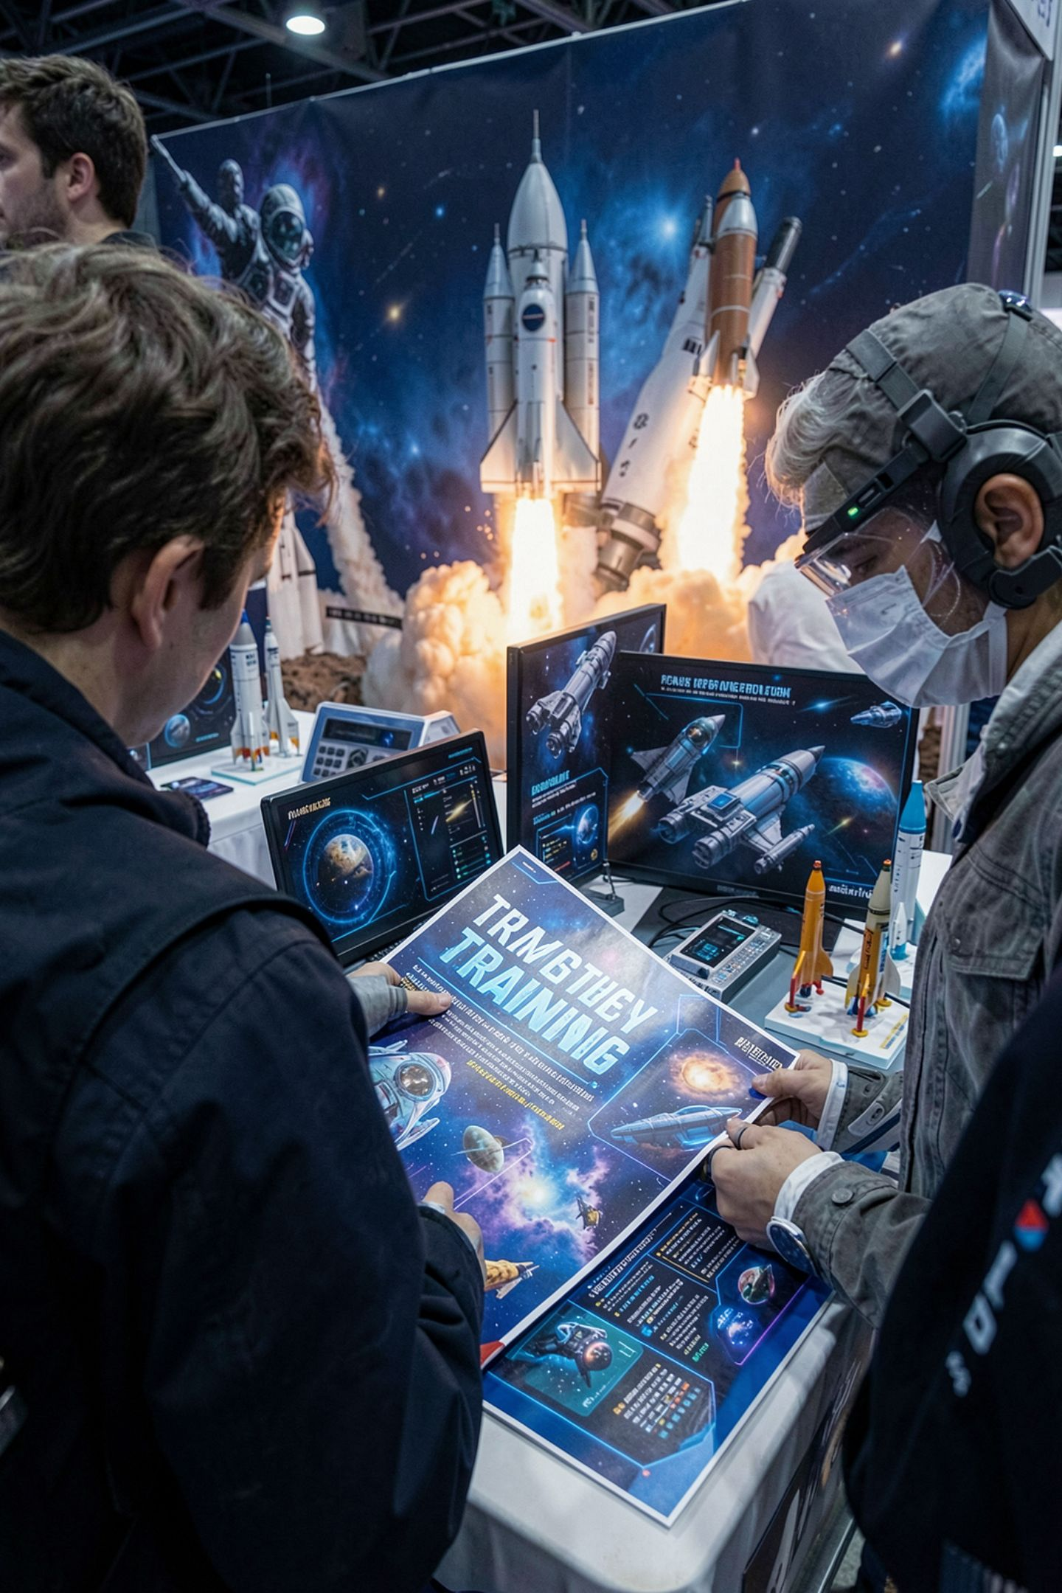

You are about to describe this to a stranger
The showcase table, the submission form, the README
Somebody who has not used it will read it
A decision rides on your description
The standard is higher than "I believed it"
MCCTC | AI Automation & Software Development
Notes:
The moment money or a decision rides on your description of a product, you are in the territory this law governs. And AI products attract exactly the kind of claim this law exists to control, because the product is hard to test and a number like ninety four percent sounds like a measurement.

Slide 3
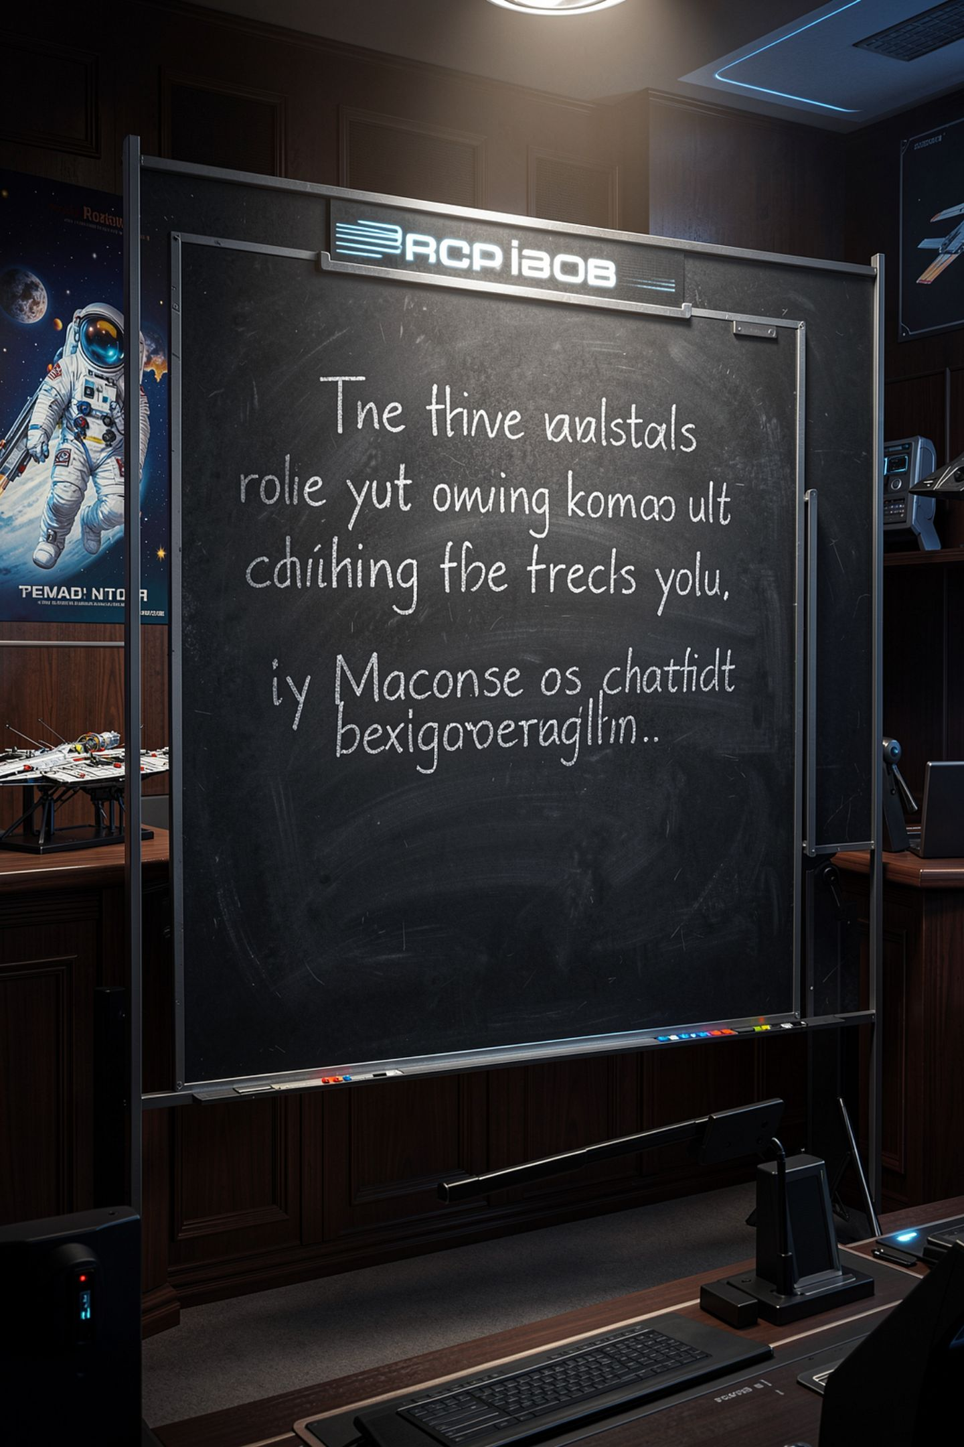
The rule, in one line
1
Make a factual claim about a product
2
And you need a reasonable basis before you make it
3
Not after somebody disproves it
4
"Nobody has disproved it" is not evidence
MCCTC | AI Automation & Software Development
Notes:
This principle is called substantiation and it is the part students find surprising. The rule is not that a false claim gets you in trouble later. It is that you need the evidence first. Which means the work happens before the poster is printed, not after a question at the table.

Slide 4
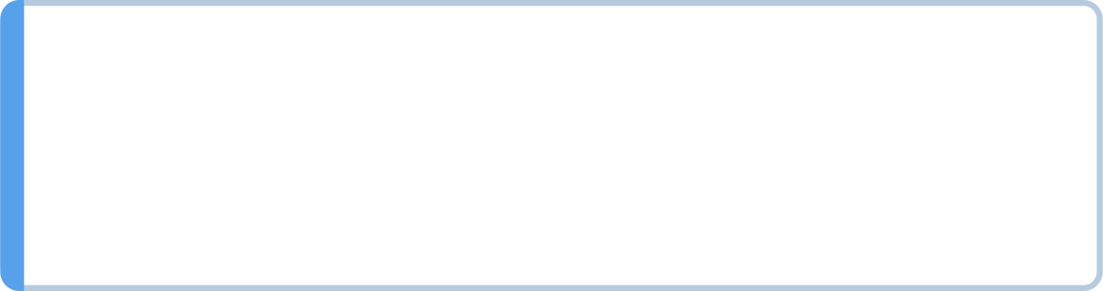

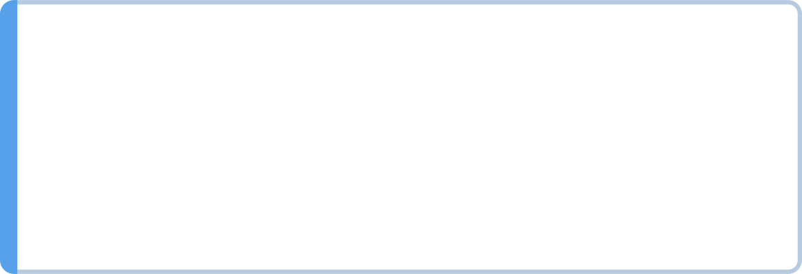
What deception means here
Likely to mislead. Nobody has to be fooled
A consumer acting reasonably, not the most careless
Material: it could affect a decision
An omission counts as much as a statement
MCCTC | AI Automation & Software Development
Notes:
Read those four lines carefully. Likely to mislead means nobody has to have actually been fooled. And the last one is the one that catches good people: leaving out the fact that changes the picture is a way of deceiving, and every cherry-picked demo lives there.

Slide 5
One test run, three accuracy numbers
Accepted, out of hints that were not ambiguous : 94.4%
Accepted, out of hints returned : 85.0%
Accepted, out of cards the user asked about : 68.0%
MCCTC | AI Automation & Software Development
Notes:
Same thirty four acceptable hints in all three lines. The only thing that changed is the denominator. Twenty six points of spread, three correct divisions, no error anywhere. Which one goes on the poster.

Slide 6
The honest denominator is the user's
50 cards tested
40 hints returned (10 got nothing: the model was unreachable)
34 accepted by a teacher
4 of the 6 rejections were arguable
50
40
34
Cards tested
Hints returned
Accepted by teacher
MCCTC | AI Automation & Software Development
Notes:
Sixty eight percent, because from where the user stands, the ten cards that got no hint were failures. Not returned is a category the user does not have. And look at how ninety four was built: exclude ambiguous, exclude failures. Both exclusions have a sensible engineering reason and neither is visible in the printed number.

Slide 7

Substantiation is a sentence, not a bigger number
01
Say the test set
02
Say the denominator
03
Say who judged and how
04
Name the file the ratings are in
MCCTC | AI Automation & Software Development
Notes:
In a test of fifty chemistry cards, hints were produced for forty and a teacher accepted thirty four. Counting every card asked about, sixty eight percent produced an accepted hint. Ratings are in tests slash hint quality dot md. That is substantiation and it took one sentence.

Slide 8
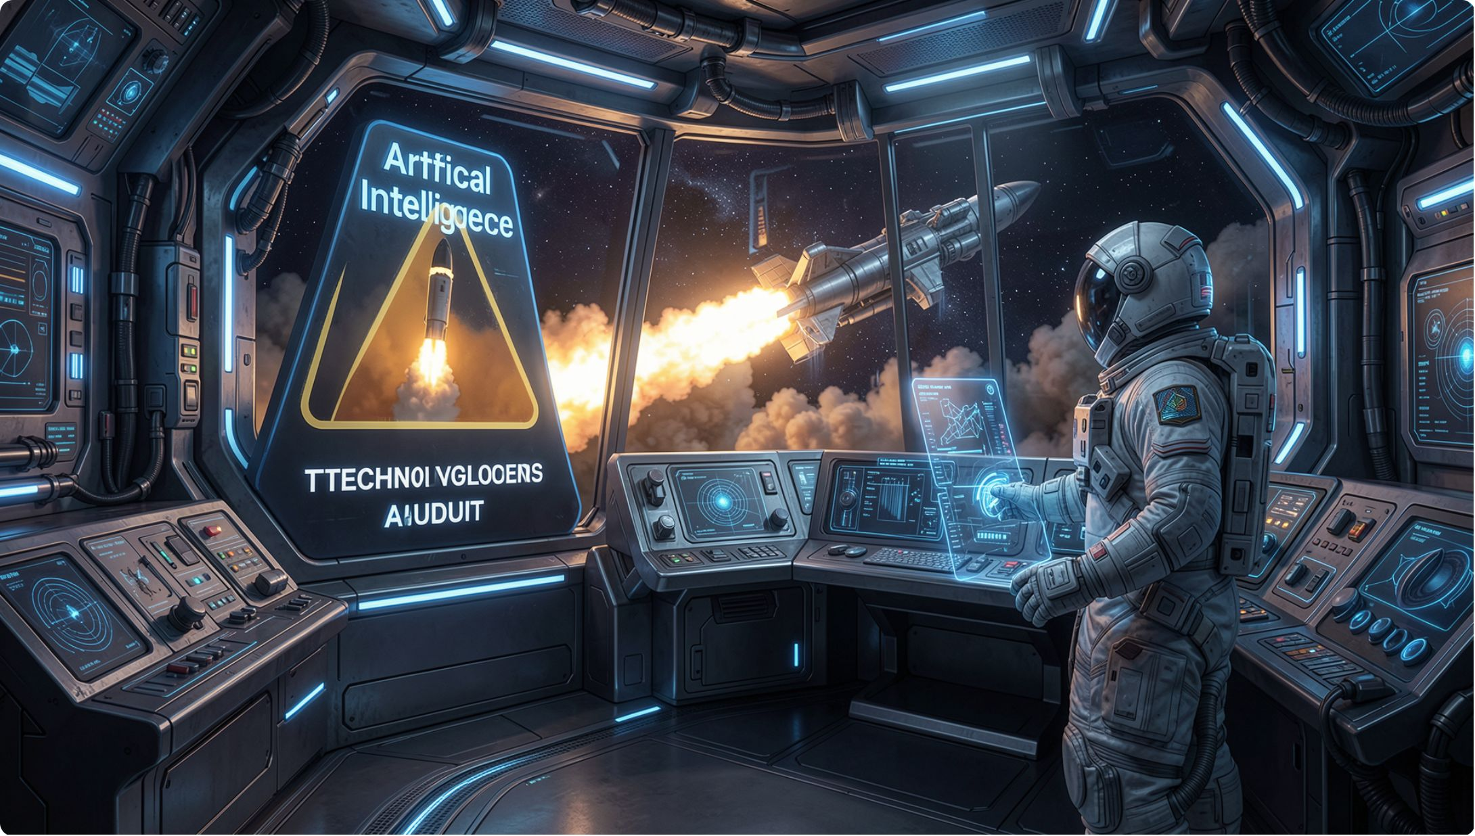
AI-specific patterns to watch for
AI washing: calling it AI when it is templates
Cherry-picked demo, hidden automation
Silent capability change when the model changes
Comparative claims about somebody else's product
MCCTC | AI Automation & Software Development
Notes:
The last row is the one people resist. A claim about a competitor is a factual claim and it needs the same basis as a claim about yourself. Better than the leading tutor app is a testable sentence, which means somebody has to have tested it.

Slide 9
Sorting your own copy
Study Buddy makes studying better opinion none needed
Study Buddy writes hints that are 94% accurate measurable NONE. Do not publish
Study Buddy runs entirely on your own computer measurable read the source
Study Buddy is the best flashcard app opinion none needed
Study Buddy never sends your notes anywhere measurable ran with adapter off
Study Buddy works with any subject measurable NONE. Do not publish
MCCTC | AI Automation & Software Development
Notes:
This program is wrong about two rows on purpose and finding them is your exercise. A keyword list cannot tell a factual claim from an opinion, because the difference is about what is being asserted, not about which words appear.

Slide 10
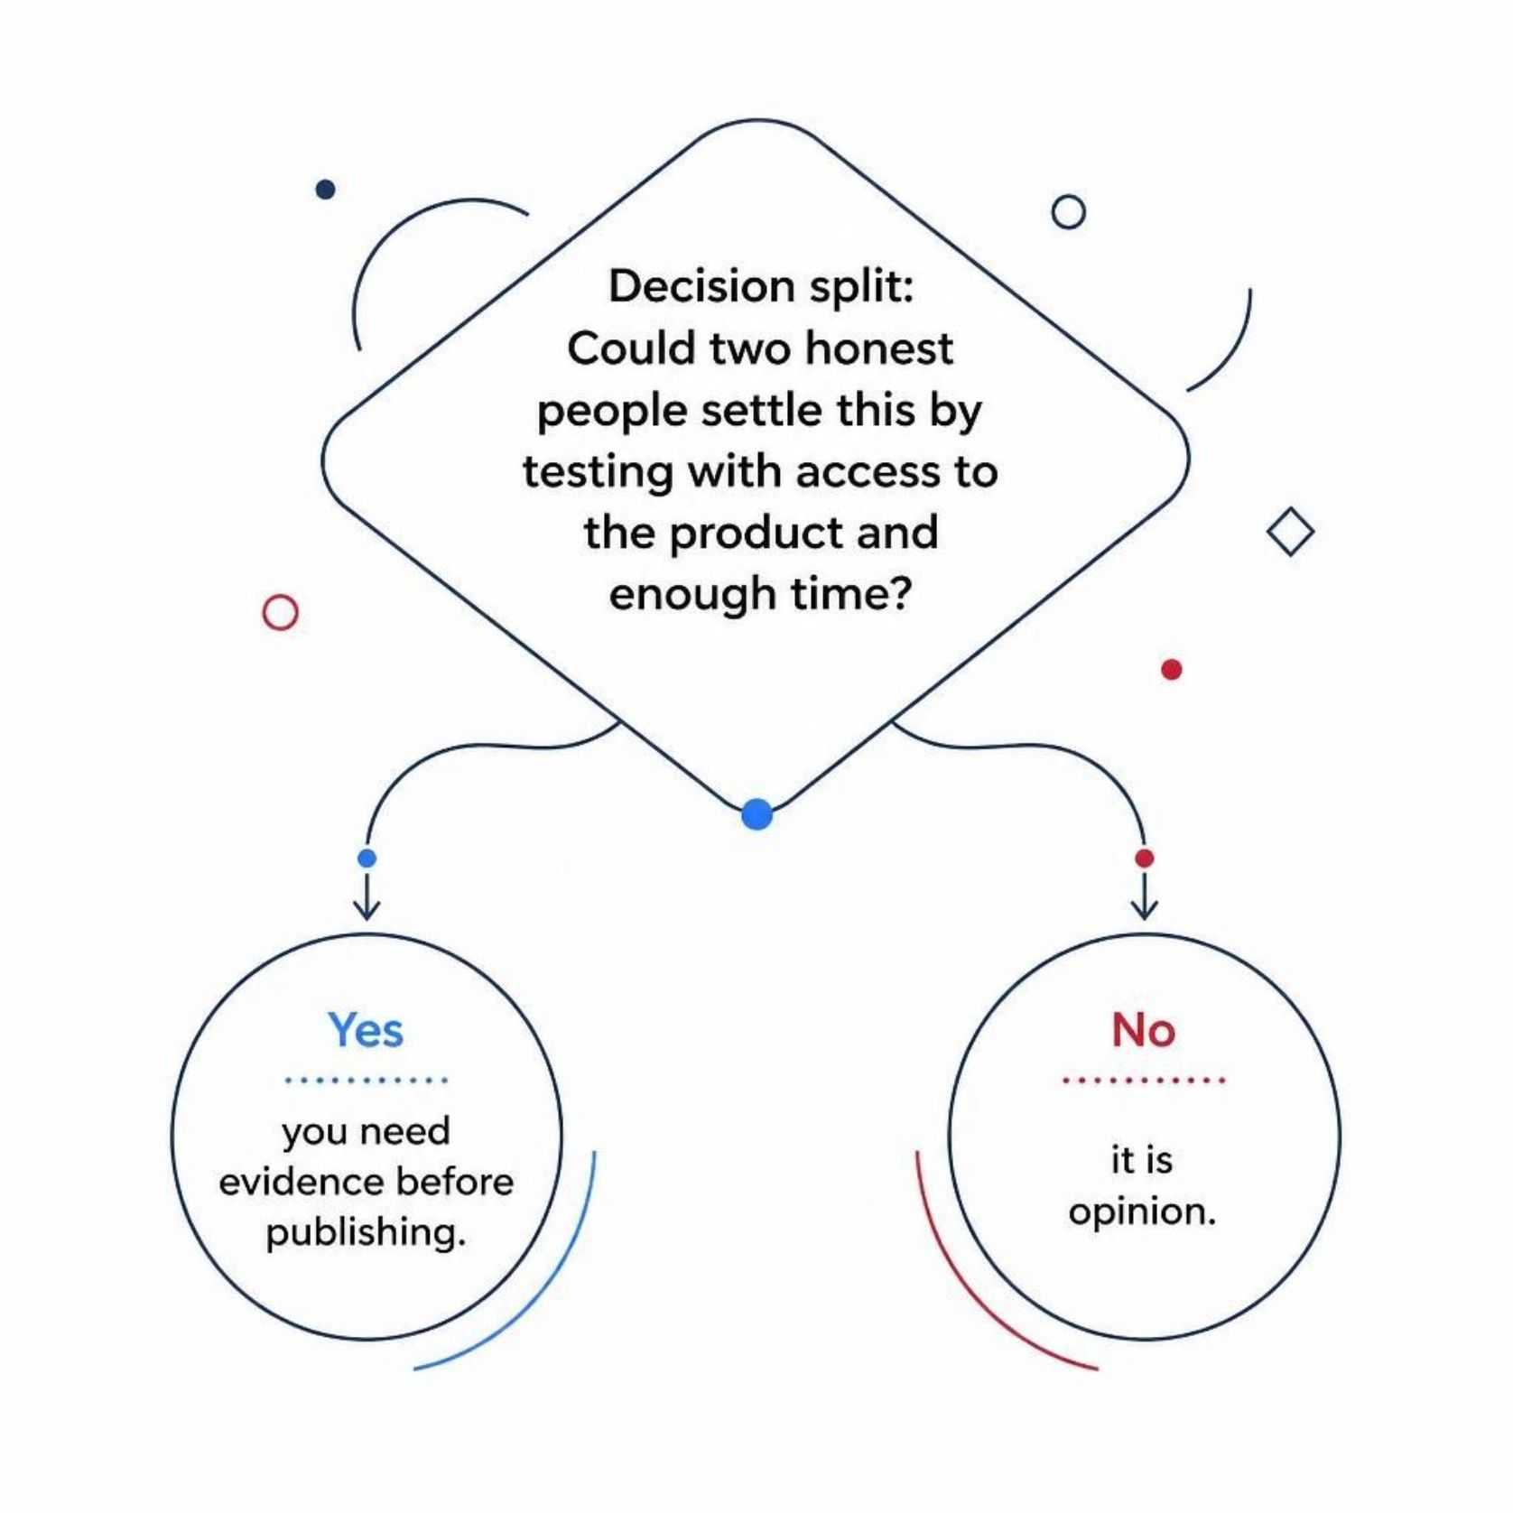

The question that classifies any sentence
Could two honest people settle this by testing
With access to the product and enough time
Yes means you need evidence before publishing
No means it is opinion
MCCTC | AI Automation & Software Development
Notes:
That question catches the comparative claims the keyword list misses, because better than theirs is settleable by testing both. Use it on every sentence on your own poster tonight.

Slide 11

The claim that mattered, ruined by its neighbours
Your data never leaves your computer: true
Works with any subject: not tested
Trusted across the district: six friends
The reader checks one, and stops believing all four
MCCTC | AI Automation & Software Development
Notes:
The true claim is the one somebody will actually build a decision on. A reader who checks works with any subject and finds it false has no reason to believe the sentence about data. Unsubstantiated claims cost you the credibility of your substantiated ones.

Slide 12

What you are about to build
1
Rewrite your project blurb, claim by claim
2
Every surviving claim names an evidence file
3
Say what you dropped and why
4
Write the one sentence you say during your demo
MCCTC | AI Automation & Software Development
Notes:
Build one is the claims audit of your own project text. Build two writes the honest demo sentence: we also tested two harder cases and those work about half the time, here is one. Saying that in front of a judge is a strength, because a judge who finds a weakness you disclosed trusts everything else you showed.

