Slide 1

The Questions You Ask Before Anything Touches Student Data

Slide 2

You will be the person who is asked
A teacher asks in a hallway on a Tuesday
Everybody in the room wants the answer to be yes
You are the only one who has read an agreement
Not in five years. This year
MCCTC | AI Automation & Software Development
Notes:
The skill is not knowing the answer. The skill is knowing the questions, and knowing when you have been handed something that is not an answer. That second half is most of today.

Slide 3

The nine questions
Where does it run, and does input leave the building
Is input retained, by whom, for how long
Is input used to train or improve anything
What does the contract say when the page disagrees
MCCTC | AI Automation & Software Development
Notes:
Nine, in order, and they are section eight of your assessment. The last one is the one people skip and it is the one that decides. A marketing page, a privacy policy, and a contract are three different documents, and only one of them is enforceable.

Slide 4

Where the answers actually live
Marketing page
What they want you to believe
Privacy policy
Consumer promises, maybe not yours
Contract or DPA
What governs
Your own test
What actually happens
MCCTC | AI Automation & Software Development
Notes:
Trust runs from the bottom of that list upward. A test you ran beats a document somebody wrote about what the software does. And you can ask for the agreement. People do not, because asking feels presumptuous, and it is the normal thing to do.

Slide 5

Five carve-outs that survive a good answer
"We do not sell your data": selling is narrow
"Not used for training": look for the next sentence
"You retain ownership": find the licence grant
"Encrypted": in transit, at rest, keys held by whom
MCCTC | AI Automation & Software Development
Notes:
Every one of those sentences is true and leaves a hole. And a fifth: we are FERPA compliant. FERPA obligations sit on the school. A vendor can help the school meet them or make it impossible, and a badge on a page is not a contractual commitment.

Slide 6
The scan gets it wrong, and that is the lesson
study-buddy\study_buddy.py
address: http://{MODEL_HOST}:{DEFAULT_PORT}/api/generate (REMOTE)
address: http://{MODEL_HOST}:{port}/api/generate (REMOTE)
network call: urlopen
MCCTC | AI Automation & Software Development
Notes:
The address is built from an f-string, so the literal never appears in the source. The scanner found the template, could not resolve it, and labelled both lines remote, which is the opposite of the truth. It did find one thing worth having: exactly one network call in the whole tree, which tells you where to look.

Slide 7
Read the two lines the tool could not
DEFAULT_PORT = 11634
MODEL_HOST = "127.0.0.1"
python study_buddy.py notes/chemistry.txt --hints --port 11634
No model answered at http://127.0.0.1:11634/api/generate.
MCCTC | AI Automation & Software Development
Notes:
Now you know, and it took reading the file. Then the behavioural test: run it with an explicit port and the program prints its own address. Note the port. A real Ollama listens on 11434 and so do several stubs in this course, and a run against the wrong server looks exactly like a working run. This module uses 11634 and every command says so.

Slide 8
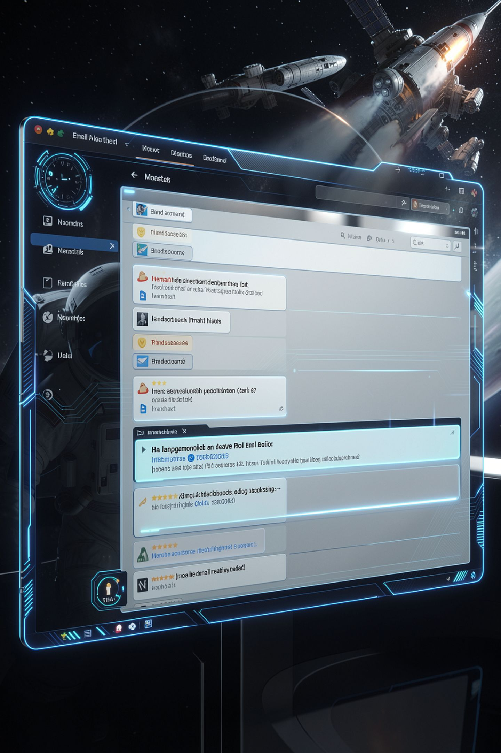
Two of six answers answered the question
"We take privacy extremely seriously"
"We do not sell student data to third parties"
"Industry-leading secure cloud providers"
"Authorized personnel on a need-to-know basis"
MCCTC | AI Automation & Software Development
Notes:
Four failures, and none of them are lies. Every one of those sentences is probably true. They are answers to questions nobody asked, and the reason they work is that they arrive in the tone of an answer.

Slide 9
What the good answer looked like
Upon written request within 30 days of termination, all customer
data is deleted from production systems and purged from backups
within 90 days.
MCCTC | AI Automation & Software Development
Notes:
A trigger, an actor, and two deadlines. Specificity is the signal, and it is a property you can check for without knowing anything about the vendor. Count the specifics in any answer you are handed.

Slide 10
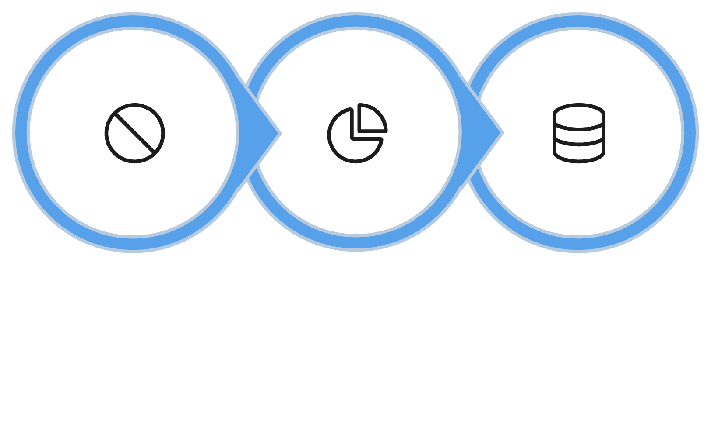
The answer that opens a new question
"Not used for training"
"Aggregated, de-identified statistics improve the service"
That is a good answer and a new row
Be suspicious of the answer with no residue
Not used for training
Aggregated statistics
New row added
MCCTC | AI Automation & Software Development
Notes:
This is a vendor answering honestly and creating work for you. De-identified is a claim to be measured, which you proved yesterday with five records. An answer that raises a question is not a failure. The version that closes everything cleanly is the one to look at twice.

Slide 11

How the decision actually gets made
Somebody sees a page headed Privacy with a badge
Says it looks fine. Two classes are using it by Friday
Nothing errored. Nobody did anything wrong
And nine questions were skipped
MCCTC | AI Automation & Software Development
Notes:
By the time anybody asks, two classes have gradebooks in it and students have accounts. The cost of the answer being no has gone from zero to a week of everybody's time. The whole value of asking early is that no is still cheap.

Slide 12
What you are about to build
1
Write the four questions you would send a vendor
2
Run the network scan on your own project
3
Then run the test that does not read source
4
Write section 8 of your assessment
MCCTC | AI Automation & Software Development
Notes:
Build one is the vendor questions for your own assessment's workflow, plus the code scan and the adapter-off test on your own project. Build two is section eight, with UNKNOWN written honestly wherever you do not have an answer, and every UNKNOWN carried down to section eleven.

