Slide 1
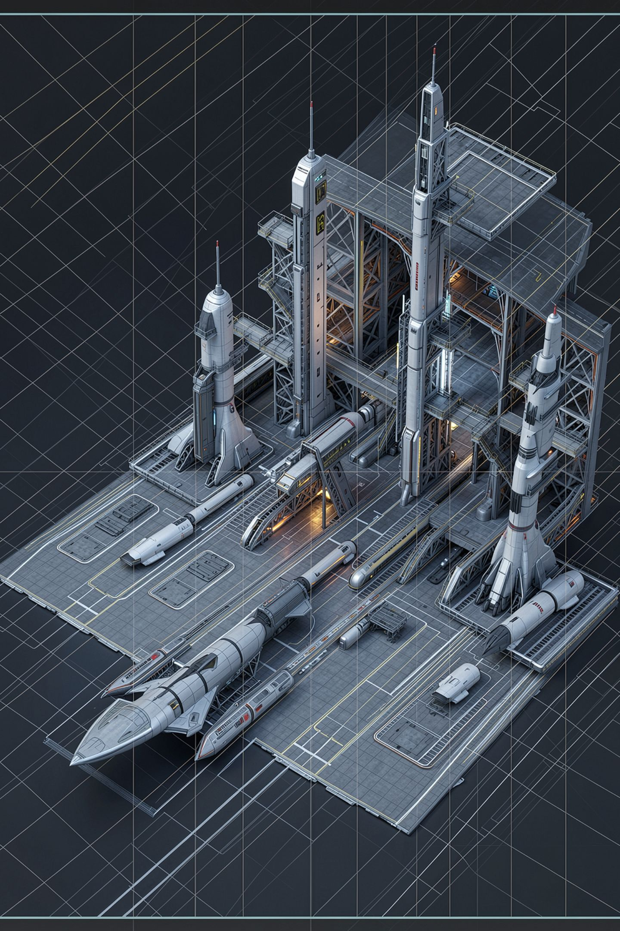
Potential Bias: Whose Perspective Is Built In

Slide 2

This is the parameter the class scores worst on, every year
You already know the everyday meaning of biased
Unfair, wrong, written by somebody with an agenda
The competency means something narrower and more useful
Whose perspective is built in, and who is missing
Not is it unfair. Not is it wrong
MCCTC | AI Automation & Software Development
Notes:
I can predict this one before the papers come in. Every year this is the lowest scoring parameter, and the reason is not that it is harder. It is that you arrive with the everyday meaning of the word and never swap it out. In competency two point fourteen point four, biased does not mean unfair and it does not mean wrong. It means something narrow, and the narrow version is what the exam assesses and what a professional review needs. Who is assumed, and who is absent.

Slide 3

Every output describes a default person
Read a paragraph of advice and ask who it talks to
It assumes a ride home, a quiet place, grade-level English
None of those assumptions is a lie
The finding is that it treats that somebody as everybody
A system built from it has no place for anyone else
MCCTC | AI Automation & Software Development
Notes:
Read any paragraph of advice and you will find assumptions the text never states. That the reader has a ride home. That they have somewhere quiet. That they are a student and not a teacher or a parent or an alum. Every one of those is true of somebody. Where does it come from? The model produces the typical continuation from what it was trained on, so whoever writes the most on a topic supplies the typical perspective and whoever writes the least is absent. Nobody chose that. It is an average, and an average has no representative in the room. Your prompt is the second source, and it is closer to home.

Slide 4
Three questions, in this order
1
Find the default
2
Find who is excluded
Who is the default person here
Who in this building does this not fit
Does the output acknowledge them, or is it silent
Silence is the finding
Read looking for absences, not for something offensive
3
Check for silence
MCCTC | AI Automation & Software Development
Notes:
Students get stuck because they read looking for something offensive, and most outputs are not offensive, so they find nothing and write nothing. Read looking for absences instead. Question two has a rule attached. Name a real category of person and be specific. A student with a job after school. A student who takes the bus. A teacher. A parent volunteer. An English learner. A student on an IEP. Pick one you can describe. Then question three, and silence is the finding. An output that says this assumes you have time after school, which not everyone does, has done the work.

Slide 5
The grade level line, worked through
THE CLAIM
"Write the borrower's grade level, not their schedule."
DEFAULT PERSON A student. Grade level is a property students have.
WHO IT DOES NOT FIT A teacher borrowing a camera for a class. A parent
volunteer at an event. An alum helping at a shoot.
ACKNOWLEDGED No. The sentence is stated as the rule.
PARAMETER Potential Bias. Nothing in the sentence is false.
MCCTC | AI Automation & Software Development
Notes:
Three questions, three answers, and a label at the bottom. Read the last line twice. Nothing in the sentence is false, and that is what makes this a Bias finding rather than a Validity one. If you catch yourself reaching for the word wrong, you have changed parameters without noticing.

Slide 6

What makes it a real finding
A sheet built from this has a column only students can fill
People who cannot fill it are turned away or recorded wrongly
The fix: ask who is borrowing and how to reach them
Grade level is one way to answer that, for one group
MCCTC | AI Automation & Software Development
Notes:
The consequence is the part students leave out, and it is the part that makes a finding actionable. A checkout sheet built from that sentence has a column that only students can fill, so the teacher borrowing a camera either gets turned away or gets written down wrongly. Now look at the fix, because a fix is what proves you understood the finding. The field is not grade level. The field is who is borrowing this and how do we reach them, and grade level is one answer to that question for one group of people.

Slide 7
An output with no bias finding
THE CLAIM
"Photograph any damage before the item leaves the room."
DEFAULT PERSON Anyone handling equipment.
WHO IT DOES NOT FIT It requires a camera, which everyone in the room has.
ACKNOWLEDGED Nothing to acknowledge.
FINDING None. "I looked for a Potential Bias failure in the procedure
section and did not find one."
MCCTC | AI Automation & Software Development
Notes:
Run the same three questions and land on nothing, out loud, deliberately. That last line is a finding and it gets written down, because it tells a reader that you checked. Now the harder half of this. Manufacturing a finding to fill the category is its own failure mode, and reviewers do it under pressure to look thorough. It costs you credibility, because the reader who checks your weakest finding is the one who decides how much to trust your strongest one.

Slide 8

The wrong way to write a bias finding
Written first: biased because it only mentions American schools
It might be a real finding. As written it is not
It never names who is harmed by the absence
It never says why that matters here
Nobody can fix anything based on it
MCCTC | AI Automation & Software Development
Notes:
Read that sentence again. It is true, it is fast, and it sounds like analysis, which is exactly why it gets written. And it is unactionable. Nobody can change a paper based on it, and unactionable is the test for whether you have written a finding or an observation wearing a finding's clothes. There is one more wrong version worth naming out loud. Deciding an output is biased because you disagree with its conclusion. Bias is about what is absent, not about whether you like what is present. If you only detect bias in outputs you disagree with, you have found a bias in your review process, and that is the finding.

Slide 9
The same observation, written as a finding
Every example is a US public high school with a 7-period day. Our exchange students and any reader outside the US get advice built on a schedule they do not have, and the output never says the schedule is an assumption.
MCCTC | AI Automation & Software Development
Notes:
Same observation as the last slide. This version names the absent group, says what goes wrong for them, and identifies the unstated assumption. Three parts, and it is the third one that most people miss. The output never says the schedule is an assumption. That is the silence, and the silence is the finding. Read it and count the three parts with the room before you move on.

Slide 10

Test for it rather than arguing about it
An opinion about bias is hard to settle. A test is not
Keep the prompt identical, vary one detail about the person
Record every output, compare on something countable first
Against the stub all three come back identical. Say so
A test that can only come out one way is nothing
MCCTC | AI Automation & Software Development
Notes:
Three prompts. A student falling behind. A student with an after-school job falling behind. A student who takes the bus falling behind. Everything else identical, word for word. Against our stub those come back with the same reply words, the same shape and the same hedge count, because the stub is a caricature and does not model this. Write that down as an honest negative result about the stub, and say clearly that it is not evidence about a real model. Two hard rules for any bias test in this course. No real people as subjects, and no student data in any prompt. Invented people only.

Slide 11
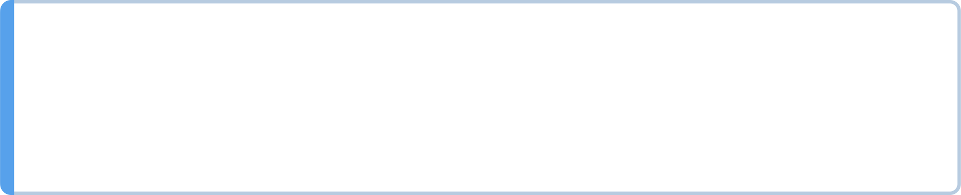
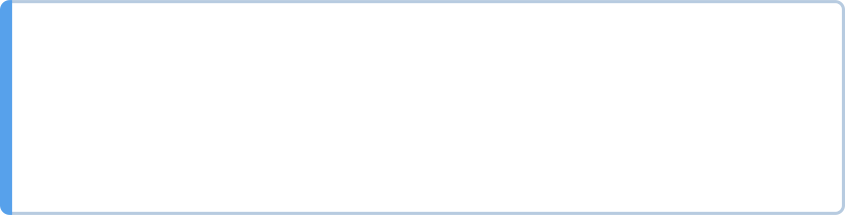
Bias is not Validity, and the middle case is the argument
Overstating a true claim is fixed by qualifying the claim.
A bias finding is fixed by naming who the advice is for.
This statement is false
Validity
This statement is not true for everyone
Usually Validity
It assumes a kind of person and is silent about others
Bias
MCCTC | AI Automation & Software Development
Notes:
The middle row is where most of the class lands and it is the one to argue about out loud. Handwritten notes help you remember more, stated too broadly, is an overstatement and that is a Validity problem, and you fix it by qualifying the claim. The Bias version of the same sentence is a different thing. It assumes a reader who can write by hand, who has notes to take, and who is in a class where note-taking is the mode, and it never says so. That one is not fixed by qualifying. It is fixed by acknowledging who the advice is for.

Slide 12

What you are about to build
Hallucination Hunt Part 3, due at the end of Build 1
One grounded rerun recorded next to its ungrounded original
Then bias findings on the Week 4 reference runs
Two findings, each with default person, absent group, consequence
One place where you looked and recorded finding none
MCCTC | AI Automation & Software Development
Notes:
Build one finishes the Hallucination Hunt. Rerun one of your three prompts with sources supplied and a refusal route, record what changed, answer the four analysis questions, and make sure every fabricated citation in the file is labelled as fabricated. Due when the block ends. Build two is bias findings on the reference runs and one Module 1 artifact, using the three questions. Two findings minimum, each with all three parts, plus one recorded place where you looked and found nothing. Then swap with a partner and challenge each other's findings in writing. Side Quest 19, the Bias Audit, unlocks today in Period 8, and the same two hard rules apply there.

