Slide 1

Feedback on Reasoning, Not on Verdicts

Slide 2
Two people trade verdicts for ten minutes and nothing improves
Everything you wrote this module gets read by somebody
When the work is a verdict, feedback becomes an argument
Two conclusions traded, neither one moves
Both of you leave with the paper you came in with
Judgement improves one way only
MCCTC | AI Automation & Software Development
Notes:
This is not a soft skill bolted onto the technical work. In this module the work is judgement, and judgement improves exactly one way. Somebody who thinks differently tells you where your reasoning does not hold, and you are able to hear it. There is a specific failure I want named before we start. When the work is a verdict, feedback turns into an argument about the verdict. Two people trade conclusions, neither moves, and nothing on either paper changes.

Slide 3

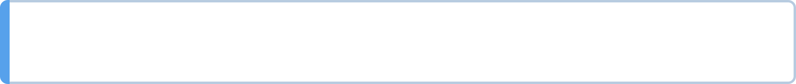
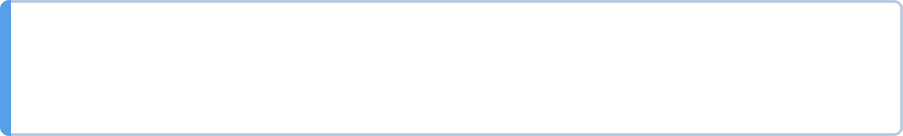
Give feedback on the reasoning and the evidence
Not on the conclusion
If you disagree, say which step you would not have taken
And why
Every useful comment names a specific place in the work
MCCTC | AI Automation & Software Development
Notes:
Here is the move. If you disagree with a conclusion, the useful thing to say is not I disagree. It is which step you would not have taken, and why. Your third finding is specific. Your analysis is not. That difference is most of the technique, and once you see it you cannot write the vague version again without noticing.

Slide 4
Instead of, say
INSTEAD OF SAY
"This is wrong" "Step 4 assumes the sample was random. The scenario
does not say it was."
"Good job" "Your Hallucination finding records the exact search
string. That is the part I am going to copy."
"You missed some" "You have six Validity findings and nothing else. Try
the two questions a terminal cannot answer on
section 3."
MCCTC | AI Automation & Software Development
Notes:
Read down the right hand column and notice what every one of them has in common. A location. Step four. Your Hallucination finding. Section three. Not one of them is about the person, and not one of them requires the receiver to guess what you meant. Notice the middle row especially, because praise is feedback too and good job gives somebody nothing to repeat.

Slide 5
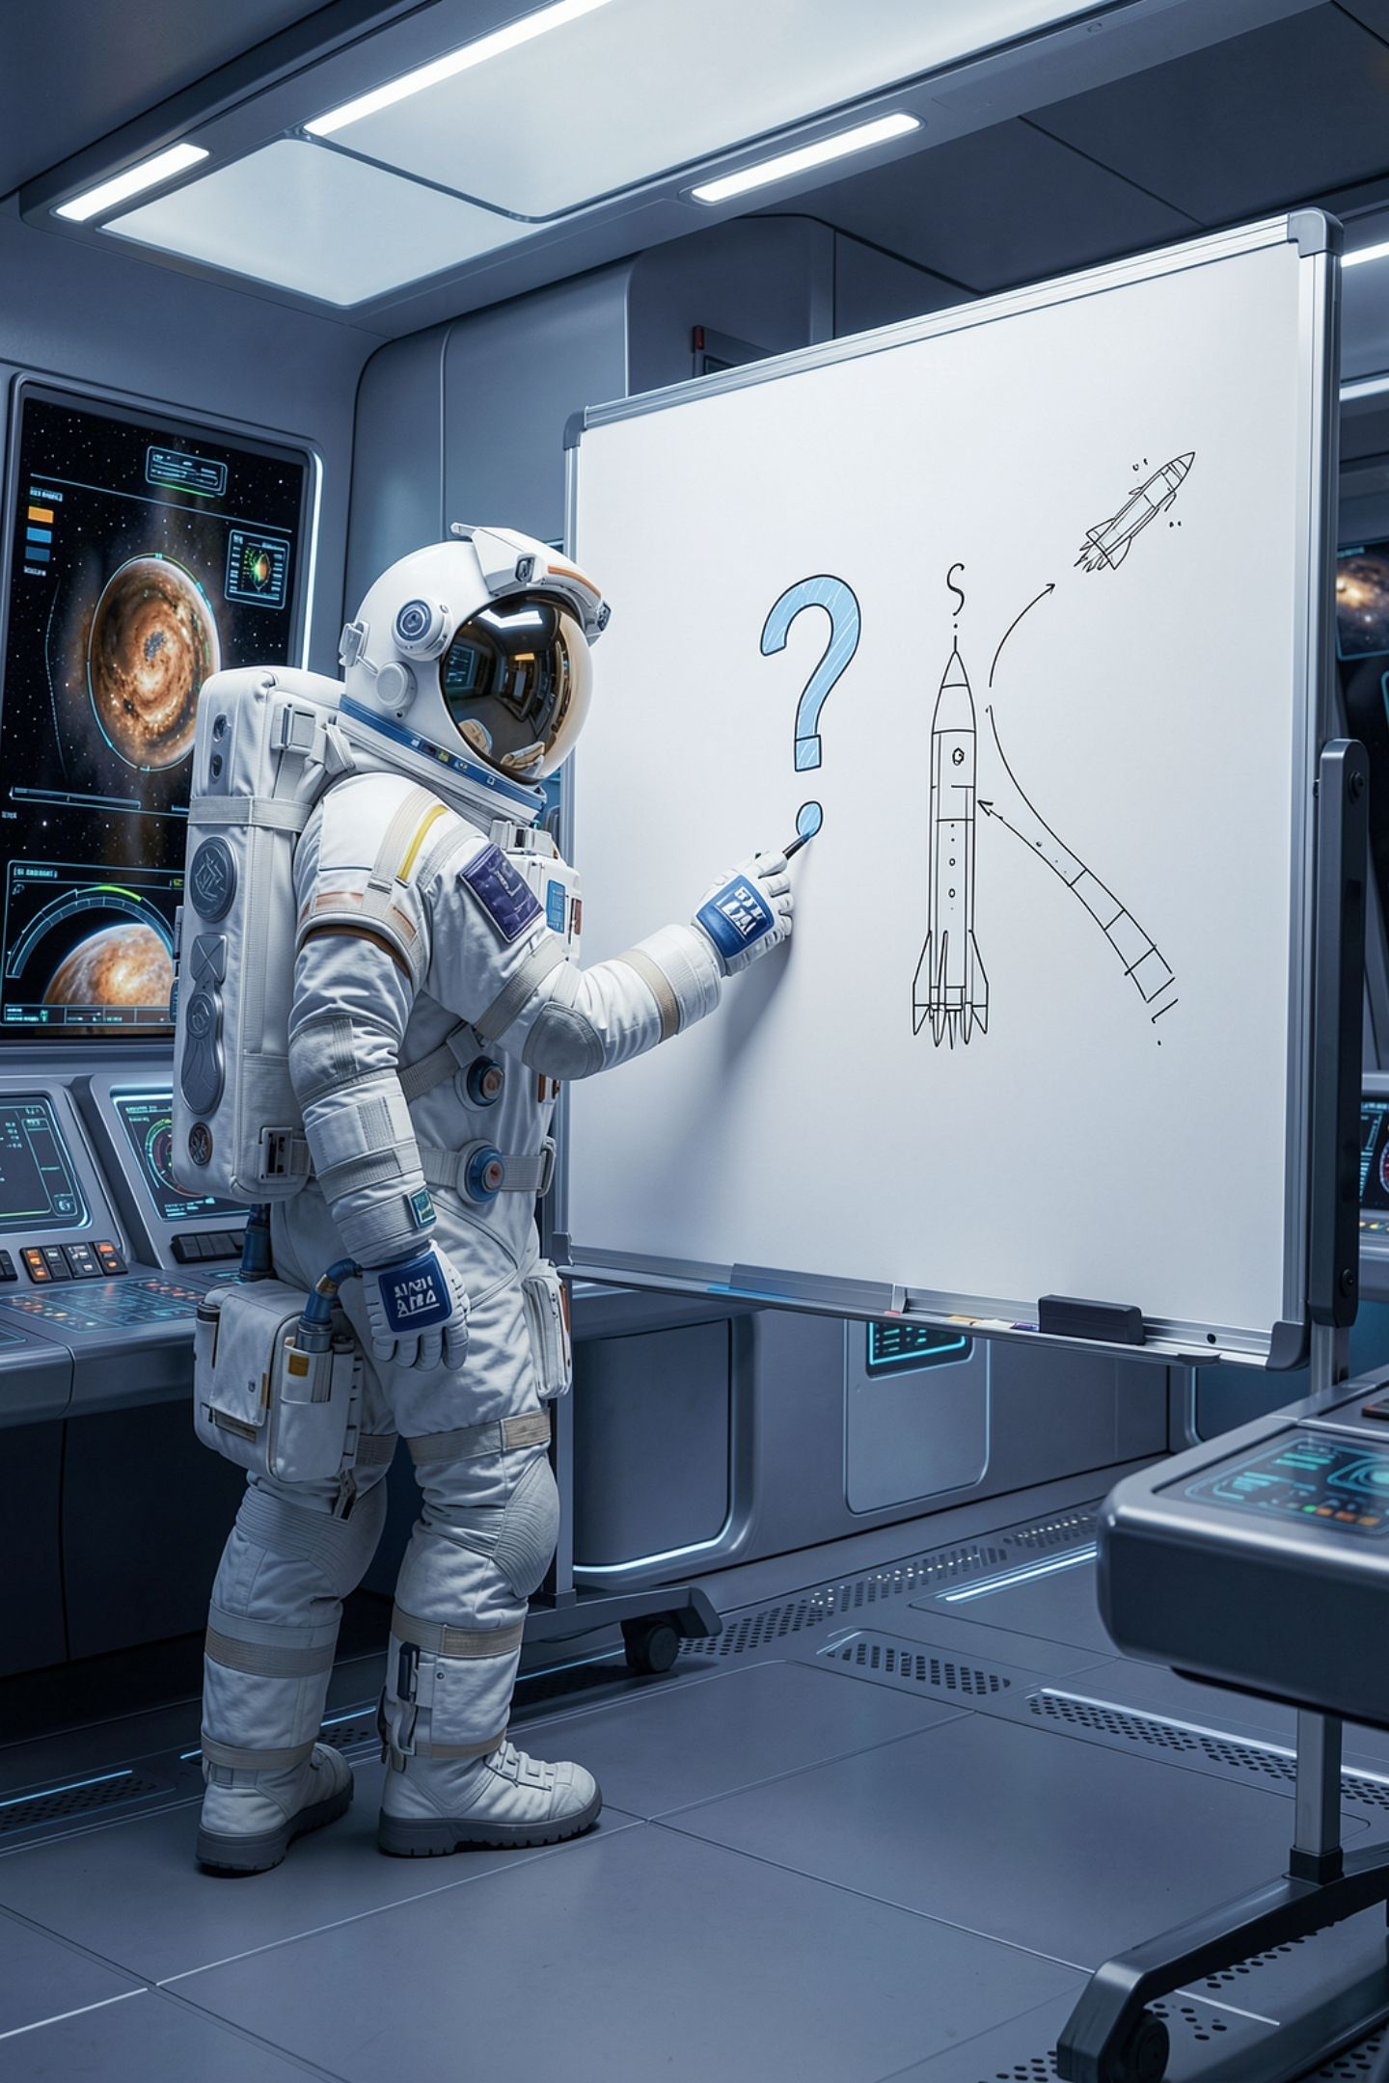
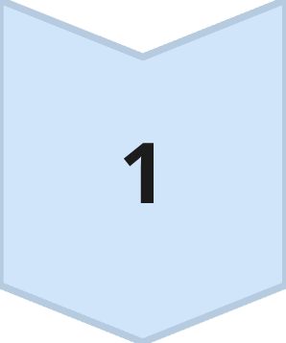
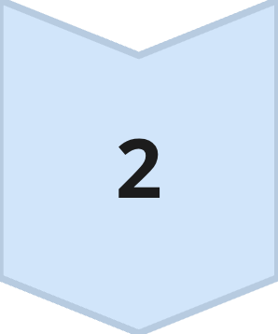
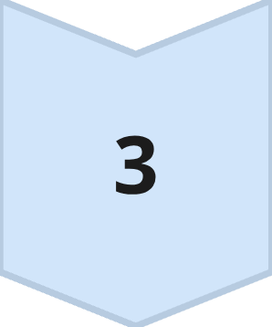
The three-part move
Name the specific thing
A section, a finding, a sentence
Say what you observed
Not what it means about them
End on a question or the next action
When they find the gap themselves it stays found
The strongest feedback in this module is a question.
MCCTC | AI Automation & Software Development
Notes:
It takes ninety seconds and the structure is worth it. Part two is the one people get wrong. This finding has no how you know line is an observation, and both of you can see it on the page. You were careless is a conclusion about a person and it cannot be acted on. Part three ends on the thing they can do. What did you search for, or add the search string and this is full credit. And a question beats a statement here, because the work is reasoning, and a question makes them walk their own reasoning again.

Slide 6
The work being reviewed
FINDING 2, FROM A HALLUCINATION HUNT
"Lindqvist, M. (2013). Structured Output and Downstream Parsing Failures.
Midland Review of Applied Learning, 9, 34-48."
Parameter: Hallucinations.
Why: this journal does not exist.
How I know: I looked and could not find it.
MCCTC | AI Automation & Software Development
Notes:
This is a real shape of finding from last week's lab, and most of you wrote one very close to it. Read the last line. I looked and could not find it. Hold on to that line, because both of the reviews you are about to see are about it.

Slide 7
The wrong way to review it
THE UNHELPFUL REVIEW
"Your second finding is weak. You should have searched better. Also I think
this might be Validity because the author could be real."
MCCTC | AI Automation & Software Development
Notes:
Read it out loud in a neutral voice and let the room sit with it for a second. Then ask one question. What, specifically, can the person who received that do next?

Slide 8
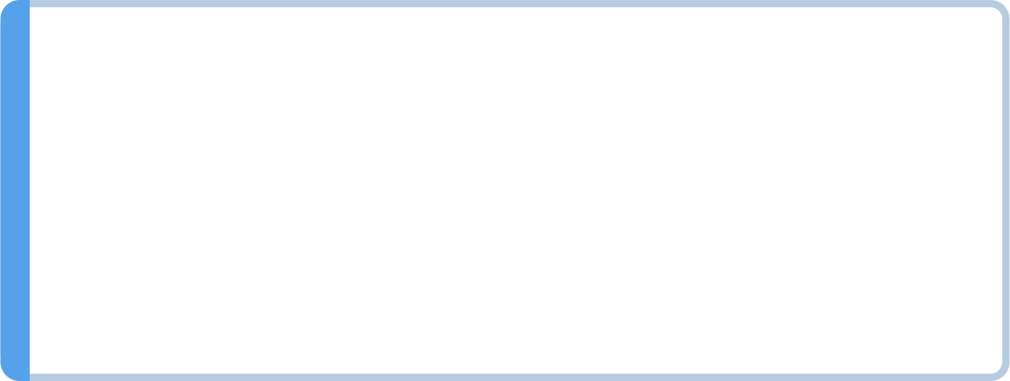
Count the problems in it
Weak is a judgement with no observation under it
Searched better names no action
The Validity idea is a verdict with no reasoning attached
The receiver can agree, argue, or feel bad
None of those three improves the work
MCCTC | AI Automation & Software Development
Notes:
Three failures in two sentences. Weak is a judgement and there is nothing underneath it that both of you can see. Searched better names no action, so there is nothing to do differently. And the Validity suggestion is a competing verdict with no reasoning attached, which turns the conversation into who is more confident. The fix for that last one is one word, and it is because. I think finding three is Bias rather than Validity, because your evidence is about who the procedure leaves out rather than about a claim being false. Now it can be argued on the evidence, and one of you will change your mind.

Slide 9
The same disagreement, made useful
THE USEFUL REVIEW
"Finding 2: your 'how I know' says you looked and could not find it, and it
does not say where. I cannot check it as written. What did you search,
exactly, and in which catalog?
Separately, I wondered about the author. If Lindqvist is a real person who
writes in this area, that changes the finding, because a real author with an
invented paper is a different thing from a fully invented citation. Did you
check the author separately from the title?"
MCCTC | AI Automation & Software Development
Notes:
Three parts, twice. It names the finding, states the observation, and ends on an action. Then the second paragraph raises a genuine alternative and frames it as a question about the evidence rather than as a competing verdict. That is the whole difference. Same disagreement, and the receiver now has two specific things to go and do.

Slide 10
Receiving it is the harder half
Write it down before you respond, anything at all
Separate the observation from the judgement underneath
Ask one clarifying question before you agree or disagree
Say what you will do, including nothing, with a reason
Never argue about whether the feedback was fair
MCCTC | AI Automation & Software Development
Notes:
You will get feedback that is wrong, badly phrased, or both. The skill is getting the useful part out anyway. Transcribing buys you the four seconds where the defence usually happens. This is confusing is a judgement, and underneath it is an observation, which is that they could not follow something, so ask which part. And read the last two lines together. Declining feedback with a reason is a complete response. Declining it with a shrug is not. Whether it was fair may be worth discussing, and it is not worth discussing at the same time as this.

Slide 11
Praise-only is the other failure, and it looks like the opposite
I could not find anything leaves the person with nothing
It quietly tells them the work is finished when it is not
If you genuinely found nothing, say what you checked
A counter-verdict feels like expertise and skips the reading
Neither one requires you to have read carefully
MCCTC | AI Automation & Software Development
Notes:
These two look like opposites and they have the same tell. Praise is comfortable and fast. A counter-verdict feels like expertise. Neither requires you to have read the work carefully, which is why both are so common at four minutes to the bell. If you genuinely found nothing, that is real information and it has a form. I read all eight findings against the four-part rule and every one has a checkable how you know. That is useful. Looks good is not.

Slide 12
What you are about to build
01
02
03
Trade Scenario Teardowns with a partner
Four comments, each naming a step or a sentence
At least one genuine disagreement, with a because in it
04
05
Four responses, each locating the comment and saying what changes
Then revise, and a second reviewer reads it cold
MCCTC | AI Automation & Software Development
Notes:
Peer feedback is graded here, on the giving side and the receiving side, under Written and Documentation. Five rows at four points each. Specificity, observation over judgement, actionability, response quality, and one genuine disagreement. That last row exists on purpose. A review with no disagreement in it is either a perfect artifact or an unread one, and the second is far more common. Build two is revision, and your teardown has to show at least two changes traceable to specific feedback, marked in the file. Then a second, different reviewer reads the revised version cold.

