Slide 1
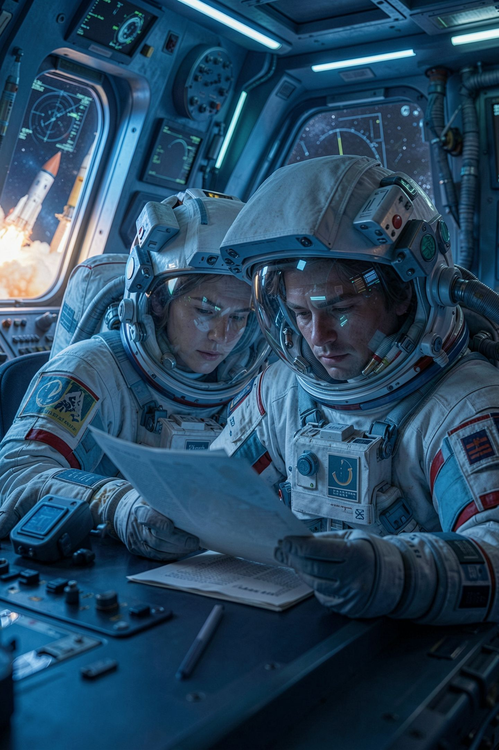
Writing for the Person Who Has to Act

Slide 2
Three weeks of work and the reader stopped at line five
The person who acts on your work is not technical
They are reading it between two other things
They decide in five lines whether to keep reading
That is not laziness. That is what their day looks like
A finding nobody reads is a finding you did not make
MCCTC | AI Automation & Software Development
Notes:
You have spent three weeks producing findings. Today is about whether any of them reach a person who can do something. The yearbook adviser, the club advisor, an assistant principal. They are not technical, they are reading your document between two other things, and they will decide inside the first five lines whether to keep going. Do not take that personally and do not call it laziness. It is what a day looks like for anybody who makes decisions, and writing for them is a technical skill with rules.

Slide 3
Two documents, two jobs
Your Record
Your Brief
Chronological, complete, including dead ends
Written for you, later, and for a checker
Conclusion first, one page, what changes the decision
Written for a person who has to decide
Your record is not a draft of your brief
MCCTC | AI Automation & Software Development
Notes:
Students collapse these two constantly and it is the single biggest reason a good analysis lands with nobody. The record is chronological and as long as the work took, and it includes the dead ends, because a reviewer checking you needs the dead ends. The brief is conclusion first and it contains only what changes the decision. Turning the first into the second is not editing. It is rewriting, and you should expect it to take real time.

Slide 4
Five parts, and the order is not negotiable
01
02
03
The recommendation, in one sentence, first
The situation, in three sentences at most
The two or three findings that drive the recommendation
04
05
What it costs, and what you are trading away
What would change your recommendation
MCCTC | AI Automation & Software Development
Notes:
The order is what makes the document survive being half read. Part one first means that if the reader stops after one line, they still got the thing they needed. Part three is two or three findings, not all eleven, and the test is which ones would change the decision if they were different. Part four has a number in it, because a recommendation with no cost reads as naive and gets discounted even when it is right. Part five tells the reader how firm this is, which is information they need and almost never get.

Slide 5
The wrong way, and it is what gets handed in first
CAPTION EVALUATION REPORT
Introduction. For this assignment I evaluated a set of forty AI-generated
captions using the five parameters of AI output evaluation, which are
validity, relevance, authenticity, potential bias, and hallucinations. This
report describes my methodology and findings.
Methodology. I first read all forty captions. I then compared each caption to
the results sheet. I recorded my findings in a table.
Findings. Finding 1: caption 4 says the game was on Friday. The results sheet
says Thursday. This is a Validity failure...
Conclusion. Overall, the captions were mostly accurate but there were some
issues. I would recommend checking them before printing.
MCCTC | AI Automation & Software Development
Notes:
Read the introduction and the methodology aloud and then stop, because that is where the reader stops. Ask the room what they have learned that they could act on. Nothing. The work behind this document may be excellent. None of it arrived.

Slide 6

What the reader actually got
The recommendation is in the last eight words
They read a definition of five parameters they already know
They read a methodology they cannot act on, and stopped
The findings that matter sit at positions six, seven, nine
Check them does not say which, by whom, or by when
MCCTC | AI Automation & Software Development
Notes:
Four minutes of reader attention spent on a definition they did not need and a methodology nobody is grading. And when you finally reach the recommendation, it is unactionable. Check them before printing names no captions, no person, and no deadline. Somebody who wanted to do the right thing still could not, from that document. Those are two separate failures and you can commit either one on its own.

Slide 7
The version that gets acted on, first three lines
Do not send the sports captions to print until every caption that names a
student is checked against the results sheet. That is twelve of the forty and
about fifteen minutes.
Forty captions were generated from the roster and the results sheet. I checked
all forty against the sheet. Thirty-seven are correct.
Three are not, and one of them names a student.
MCCTC | AI Automation & Software Development
Notes:
Same work. Same eleven findings behind it. The reader can act after the first sentence, and every sentence after it is support for the same decision. Count what is in that opening. An action, a named object, a number, and a time cost, all before the reader has to decide whether to keep going.

Slide 8
The findings, the cost, and the falsifier
Caption 12 says a named sophomore scored the winning goal in the district
semifinal. The results sheet lists him as a manager that week. He did not
play. This is the one that cannot go to print.
Caption 31 says "the team's first district win," which the sheet does not
support either way. I could not confirm it.
What this costs: fifteen minutes and a delayed sign-off. The alternative is a
permanent printed claim about a named student that is not true.
What would change this: if the roster distinguishes managers from players and
I misread it, caption 12 may be correct.
MCCTC | AI Automation & Software Development
Notes:
Three things to point at. First, the findings are quoted and each carries its evidence in one line, so a reader can check any of them in under a minute. Second, the cost is priced against the alternative, which is what makes fifteen minutes sound cheap. Third, and this is the one students resist, I could not confirm it. That sentence buys more trust than the two confident bullets above it, because it shows the confident ones were a choice rather than a habit.

Slide 9

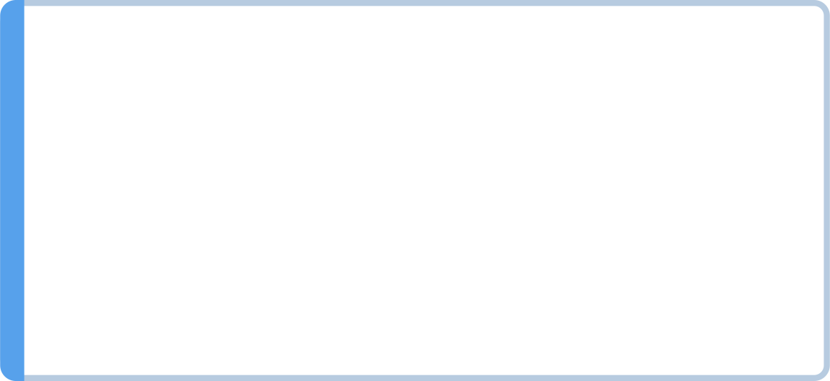
The rules that do most of the work
Lead with the decision, not with the process
Name the person, the action, and the time
Quantify the cost. Fifteen minutes. Twelve captions
One recommendation. Three recommendations is three briefs
Cut the definitions. Your reader does not need them
MCCTC | AI Automation & Software Development
Notes:
Somebody should check these and the yearbook adviser should check the twelve captions that name students before sign-off are different documents. Numbers stop a recommendation from reading as an abstraction. And say what you are not sure about, in its own sentence, because part five is what lets you be direct without overclaiming. If you have three recommendations you have three briefs, or you have one brief and everything else at the bottom under a heading that says so. For a one-page brief, the second option is nearly always right.

Slide 10
The other wrong version, and it is subtler
The problem with hedging
There may be some issues, and it might be worth considering
Hedging removes the risk by removing the content
Say it definitely, and say what would change it
Nothing in that sentence can be wrong.
That is why it was written, and why it is useless.
MCCTC | AI Automation & Software Development
Notes:
Read that first line as though you meant it and let it hang. Nothing in it can be wrong. If the captions go to print and one of them is false, the writer can point at that sentence and say they raised it. That is what it is for. Why is it tempting? Because a definite recommendation can be wrong, in front of people, in writing. Hedging removes that risk by removing the content. The professional move is the opposite of hedging, and it is part five. Say the thing definitely, then name the specific fact that would change it.

Slide 11
Same evidence, three readers
The Adviser
The Student
The Principal
Needs which captions, and by when
Needs what to change, and that thirty-seven were fine
Needs whether a student's name is at risk
Cut the parameter names for the principal. Changing audience is not tone. It changes paragraph one.
MCCTC | AI Automation & Software Development
Notes:
Same eleven findings, three completely different documents. For the adviser, cut anything about how models work. For the student who wrote the captions, cut the print deadline framing and lead with the thirty-seven that were right, because they have to keep working after they read it. For the principal, cut the parameter names, the method, and the other two findings, and lead with whether a student's name is at risk and what is being done about it. Changing the audience is not a matter of tone. It changes what goes in paragraph one and what comes out entirely.

Slide 12

What you are about to build
Turn your revised teardown into a one-page brief
The lab assigns your reader, and readers differ across the room
First sentence names a person, an action, and a time
A quantified cost, and one sentence on what would change it
Then rewrite the same brief for a different reader
MCCTC | AI Automation & Software Development
Notes:
Build one is the brief, one page or less, due at the end of the block. Your reader is assigned by the lab and different people get different readers, which is the point of the second half. Build two is the audience swap for the first twenty-five minutes. Same evidence, different reader, and what I want to see is a visible difference in what comes first and what you cut. The remaining thirty minutes are module review against the exit criteria checklist, and you bring me one gap you found in yourself.

