Slide 1

Tables, Keys, and the Fact Written Down Twice

Slide 2


One player, two names, same person
nightowl99 is Jamal Petrov on line 4
nightowl99 is Jamaal Petrov on line 27
Key on the name and you have nine players
Key on the gamertag and you have eight
MCCTC | AI Automation & Software Development
Notes:
Same account, same person, two spellings, because a human typed it twice. Your entire schema turns on which of those two columns you pick as the key, and the file is telling you the answer if you look at it. Today is about picking keys and then living with the choice.

Slide 3
The words, once, properly
Table
Row
Column
One kind of thing
One of that thing
One fact about it
Primary Key
Foreign Key
Identifies exactly one row
Points at a row elsewhere
MCCTC | AI Automation & Software Development
Notes:
Five words and you know four of them already. The one worth slowing down on is primary key, because a key is a promise about the real world rather than a detail about storage. If the promise is ever false, the key is wrong, and the database will tell you the first time it happens.

Slide 4

The question that picks a key
Which value stays the same if they change their mind
A gamertag is chosen once
A name is typed every time
The file already proves which is stable
MCCTC | AI Automation & Software Development
Notes:
One question. Which of these two values would still be the same tomorrow if the person changed their mind about the other one. A gamertag is an account. A name is typed by whoever is at the desk. You do not have to guess which is stable here because the file contains the evidence.

Slide 5
A match has many players, a player has many matches
CREATE TABLE appearances (
match_id INTEGER NOT NULL REFERENCES matches (match_id),
gamertag TEXT NOT NULL REFERENCES players (gamertag),
role TEXT NOT NULL,
PRIMARY KEY (match_id, gamertag)
);
MCCTC | AI Automation & Software Development
Notes:
Neither table can hold the other, because a column holds one value. So the relationship gets its own table. Read that primary key out loud: one row per player per match. And notice where role lives. Role depends on the player and the match together, which is why it is here and not on players.

Slide 6

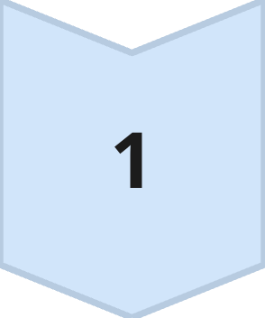
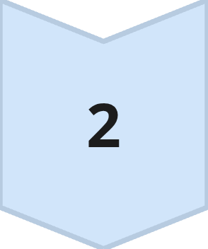
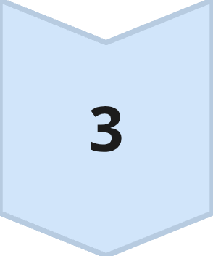
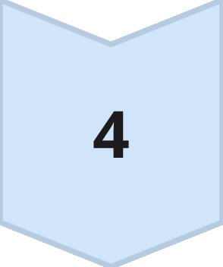
What does this fact depend on
Score
Depends on the match
Grade
Depends on the player
Role
Depends on both together
Normalized
Answer that and you have it
MCCTC | AI Automation & Software Development
Notes:
That is normalization without the formal definitions. Every fact gets written down once, and where it goes is decided by what it depends on. If you can say which of the three a fact depends on, you are finished. You do not need third normal form to do this week's work.

Slide 7

What repetition costs, exactly
kettlecorn appears in 3 rows of the flat file
UPDATE players SET grade_level = 12 WHERE gamertag = 'kettlecorn';
1 row changed
One row changed. Not three. That is the point.
MCCTC | AI Automation & Software Development
Notes:
Kettlecorn moved up a grade. In the flat file that is three rows to edit and a fourth time somebody will miss one. In the normalized version it is one statement and one row. That is the whole argument for normalization in two lines, and it is not about elegance, it is about one place to change one thing.

Slide 8
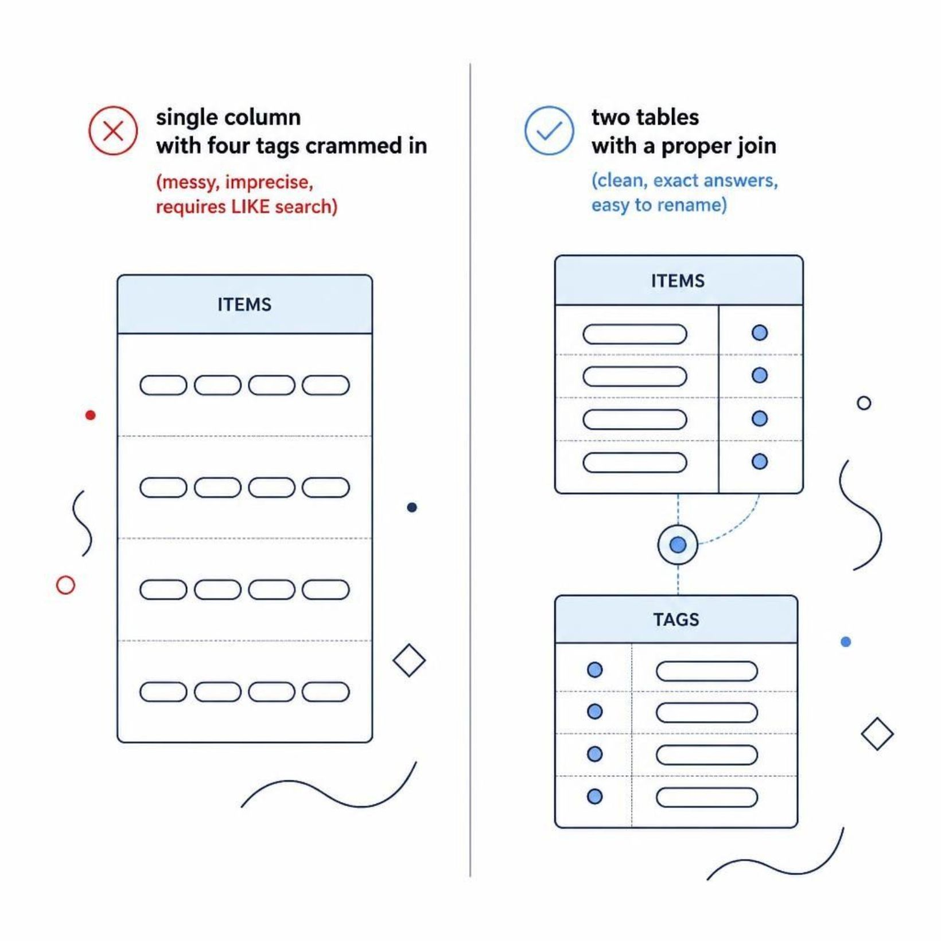
An array does not fit in a column
The catalog gives four tags per item
One column means LIKE and hope
Two tables means a question with an exact answer
Renaming a tag stops being a search and replace
MCCTC | AI Automation & Software Development
Notes:
The makerspace catalog hands you a tags array. Put it in one column and every item that needs training becomes a LIKE query that also matches a tag called training optional the day somebody adds one. Two tables cost you a join. They buy you a question you can answer exactly, which the report asks.

Slide 9
Here is the wrong one
CREATE TABLE season (
played_on TEXT, opponent TEXT, our_score INTEGER,
gamertag TEXT, player_name TEXT, grade_level INTEGER,
role TEXT, kills INTEGER, deaths INTEGER
);
MCCTC | AI Automation & Software Development
Notes:
This is the CSV with a CREATE TABLE in front of it, and it is what you get if you ask a model for a table for this file, because it is literally what you asked for. It loads. Every query works. Predict what goes wrong before I show you.

Slide 10

Two answers, one person, no error
SELECT DISTINCT grade_level FROM season WHERE gamertag = 'kettlecorn';
[(11,), (12,)]
Two distinct grade levels returned for one gamertag. The flat table cannot tell you which is true.
MCCTC | AI Automation & Software Development
Notes:
No primary key, so the duplicate row goes in. The match is repeated on every player row, so two rows can disagree about the score. The grade is repeated, so one person is in two grades at the same time. Nothing raised. The table is perfectly happy and you now have two answers to one question about one person.

Slide 11

What you are about to build
Three tables out of twenty eight flat rows
Four key decisions, written down, no AI
Two deliberate breaks in step eight
Then one UPDATE that touches one row
MCCTC | AI Automation & Software Development
Notes:
Build one is lab M zero four dash zero one. Step three is the four key questions and it is the part of the lab that is not typing. Step eight breaks a foreign key with the pragma on and then with it off, and you write down both results. The second one is the sentence you carry into Friday's Gate 2.

