Slide 1

Database Types and Structures, Compared Honestly

Slide 2
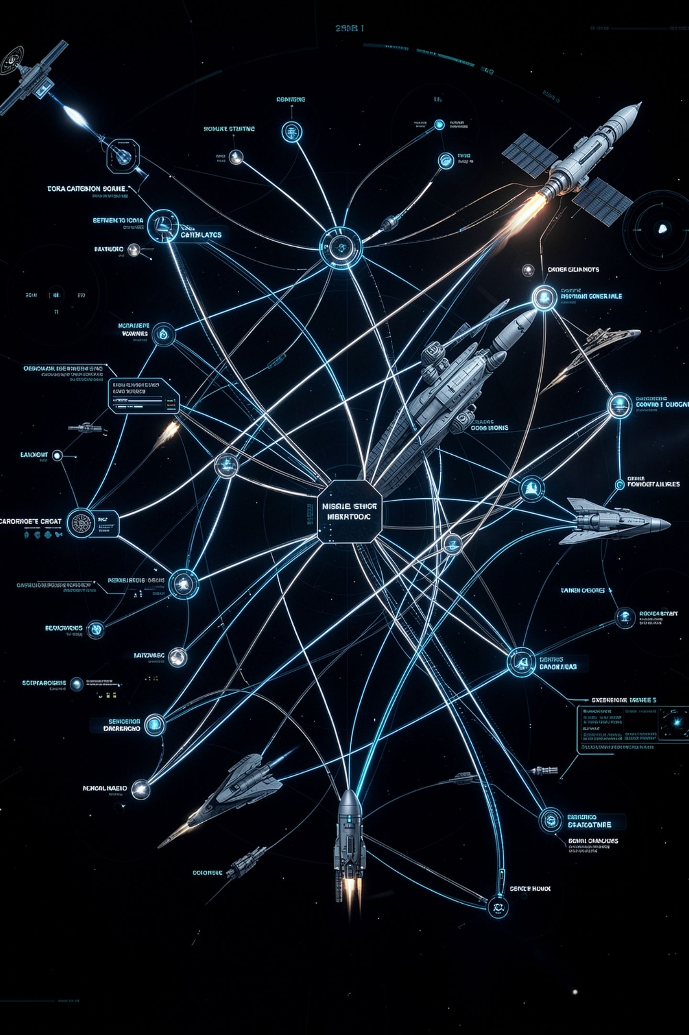
The list nobody explains
Data Model
Relational, NoSQL, graph, data warehouse
Deployment
Distributed, open source, cloud, AI database
Structure
Flat file, hierarchical, data lake, multi-modal
The Point
These are four different kinds of category
MCCTC | AI Automation & Software Development
Notes:
This is the list the exam asks you about and it feels slippery for a reason nobody tells you. Those words are not competing answers to one question. They answer four different questions, and once you see which is which the whole topic stops being a pile you have to memorise.

Slide 3
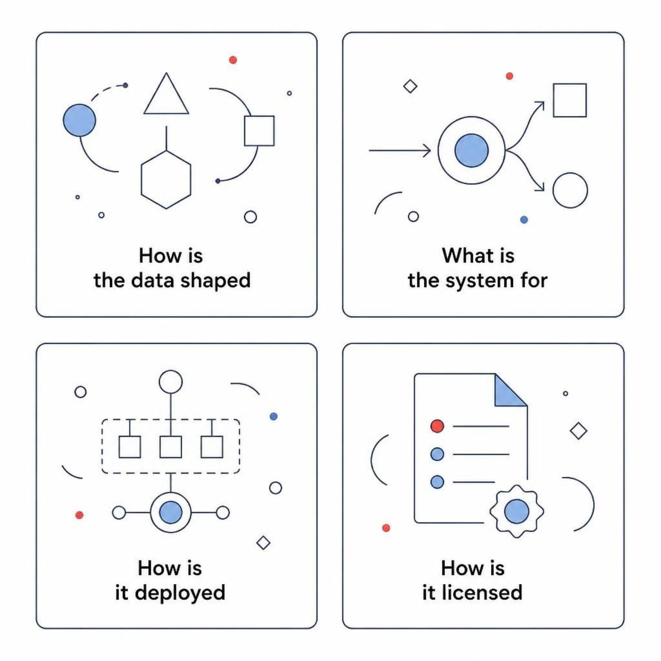
Four questions, not one
1
How is the data shaped
2
What is the system for
3
How is it deployed
4
How is it licensed
MCCTC | AI Automation & Software Development
Notes:
Shape is relational, document, graph, vector. Purpose is warehouse or lake. Deployment is distributed or cloud. Licence is open source. A hosted PostgreSQL is all four at once: relational, distributed, cloud, and open source. Those are not four answers to pick between.

Slide 4


The question picks the structure
Relational
1
How many, by group, over a period
Document
2
Give me this whole thing by id
Graph
3
Who is three steps away
Vector
4
Which text means roughly this
MCCTC | AI Automation & Software Development
Notes:
One rule for the whole topic. Look at the shape of the question you are going to ask and pick the structure that answers that shape cheaply. Not the newest one, not the one in the job advert. And say the size out loud, because a recommendation with no size in it is not a recommendation.

Slide 5

Document store is good at this
Fetching a complete record by its identifier is where a document store excels. The entire object comes back in one read, with no joins required.
item = by_id["EQ-0110"]
print(item["name"], "|", ", ".join(item["tags"]))
Resin 3D printer | printing, resin, training-required, ventilation-required
MCCTC | AI Automation & Software Development
Notes:
One lookup, everything about that item, no joins at all. That is the document model's whole argument and it is a good one. The catalog arrives in exactly this shape, so somebody could reasonably say we already have a document database and it is called a JSON file.

Slide 6

And this is where it costs you
Aggregating across all documents requires iterating every record in application code. The database does not do this work for you.
counts = {}
for item in items:
for tag in item["tags"]:
counts[tag] = counts.get(tag, 0) + 1
[('training-required', 7), ('battery', 4), ('printing', 3)]
MCCTC | AI Automation & Software Development
Notes:
Same answer as the SQL version, one line longer, and notice what you did. You wrote the loop. The document store has no index across documents unless you build one. Same answer, different person writing the loop, and that is most of the trade in one sentence.

Slide 7


Graph, and what a step costs
One step is one join, eight members come back
Two steps is a self join on a self join
Three steps is a query nobody can debug
At fourteen members, do not
MCCTC | AI Automation & Software Development
Notes:
Who has borrowed the same equipment as Amara is one join and it returns eight of the other thirteen members. Two steps is that join nested inside itself. A graph database stores the relationship as a thing, so three steps is one short expression. It is also a whole second system to install, learn, and back up.

Slide 8
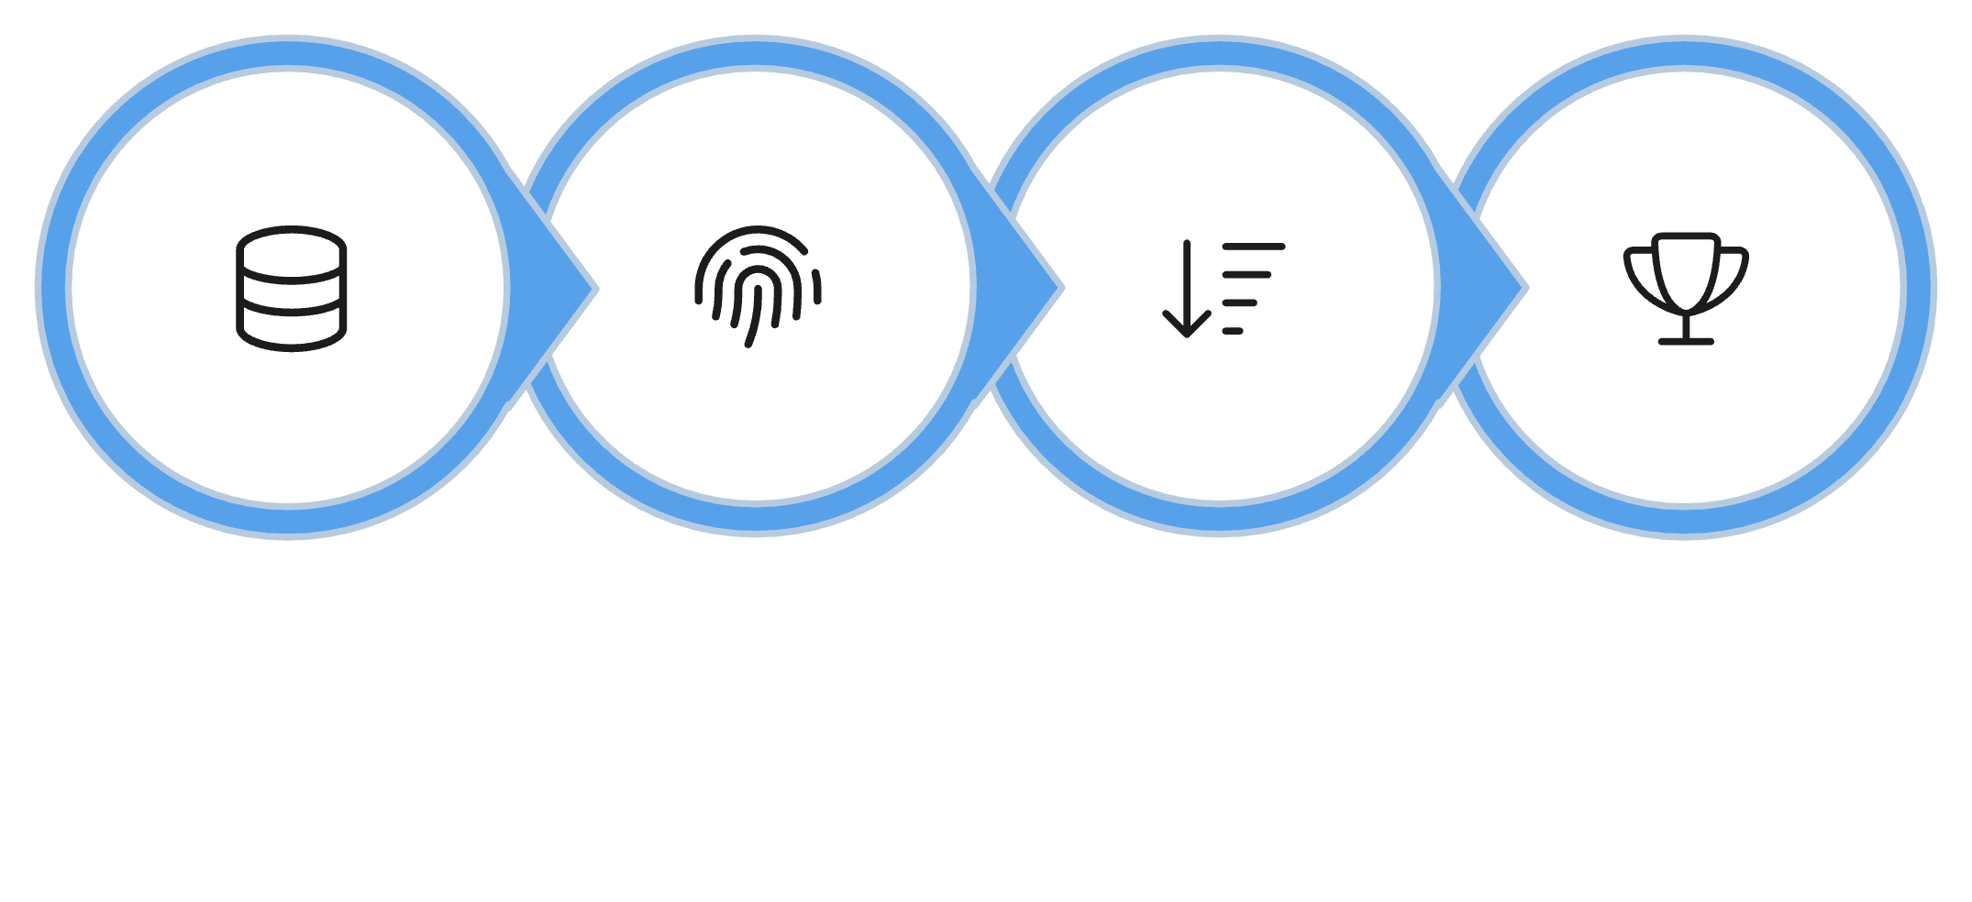
A vector database is a table and a loop
Store vectors, score similarity, sort, return the top
That is the entire mechanism
A real one adds an approximate neighbour index
That matters at a million rows, not fifty six
Store Vectors
Score Similarity
Sort Results
Return Top
MCCTC | AI Automation & Software Development
Notes:
This is the part people think is magic. It is not. You will write the whole thing in Week 12 in about eight lines over SQLite. What a real vector database adds is an index so it does not compare every row, and that starts to matter in the millions. It does not add meaning.

Slide 9

AI database is not a data model
Vector store
Relational with vectors
Stores and retrieves by embedding similarity
A relational database with vector column support
Feature store
Holds a model's training inputs
It usually means one of three different things. Ask which one. That question is the competency.
MCCTC | AI Automation & Software Development
Notes:
When somebody says AI database, they mean one of those three, and they often have not decided which. Asking is not being difficult, it is the skill. You will meet this in a Gate 2 in this module, in a document that gets several other things right.

Slide 10

The sentence to distrust
We should use NoSQL, it scales better and is more flexible
NoSQL is at least four unrelated models
Scales better than what, at what size
Flexible describes a cost as if it were a benefit
MCCTC | AI Automation & Software Development
Notes:
You will hear this sentence, from somebody who sounds like they know. Three problems. NoSQL names four different things. Better has no comparison and no number. And a store that accepts any shape accepts your typo too, which is exactly what Tuesday was about. Sometimes that is the right trade, and you say so out loud when you make it.

Slide 11

What you are about to build
Your project memo recommends one per workload
Every recommendation names a cost
One contested call, argued against yourself
Build two starts the comparison memo today
MCCTC | AI Automation & Software Development
Notes:
Build two is the start of the database comparison memo, which is due Friday of Week 11 and is the largest single piece of written work in this module. Four workloads, four recommendations, and every one of them names something it makes harder. A recommendation with no cost in it is a sales pitch and it scores like one.

