Slide 1

Calculated Fields, and Reports Somebody Will Act On

Slide 2


Nobody asked you for a database
The advisor asked two questions
She wants numbers she can put in front of a board
The database is how you get there
The report is the thing
MCCTC | AI Automation & Software Development
Notes:
Read the brief again. She never says database. She says which equipment is being used, and what has not come back, and I do not want a number I cannot explain. Everything you built this week exists to produce one page. Today is that page.

Slide 3
Three words in the competency
Calculated field
Function
Form
Worked out at query time, never stored
COUNT, SUM, AVG, ROUND, julianday, printf
One record, laid out for a person
All three come out of one database
MCCTC | AI Automation & Software Development
Notes:
A calculated field is a column that exists nowhere. It is worked out when the query runs from columns that are stored. That is why changing the rule means changing one query rather than reloading the data, and it is why the query is the documentation for the number.

Slide 4
The anatomy of one
ROUND(AVG(CASE WHEN l.returned_on IS NOT NULL
THEN julianday(l.returned_on) - julianday(l.checked_out_on)
END), 1) AS avg_days_out_returned
MCCTC | AI Automation & Software Development
Notes:
Four things at once. julianday turns a date string into a number so it can be subtracted, because SQLite has no date type. CASE with no ELSE returns null. AVG skips nulls. So this averages only the loans that came back, in one pass, without a second query.

Slide 5

Check one number by hand, first
fabrication: 9 returned loans
6 + 6 + 6 + 7 + 6 + 5 + 8 + 13 + 6 = 63
63 / 9 = 7.0
MCCTC | AI Automation & Software Development
Notes:
Nine loans came back, here are the nine durations, they add to sixty three, and sixty three over nine is seven point zero exactly. The query agrees. Do this before you write the query, not after. A calculated field checked against your own program's output only proves the program agrees with itself.

Slide 6



The pattern you will use most
SUM of CASE WHEN condition THEN 1 ELSE 0 END
Counts matching rows inside the same pass
Replaces running a second query and subtracting
Use 100.0 not 100, or you get zero
MCCTC | AI Automation & Software Development
Notes:
This one pattern gives you late returns, still out, overdue now, and the rate, all in the same statement. And write one hundred point zero, because two integers divided in SQLite give an integer. Fourteen over twenty four is zero. One point zero anywhere in the expression fixes it.

Slide 7
Round at the edge, never in the middle
printf formats the answer for a person
Rounding each row before adding is a wrong total
And the wrongness is untraceable
The date is a parameter, not the clock
MCCTC | AI Automation & Software Development
Notes:
Round for display, not while you are calculating. And overdue is a claim about a moment, so the as of date is an input. With the clock in the query the same command gives two answers on two days, no test can check a number, and a number you showed somebody last week cannot be reproduced.

Slide 8


Trap one, the row that is not a row
robotics loans 3 still out 3 value out $754.75
A category with no returned loans still appears as a row. The average days out is null, not zero.
MCCTC | AI Automation & Software Development
Notes:
Robotics has three loans and two of them are still out. The report says three, and seven hundred and fifty four dollars out the door instead of six hundred and fifty eight. There is a piece of equipment nobody has ever borrowed, and the LEFT JOIN made it a row with every loan column null, so returned is null was true for a thing sitting on a shelf.

Slide 9
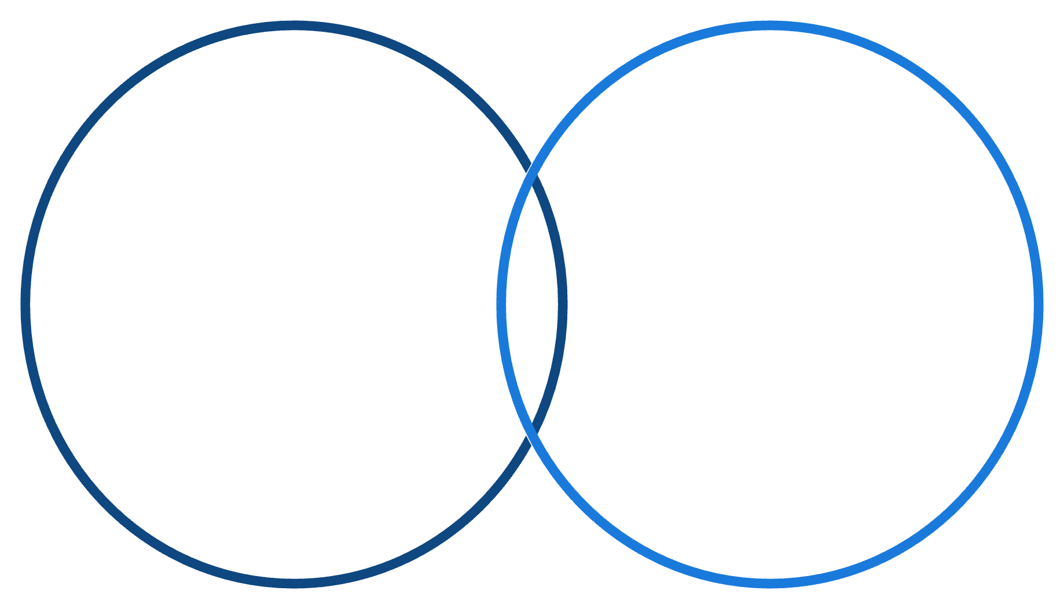
COUNT star counts rows, COUNT column counts values
SUM(CASE WHEN l.loan_id IS NOT NULL
AND l.returned_on IS NULL THEN 1 ELSE 0 END) AS still_out
COUNT(column)
COUNT(*)
Counts every row, includes NULLs
Counts only non-NULL values
MCCTC | AI Automation & Software Development
Notes:
They are the same number until a LEFT JOIN produces a row with no values in it. Guard on the loan's own key and the number goes back to two. This exact defect is in one of the labs this week and in a Gate 2, because it produces a wrong number and no error, which is the shape of the whole module.

Slide 10

Trap two, the guard the formatter undoes
printf of a null
ROUND of a null
Prints 0.00 in SQLite
Stays null
One over zero
A ratio of zero
Is null, not an error
Is a claim, not an absence
MCCTC | AI Automation & Software Development
Notes:
You guard a division with NULLIF, you get a proper null, and then printf turns it back into a number that looks real. A kill to death ratio of zero point zero zero says this player plays and never scores. Every step between the data and the page is a place a null can become a number.

Slide 11

What you are about to build
01
Four queries and a one record form
02
Column names come from the query itself
03
Both traps spring on you in steps seven and eight
04
Lab M04-04, and step one is arithmetic on paper
MCCTC | AI Automation & Software Development
Notes:
Build one is lab M zero four dash zero four. Four calculated field queries against the esports database, plus a player record form. Step one is adding up three rows on paper, and it is the step people skip. Steps seven and eight are the two traps, and I am not telling you what happens.

