Slide 1

Migration, and How to Find Out What You Lost

Slide 2

Thirty three rows out, thirty three rows back
The row count matches exactly
The migration lost four things
Nothing in the file says so
This is the check most people run
MCCTC | AI Automation & Software Development
Notes:
Here is an export of the makerspace loans. Thirty three rows went out and thirty three came back, so the migration is fine. It is not fine. It lost two catalog items, a member, every tag relationship, and every quarantined row. A row count is the check that passes.

Slide 3


Convert is half the job
Every format holds some of what a database holds
The rest disappears with no error
So export, then load it back, then compare
Nobody skips the first half
MCCTC | AI Automation & Software Development
Notes:
Migrate the data to a new format sounds like a file operation. It is not. Each format can say some things and not others, and the things it cannot say vanish quietly. The half everybody does is the export. The half that is graded is loading it back and counting what came home.

Slide 4
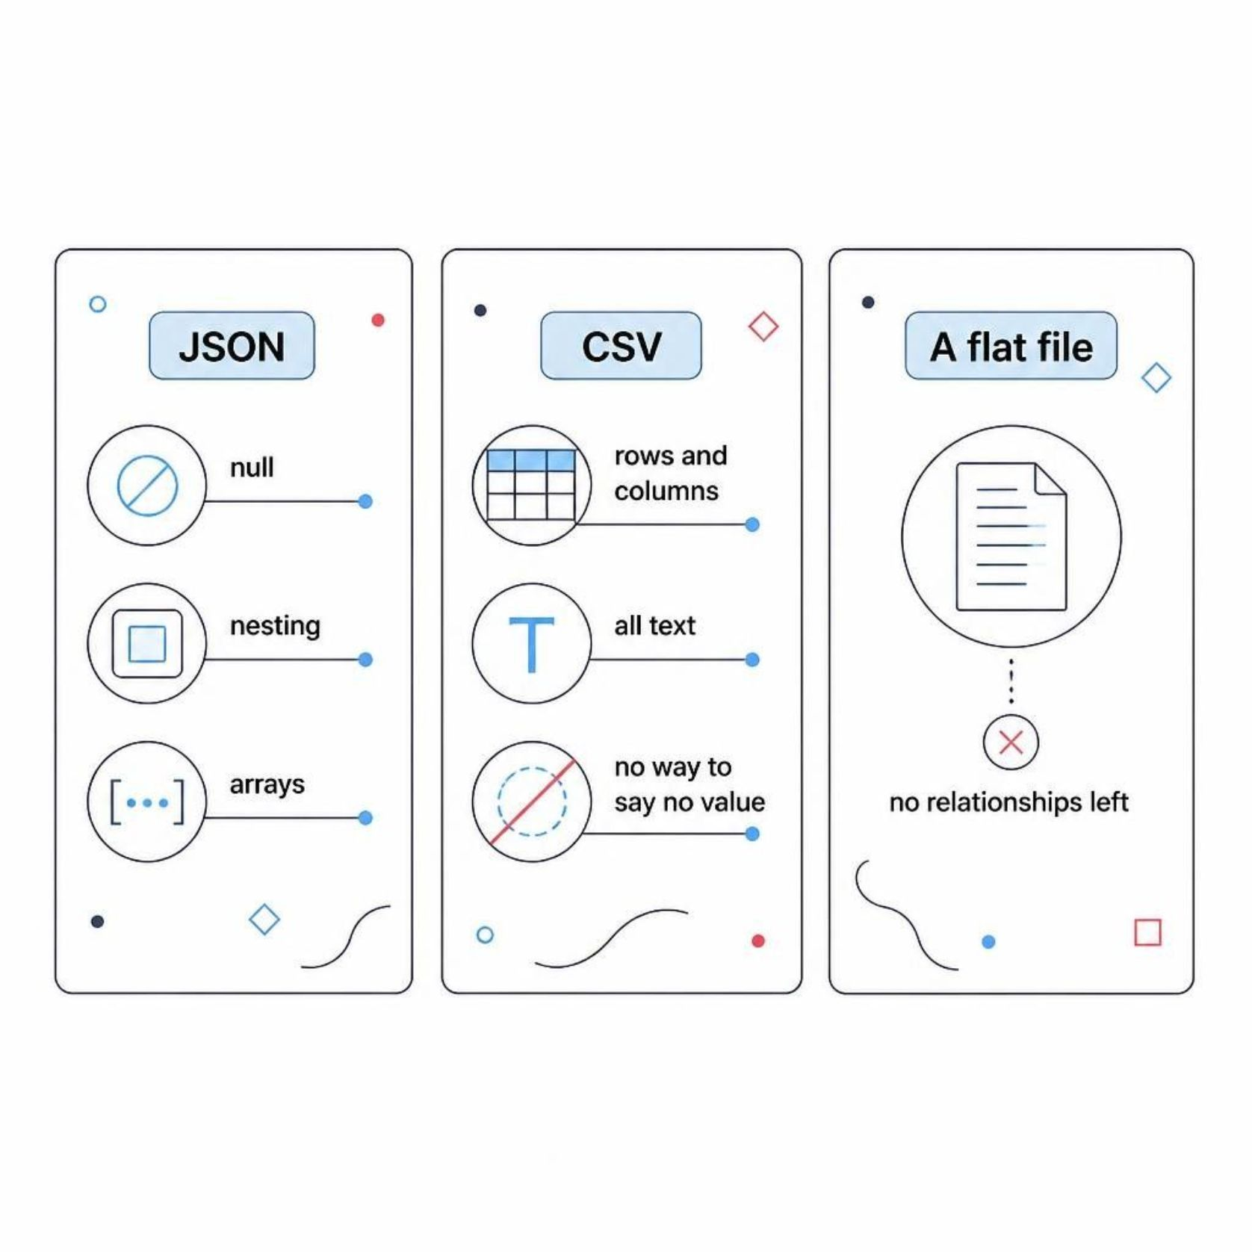

What each format can actually say
JSON
Has null, nesting, and arrays
CSV
Has rows and columns and all text
Has no way at all to say no value
Flat file
Has no relationships left
MCCTC | AI Automation & Software Development
Notes:
The column that decides most arguments is the null column. In a CSV, a field that is empty and a field whose value is unknown are the same thing: nothing at all. And the seven loans that have not come back are exactly the rows that difference matters for.

Slide 5

JSON round trips exactly
json
members 14 14 ce94ac920c46 -> ce94ac920c46 yes
loans 33 33 1f8b3a7fc2b3 -> 1f8b3a7fc2b3 yes
round trip: exact
Round trip: exact
MCCTC | AI Automation & Software Development
Notes:
A fingerprint is a hash of every row, sorted, with null hashed as something the empty string cannot produce. Same rows, same fingerprint, both ways. JSON has null natively, so nothing had to be agreed in advance and nothing was lost.

Slide 6

One CSV per table, with a convention
csv-tables, sentinel honoured round trip: exact
csv-tables, importer that never read the note
members 14 14 ce94ac920c46 -> 1861c72a06a2 NO
loans 33 33 1f8b3a7fc2b3 -> 11219c45bc75 NO
When the importer ignores the sentinel, hashes diverge on both tables.
MCCTC | AI Automation & Software Development
Notes:
Same export both times. The only difference is whether the importer knew that backslash N means null. Read the row counts on the failing lines: fourteen out, fourteen back, thirty three out, thirty three back. Every row is there and two tables are different.

Slide 7

Seven loans were still out. Now none are.
Sentinel loaded as data, not as null
returned_on is now the two characters backslash N
The count of rows is perfect
The meaning of two tables is gone
MCCTC | AI Automation & Software Development
Notes:
Seven pieces of equipment have not come back, and the new database believes every item is on the shelf. The convention was written down, in a file next to the export, and an importer that did not read it produced a database that passes every count and answers one question wrongly.

Slide 8



The flat export, and what it costs
A member with no loan is not in the file
Two items nobody borrowed are not in the file
Thirty tag links became text in one column
Six quarantined rows have nowhere to go
MCCTC | AI Automation & Software Development
Notes:
A flat export is a join, and a join produces rows where the join matches. Somebody who has never borrowed anything matches nothing, so they are not there. Nothing was deleted. The row was never eligible, and that is the first thing to check when a count comes out short: ask whether the export was a join.

Slide 9

The check that looks like proof
before = connection.execute("SELECT COUNT(*) FROM loans").fetchone()[0]
after = len(list(csv.DictReader(open("loans_flat.csv"))))
print("migration ok" if before == after else "MISMATCH")
migration ok
The row count matches. The data loss is invisible to this check.
MCCTC | AI Automation & Software Development
Notes:
Every claim in that output is true, and the migration lost four things. A row count proves exactly one thing: that no row of the one table you counted went missing. It says nothing about columns, nothing about nulls, and nothing about the tables you did not export.

Slide 10


Preserve, convert, migrate are three words
Preserve
Convert
Keeps the original so mistakes are recoverable
Produces the same data elsewhere
Migrate
Means the old system stops being updated
Never migrate without a round trip.
MCCTC | AI Automation & Software Development
Notes:
Your raw folder is preservation, and that is why the rule is never to edit it. Migration is the risky one, because after a migration the thing you lost is gone rather than merely absent from a copy. Convert, load back, compare, and only then stop writing to the old system.

Slide 11

What you are about to build
01
Two export formats from your own database
02
Load both back into a fresh empty schema
03
Compare table by table, not by row count
04
At least one format must lose something, and you say what
MCCTC | AI Automation & Software Development
Notes:
Build two is the migration stage of your project, and the requirement is not only to export. Load it back into a database built from the same schema file and compare each table. At least one of your formats has to lose something, and the README has to say exactly what and why. That is the graded part.

