Slide 1

Protecting Data You Hold, and Saying Only What Is True

Slide 2

Your report names five people
Every other section is counts and totals
Section four is five names and something unflattering
The handbook says board reports carry no names
So that section must not leave the room
MCCTC | AI Automation & Software Development
Notes:
Here is section four of the report you are building. It names five members and says each of them has not returned something. Every other section on that page names nobody. Your own handbook says the board report carries counts and no names. So you have built something correct that must not be pasted into an email.

Slide 3


The sentence to learn to distrust
The data is encrypted
So member records are protected
And access control is handled
Three claims, one true
MCCTC | AI Automation & Software Development
Notes:
You will meet this sentence next week in a Gate 2, in a document that gets several other things right. Three claims in one sentence. The first is true. The second is much weaker than it sounds. The third has not been addressed at all, and it is the only one that affects section four.

Slide 4
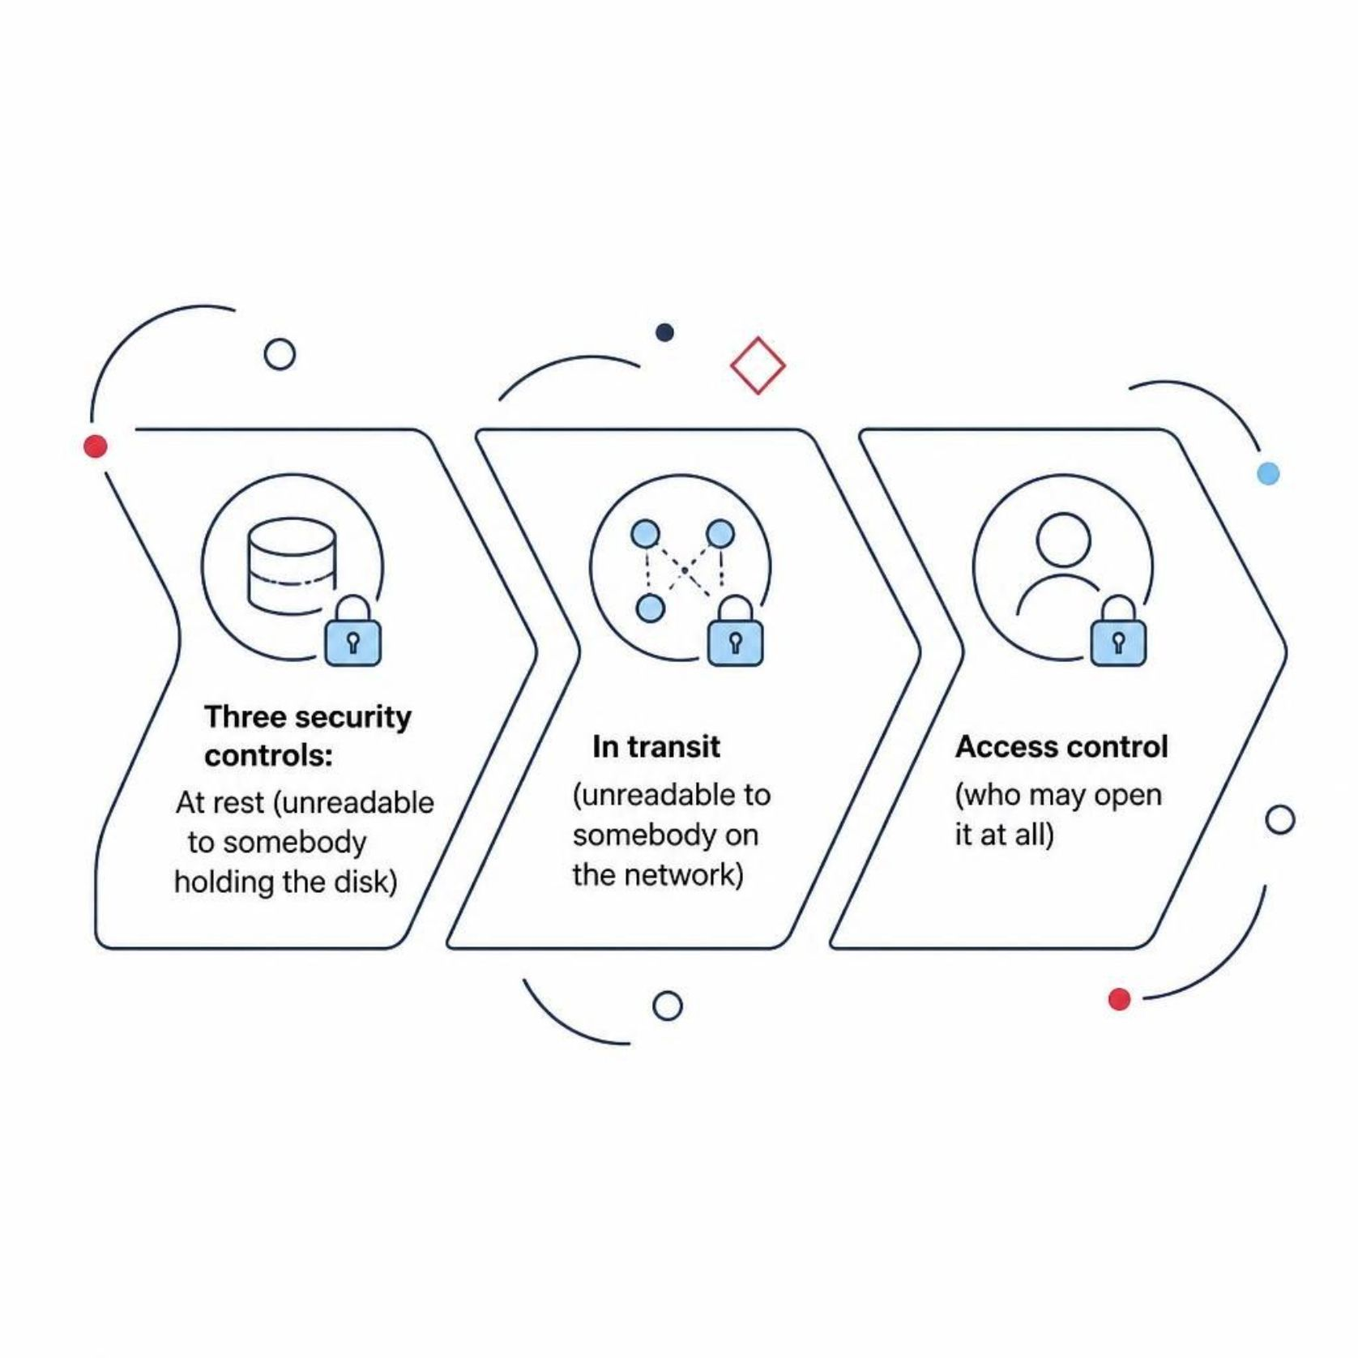

Three controls, three questions
1
At rest
Unreadable to somebody holding the disk
2
In transit
Unreadable to somebody on the network
3
Access control
Who may open it at all
The file decrypts automatically for anybody signed in
MCCTC | AI Automation & Software Development
Notes:
Encryption at rest protects a stolen laptop. It does nothing about the twelve people who can already open that shared folder, because for them the file decrypts automatically. That is what at rest means. And encryption is not access control. They are different controls answering different questions.

Slide 5


CIA, and the trade inside it
Confidentiality
Integrity
Only the right people can read it
It is correct and unchanged
Availability
It is there when somebody needs it
The strongest confidentiality control is deletion
MCCTC | AI Automation & Software Development
Notes:
Everything in this module so far has been integrity: keys, constraints, transactions, quarantine, fidelity. Today is mostly confidentiality. And notice they trade: the very strongest confidentiality control is to delete the data, and that is also the worst possible thing for availability.

Slide 6


Go and find grade_level in your report
It is in your members table
The report never uses it
It was there because it was in the source file
A field you never read is pure cost
MCCTC | AI Automation & Software Development
Notes:
Look for it. It is not there. It is in your schema because it was in the file you were given, and that is the most common reason a field exists anywhere. It can be leaked, it can be wrong, it can be used later for something nobody agreed to, and it protects nothing.

Slide 7


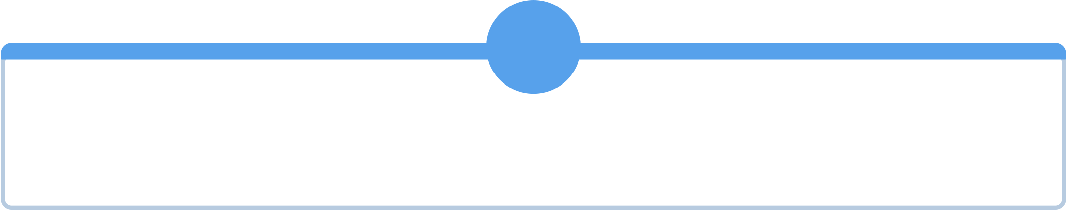

Three questions for every column
1
2
What question does this answer
What is the worst thing somebody could do with it
3
How long does it have to exist
If you cannot name the question, remove the column
MCCTC | AI Automation & Software Development
Notes:
Three questions, and they go in your data protection document. The makerspace's own privacy page says every field had to earn its place by answering a question the makerspace actually has to answer. That is minimisation, and it is cheaper than every control you would otherwise need.

Slide 8



FERPA, at the level this course teaches
These records are the shape of a student record
The framework exists to say who may see it
This course states no threshold and gives no advice
The skill is knowing who to ask, with a list
MCCTC | AI Automation & Software Development
Notes:
Your fixture is invented so you can practise this analysis without holding anybody's record. Understand what the framework is for. Do not state a threshold or a penalty, and do not tell anybody their system is compliant. A developer who says I do not know, here is my field list, and here is who has to look at it, is the useful one.

Slide 9
Verify means a command, not a tick
PRAGMA foreign_keys -> (1,)
rows read = loaded + quarantined
scan every source file for credentials
MCCTC | AI Automation & Software Development
Notes:
The competency says verify compliance, not assume it. Verification is a check somebody else could repeat. A checklist somebody ticked is not verification. A command anybody can run is, and so is a test that fails when the claim stops being true.

Slide 10
Here is security theatre
encoded = base64.b64encode(open("makerspace.db", "rb").read())
print("Database encrypted.")
b'SQLite format 3\x00'
MCCTC | AI Automation & Software Development
Notes:
The program says encrypted. The second line is what comes back out with one call and no key. Base sixty four is an encoding, not a cipher. It exists to move binary through text channels. The output is unreadable, so it looks protected, and the word encoded is one letter away from the word people mean.

Slide 11

What you are about to build
01
data-protection.md, half a page, in your project
02
What this data would be if it were real
03
Which fields you would not collect
04
Who sees the section that names people, and who to ask
MCCTC | AI Automation & Software Development
Notes:
Build two starts the data protection document for your project. Half a page. What this dataset would be if it were real, which fields you would not collect, who should see section four of your report, and what you would have to ask and of whom before this ran on real students. No legal thresholds and no advice.

