Slide 1

Three Ways to Import, and Why You Stage First

Slide 2

Thirty eight of thirty nine loans have no member
The query is correct
The count is reproducible
The member file has all fourteen of them
Nothing is broken
MCCTC | AI Automation & Software Development
Notes:
Here is a real result from your fixture. Thirty eight of thirty nine loans point at a member who does not exist. Every one of those numbers is true, the query is right, and the member file is fine. Work out what happened and you have understood today.

Slide 3


The two files write the same id differently
A join compares values, not meanings
Loans file
Member file
RC-0142
RC0142
Two spellings are two values
MCCTC | AI Automation & Software Development
Notes:
One hyphen. That is the whole thing. A join compares characters, and two values that mean the same person and are written differently are two different values. SQL will tell you so with a completely straight face, and the number it gives you will be correct and useless.

Slide 4

Normalize both sides and ask again
Orphan members, raw text join 38
Orphan members, both sides normalized 1 RC-0199
MCCTC | AI Automation & Software Development
Notes:
One. There really is one loan pointing at a member who is in no source, and that is a row somebody has to go and ask about. The other thirty seven were a question nobody meant to ask. This pair of queries is the reason staging is worth a whole lesson.

Slide 5
A staging table is a photograph
CREATE TABLE stg_loans (
source_row INTEGER NOT NULL,
loan_id TEXT, member_id TEXT, item_id TEXT,
checked_out TEXT, due TEXT, returned TEXT, notes TEXT
);
MCCTC | AI Automation & Software Development
Notes:
Every column is TEXT and nothing is converted. Int of eleven and int of space eleven space are both eleven, and one of them was telling you a volunteer typed a space. The moment you convert you have thrown the evidence away. And every row carries its line number, so a problem can be handed to a person with a place to look.

Slide 6

Route one, the bulk command
01
executemany, one call, many rows
02
Statement prepared once and reused
03
Values travel separately from the SQL
04
That second property is why it is the default
MCCTC | AI Automation & Software Development
Notes:
This is the one you use unless you have a reason not to. Fast because the statement is prepared once. Safe because nothing in a value can ever be read as SQL, since the value never touches the statement. That is not a bonus feature, it is the whole argument.

Slide 7
Route two, the generated SQL script
INSERT INTO stg_members (source_row, member_id, full_name, grade_level, program, joined)
VALUES (4, 'RC0142', 'Amara Delgado', '11', 'Engineering Technology', '09/02/2026');
MCCTC | AI Automation & Software Development
Notes:
A text file full of statements, run all at once. People do this when the database is on another machine, or when the load has to be checked into a repository and reviewed like code. A dot sql file is portable in a way a Python program is not.

Slide 8



And here is what it costs you
Every value has to be escaped, by you, every time
This fixture has no apostrophe in any name
So your bug will not show up today
It shows up when O'Brien joins
MCCTC | AI Automation & Software Development
Notes:
One doubled quote character is the only thing between you and a broken load. Forget it and the first name with an apostrophe ends the SQL string early. Nobody in this fixture has one, which is exactly why this is dangerous: the bug ships, works for months, and fails in front of somebody waiting for a report.

Slide 9
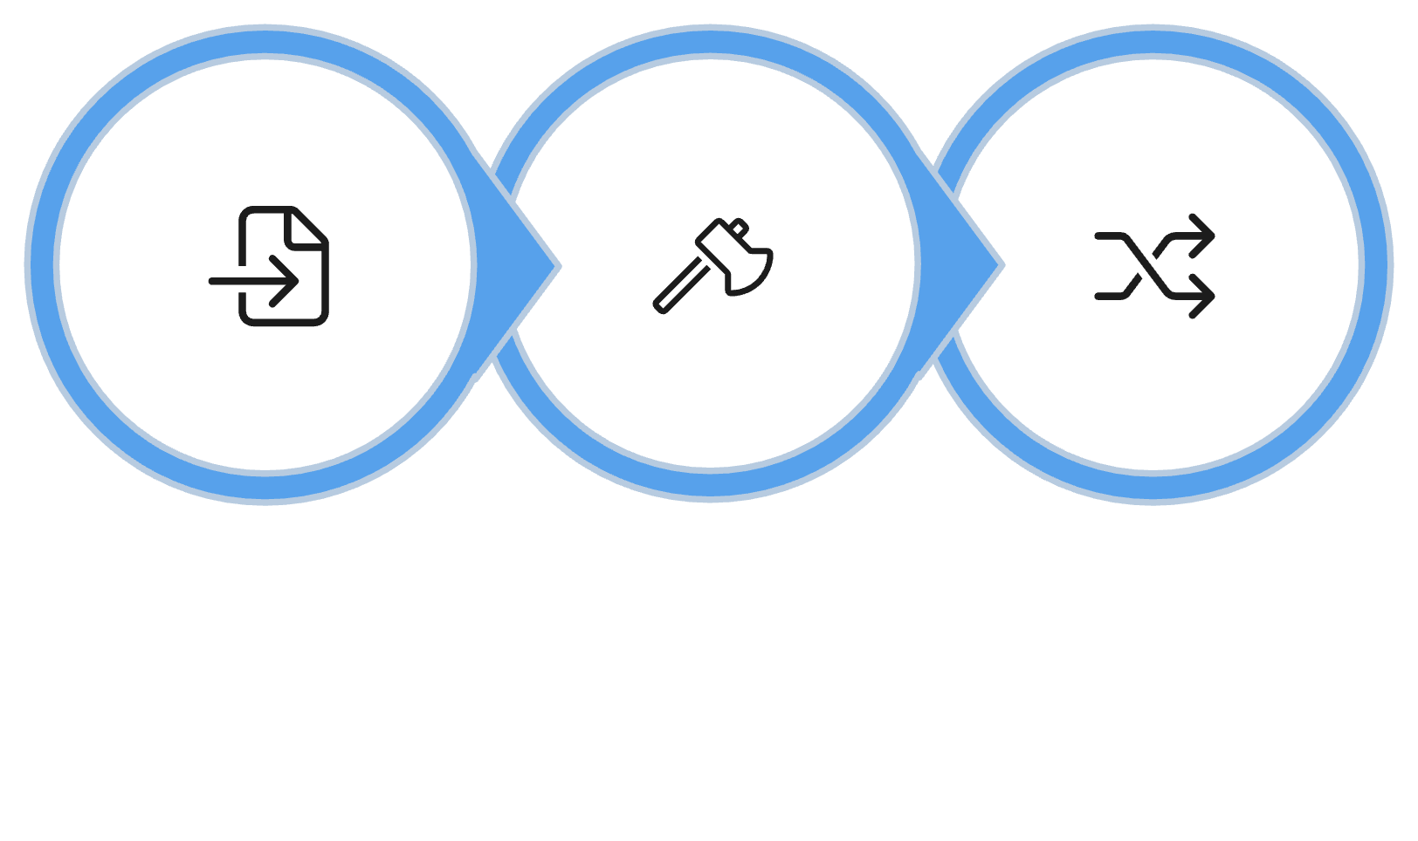
Route three is always the first half
json, csv, or your own parser
Then route one or route two
The file is never already SQL
Parse File
Route One
Route Two
Keep the nesting as it arrived for now
MCCTC | AI Automation & Software Development
Notes:
Reading the format is not an alternative to the other two, it is the first half of both. And notice what staging does with the tags array: it joins it into a string, which is the opposite of what Tuesday of Week 10 told you. That is on purpose. Splitting it is a schema decision and decisions come later.

Slide 10
The byte order mark, which costs everybody once
'﻿loan_id'
KeyError: 'loan_id'
MCCTC | AI Automation & Software Development
Notes:
Three invisible bytes a spreadsheet writes at the front of the file. Your first column is not called loan id, and the error points at a line that reads perfectly. The fix is encoding utf dash eight dash sig, and strip does not remove it, because as far as Python is concerned it is not whitespace.

Slide 11

What you are about to build
Lab M04-03
Fourteen questions
Three importers, one staging database
Asked of the data
Nine you write
Answers go into your project README
MCCTC | AI Automation & Software Development
Notes:
Build one is lab M zero four dash zero three. Two of the three importers are yours to write. Then you write nine profiling questions, and questions eight and nine are the pair you watched a moment ago. What you find today is the Measure step of your project and it is due at the end of build two.

