Slide 1
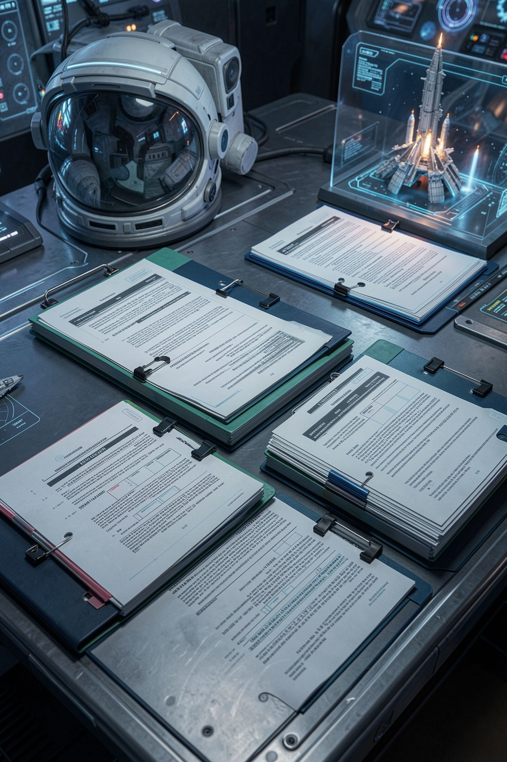
Chunking: Deciding What a Piece of a Document Is

Slide 2
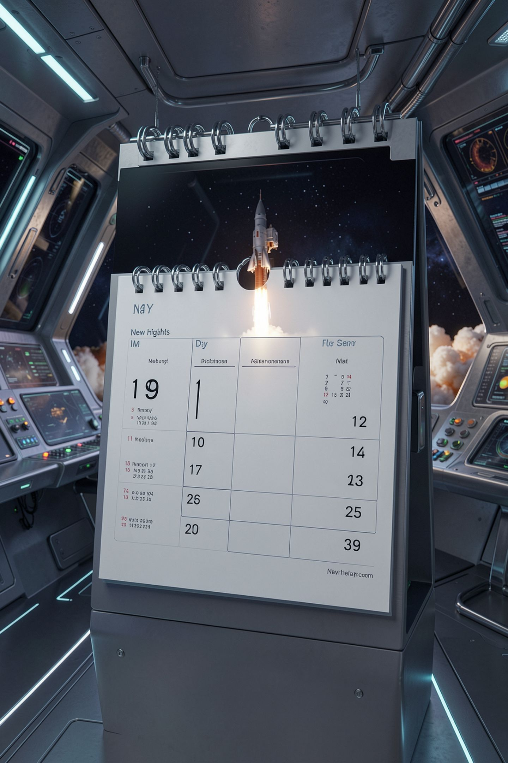

Five days
That is a true sentence from your handbook
It is also useless
Five days of what
A chunk that is too small stops being an answer
MCCTC | AI Automation & Software Development
Notes:
Five days. True, it is in the handbook, and it answers nothing, because the chunk no longer says five days of what. Now imagine the opposite mistake and you have both failure modes of today's lesson before we have written a line.

Slide 3
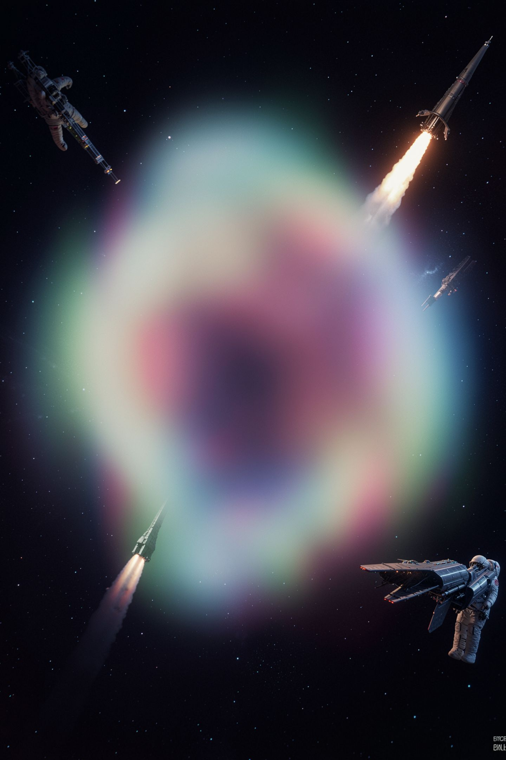
The other way to get it wrong
A whole document is one vector
That vector averages everything in the document
Hours, guests, glasses, training, damage, fire
It comes back for every question, which is none
MCCTC | AI Automation & Software Development
Notes:
Embed a whole document and its vector is an average of everything in it. The access and safety document covers six unrelated things, so it is not strongly about any of them. A chunk that comes back for every question is the same as a chunk that comes back for none.

Slide 4
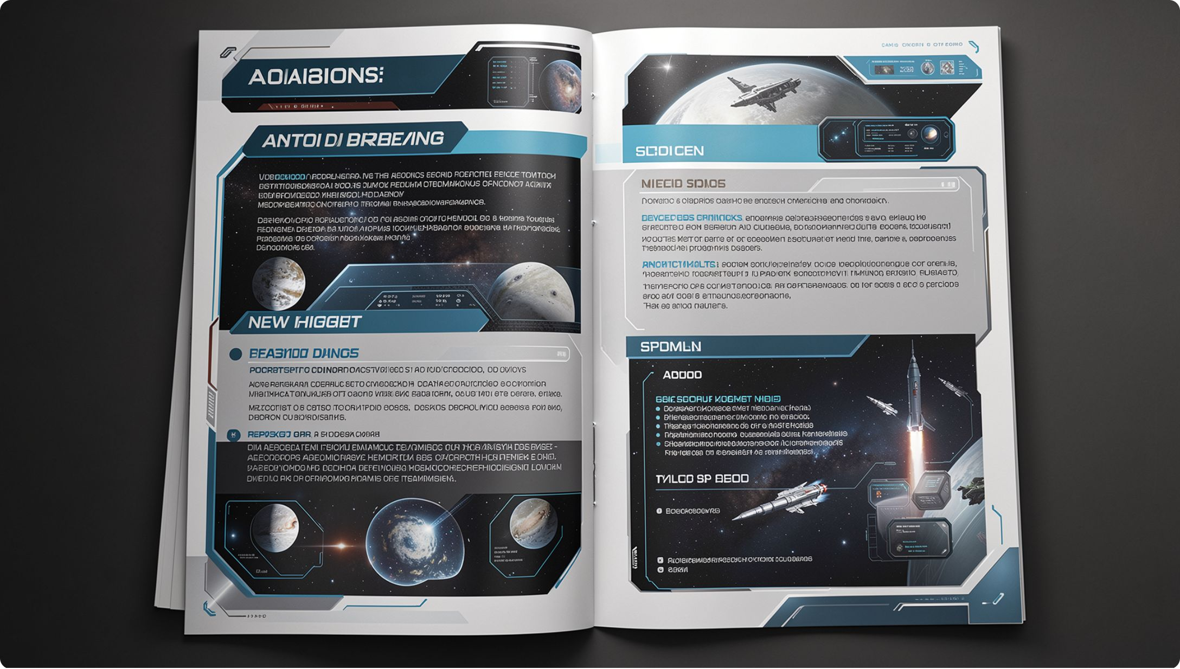
Split on headings first
1
A heading is a boundary somebody already chose
2
They knew the content when they chose it
3
Then split any section that is still too long
4
Never in the middle of a word
MCCTC | AI Automation & Software Development
Notes:
Somebody who understood this material already decided where the topics change, and they wrote it down as headings. Use that. Then cut anything still too long at a blank line, a sentence end, or a space, and repeat some characters at the seam so a cut sentence survives whole in one of the two pieces.

Slide 5
Fifty six chunks, eight documents
documents 8
chunks 56
shortest 76 characters
longest 608 characters
average 267 characters
8
56
267
Documents
Chunks
Avg Characters
MCCTC | AI Automation & Software Development
Notes:
That is the real output for your handbook with a nine hundred character maximum and a hundred and twenty character overlap. Look at the longest chunk. Six hundred and eight. Hold that number for the next slide.

Slide 6
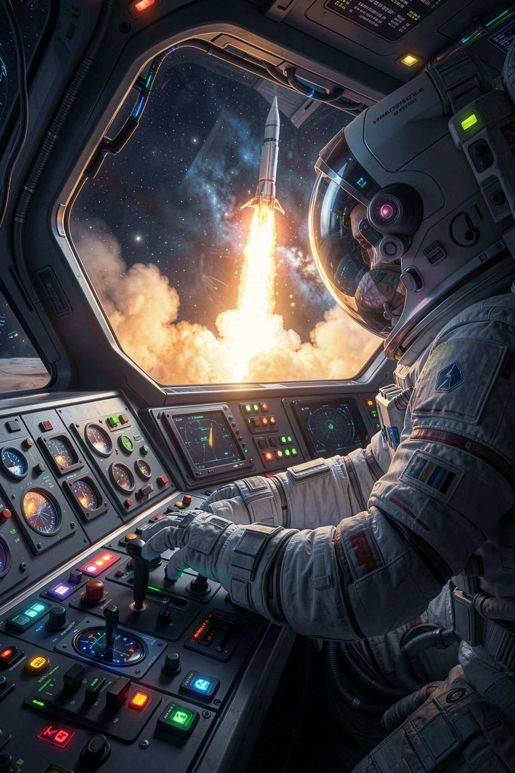
Now turn the lever
--max-characters 900 --overlap 120 56 chunks
--max-characters 250 --overlap 30 79 chunks
--no-headings 22 chunks
--max-characters 5000 --overlap 0 56 chunks
MCCTC | AI Automation & Software Development
Notes:
Read the last line. I raised the maximum from nine hundred to five thousand and nothing moved, because no section of this handbook is nine hundred characters long. For this corpus the length limit is a safety net that never catches anything. The heading rule is the chunking strategy.

Slide 7



A parameter you did not measure
Somebody will say 512 tokens with 64 overlap
They will call it the industry standard
Ask what it does to your documents
Finding out takes one command
MCCTC | AI Automation & Software Development
Notes:
You will hear that number. It is not wrong exactly, it is unmeasured, and on this corpus it would do nothing at all. There is no standards body for chunk size. The command that settles it for your documents takes four seconds and you now know how to run it.

Slide 8
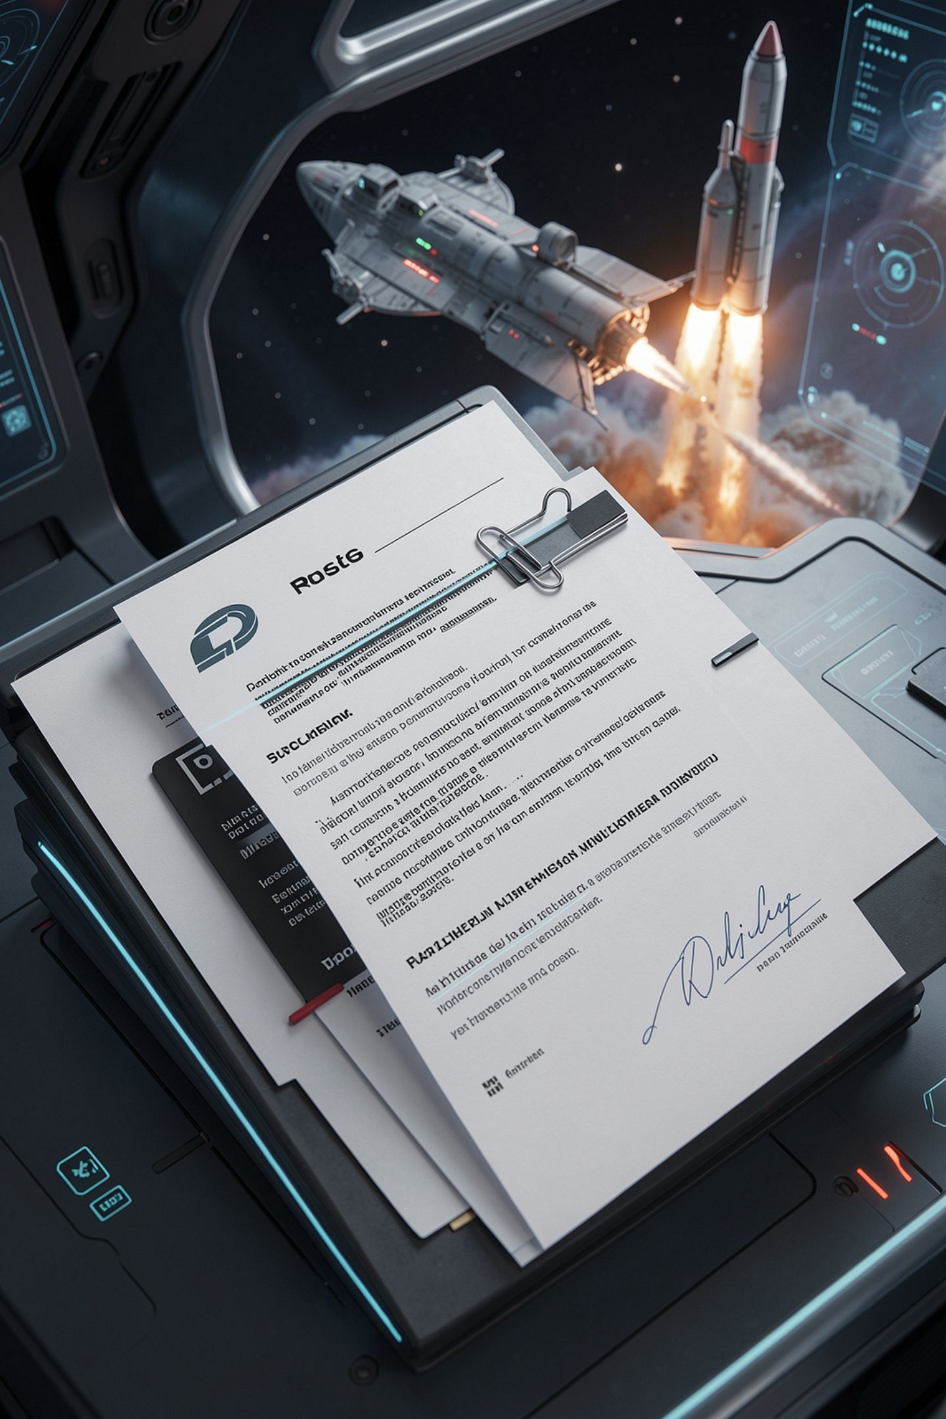
Here is a rule with a cost
Loan length
A thirty two character section
Too short
Too short to stand alone
Attaches
So it attaches to the chunk before it
Which is
Which is about contents cards
MCCTC | AI Automation & Software Development
Notes:
A section that short is the five days problem, so the chunker attaches it to the previous chunk rather than storing a stub. Defensible rule. And now the answer to how long can I keep a camera kit is filed under a heading about contents cards, and you would never find that out unless you read your own chunks.

Slide 9
What a chunk has to carry
{"doc_id": "05-media-kits.md", "heading": "Memory cards",
"ordinal": 3, "char_start": 717, "char_end": 925,
"text": "05-media-kits.md . Memory cards\n\nThe card in the kit is a lab card. ..."}
MCCTC | AI Automation & Software Development
Notes:
Two things in there are not obvious. The heading is repeated inside the text, because the embedding only ever sees the text, and a chunk whose heading is missing from it has thrown away its strongest clue. And the offsets point at the real file, which is how any hit gets traced back to a line somebody wrote.

Slide 10
The four line version, and its output
0 '# Ridge Creek Makerspace: Loan Policy\n\nInvented sample docum'
2 'ut.\n\n## Late items\n\nAn item is late when the current date is'
MCCTC | AI Automation & Software Development
Notes:
This is text sliced every five hundred characters. Chunk two starts with u t full stop, which is the tail of the word out. The word is split across two pieces and the sentence is whole in neither. No heading, no offsets, no document id. It never crashes, which is why people ship it.

Slide 11
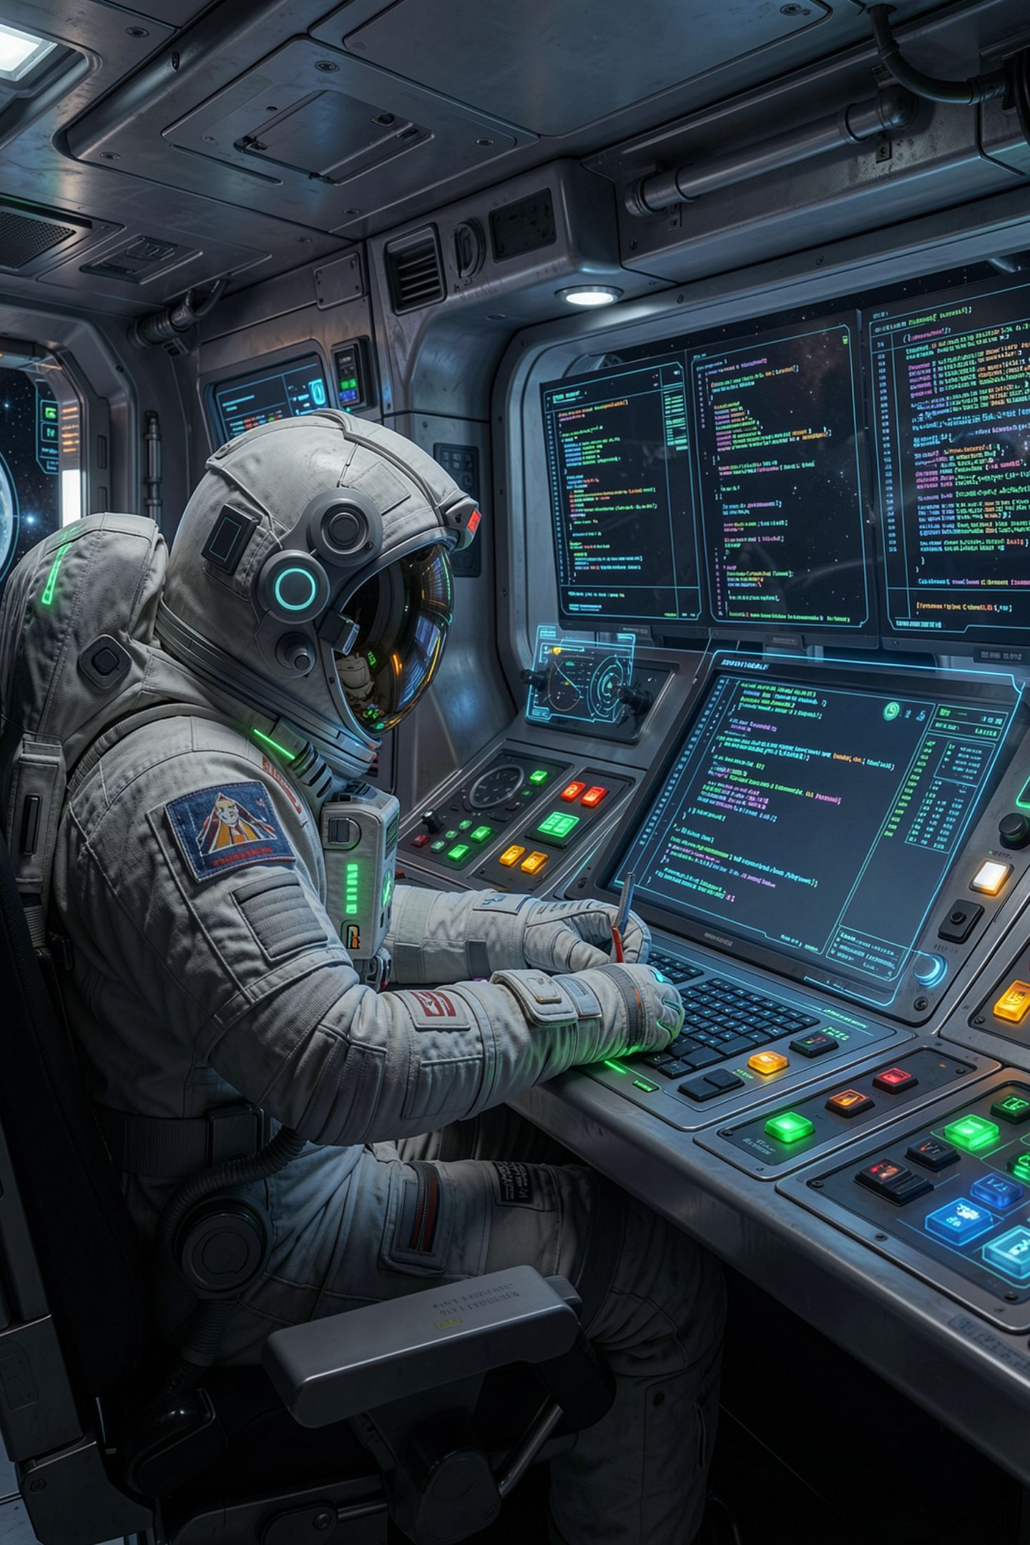
What you are about to build
01
Part one of lab M04-05, no model needed today
02
Write chunk_text, then read your own chunks
03
Run three settings and find the lever that matters
04
Then write down the boundary rule and why
MCCTC | AI Automation & Software Development
Notes:
Build one is part one of the retrieval lab and it needs no embeddings endpoint at all. You write the chunker, then you read the chunks you produced, out loud in your head, and find one that cannot answer a question on its own. Then three settings and a paragraph about which lever actually moved anything.

