Slide 1

Retrieval Versus Fine Tuning

Slide 2

The advisor said one sentence
I would like to be able to point at the paragraph
One approach can do that
The other one cannot, ever
That is most of today in one line
MCCTC | AI Automation & Software Development
Notes:
Go back and read the brief. She did not ask for an assistant, she asked to be able to point at the paragraph. One of the two approaches we are comparing hands you a file name, a heading, and a character range. The other hands you a sentence with no source. Hold that while we do the other three arguments.

Slide 3
Two routes, and one of them is not what you think
Fine Tuning
Retrieval
Changes the model's weights
Does not touch the model at all
Prompting
Retrieval Again
Pasting context in by hand
Prompting with the pasting automated
MCCTC | AI Automation & Software Development
Notes:
Three things and people mix up two of them. Fine tuning is the only one that changes the model. Retrieval finds the relevant pieces at question time and puts them in the prompt, which is prompting with the choosing automated. Getting that distinction right is worth marks on its own.

Slide 4

Cost, honestly
Retrieval is a file and a loop, per query, forever
Fine tuning is hardware, a training set, and a specialist
And again every time the material changes
The costs are shaped differently, not only bigger
MCCTC | AI Automation & Software Development
Notes:
Do not say fine tuning is expensive and stop. Say the costs are shaped differently. Retrieval costs a little on every query forever. Fine tuning costs a lot once and little per query. At enormous query volume over material that never changes, that trade can actually go the other way.

Slide 5

Freshness decides most real cases
Change the policy, rebuild the index, done
A fine tuned model still believes the old policy
Confidently, with no version number to check
Until somebody retrains it
MCCTC | AI Automation & Software Development
Notes:
This is the boring argument that wins. Handbooks change, policies change, prices change. There is no way to look at a model and tell which version of a fact is inside it. A system that is wrong until the next training run is a system that is wrong, and nobody can tell by looking.

Slide 6
Traceability, on screen
4. score +0.3123 07-electronics-bench.md . How many at once characters 483-668
You may sign out up to three items from the electronics bench at one time...
MCCTC | AI Automation & Software Development
Notes:
A file name, a heading, and a character range. Somebody who knows the handbook checks that in ten seconds. And there is a second thing it buys: when the answer is wrong you can tell whether the retrieval went wrong or the source was wrong, and those have different fixes. With fine tuning they are the same indistinguishable failure.

Slide 7
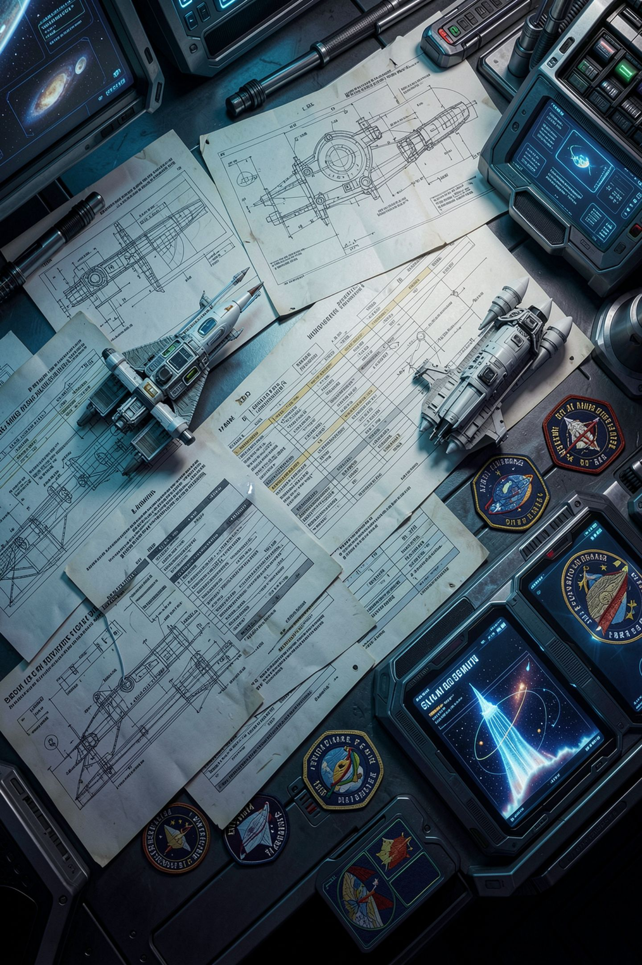
And the fourth section
It retrieves what is near, not what is true
It inherits every contradiction in your sources
It cannot answer what no passage contains
The chunking already decided what is answerable
MCCTC | AI Automation & Software Development
Notes:
An argument with no fourth section is a sales pitch. Anybody can say cheap, fresh, traceable. The person worth listening to says what it still gets wrong, specifically, and tomorrow is a whole lesson on it. For today, know the four so you can write the memo.

Slide 8

Where fine tuning actually wins
Teaching behaviour, not facts
Always answer in this format, this tone
Refuse this kind of request, sound like our team
None of that is a passage you can retrieve
MCCTC | AI Automation & Software Development
Notes:
Be able to say this, because a memo claiming retrieval is always better is not an analysis. Format, tone, refusals, vocabulary: those are behaviour, and they are not written down anywhere as a passage. The usual real answer is both, a model fine tuned for the shape and the facts retrieved at question time.

Slide 9

The sentence in a plan you should push back on
We will fine tune a model on the handbook
Eight documents is not a training set
The first policy change makes it wrong, silently
And you threw away the citation she asked for
MCCTC | AI Automation & Software Development
Notes:
You will read this in a plan. It sounds more serious than we chunked the handbook, and it is more work. More work is not a better answer. The most likely outcome of fine tuning on eight documents is a model that sounds like the handbook and makes up its contents.

Slide 10
One table to carry out of here
 | retrieval | fine tuning
changes the model | no | yes
material changes | rebuild index | retrain
can cite a source | yes, exactly | no
teaches format | poorly | well
MCCTC | AI Automation & Software Development
Notes:
Four rows, and you should be able to reproduce them from memory in the exit assessment. The two that decide most arguments are the middle two. The bottom one is the one that stops your memo being a sales pitch.

Slide 11

What you are about to build
The retrieval versus fine tuning section of your memo
All four points, specific, not generic
Name a failure in the actual handbook
Your search results from yesterday are the evidence
MCCTC | AI Automation & Software Development
Notes:
Build two is the memo section that carries ten of its fifty marks. All four points. The fourth one has to name a failure you can point at in the Ridge Creek handbook, not a generic sentence about retrieval being imperfect. You ran the queries yesterday. The evidence is already in your README.

