Slide 1
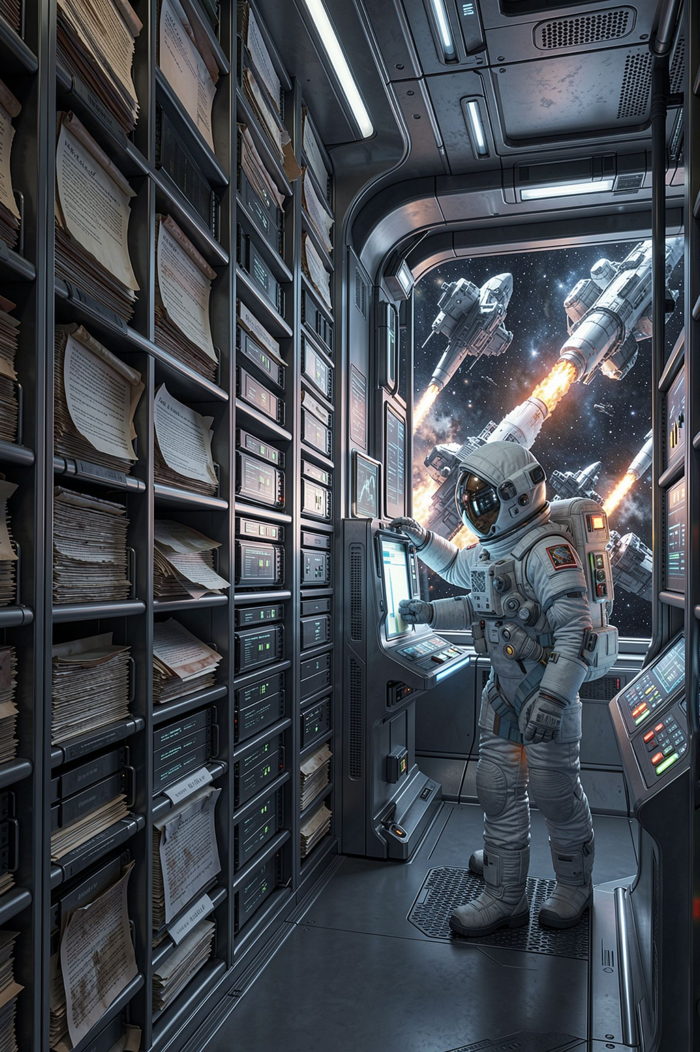
What Retrieval Still Gets Wrong

Slide 2
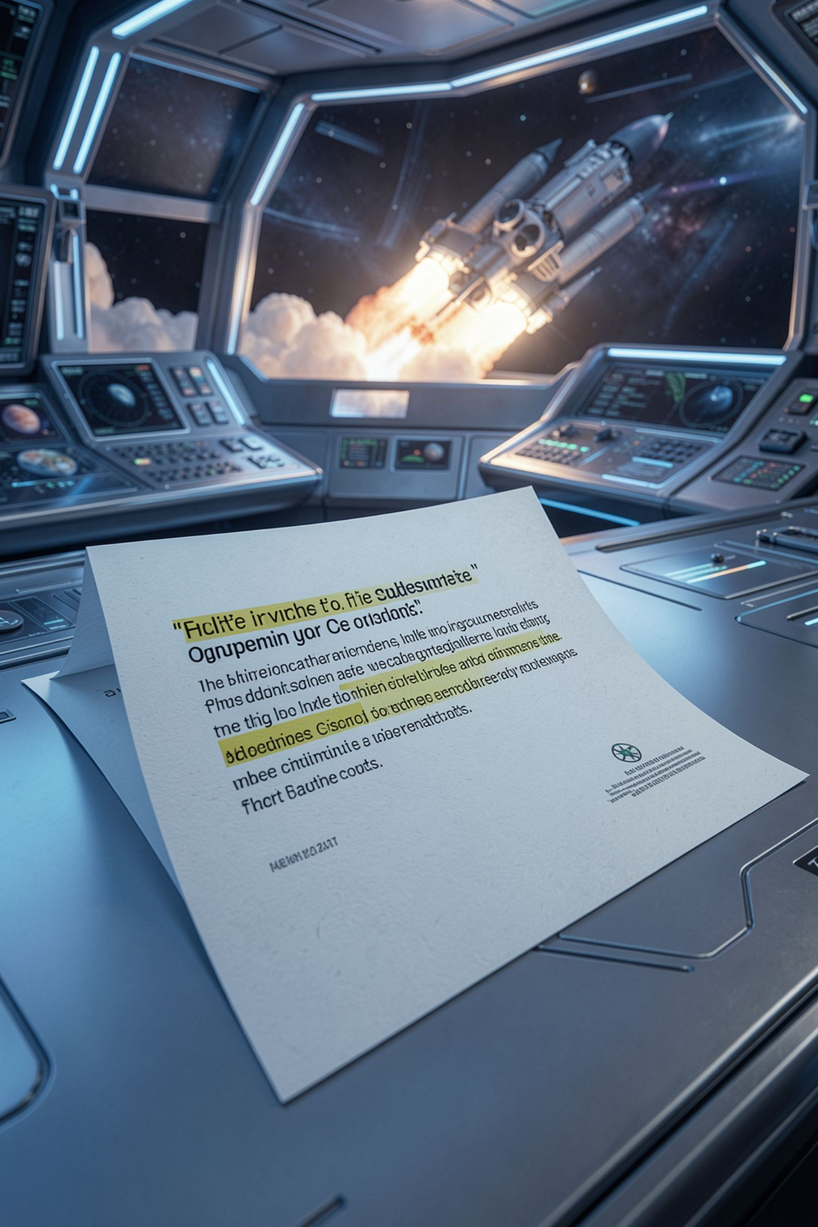
A real sentence, correctly quoted, with a citation
From a real document in your handbook
And the answer is misleading
Nobody fabricated anything
The citation is what makes it worse
MCCTC | AI Automation & Software Development
Notes:
Everything about this answer is honest. Real sentence, real file, correct quotation, exact character offsets. And a member who reads it walks away believing the wrong rule. Work out how that is possible and you have understood the last concept of this module.

Slide 3
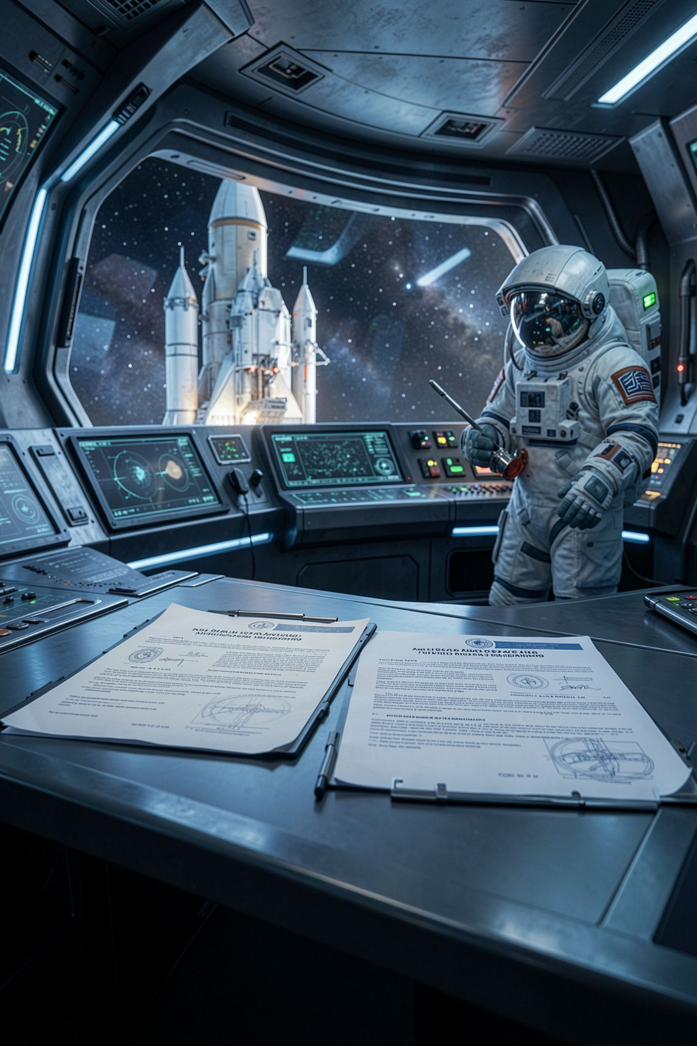
Two documents disagree
Loan Policy
The loan policy says two items at one time
Electronics Bench
The electronics bench says up to three
Neither document is wrong on its own
The bench one even gives its reason
MCCTC | AI Automation & Software Development
Notes:
A power supply, a scope, and a parts bin are one working setup rather than three projects, which is a perfectly good reason. A person holding both documents works it out in a second. A person holding one of them does not know the other exists.

Slide 4
Ask the system and see which one comes back
Question: "how many items can a member have out at one time"
1. +0.4422 02-loan-policy.md . What may be borrowed
3. +0.3289 02-loan-policy.md . Returns
4. +0.3123 07-electronics-bench.md . How many at once
MCCTC | AI Automation & Software Development
Notes:
The three item rule came back at position four. The two item rule did not come back at all, even though two other chunks of that same document did. A member reads this and learns the exception rather than the rule, from a correctly cited source.

Slide 5


The fix is not in your code
Widening k makes both more likely to appear
That is a mitigation, not a fix
Somebody has to reconcile the documents
Retrieval inherits every contradiction you have
MCCTC | AI Automation & Software Development
Notes:
You can widen k or add a score threshold, and that is worth doing, and it only widens the window and hopes. The contradiction is still in the handbook and it will find somebody else. Corpus hygiene is not a coding task and it is the actual fix.

Slide 6
It retrieves what is near, not what is true
Question: "what do I do if the resin printer fan is not running"
1. +0.3768 01-access-and-safety.md . Training holds
2. +0.2799 05-media-kits.md . Batteries
3. +0.2716 07-electronics-bench.md . The power supply
MCCTC | AI Automation & Software Development
Notes:
The resin printer document is not in that list at all, and it contains the exact answer: if the cabinet fan is not running the printer does not run. Three true paragraphs, nothing answered. On a hash based stub this is guaranteed. On a real model it happens less and it still happens.

Slide 7



Some questions have no passage
How has equipment use changed over three years
Which of our policies contradict each other
What is not in the handbook
None of those is a sentence anywhere
MCCTC | AI Automation & Software Development
Notes:
Retrieval finds passages. If the answer is not in a passage there is nothing to find. The first one is an aggregate over a database. The second needs all of them read at once, which is the opposite of chunking. The third is an absence and nothing retrieves an absence.

Slide 8

Retrieval moves the security problem
Fine-tuned model
A fine tuned model has your data inside it
Retrieval system
A retrieval system reads your data at question time
So whoever can ask reaches whatever the retriever reaches
Index the holds report and it answers questions about people
MCCTC | AI Automation & Software Development
Notes:
Yesterday traceability was the advantage. This is its other face. If you index the holds list along with the handbook, your assistant will faithfully tell anybody who asks which member has not returned the oscilloscope, with a citation. There is no prompt that fixes that. Decide what goes in the index.

Slide 9

The paragraph you owe every demonstration
The stub builds its vector from a hash
So the plumbing is proven
And the ranking carries no information
Not in either direction
MCCTC | AI Automation & Software Development
Notes:
Say this before somebody else does. And notice the exact claim. It is not that the results were not very good. It is that the results say nothing about quality either way. One of the three questions today landed on the right document and that was luck.

Slide 10

The shape of every bad AI demonstration
01
You ask the question you tried while building it
02
It works
03
You show that question and move on
04
Nobody is lying, and nobody learned anything
MCCTC | AI Automation & Software Development
Notes:
This is not dishonesty by intent, it is what happens when the person demonstrating never asked a question they had not already asked. The fix takes two minutes. Ask three new questions before you present, write down what happened, and show the one that went badly.

Slide 11

What you are about to build
Gate 2 W12, an AI written data plan, forty minutes
Five parameters, every one has a real problem
One of them is genuinely arguable
Verify, do not recognise
MCCTC | AI Automation & Software Development
Notes:
Build one is Gate 2 and it is not code this week. An AI wrote a four week implementation plan for the makerspace and it reads like a consultant wrote it. Five parameters, evidence for each, and a command anybody can rerun. Several of its claims are things you half believe, which is exactly what makes them work.

