Slide 1

Understanding Ethereum & Blockchain
Six questions answered

Slide 2
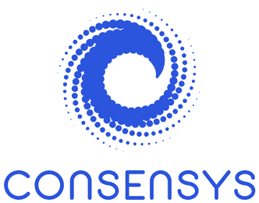
1. What makes Ethereum unique as a blockchain?
Ethereum is a decentralized blockchain that runs smart contracts.
Smart contracts are code written into a blockchain that executes the terms of an agreement or contract from outside the chain. It automates the actions that would otherwise be completed by the parties if certain conditions are met without requiring the help of an intermediary company or entity. Smart contracts run on the Ethereum Virtual Machine (EVM); a distributed computing network made up of all the devices running Ethereum nodes.
Smart contracts can be used for: automated payments and settlements, decentralized lending and borrowing, insurance and risk management, and supply chain finance.
A blockchain consists of a growing list of records, called blocks, that are securely linked together using cryptography. Each block contains a cryptographic hash of the previous block, a timestamp, and transaction data.
Ethereum is not the only blockchain to offer smart contracts. Other blockchains with smart contract functionalities include Solana and Cardano. However, Ethereum is widely considered the home of smart contract development in the crypto space and boasts more blockchain developers and DAOs than other competing networks.

Slide 3
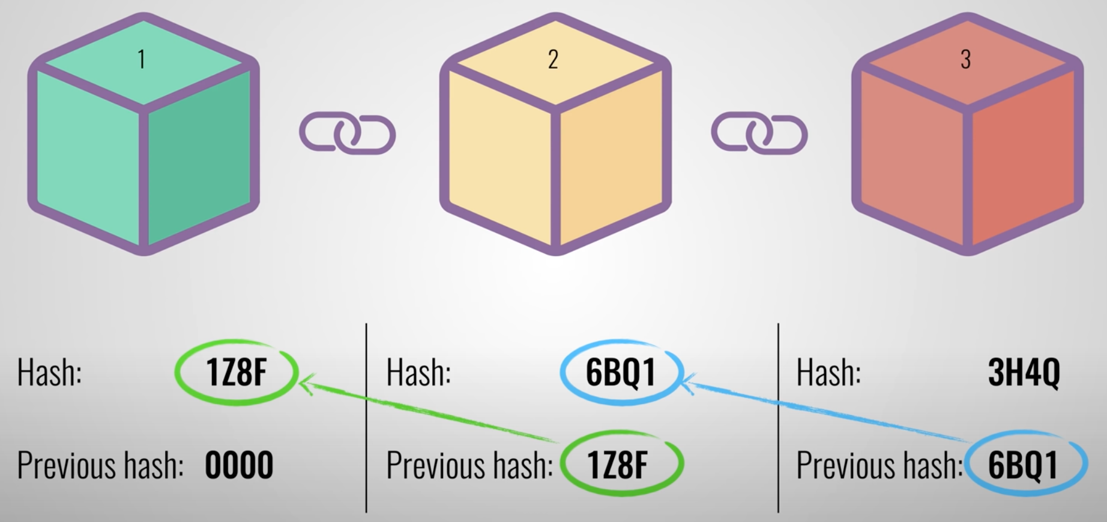
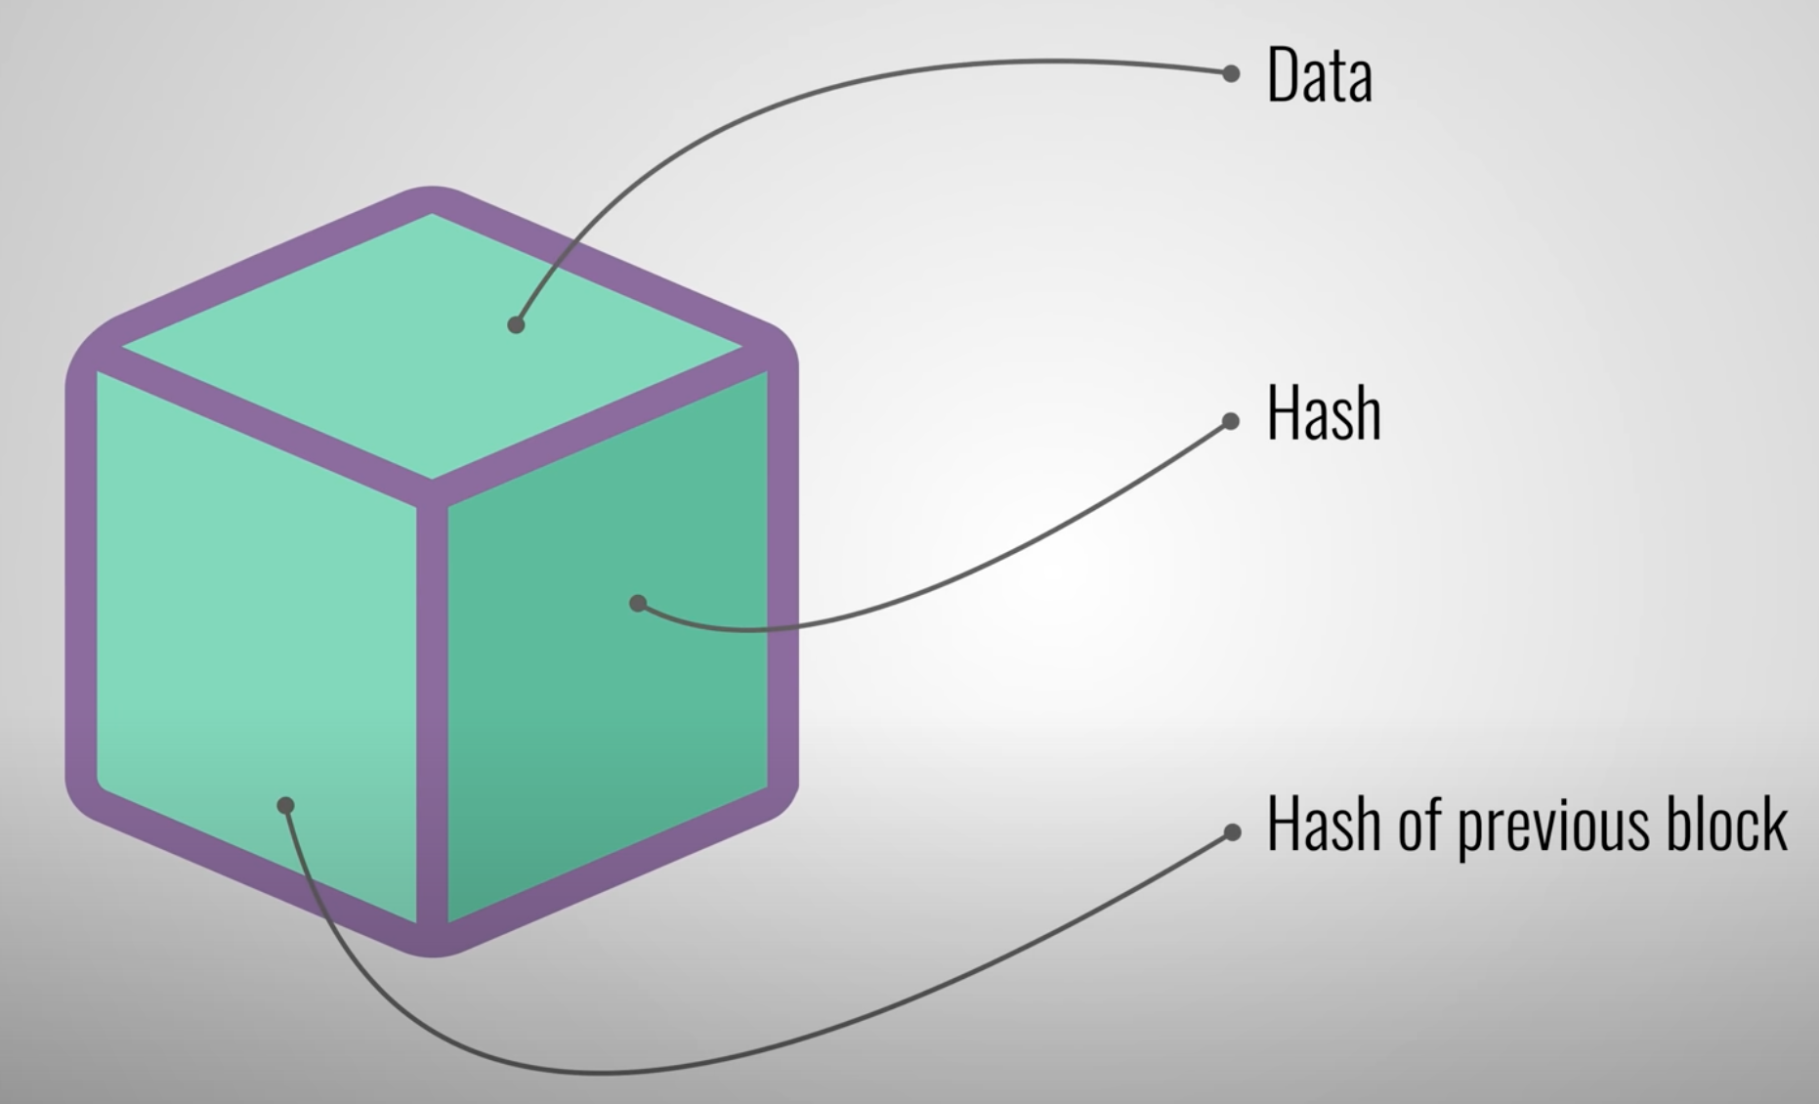
1. What makes Ethereum unique as a blockchain (cont’d)?
A blockchain consists of a growing list of records, called blocks, that are securely linked together using cryptography. Each block contains a cryptographic hash of the previous block, a timestamp, and transaction data. Since a smart contract control the execution of a transaction, the contract is part of the transaction data.

Slide 4
2. What is the role of an execution client and consensus client in Ethereum?
Ethereum is a distributed network of computers (nodes) running software that can verify blocks and transaction data. The software running on a computer make it an Ethereum node. There are two separate pieces of software (known as clients) required to form a node: an execution client and a consensus client. These two clients work together to sync the Ethereum state.
◆ Execution Client (Execution Engine or EL client)
Executes smart contracts and dApps
Listens and executes transactions and maintains the latest state and database of all Ethereum data
◆ Consensus Client (Beacon Node or CL client)
Ensures that transactions are validated, and consensus is maintained across the network
Provides consensus (using Proof-of-Stake (PoS) algorithm) from validated data from the Execution Client
Proof-of-Stake (PoS) was created as an alternative to Proof-of-Work (PoW), the original consensus mechanism used to validate transactions and open new blocks. PoS changes the way blocks are verified using the machines of coin owners, so there doesn't need to be as much computational work done, as with PoW. The owners offer their coins as collateral—staking—for the chance to validate blocks and earn rewards.

Slide 5
3. What are the different networks in Ethereum? Describe Mainnet vs. Testnets. Describe public vs. private networks.
◆ There are two types of Ethereum networks:
Public mainnet: accessible to anyone.
Private network: a private blockchain network.
Testnet: a test Ethereum blockchain network for collaborative testing on the network.
A new hybrid network called Whisper Network is under development.
When there is a massive spike in smart contract traffic and transactions, the Ethereum Foundation will initially be responsible for managing the public network through a public-private hybrid consensus mechanism.

Slide 6
3. What are the different networks in Ethereum? Describe Mainnet vs. Testnets. Describe public vs. private networks (cont’d).
◆ General things to know about Mainnet and Testnet…
There is only one Ethereum Mainnet, but multiple independent networks—Testnets, conforming to the same protocol rules can be created for testing and development purposes.
You can join a Testnet locally on your own computer for testing smart contracts and web3 apps.
Your Ethereum account will work across different Testnets, but your account balance and transaction history won't carry over from the Mainnet.
For testing purposes, it's useful to know which Testnets are available and how to get Testnet ETH to play around with.
For security considerations, don’t reuse Mainnet accounts on Testnets or vice versa.

Slide 7
3. What are the different networks in Ethereum? Describe Mainnet vs. Testnets. Describe public vs. private networks (cont’d).
◆ Mainnet
The live, operational version of the public Ethereum blockchain where real transactions and operations are executed and recorded on the distributed ledger.
All the rules, consensus mechanisms, and security protocols are enforced—enabling you to transact with cryptocurrencies and conduct various operations on the network, such as smart contracts, token issuance, and decentralized applications (dapps).
Provides users with the confidence that their transactions are secure and immutable— and thus operating a successful Mainnet is vital to a blockchain's adoption.
Ether prices refer to Mainnet ETH.

Slide 8
3. What are the different networks in Ethereum? Describe Mainnet vs. Testnets. Describe public vs. private networks (cont’d).
◆ Testnet
A version of the blockchain network that is used for testing purposes. It is a simulated version mainnet that enables users to explore new ideas and test applications without losing funds or impacting the mainnet.
Most testnets start by using a permissioned proof-of-authority consensus mechanism. This means a small number of nodes are chosen to validate transactions and create new blocks – staking their identity in the process. Alternatively, some testnets feature an open proof-of-stake consensus mechanism where everyone can test running a validator, just like Ethereum Mainnet.
Since Ether (ETH) is necessary to interact with Ethereum (including testnets), you can get free testnet ETH from crypto faucets. Most faucets are webapps.
A devnet can either be local/private (in which case it's only running on a single machine for development and is very lightweight and fast) or public testnet with "fake gas" so it doesn't cost anything to use.
Gas is the fee required to successfully conduct a transaction or execute a contract on the Ethereum blockchain platform.
The two public testnets that client developers are currently maintaining are Sepolia and Goerli.
Sepolia is the recommended default testnet for application development. Because it’s fairly new, its state and history are both quite small. Therefore, the network is quick to sync to and that running a node on it requires less storage.

Slide 9
3. What are the different networks in Ethereum? Describe Mainnet vs. Testnets. Describe public vs. private networks (cont’d).
Private network
An Ethereum network is private if its nodes are not connected to a public network (public mainnet or a testnet). Private only means reserved or isolated, rather than protected or secure.
To develop an Ethereum application, you'll want to run it on a private network to see how it works before deploying it. Similar to how you create a local server on your computer for web development, you can create a local blockchain instance to test your dapp. This allows for much faster iteration than a public testnet. <Using a public Testnet may suffice in some cases>
Public network
Public networks are accessible to anyone with an internet connection. Anyone can read or create transactions on a public blockchain and validate the transactions being executed. The consensus among peers decides on the inclusion of transactions and the state of the network.
Mainnet is the primary public Ethereum production blockchain, where actual-value transactions occur on the distributed ledger.

Slide 10
4. How does proof-of-stake work in Ethereum?
Proof-of-stake (PoS) is a way to prove that validators have put something of value into the network that can be destroyed if they act dishonestly. In Ethereum’s PoS, validators explicitly stake capital in the form of ETH into a smart contract on Ethereum. The validator is then responsible for checking that new blocks propagated over the network are valid and occasionally creating and propagating new blocks themselves. If they try to defraud the network (for example by proposing multiple blocks when they ought to send one or sending conflicting attestations), some or all of their staked ETH can be destroyed.
◆ Additional info…
PoS is the underlying mechanism for Ethereum’s consensus algorithm.
Ethereum switched from Proof-of-Work (PoW) to the PoS mechanism, which is believed to be less energy-intensive and provides a platform for implementing new scaling solutions.
PoS was created as an alternative to PoW, the original consensus mechanism used to validate transactions and open new blocks. PoS changes the way blocks are verified using the machines of coin owners—validator nodes, to reduce the computational work done, as with PoW. Validator nodes offer their coins as collateral—staking—for the chance to validate blocks and earn rewards.
Validators run nodes that can add new blocks to the Ethereum blockchain. A validator node participates in the consensus-building process of a PoS blockchain by voting on the authenticity of a new block of transactions, thus communally ensuring new blocks are valid before permanently adding them to the blockchain.

Slide 11
4. How does proof-of-stake work in Ethereum? (cont’d)
◆ Additional info…
To participate as a validator, a user must deposit 32 ETH (~ $53,200 USD) into the deposit contract and run three separate pieces of software: an execution client, a consensus client, and a validator. On depositing their ETH, the user joins an activation queue that limits the rate of new validators joining the network. Once activated, validators receive new blocks from peers on the Ethereum network. The transactions delivered in the block are re-executed to check that the proposed changes to Ethereum's state are valid, and the block signature is checked. The validator then sends a vote (an attestation) in favor of that block across the network. <The validator is part of the consensus client. Beacon node and validator make up the consensus client. See the Besu docs for a complete description of this.>

Slide 12
5. What is the Ethereum JSON-RPC API?
The Ethereum JSON-RPC API is implemented as a set of Web3 object methods that enable clients to interact with the Ethereum blockchain. This API is a stateless, light-weight remote procedure call (RPC) protocol. It defines several data structures and the rules around their processing. It is transport agnostic in that the concepts can be used within the same process, over sockets, over HTTP, or in many various message-passing environments. It uses JSON as data format.
Stateless: REST APIs are stateless, meaning that calls can be made independently of one another, and each call contains all of the data necessary to complete itself successfully.
When users create and sign a transaction with their private key, this is usually handled by a wallet or a library. But in the backend, the user is making a request to a node using the Ethereum JSON-RPC API.

Slide 13
6. How does Ethereum governance work?
Since so many people depend on Ethereum's stability, there is a very high coordination threshold for core changes, including social and technical processes, to ensure any changes to Ethereum are secure and widely supported by the community.
There are two types of Ethereum governances: on-chain and off-chain.
◆ On-chain
This governance offers new capabilities.
Proposed protocol changes are decided by a stakeholder vote, usually by holders of a governance token, and voting happens on the blockchain.
With some forms of this governance, proposed protocol changes are already written in code and implemented automatically if the stakeholders approve the changes via signing a transaction.
While at the protocol level Ethereum governance is off-chain, many use cases built on top of Ethereum, such as DAOs, use on-chain governance.
◆ Off-chain
Any protocol change decisions happen through an informal process of social discussion, which, if approved, would be implemented in code.
Ethereum governance happens off-chain with a wide variety of stakeholders involved in the process.

Slide 14
6. How does Ethereum governance work? (cont’d)
Ethereum Improvement Proposals (EIPs) are standards specifying potential new features or processes for Ethereum. Anyone within the Ethereum community can create an EIP.
◆ The process…
Familiarize yourself with prior work and proposals before creating an EIP. This helps to ensure that the EIP brings something to the Ethereum Mainnet, and not something already rejected.
Propose an EIP. Detailing a proposed change in a Core EIP will act as the official specification for an EIP that Protocol Developers will implement if accepted.
Present your EIP to Protocol Developers.
Iterate towards a final proposal. This effort may require multiple rounds of reviews and changes.
EIP Included in Network Upgrade. Given the high coordination costs of network upgrades (everyone needs to upgrade simultaneously), EIPs are generally bundled together in upgrades.
Network Upgrade Activated. Network upgrades are usually activated on testnets before being activated on the Ethereum Mainnet.

Slide 15
6. How does Ethereum governance work? (cont’d)
◆ Additional info…
Chain split – When some stakeholders protest implementing a protocol change resulting in different, incompatible versions of the protocol operating, from which two distinct blockchains emerge.
(Network upgrade) Forks – When major technical upgrades or changes need to be made to the network and change the "rules" of the protocol. Ethereum clients must update their software to implement the new fork rules.
DAO fork – This fork was in response to the 2016 DAO attack where an insecure DAO contract was drained of over 3.6 million ETH in a hack. The fork moved the funds from the faulty contract to a new contract allowing anyone who lost funds in the hack to recover them.
Ethereum/Ethereum Classic fork – An example of a healthy fork. When two groups who disagreed strongly enough with each other on some core values to feel it was worth the risks involved to pursue their specific courses of action.
Upgrade fork

