Slide 1

Intelligent Content & Chatbots
Positioning an organization to create chatbot-based user guidance

Slide 2
What we’re in for today…
This presentation focuses on the power and benefits of Intelligent Content and how this authoring methodology could drive the content effort for chatbots.

Slide 3
Assumptions…the small print
► Me
I am not an expert in Chatbot/AI technology.
This technology is still somewhat flued in Tech Comm.
But I believe Intelligent Content can be foundational to the content effort for a chatbot.
Because I’m still new and there are gaps in my knowledge of things Pliny/Consensys, some of my ideas may require adjusting or may not be feasible.

Slide 4
Assumptions…the small print (cont’d)
► Other
AI technology varies vastly and is quickly changing and maturing.
Style guide may need an adjusting.
Can our current authoring tools and publishing method support a chatbot effort?
Is there adequate infrastructure support?
Possible new tools and publishing method.
Possible backend developer who is dedicated to (to some degree) our implementation effort.
Open to a phase-in plan.
Create chatbot content while still supporting our current forms of documentation.

Slide 5
Purpose
Enrich UX by providing product information and supporting user workflows through the dissemination of information in a chatbot, while still producing traditional content as needed.

Slide 6
How should we view a chatbot?
► Chatbots are channels to content and data to solve specific problems.
They are not magic, and they require that we look at the needs of the user in a new light.
We need to understand the user journey in detail.
We need to know what they’re trying to accomplish and what gets in their way. Let us not get in their way!
Chatbots are the opposite of the “flood-and-find” information approach.
► AI is the content delivery platform.
► The “magic” is in how the content is structured and rationalized (intelligent content).

Slide 7
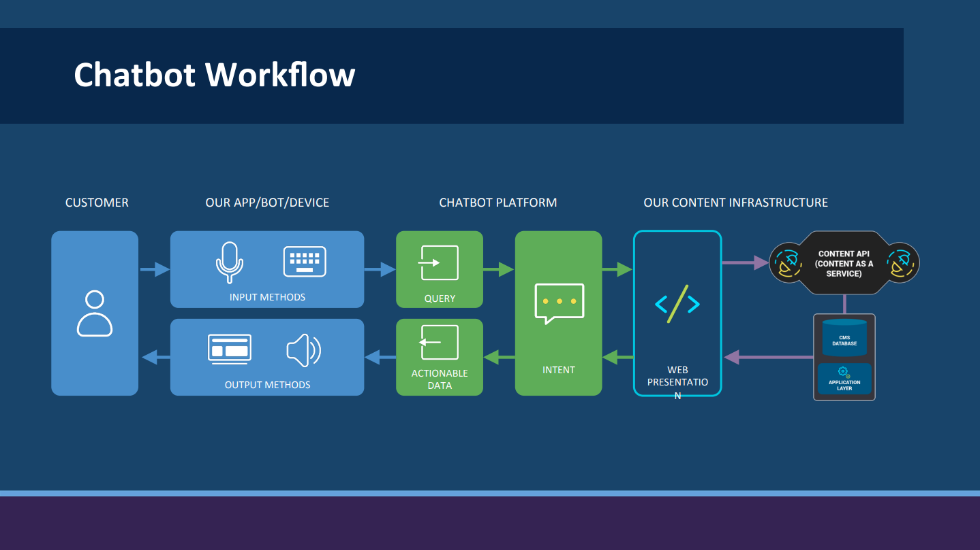
How should we view a chatbot? (cont’d)

Slide 8
A chatbot that we can support
Artificial Intelligence is a broad term that encompasses a range of technologies. There are four types of AI:
► Reactive AI
Most basic form of AI.
It is designed to respond to inputs in a specific way.
Example: an email spam filter is reactive AI.
► Limited memory AI
It can remember past events and learn from them.
Example: semi-autonomous vehicles. They can use cameras and sensors to detect nearby traffic, pedestrians and stoplights. This stored information enables them to make smarter, safer decisions on the road.

Slide 9
A chatbot that we can support (cont’d)
► Theory of mind AI
Can understand the thoughts and emotions of people and animals and adjust its own behavior accordingly.
Some believe that ChatGPT is an example of this.
► Self-aware AI
Most advanced form of AI.
Would have its own thoughts, feelings, and aspirations.
At this point, self-aware AI is largely theoretical.
► While the frontier of AI currently lies between Limited memory and Theory of mind, I believe that a chatbot supported by Tech Pubs lies between Reactive and Limited memory.

Slide 10
Chatbots need the right content and content structure
► Chatbots can be a powerful tool for improving user experiences.
They are commonly used for customer support, website help, and more.
If chatbots are not implemented correctly — with a structured content strategy — they'll produce little more than a headache for companies that use them.
► Not all chatbots use AI.
Some basic chatbots work from a set of content that follows a decision-tree.
To deliver personalized experiences with a chatbot, you will need one that leverages AI and machine learning.
In both instances, structured content is critical for the chatbot to work properly.
► You could copy and paste the content directly into a chatbot application.
It would be a nightmare to keep it up to date and synchronized with similar content on other digital properties.
► Provide the best content to a chatbot, and in turn, to your customers and website visitors.
This is done by defining a complete structured (intelligent) content model, used across the organization, that incorporates the elements a chatbot requires.

Slide 11
Chatbots need the right content and content structure (cont’d)
► Three main elements to chatbot interactions:
Context – reason for the interaction
Intent – purpose or goal of the interaction
Entity – specific content (type and format considered) being delivered as a result of the interaction
Intelligent content supports all these elements. But we’ll get to that soon enough…
► Any entity can be a granular component of information and be semantically tagged. The chatbot can then interface with it and pull out a smaller piece of information it requires.
► When dealing with augmented reality (AR) or virtual reality (VR), structured content is the audio, video and animation content. This content is tagged with metadata that tells the service what the content is, who the person is using it, where they are located, and what they are looking at.
► While AI can work with unstructured content, it is often more robust and faster when it works with structured content.

Slide 12
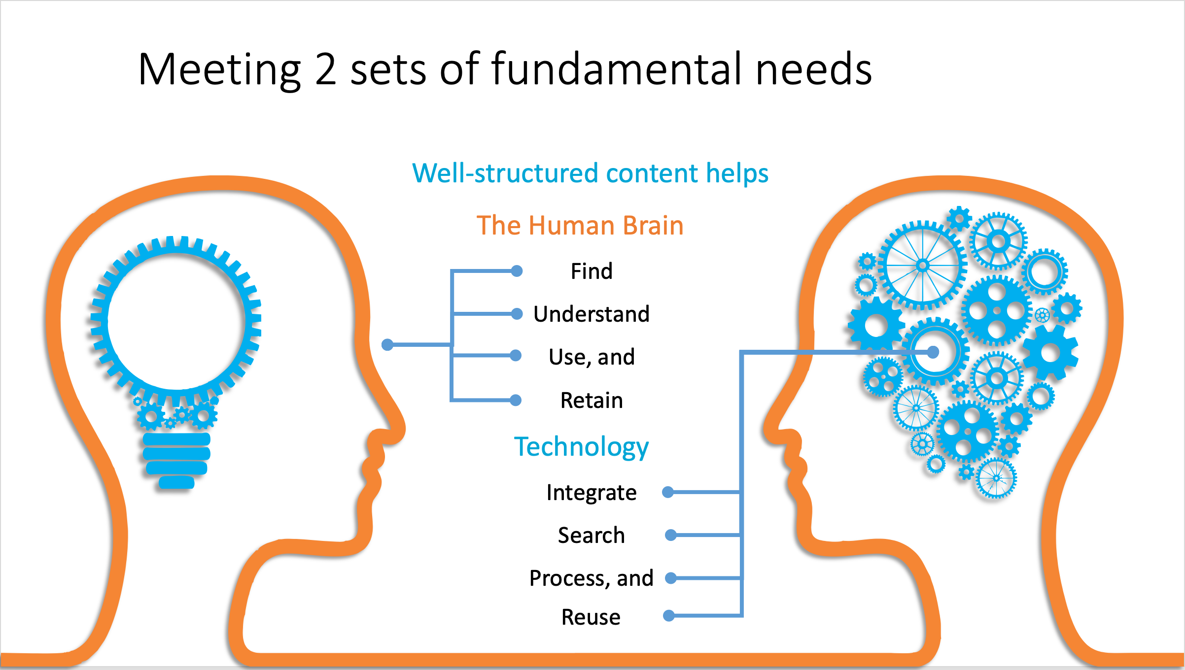
Chatbots need the right content and content structure (cont’d)

Slide 13
Intelligent content is the content and content structure solution
► What is intelligent content?
It’s not limited to one purpose, technology or output.
It’s structurally rich and semantically aware, and is therefore discoverable, reusable, reconfigurable and adaptable.
It helps you and your customers get the job done. It’s content that works for you and it’s limited only by your imagination.

Slide 14
Intelligent content is the content and content structure solution (cont’d)
► Benefits of intelligent content:
More easily find information
Customizable/scale it
Personalize it (corner case are no longer a big concern)
Automatically deliver it to multiple channels simultaneously
Speeds up delivery time
Optimizes resources
Do more with the same resources
Create more effective documentation

Slide 15
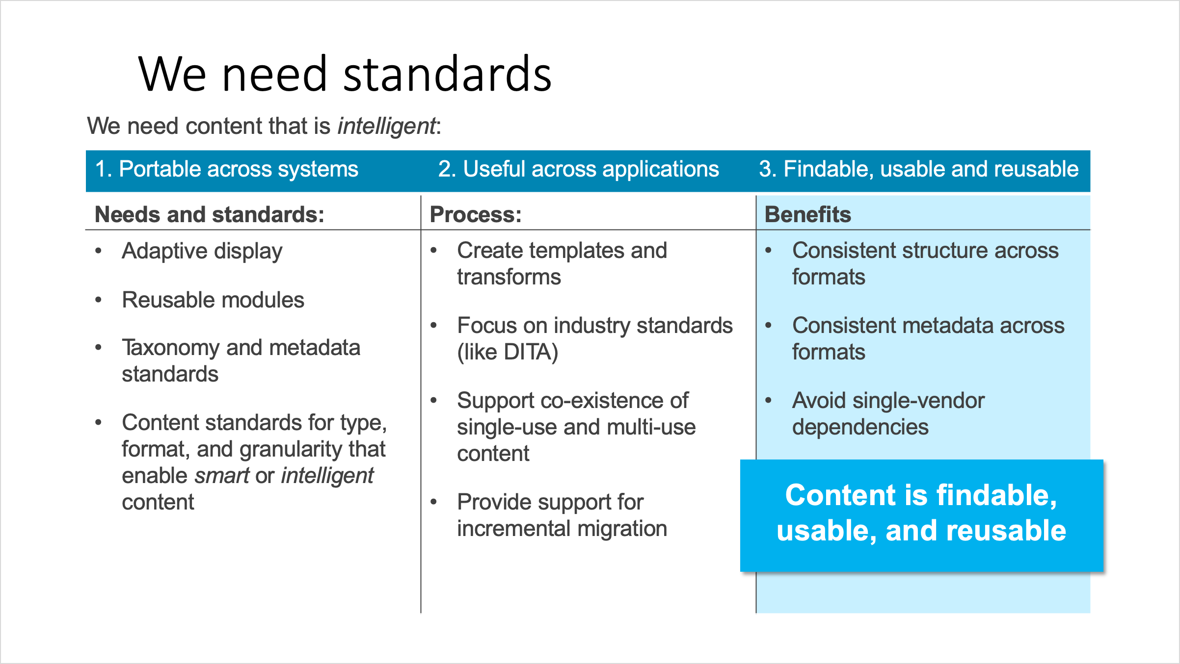
Intelligent content is the content and content structure solution (cont’d)

Slide 16
Intelligent content is the content and content structure solution (cont’d)
Cognitive principle Intelligent content convention
► Consistency = Structured style based in DITA and minimalism
► Chunking = Topic segments and normalized text
► Relevance = Precise content at the point of need and ability to opt into more content
► Labeling = Identify topic segments with labels and employ comprehensive topic titles

Slide 17
Intelligent content is the content and content structure solution (cont’d)
► Routes of Intelligent Content
The effectiveness of intelligent content is dependent on how well content is gathered, stored, normalized, purposed, and then disseminated. When all this is done well, content can easily take the form of some or all of the following:
Traditional print (PDFs)
Workflow summary topics
Traditional online help (Web-based Help)
Screen text
Integrated information available in product UI (Integrated Information System)
Chatbots! ☺
Other information forms not yet known

Slide 18
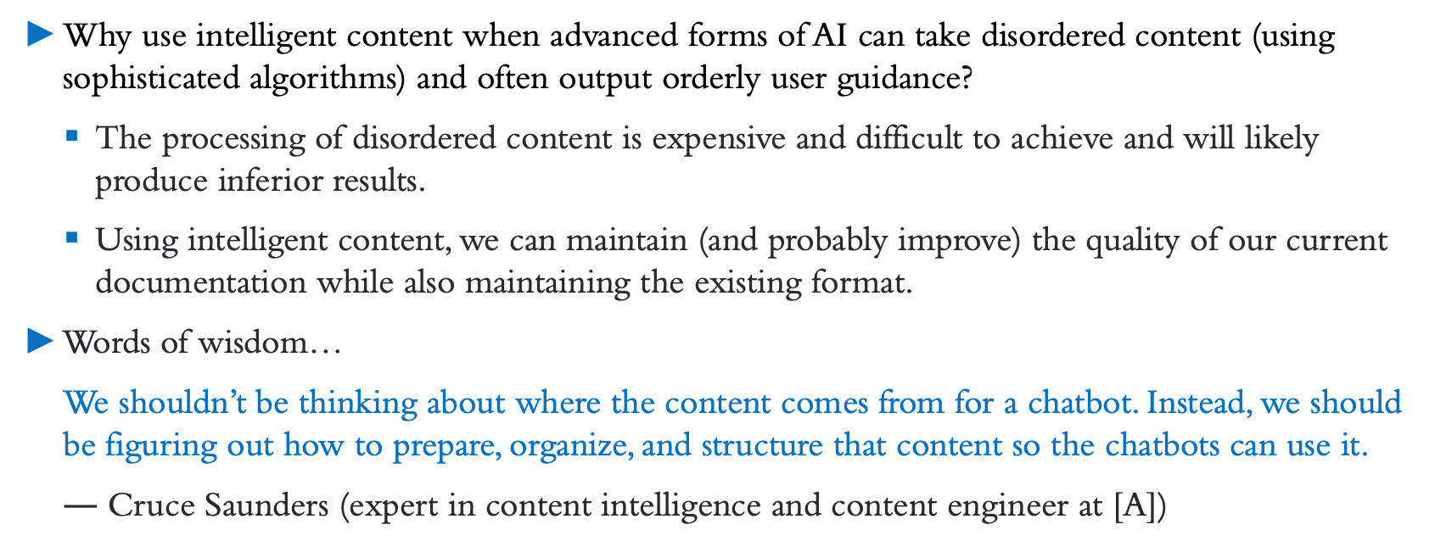
Intelligent content is the content and content structure solution (cont’d)
► Why use intelligent content when advanced forms of AI can take disordered content (using sophisticated algorithms) and often output orderly user guidance?
The processing of disordered content is expensive and difficult to achieve and will likely produce inferior results.
Using intelligent content, we can maintain (and probably improve) the quality of our current documentation while also maintaining the existing format.
► Words of wisdom…
We shouldn’t be thinking about where the content comes from for a chatbot. Instead, we should be figuring out how to prepare, organize, and structure that content so the chatbots can use it.
$—$ Cruce Saunders (expert in content intelligence and content engineer at [A])

Slide 19
The four pillars of intelligent content
Create Once, Publish Everywhere (COPE)
Respond in real time
Enable content control
Right person, right time, right content
These four pillars were foundational in creating integrated information systems and should prove helpful in creating effective chatbot content.

Slide 20
Supporting the pillars with intelligent content principles
► Semantically structured content (structurally rich)
Content where the structure has meaning—a strong functional purpose, adds capability to the content. Enter, topic segments.
Topic segmenting, also known as modular content, is a form of structured content that is designed (strategized), created, and delivered as discrete components within the context whole–the topic.
Modular content enables device-independent delivery in multiple contexts, at multiple levels of detail, and with varying consumer focus. It enables the content strategist to meet today’s delivery challenges and prepare for tomorrow’s unknowns.

Slide 21
Supporting the pillars with intelligent content principles (cont’d)
► Semantically structured content (structurally rich)
Modular content also enables a topic to be extensible. Content can be scaled, driven by the user’s needs
Segmenting a topic also lends well to adaptive content—content that is designed to adapt to the needs of the user, not just cosmetically, but also in substance and in capability.
Topic segmenting is fashioned after the elements of the Darwin Information Typing Architecture (DITA). The topic-based writing style described here groups information as either task, concept, or reference, as prescribed by DITA.

Slide 22
Supporting the pillars with intelligent content principles (cont’d)
► Semantically aware content
Content is tagged with metadata to identify the kind of content within it.
Content tagged with semantic metadata can be used to automatically build customized information sets based on audience, product, or industry. The COPE principle is used here…Create Once Publish Everywhere.
► Every-Page-is-Page-One (EPPO) principle
Based on the extent of implementation of the above disciplines, a topic should be (as much as possible) “self-contained” — independent, having the potential to provide an abundance of information as close to the user’s point of need as possible.

Slide 23
Learning intelligent content from an IIS
► Intelligent content principles that I used in my Integrated Information Systems (IIS’s) can be used in a like manner to create the content for chatbots.
► I did not use AI to create IIS’s. (Not all chatbots use AI.) The information patterns followed were based on possible workflows (and even FAQs).
► A chatbot and an IIS are both information dissemination systems with the following basic similarities:
Bring relevant information to the user’s point of need
Present pertinent information based on the user type, function, and needs
Correct information is delivered due in large part to an accurate understanding of user workflows
Enable users to opt into more info.
Easy to use.
Highly effective due to function and structure.

Slide 24
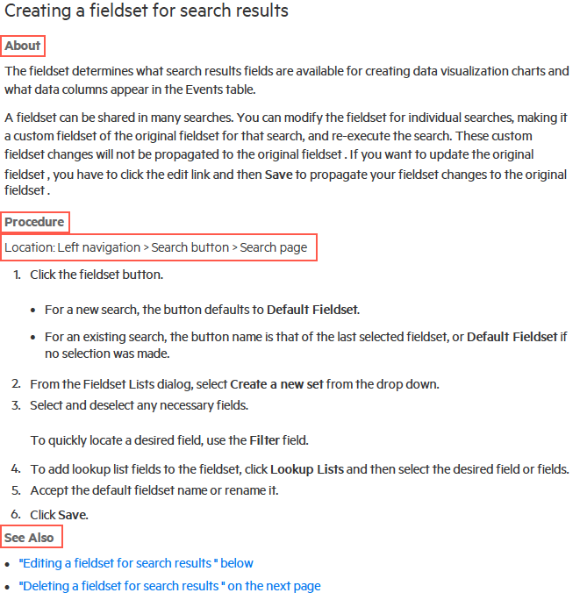
Some real-life examples from an IIS
► Traditional print content + Intelligent Content
In this print example, the cognitive load is distributed across the topic segments of About (concepts and reference info), Procedure (task info), and See Also.
The Location statement is an intelligent content convention that quickly and easily puts the user in the UI in order to start the first step of a workflow.

Slide 25
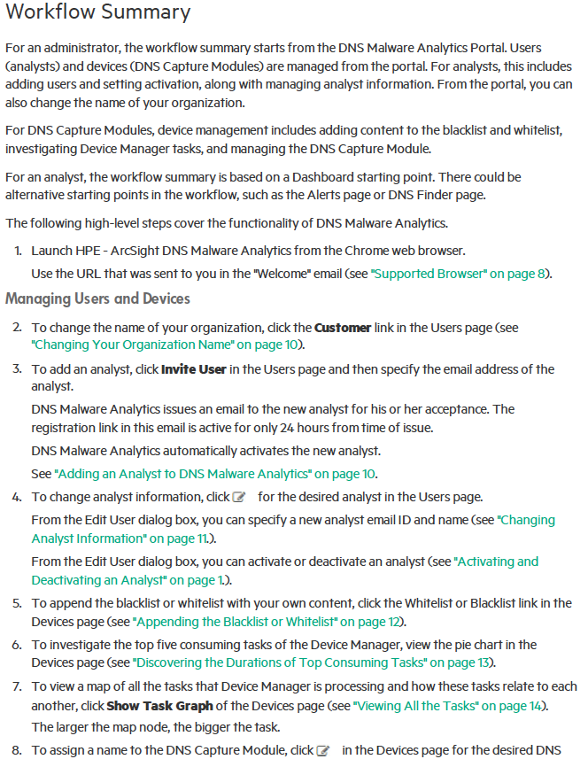
Some real-life examples from an IIS (cont’d)
► Workflow summary topics + Intelligent Content
Workflow summary topics provide all the necessary steps (and any optional steps) required to complete a workflow. New product features are called out in a workflow summary topic.
There is at least one overall workflow summary topic that covers all the functionality of the product.
There can be smaller workflow summary topics geared to specialized workflows.

Slide 26
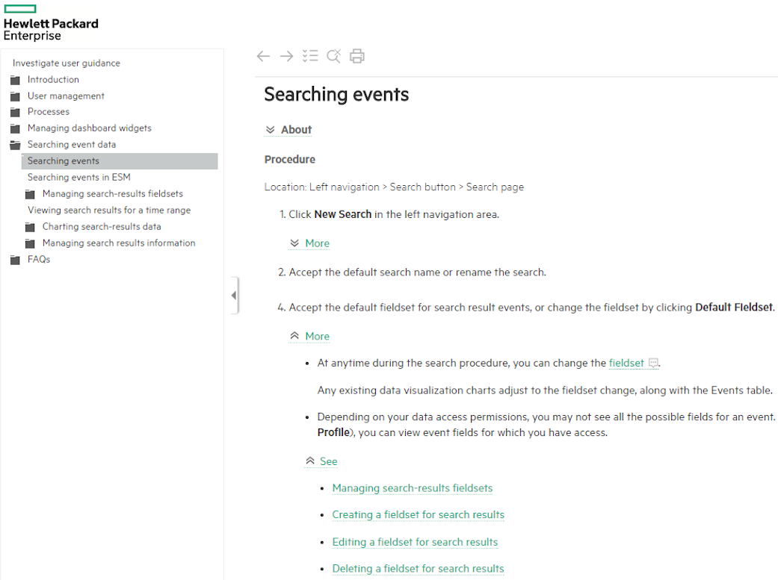
Some real-life examples from an IIS (cont’d)
► Traditional online help + Intelligent Content
Separating task information from other types of information can make it easier and more efficient to comprehend and retain the task information.
Concept information has the highest cognitive loading for the brain since the reader is being asked to compare and evaluate information based on what the reader already knows.

Slide 27
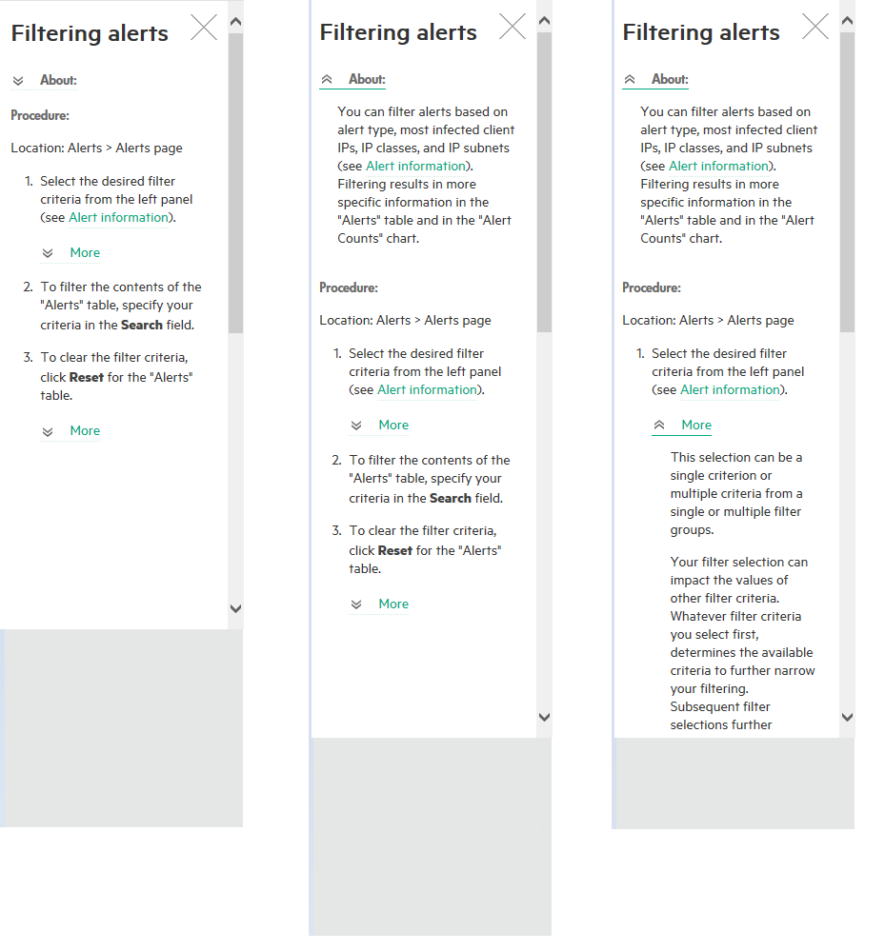
Some real-life examples from an IIS (cont’d)
► Traditional online help + Intelligent Content (cont’d)

Slide 28
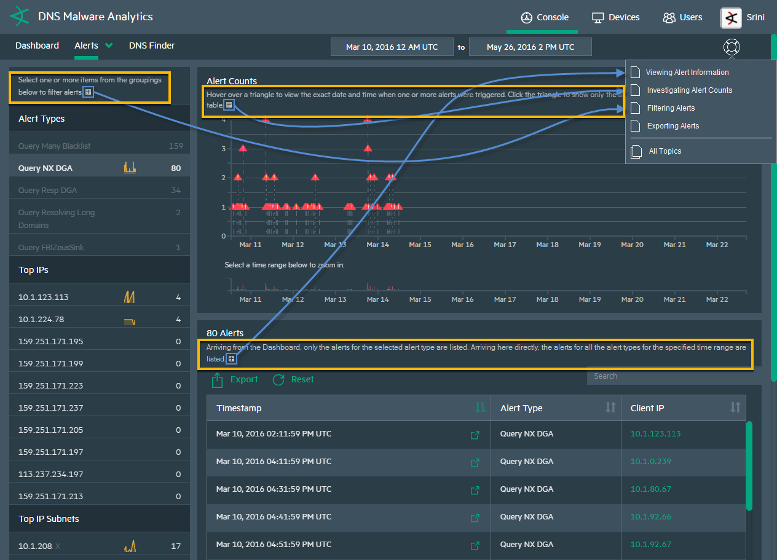
Some real-life examples from an IIS (cont’d)
► Screen text + Intelligent Content
The product UI is the starting place and the most significant place, to enhance the user experience. Therefore, precision content originating from the UI could be extremely useful in aiding in a workflow.

Slide 29
Some real-life examples from an IIS (cont’d)
► Integrated information in product UI + Intelligent Content

Slide 30
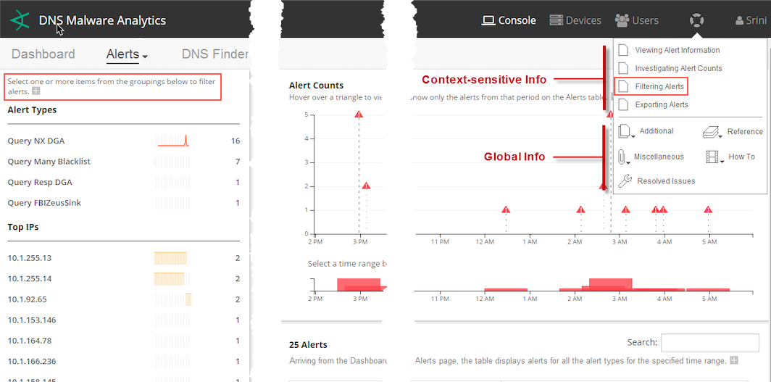
Some real-life examples from an IIS (cont’d)
► Integrated information in product UI + Intelligent Content (cont’d)

Slide 31
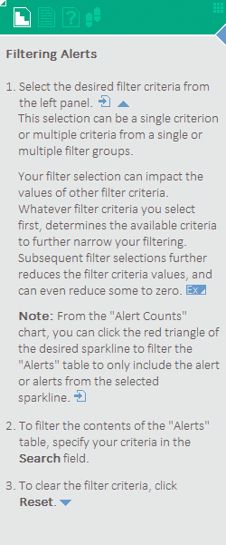
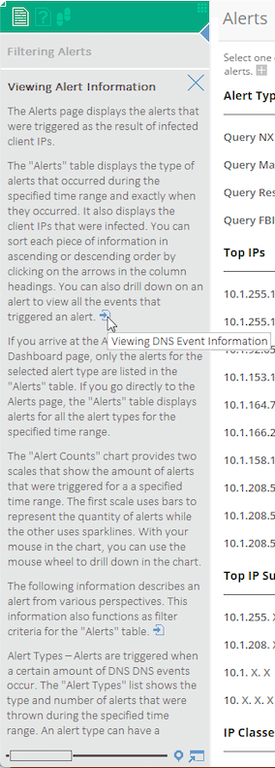
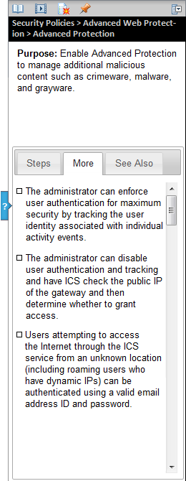
Some real-life examples from an IIS (cont’d)
► Integrated information available in product UI + Intelligent Content (cont’d)
Help panels extend the product UI and enables users to opt into granular content as needed.

Slide 32
Managing chatbot content
► You could store your chatbot content directly in your chatbot software, but it makes more sense to manage it within your CMS, as part of your existing content.
The CMS must provide an open API that the chatbot can connect with to pull content.
The CMS must support a structured content model.
A content model assists with the conversational UI aspect a chatbot, which helps to lay out attributes.
► The content model must include the elements required for AI and chatbots: entities, intents, and responses.
► Content that a chatbot may need could be in several different repositories.
Since a chatbot cannot connect to multiple repositories, a central location is required with a defined (structured) content set to work properly.
A CMS that can import or integrate content from multiple content repositories, like a Component Content Management System (CCMS) used for help documentation can build out the content model for that additional content and use it to support chatbots.

Slide 33
Designing for structured content
► The most important thing is to look at content and identify what it is, not what it looks like.
► When you define the structure, ask yourself:
Does the structure help authors create better content?
Does the structure make the content reusable? Do you need the structure for processing?
Do you need to filter the content (hide and show different elements of the content depending on the situation)?
Do you want to display content differently for different channels or audiences?
Do you need to deliver targeted content?
These are all key questions for structured content best practices.

Slide 34
Designing for structured content (cont’d)
► You should be able to identify content to:
Write to the structure.
Extract the structure.
Manipulate the structure.

Slide 35
What’s required of you–what’s required of us?
► Your value in the chatbot/AI effort
This is about using content to understand customers and meet their needs.
Finding the right words to do this will often depend on you–the professional technical writer.
Your significance is often obscured by the latest technology, but your importance will only grow as this technology matures.
All the points made here have real significance when the content of the next slide is realized.

Slide 36
What’s required of you–what’s required of us? (cont’d)
► Some high-level things you should consider as you embark upon this exciting endeavor:
Thoroughly understand the purposes and functionalities of your products and the users’ needs & workflows.
How well do these match? Where are there any gaps and/or deficiencies?
Understand UX and CX (and even effective UI), or at least appreciate them.
Understand the purpose of content and the various types and their possible relationships.
Be able to determine the effectiveness—the value of information before you make it content.

Slide 37
What’s required of you–what’s required of us? (cont’d)
► Begin by working with direct, customer-facing organization (Marketing, Tech Support) to:
Understand and map out the customer lifecycle (and workflows).
Identify the points in the lifecycle (and workflow) where the customer needs to accomplish an objective.
Deconstruct this objective into a finer-grained journey that illustrates the customer’s wants, needs, thoughts, emotional state, and tasks along with the content and information the customer requires to get to the next step to achieve their objective (Psychology of learning)
Identify the sources of content and data and how they will be accessed.

Slide 38
What’s required of you–what’s required of us? (cont’d)
► Begin by working with direct, customer-facing organization (Marketing, Tech Support) to:
Determine the best channel to that content—whether human, a website, a mobile device, etc.
Evaluate the state of the content and restructure it to answer specific, common, high-value questions.
Map out the possible questions that the customer may have at each step and structure dialog to prompt the correct question.
Test on actual customers.
Measure, manage, govern, and improve.

Slide 39
Questions?

Slide 40
Designing for Structured Content (extra)
► What is a Master Content Model™?
An MCM is a single, integrated model that defines how content assets will be structured and represented throughout their complete content lifecycle.
► A few things in this definition merit elaboration:
The MCM focuses on the structure of content, literally its physical organization into components that can be enriched, reused, processed, and consumed.
By defining the structure of content assets, the MCM facilitates the creation, exchange, and utilization of semantic value. Here, semantics refers to the introduction of enriched meaning into the content in such a way that applications can find, interpret, and act on those details.
The MCM seeks to encompass the complete content asset lifecycle, from planning through delivery and use. This lifecycle orientation is important as it is a central goal of an MCM to facilitate the representation of content structures in all the applications that will need to access, display, manage, and potentially modify the content. In this way, the MCM enables the flow of content between all the applications that play a role in the content lifecycle.

