Slide 1
Dissemination of intelligent information
Focus on Integrated Information Systems

Slide 2
Goal
Enrich UX by supporting user workflows through the dissemination of information at the user's point of need, while still producing traditional content when necessary.

Slide 3
The four cognitive principles
The best way to manage cognitive loading when learning something is to increase the comprehension and retention of information by creating content based on the four cognitive principles.
◆ Consistency
◆ Chunking
◆ Relevance
◆ Labeling

Slide 4
The four cognitive principles  intelligent content
Intelligent content is content which is not limited to one purpose, technology, or output. It’s content that is structurally rich and semantically aware, and is therefore discoverable, reusable, reconfigurable and adaptable. Because of these qualities, intelligent content can be delivered with precision. It’s content that helps you and your customers get the job done. It’s content that works for you and it’s limited only by your imagination.
Cognitive principle Intelligent content convention
◆ Consistency = Structured style based in DITA + minimalism and normalized content
◆ Chunking = Practical topic segments
◆ Relevance = Precise content at the point of need and ability to opt into more content
◆ Labeling = Identify topic segments with labels and employ comprehensive topic titles

Slide 5
Routes of intelligent content
The effectiveness of intelligent content is dependent on how well content is gathered, stored, normalized, purposed, and then disseminated. When all this is done well, content can easily take the form of some or all of the following:
◆ Traditional print (PDFs)
◆ Workflow summary topics
◆ Traditional online help (Web-based Help)
◆ Screen text
◆ Integrated information available in product UI (Integrated Information System)
◆ Other information forms not yet known

Slide 6
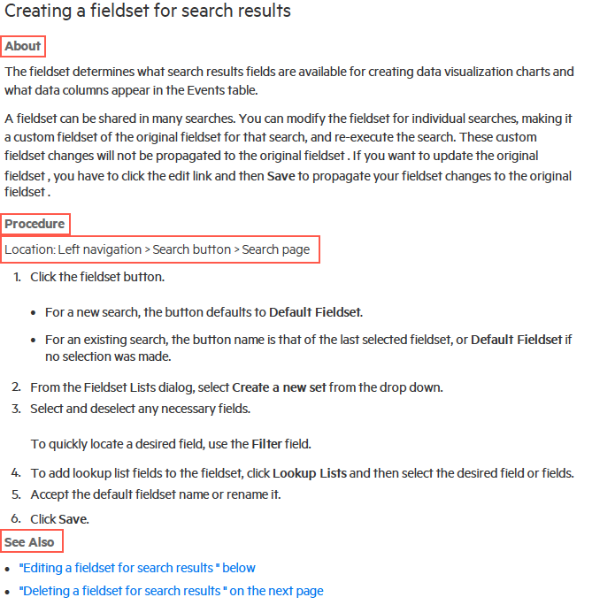
Traditional print content + intelligent content
In this print example, the cognitive load is distributed across the topic segments of About (concepts and reference info), Procedure (task info), and See Also.
The Location statement is an intelligent content convention that quickly and easily puts the user in the UI in order to start the first step of a workflow.

Slide 7
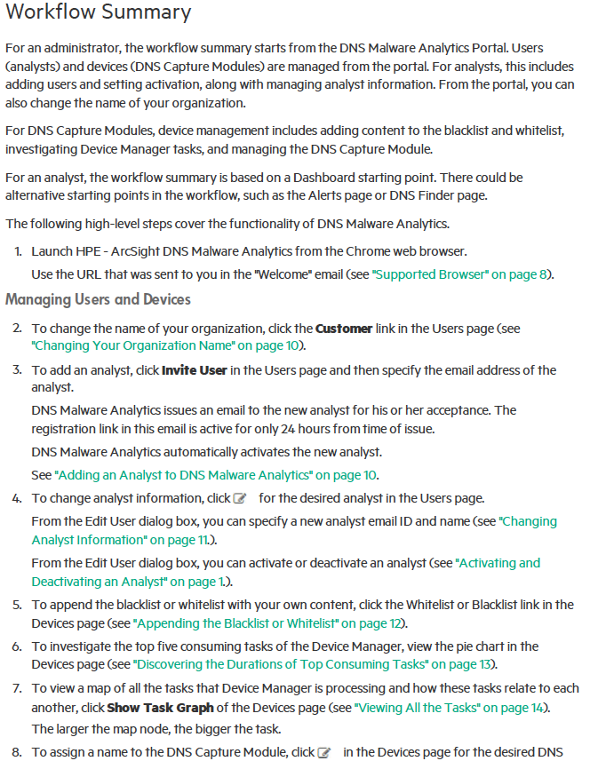
Workflow summary topics + intelligent content
Workflow summary topics provide all the necessary steps (and any optional steps) required to complete a workflow. New product features are called out in a workflow summary topic.
There is at least one overall workflow summary topic that covers all the functionality of the product.
There can be smaller workflow summary topics geared to specialized workflows

Slide 8
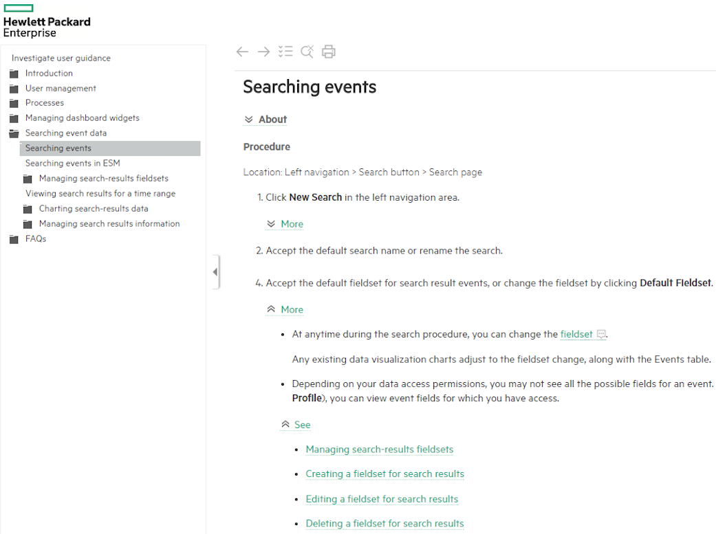
Traditional online help + intelligent content
The About topic segment is rolled up in this OLH example because the procedure is the priority in the topic.
Separating task information from other types of information can make it easier and more efficient to comprehend and retain the task information.
Concept information has the highest cognitive loading for the brain since the reader is being asked to compare and evaluate information based on what the reader already knows.

Slide 9
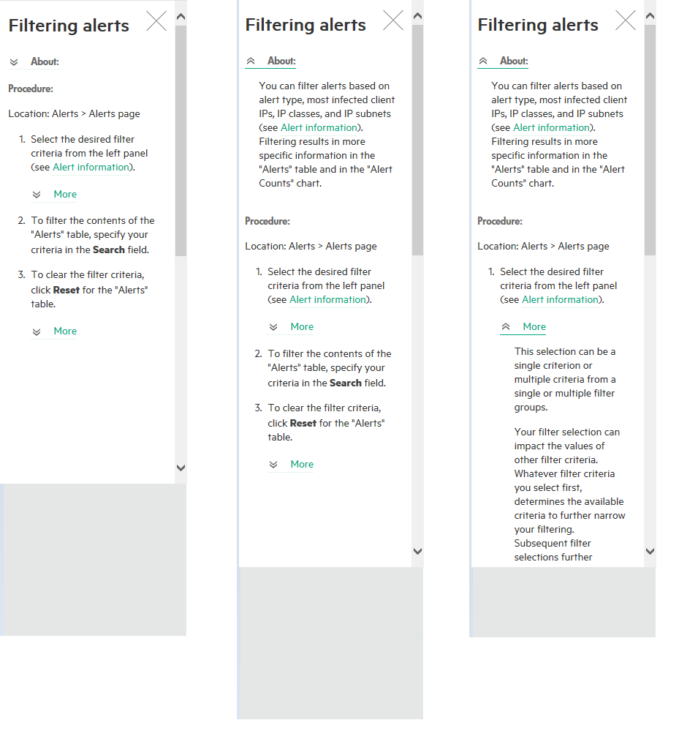
Traditional online help + intelligent content (cont.)

Slide 10
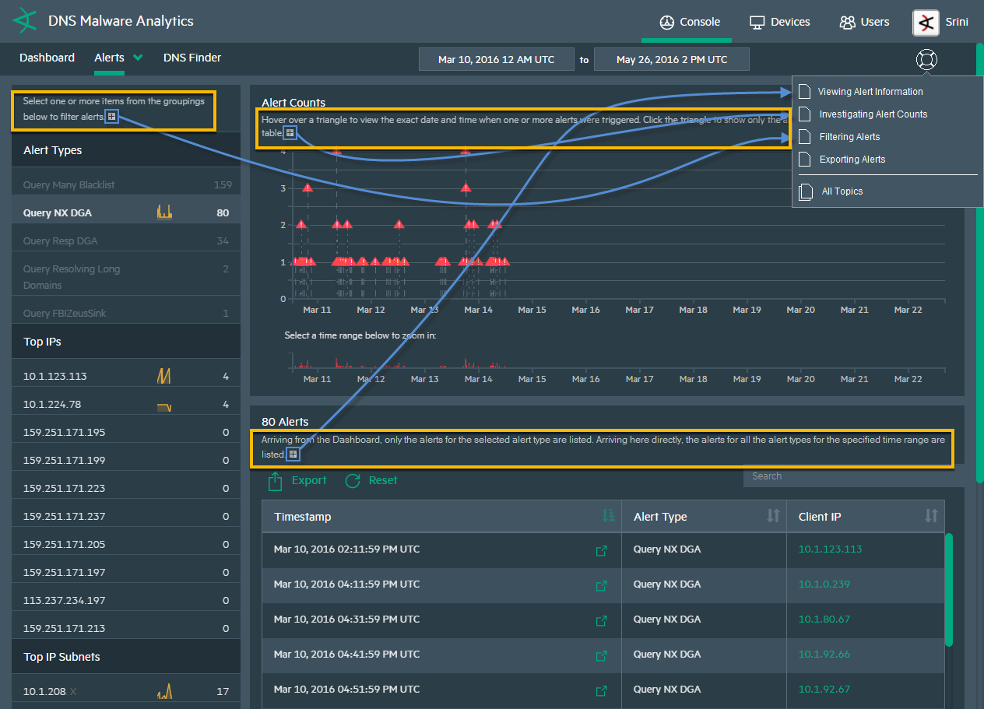
Screen text + intelligent content
The product UI is the starting place—and the most significant place, to enhance the user experience. Therefore, precision content originating from the UI could be extremely useful in aiding in a workflow.

Slide 11
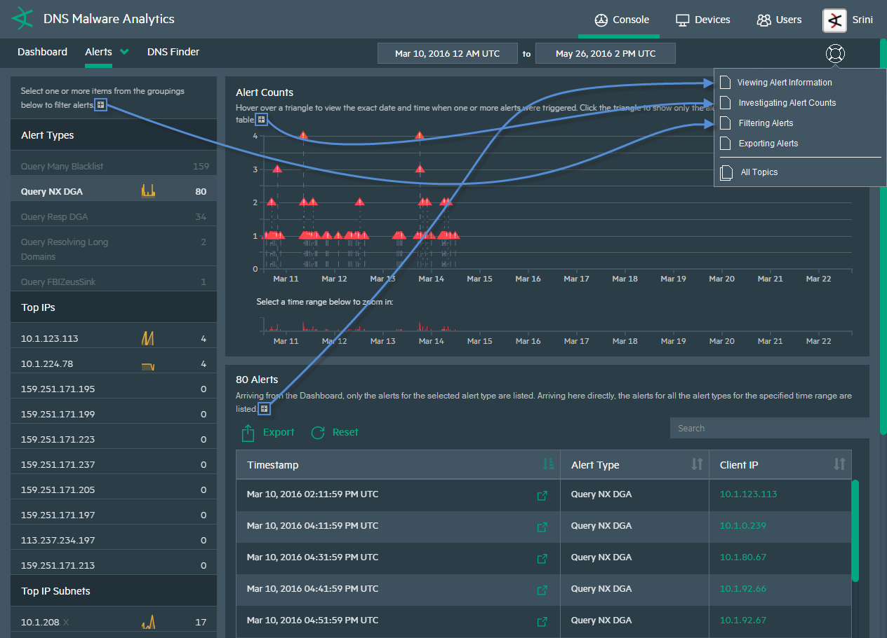
Integrated information in product UI + intelligent content

Slide 12
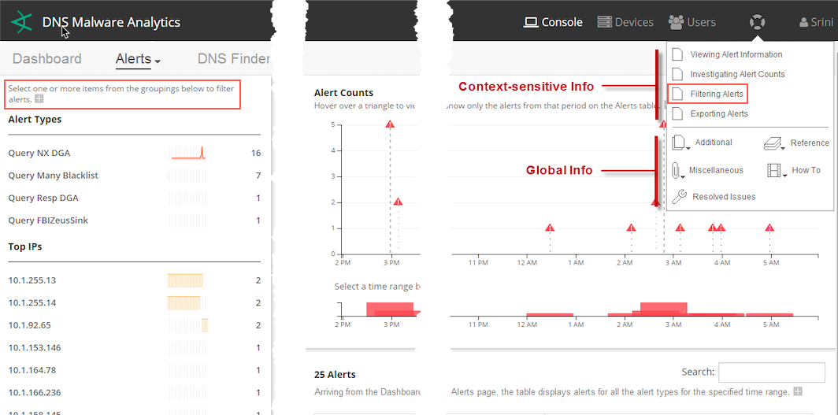
Integrated information available in product UI + intelligent content (cont.)

Slide 13
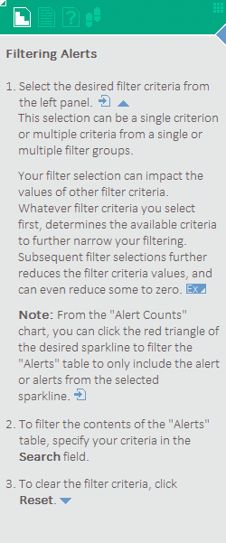
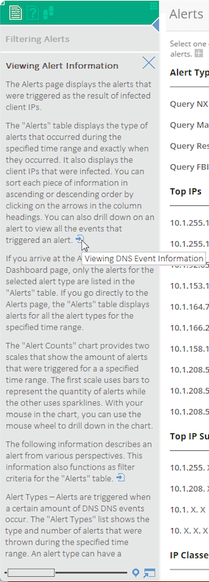
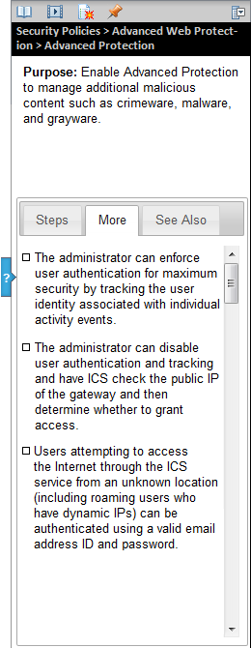
Integrated information available in product UI + intelligent content (cont.)
Help panels extend the product UI and enables users to opt into granular content as needed.

Slide 14
More about integrated information
◆ Key Points
An Integrated Information System (IIS) provides context-sensitive information integrated into the product UI.
IIS is based on Intelligent Content principles (minimalism, COPE, EPPO, DITA structure, content-aware design, etc.)
Information can be presented in the product UI as:
Embedded text
Content within a mechanism such as a panel
Animated steps (walk-thrus)
Videos
Combination of these or all of these
The IIS is an extension of the product UI and therefore does not distract from the product UI.
An “Information Hub” can be used to add further management to information and “bridge” the worlds of integrated information and traditional information delivery.

Slide 15
Intelligent Content meets flat UI design
Why the Flat UI Design is Popular
Minimal by nature
Icons and widgets are two dimensional and do not compete for attention.
Provides UI affordances as needed
Keeps the UI working space simple and clean—making functionality easily accessible and inviting
Can “tame” a functionality robust UI
Why IIS + Flat UI Design are a Happy Union
The IIS shares the design principles of Flat UI Design.
Minimal UI affordances gives the IIS a more subtle presence in the product UI, and complements the product UI.
Minimal (essential) text is in harmony with the simple and clean working space of the product UI.
DITA structure (Task, Concepts, and Reference) with minimalism applied can “tame” a complex topic.

Slide 16
What can the Integrated Information System achieve?
◆ Meet users at their point of need with the right information
This is primarily achieved with context-sensitive information integrated into the product UI. More traditional information is still supported because it’s still useful to some users.
Making users find the solution to a problem they may not understand is not serving the user and can diminish the overall UX.
◆ Provide additional information as needed
Users can opt into as much information as they require, by making information available in a granular fashion.
Information is smartly structured and is presented in a logical way, with completing the procedure as the priority.
Providing all possible information at once can be overwhelming and self-defeating.
Ultimately, benefit the product UX
A well-done IIS can ease any displeasures of an awkward product UI and can make a well-done product UI an even better UX.

Slide 17
Questions?

