Slide 1

Introduction to Docker
BUILD, SHIP, RUN
Michael Smith

Slide 2
Outline
What is Docker?
Why Docker?
Docker Concepts
  Container
  Container vs VM
  Image
  Dockerfile
  Registry / Dockerhub
  Docker Engine
Demo
Questions / Comments

Slide 3
What is Docker?
“Docker is an open source project to pack, ship and run any application as a lightweight container.”
  https://github.com/docker/docker
Docker allows you to package a piece of software in a standardized unit for software development, containing everything the software needs to run

Slide 4
Why Docker?
Consistent
  Build once, run anywhere
  Isolation and repeatability, eliminate inconsistencies between dev, test, prod environments
Scalable
  Docker containers share the host's OS which makes them much more scalable than VMs
Simple
  Simplifies the build, test, deploy process

Slide 5
Docker Concepts - Container
Docker Container
  Self contained runtime environment
    Runs in isolated process on the host's OS
  Contains software and dependencies
    Code, runtime, system tools, system libraries, etc
  Uses host machine's Linux Kernel
    Shares host's kernel with other containers
    If running windows or mac, then containers run on a lightweight Linux VM
  Runnable instance of a Docker image

Slide 6
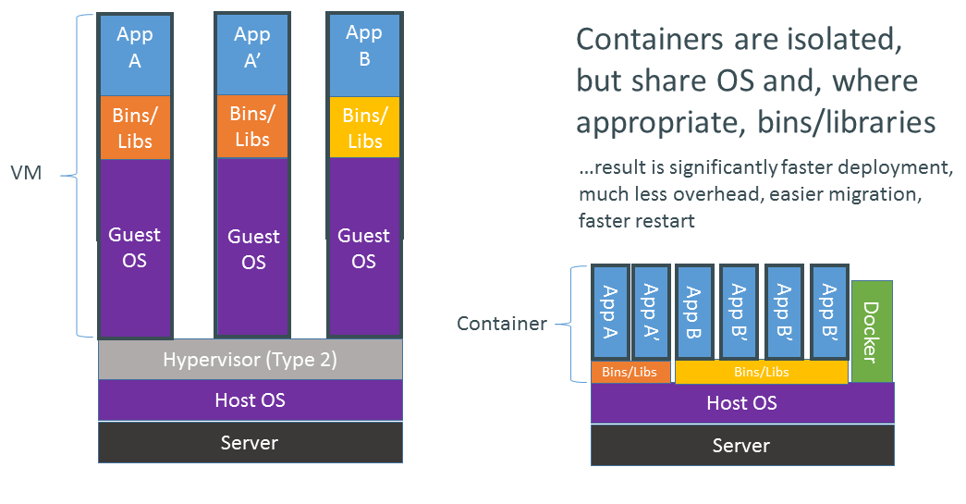
Docker Container vs Virtual Machine

Slide 7
Docker Concepts - Image
Docker Image
  Read-only template with instructions for creating a Docker container
  Immutable
    Images do not change
  Snapshot of a container
    Created via the docker commit command
  Images can also be created from a Dockerfile

Slide 8
Docker Concepts - Dockerfile
Dockerfile
  Describes a docker image
    List of instructions to assemble an image
  Simple, well-defined syntax
    Starts with a base image
    Additional commands to customize the image
  The docker build command is used to create an image from a Dockerfile

Slide 9
Docker Concepts - Registry
Docker Registry
  Public or private servers that host docker images
  You can upload, download, or search for images on a registry
Docker Hub
  Public Docker registry which serves a huge collection of existing images and allows you to contribute your own
  Centralized resource for container image discovery, distribution and change management, collaboration, and workflow automation throughout the development pipeline
  https://hub.docker.com/

Slide 10
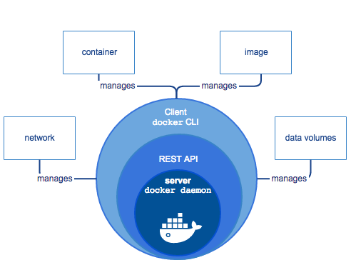
Docker Concepts - Docker Engine
Server
  Daemon process that creates and manages Docker objects, such as images, containers, networks, and data volumes
REST API
  Interfaces with daemon process
CLI Client
  Command-line interface for executing Docker commands

Slide 11
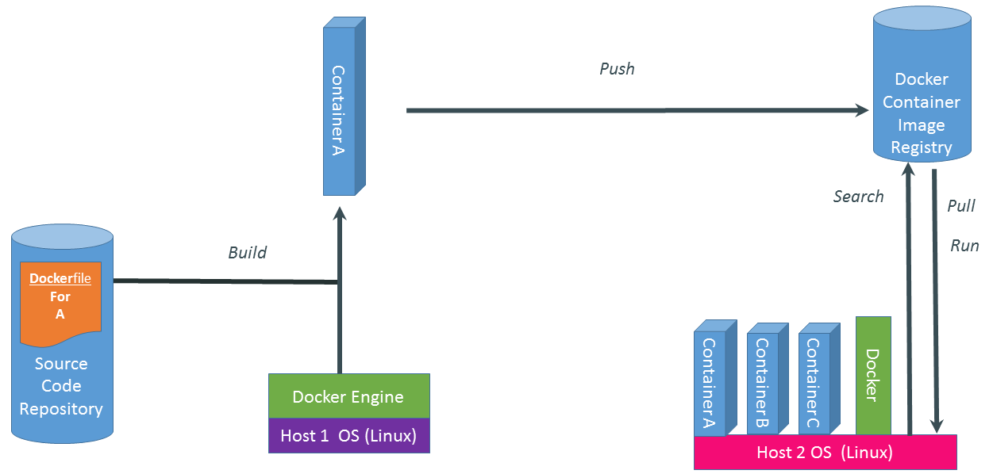
Docker Concepts - Overview

Slide 12
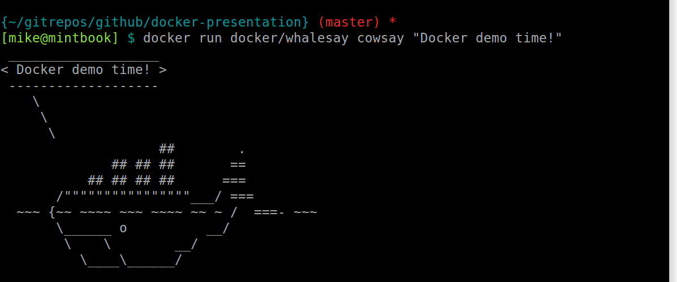
Demo

Slide 13
$ docker stop presentation
Questions or Comments?

Slide 14
References
https://www.docker.com/
https://github.com/docker/docker
https://hub.docker.com/
https://github.com/dgageot/dockercon16
https://www.youtube.com/watch?v=SK0sqfVn7ls
https://github.com/mjsmith1028/docker-presentation

