Slide 1
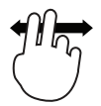
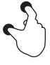
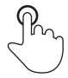





Tool Overview
 | Use two fingers to pan the model.
 | Pinch to zoom the model.
 | Tap a model component to display visibility controls.
 | Open the model visibility dialog.
 | Enable gesture mode: Draw a circle to select multiple components; tap inside the completed circle to show only the selected components; tap outside the circle to remove the selected components from the display.
 | Enable view manipulation mode: Components that lie outside of the viewing area are removed from the display as you pan and zoom the model.
 | Open the view filter dialog; view filters are applied only while the dialog is open.
 | Reset the display.

