Slide 1
Programming Graphical User Interfaces (GUI) with Java
2/2
Antonius Camara

Slide 2
About Event Handling (last week)
Event handling is a fundamental concept related to GUI’s and how to process user interactions with the GUI (events)
The slides provided by the teacher and the exercises performed in the contact sessions are not enough to ensure a comprehensive learning about the topic
To properly learn the concept, you *have* to refer to a text book that comprehensively explains the concept
The following book contains a very good coverage about the topic:
Java – How to Program, 8th Edition, Paul Deitel, Pearson, 2010 (Hard copies available from Laurea’s library)
Chapter 14 (GUI Components: Part I)

Slide 3
How to implement Apps with many screens
Having one “Main” screen and using dialog boxes to interact with the user
Standard dialogs (JOptionPane)
Messages (Errors, Alerts, Info), Confirmations, Input dialog, Option dialog
Custom dialogs (JDialog)
Beginning Java 8 API’s, chapter 2: Swing components, sections → Custom dialogs, Standard dialogs
Applications with a more complex usage of screens: Beginning Java 8 API’s, chapter 3 Advanced Swing, section → Multiple Document Interface Application
Explore other options from online resources
Ex: Using CardLayout Layout Manager (http://stackoverflow.com/questions/27687427/how-to-create-a-swing-application-with-multiple-pages)

Slide 4
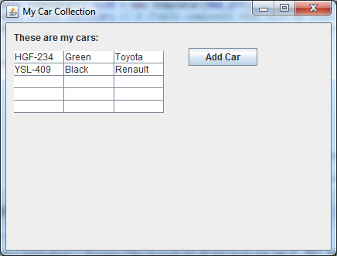
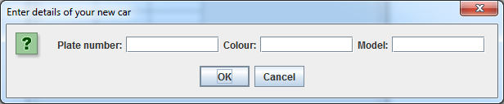
Swing Apps with many screens – In this course
Having one “Main” screen in your app and using dialog boxes to interact with the user
“Add Car” dialog box
Main screen

Slide 5
Input dialog with several input fields
Use JOptionPane.showConfirmDialog()
Give as a second parameter a JPanel object containing the input text fields
JOptionPane.showConfirmDialog
(
null,
myPanel,
"Enter details of your new car",
JOptionPane.OK_CANCEL_OPTION
);

Slide 6
Example code

Slide 7
Hands-on: Understanding the MultipleScreens.java program:
Download from GitHub the files MultipleScreens.java and SimpleCar.java
Create a project in Eclipse and add these two files (Classes) under the project’s default package
Test the application, inspect the code, and try to understand how it works. Answer the questions below to test if you have understood some basic concepts seen so far in the course:
What variables are declared as “Class variables” in the MultipleScreens.java file?
What java keyword is used to declare a Class variable?
Why the MAX_QTY variable is written in capital letters? What does the keyword “final” mean?
Why the array “myDB” is defined as a Class variable in this program?
What is the benefit of having the operations performed by “populateTable()” in an own, separate method?
Try first to come up with your own answers. You can then compare your answers with the teacher’s answers provided in the last slide of this presentation

Slide 8
Hands-on: Improving the MultipleScreens.java program:
Make the following changes in the program and test it to check if you got it right (check the outcomes in the next slide)
Increase the maximum amount of cars in the collection to 6 (MAX_QTY)
Add a new field to the Car object: “Model year”
Update items in myDB[] with this new field
Update the JTable tableCar to display the “Model year” column
The Add Car input dialog should also ask for this new field
When clicking on “Add Car”, if myDB[] already contains MAX_QTY items, the program should display a message dialog instead of the input dialog. The message displayed should be “You can not add more cars in your collection”, with an OK button

Slide 9
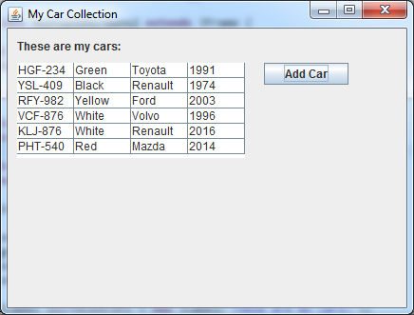
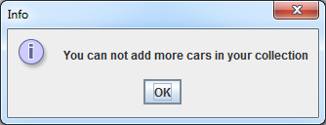
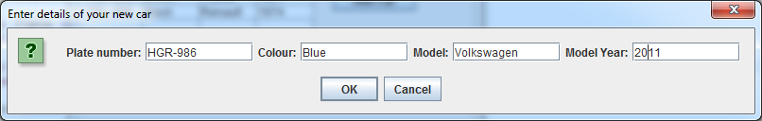
Hands-on: Improving the MultipleScreens.java program: Outcomes

Slide 10
Understanding the MultipleScreens.java program (Answers)
What variables are declared as “Class variables” in the MultipleScreens.java file?
Answer: MAX_QTY, dbItems, myDB, tableCar, btnAddCar
What java keyword is used to declare a Class variable?
Answer: static
Why the MAX_QTY variable is written in capital letters? What does the keyword “final” mean?
Answer: Variables written in capital letters are used to store CONSTANT values, i.e values that do not change during program execution. The “final” keyword is used to ensure that Java will allow the variable value to be set only once
Why the array “myDB” is defined as a Class variable in this program?
Answer: Class variables can be accessed by any method and from any place within the Class where they are defined. In the case of myDB, we need to define it as a Class variable because we need to access and modify the content of myDB from the following methods: populateTable(), initiateCarCollection(), getNewCarFromUser()
What is the benefit of having the operations performed by “populateTable()” in an own, separate method – populateTable()?
Answer: By doing this way, we are creating re-usable code. The operations performed by populateTable() can be used in different parts (by different method) of the application. For example, populateTable() is used in the constructor method MultipleScreens() and in the actionPerformed() method of the event handler class MyEventHandler

