Slide 1
Accessing a relational database with
JDBC
Object-Oriented programming
Antonius Camara

Slide 2
“Object persistence” is the goal
Until now, the objects processed in your programs were transient/temporary: i.e, when the program stops executing, the objects and their associated data are destroyed from the computer’s run-time memory
In normal applications you would like to store objects’ data after the program stops executing. This is called Object Persistence
Persistence is achieved by storing object data in files or databases
JDBC allows programs to store object data in Relational Databases

Slide 3
JDBC (Java Database Connectivity)
Standardized API to access data sources with tabular data (ex: Relational Databases)
Supported in different database vendors/providers
MySQL, MariaDB, Oracle
By using JDBC, a developer does not need to learn the database vendor’s specific API
It is also possible to change the DBMS used in an application without needing to change the application’s code
MySQL
API
Java
program
JDBC
API
Oracle
API
Other
DBMS
API
Hidden layer

Slide 4
Some JDBC Classes you will need to use
JDBC Class | Purpose | Import Package
DriverManager | Connects to the JDBC driver | java.sql.DriverManager
Connection | Setup a database connection | java.sql.Connection
Statement | Define SQL statements | java.sql.Statement
ResultSet | Contains the results of a query | java.sql.ResultSet

Slide 5
A simple example
Example from: https://docs.oracle.com/javase/tutorial/jdbc/overview/
1. Connect to the database
2. Initialize a SQL statement
3. Execute the query
4. Process the result set
Check also another instructive example at:
https://www.tutorialspoint.com/jdbc/jdbc-sample-code.htm

Slide 6
Coding object persistence is challenging
The basic idea in using the JDBC API is simple and straightforward
However, integrating a database in your application is not a straightforward task
Implementing “object persistence” in your application requires careful and good design
In the implementation of large applications you would probably use some ready made framework (Classes, methods) that provides a higher layer to interact with a database. Using such frameworks are not in the scope of this course

Slide 7
Proposed “object persistence” technique for this course’s projects
Run-time object data should be kept in the application’s object instances (ex: Car objects)
“Array Lists” should be used store collections of objects in run-time memory (ex: Array List of Car objects)
For each object Class you have in your application, you should have an associated Class that handles the operations towards the database (ex: CarQueries)
Use “Prepared Statements” to implement the SQL queries
This technique is described in the book “Java – How to Program, Paul Deitel” pages 1223-1237

Slide 8
Proposed approach - diagram
Run-time memory
Persistent
storage
carQueries.getAllCars()
SQL Select
populateTable()
Select query
(selectAllCars)
Car 1
DB
getNewCarFromUser()
Insert query
(insertCar)
carQueries.addCar()
SQL Insert
Update queries
Delete queries
Car objects stored in an ArrayList
JdbcExample.java
Car Class
CarQueries Class
The rest of the application only knows about Car objects. All operations related to manipulating Cars and Car data are done by using the public methods provided by the Car Class and CarQueries Class. The Car data model used in these interactions is the one used in the Car Class (Car objects). The rest of the application don’t need to deal with relational database specific details (tables&fields) neither need to use SQL
This class “hides” database specific details from the rest of the application. It also has the task to provide the interface that transforms the tabular Car data from the relational tables into the run-time data model of Car objects

Slide 9
Database options you can use in your computer
XAMPP
Download from: https://www.apachefriends.org/index.html
Most of you already using it
Apache (web server), DB server (originally with MySQL but later with MariaDB), PHP
phpMyAdmin for database administration
MySQL (by Oracle)
Download from: https://www.mysql.com/products/community/
Just the database server. Enough for this course as we don’t need Apache
The free version is called “MySQL Community Edition”
MySQL Workbench is the tool for database administration
MariaDB
Download from: https://mariadb.org/download/
Made by the original developers of MySQL and guaranteed to stay open source
The download package contains only a command line client for db administration. Most MySQL tools work also with MariaDB (ex: phpMyAdmin)
If you need a GUI tool you will need to install one separately. Here’s a list of options: https://mariadb.com/kb/en/mariadb/graphical-and-enhanced-clients/

Slide 10
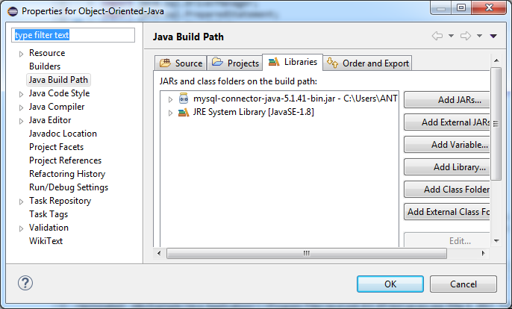
Configuring Eclipse to access MySQL with JDBC
Download the MySQL JDBC Driver (https://dev.mysql.com/downloads/connector/j/)
Extract the zip file mysql-connector-java-5.1.41.zip to a safe location in your computer
In Eclipse, Package Explorer: right click on your project -> Properties -> Libraries -> Add external JARs
Select the file “mysql-connector-java-5.1.41-bin.jar” from the location where you extracted the downloaded driver. MAKE SURE YOU ARE SELECTING THE .JAR FILE, NOT THE .ZIP FILE
After you successfully add the JAR your Java Build Path / Libraries list should contain the mysql-connector-java-xxxx-bin.jar file

Slide 11
Hands on… (jdbcExample)
Step | Notes
Check how ArrayLists work | https://www.tutorialspoint.com/java/java_arraylist_class.htm
Check how JDBC SQL prepared statements work | http://tutorials.jenkov.com/jdbc/preparedstatement.html
Make sure you have a database server installed in your computer | In the classroom computers, XAMPP should be installed
Download the JDBC driver for your database server | See instructions in a previous slide
Download the project/package jdbcExample from github | Create the project in your Eclipse IDE. Configure the properties of the project, adding the JDBC driver for your database server
In your database server, create a database with name “jdbcexample” | Import the SQL script “jdbcexample.sql” to create the cars table and some test data
Run the project (file JdbcExample.java) in Eclipse and see how the application works | Read the comments at the source code to understand how the program works. Refer also to the diagram in this presentation to visualize the program structure
Add some missing code in the program to get the “Add Car” functionality working

