Slide 1
Project files in Eclipse and Github (Local computer)
Eclipse – Project Explorer
Java project
Java package
Classes in your app (all .java files)
SQL script that creates your app db, tables, and test data
Windows – file explorer
Eclipse workspace: C://antonius_demo
Folder containing source files: C://antonius_demo/MyApp/src/myApp
When you create your local repository with GitHub Desktop App, it will create these hidden git files and folder (.git*)

Slide 2
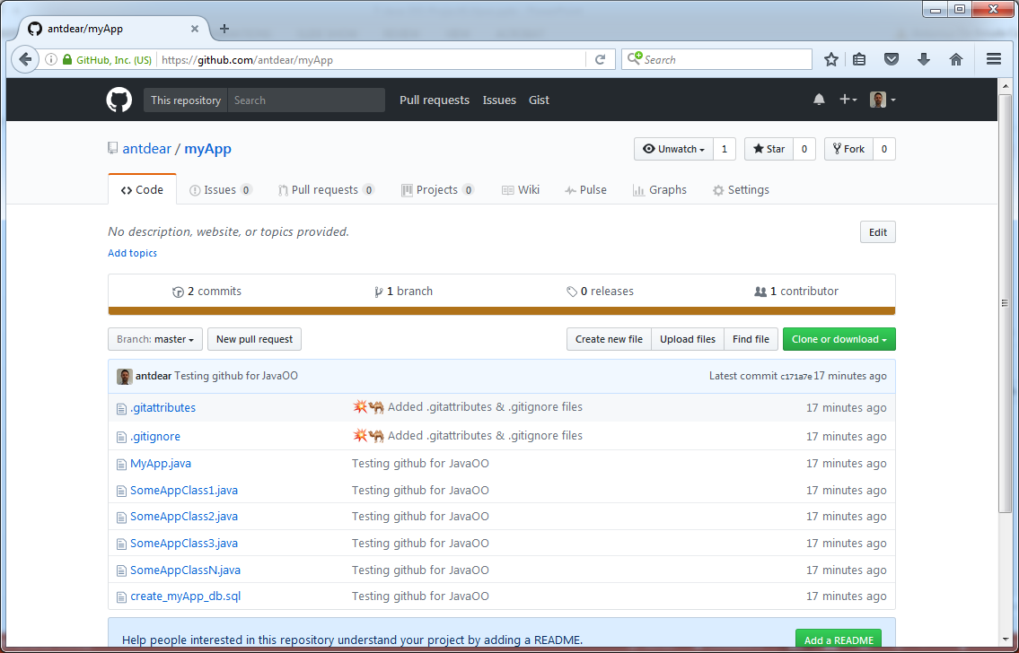
Project files in www.github.com (public repository)
Here you can see the source files of your project (.java and .sql files)

