Slide 1
Programming Graphical User Interfaces (GUI) with Java
1/2
Antonius Camara

Slide 2
GUI Libraries or toolkits
Ready set of Classes representing graphical elements and their behavior
Screens, Windows, Panels, Dialogs
UI components (widgets) : Text boxes, Labels, Check boxes, Command buttons, Tables, Scroll boxes, etc…
There are many GUI libraries available in Java
Abstract Window Toolkit (AWT): early library
Swing: Improvements over AWT, most commonly used
Standard Window Toolkit (SWT): IBM version of AWT
JavaFX: newer, targeting rich Internet apps and mobile apps. Not yet succeeding in replacing Swing. Competing with HTML/CSS frameworks in the web/mobile scene
Other toolkits: Specific purposes, 3rd parties, commercial

Slide 3
Swing Containers and Controls
Containers and Controls are the building blocks to create the user interfaces
Containers are used to hold components
A ”Canvas” where you can place the UI components
JFrame, JPanel, JWindow, JDialog, JApplet
Components
Basic GUI entities with a specific purpose
Command buttons, text boxes, labels, check boxes, etc…

Slide 4
Swing components (1/2)
Picture from: Beginning Java Programming: The Object-Oriented Approach, Baesens Bart, Wiley, 2015

Slide 5
Swing components (2/2)
Picture from: Beginning Java Programming: The Object-Oriented Approach, Baesens Bart, Wiley, 2015

Slide 6
Layout Managers
Classes that help us control how UI components are laid out in a container
Layout managers automatically position and resize components to match different screen sizes and resolutions. Responsive UIs.
When you create a Container, you specify a Layout Manager for it
Swing Layout Managers:
Absolute position (no Layout Manager. “NULL”)
FlowLayout, BorderLayout, GridLayout, GridBagLayout, CardLayout, BoxLayout, GroupLayout, SpringLayout
The effectiveness and ease of use of these layout mangers may vary a lot. Depending of the needs of your application you will need to use different layout managers
You may also need to create hierarchies of Containers (containers inside containers) with different Layout Managers to achieve your needs
Experienced programmers can also create their own Layout Managers
Designing fully functional user interfaces with Layout Managers is *outside* the scope of this course. In this course it is enough you understand the key concepts related to Layout Managers.

Slide 7
First steps in building a GUI
Create a JFrame
The JFrame contains a default container: “Root pane”
Set some properties for the JFrame and its root container
Add elements to the root container
Sub-containers
UI Components
Set properties for these elements
Add components to Sub-containers

Slide 8
JFrame and its root Container
JFrame
Root Container
JFrame properties
Container properties
Layout manager
Swing also uses Classes from AWT.
Container is an AWT Class

Slide 9
Placing components in a Container
Labels
Text boxes
Command button
JLabel properties
JTextField properties
JButton properties

Slide 10
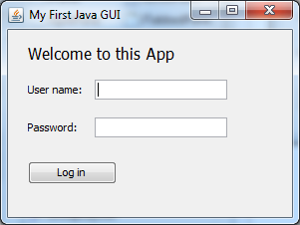
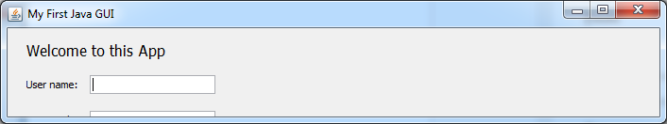
Container with no Layout Manager (Absolute Positioning)
Original dialog as designed by the programmer. The programmer manually coded the position of the UI elements
Resized screen: The UI elements remain in their original positions

Slide 11

Container with a Layout Manager (Flow Layout)
Container with FlowLayout. In this example, elements are Left aligned. The Flow Layout tries to position all elements in a single row if the container size allows so.
Resized screen: The UI elements are automatically repositioned by the Layout Manager
Note: As you see, the resizing does not have an ideal outcome. You will need to further design the UI so it works better. For example, the Username and Password field could start in a second row. To be able to optimally design the layout of your interface you may need to use sub-containers under the root container and assign different layout managers for different containers. Properly designing a user interface with Layout Managers is *outside* the scope of this course. In this course it is enough you understand the purpose of Layout Managers.

Slide 12
Coding the User Interface
Using the methods available by the Container Classes and Component Classes
In Eclipse, you can use the WindowBuilder plugin to help you designing (i.e “drawing”) the layout
Drag-and-Drop, WYSIWYG designer
WindowBuilder automatically generates the code
You will still need to “tweak” the code so it fits well to the overall architecture and standards of your code. Ex:
Renaming components’ variable names
Re-defining the scope of the variables generated by WindowBuilder
Local variables vs. Instance Variables vs. Class variables

Slide 13
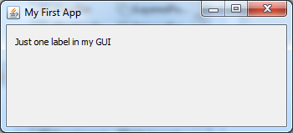
Code example: MyFirstGUI.java

Slide 14
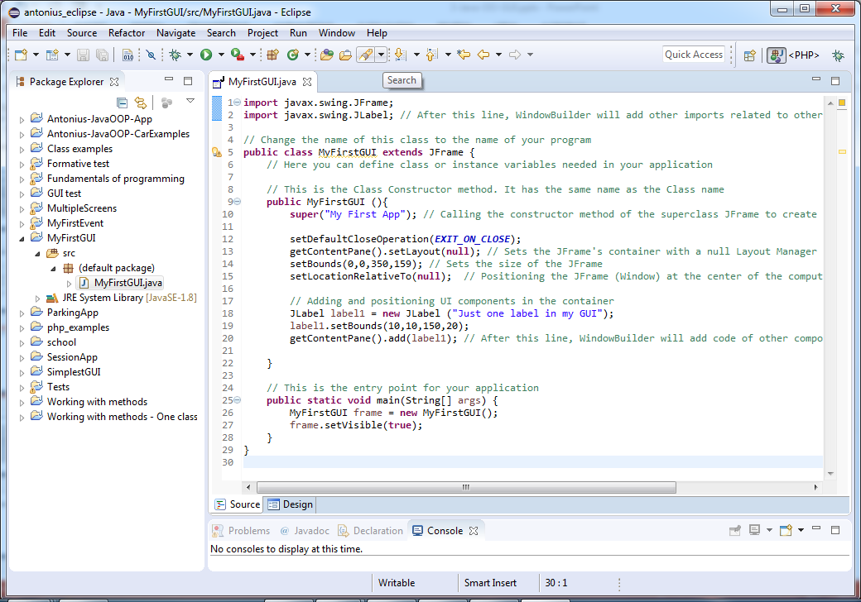
Using Eclipse with WindowBuilder
Java project
Default package
Main Class of your app

Slide 15
Open your java file (MyFirstGUI.java) with WindowBuilder editor

Slide 16
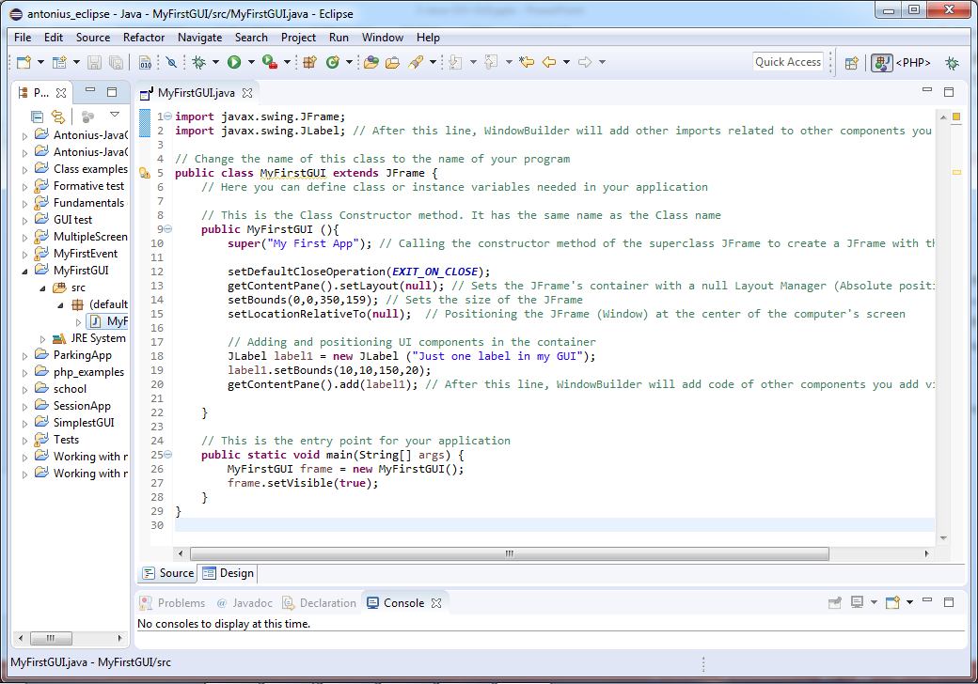
Switch between source and design view
Source View
Design View

Slide 17
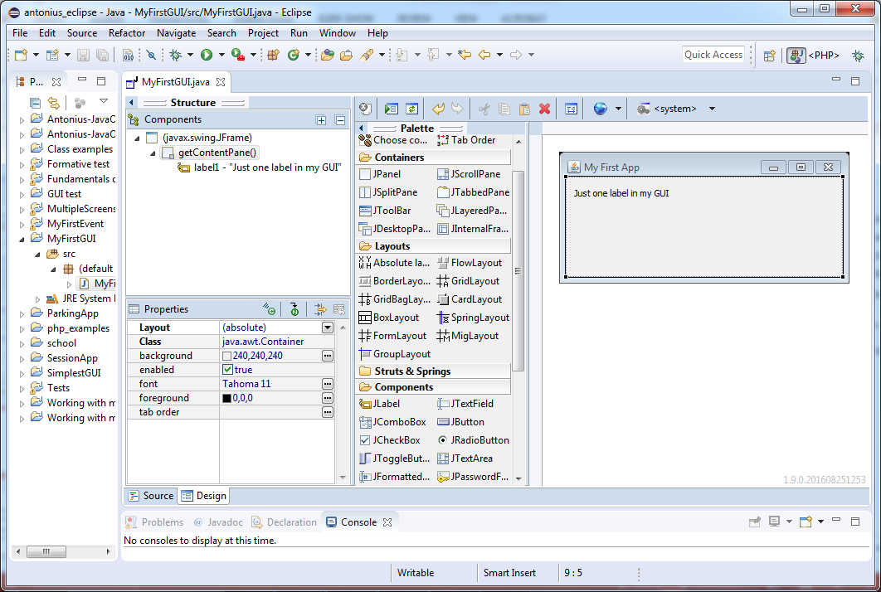
Design view
Test/Preview the window by clicking on this icon
Pick elements from these sections
Design canvas, drag-and-drop elements here
Element Properties

Slide 18
Exercise - MyFirstGUI
Download MyFirstGUI.java from GitHub
Create a project in Eclipse with the source code from MyFirstGUI.java
Inspect the code and the user interface using WindowBuilder
Via WindowBuilder’s Design tool, add:
One command button with label “Do something”
One check box with label “Select me”
Inspect the code to see the lines that were automatically added by WindowBuilder
Run MyFirstGUI.java as a java application to see how the window looks and behave
Nothing happens when you click on “Do something”, why?

Slide 19
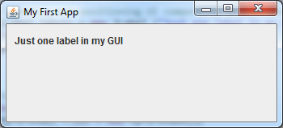
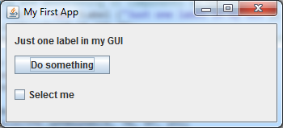
Exercise - MyFirstGUI
Before
After

Slide 20
Event handling
Event: An action taken by a user when interacting with the UI.
Clicking on a command button
Entering text in a text box
Moving the mouse over a UI component
Applications interact with the user by reacting to these events
An application should contain methods called “Event Listeners” or “Event Handlers” to react to events and process them
Some event listeners are readily coded (built in) in a Swing component. Ex: Typing text in a text box
For some other events you will need to code the event listener. Ex: Do some action when the user clicks a command button
To learn how to code an event listener you will need to refer to a book that explains the coding process in detail, with examples. Ex:
Beginning Java Programming: The Object-Oriented Approach, Baesens Bart, Wiley, 2015
Beginning Java 8 APIs, Extensions and Libraries, Kishori Sharan, Apress 2014

Slide 21
Example: Reacting to a command button (MyFirstEvent.java)
I coded this Class to handle the “ActionEvent” generated by the command button
The class should contain the method “actionPeformed” to process the ActionEvent

Slide 22
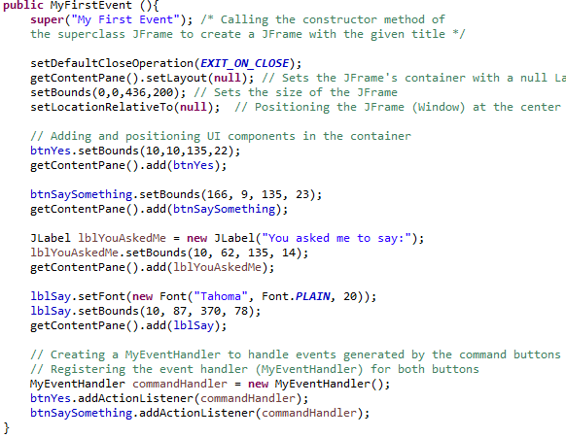
Example: Reacting to a command button (MyFirstEvent.java)
Here, you create a MyEventHandler object (commandHandler) and register it as an ActionListener for each button you want to react to

Slide 23
Explaining with a programming jargon
The action type ActionEvent is fired when you click on a JButton.
Your application should implement a Class of type ActionListener to handle the event.
In this Class you should define a method called actionPerformed to process the event.
The component that generates the event has a method called addActionListener that you should call to register your event handler for that object
btnYes.addActionListener(commandHandler);

Slide 24
Some other event types in Swing
Source: Beginning Java Programming: The Object-Oriented Approach, Baesens Bart, Wiley, 2015
For a complete list check:
Beginning Java Programming: The Object-Oriented Approach, Baesens Bart, Wiley, 2015
Chapter: Understanding Eevents
Section: Event Listeners

Slide 25
Exercise: MyFirstEvent
Download MyFirstEvent.java from GitHub
Create a project in Eclipse with the source code from MyFirstEvent.java
Inspect the code and the user interface using WindowBuilder
Edit the code to add a phrase you would like the application to display when you click on “Say something”
Run MyFirstEvent.java as a java application to check the results

