Slide 1
ORQENTIS
Data contracts, enforced.
The Microsoft Fabric–native control plane for ODCS v3.1.0.
AI-assisted authoring · OneLake-deep enforcement · Activator-grade alerts
Microsoft Fabric ISV
ODCS v3.1.0
AI-Native
Series Seed
Investor Deck · 2026 · Confidential

Slide 2
THE PROBLEM
Every modern data team is silently broken by undeclared contracts.
Lakehouses run on tribal knowledge. Schemas drift. PII leaks. Dashboards lie. AI models train on bad data.
$12.9M
84%
0
Average annual cost of bad data per enterprise (Gartner, 2023). 60% of AI projects stall on data quality.
Data engineers say schema breakage is their #1 incident driver. Producers and consumers never sign an agreement.
Number of Fabric-native tools that enforce a portable ODCS contract on Delta tables. Until now.
Orqentis | Investor Deck | Confidential
02 / 14

Slide 3
WHY NOW
Three tectonic shifts make this the moment.
Microsoft Fabric is the new center of gravity.
Fabric crossed 19,000 paying enterprise customers in 2025 and ships with OneLake, the first universal multi-cloud data lake. Every Fortune 500 either runs it or evaluates it. The platform finally exposes a real workload SDK for ISVs.
ODCS v3.1.0 just standardised the contract.
Bitol Foundation (Linux Foundation) shipped ODCS 3.1 in 2025: a portable YAML spec for schema, quality, SLA, security, and AI metadata. Adopted by JPMorgan, PayPal, Roche, AT&T. Replaces 10 proprietary catalog dialects.
Agentic AI demands provable data lineage.
Regulators (EU AI Act, US NIST AI RMF) now require demonstrable provenance for any data used in AI. ‘Trust me, the dashboard is correct’ doesn’t pass an audit. Contracts are the audit artifact.
Orqentis | Investor Deck | Confidential
03 / 14

Slide 4
OUR SOLUTION
Orqentis is the Fabric-native ODCS enforcer.
Author, evaluate, and enforce ODCS v3.1.0 contracts directly on OneLake Delta tables — without leaving Microsoft Fabric.
Author
Evaluate
Enforce
Explain
Monaco YAML with ODCS JSON-Schema IntelliSense, AI suggest from real samples, drift-aware reviews.
Engine reads Delta logs over OneLake (OBO) and runs schema, quality, SLA, freshness, and PII rules in <60s.
Block downstream pipelines, raise Activator alerts, write back violations as catalog tags — fully auditable.
AI agents translate violations into plain-English remediation tickets routed to Teams + Jira + ServiceNow.
Orqentis | Investor Deck | Confidential
04 / 14

Slide 5
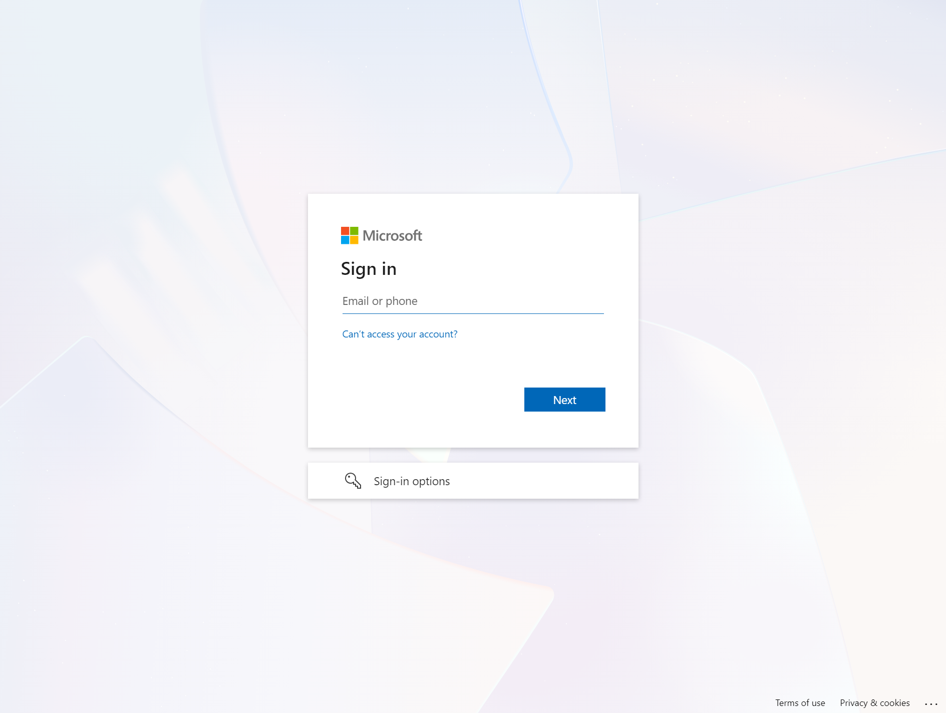
PRODUCT · FABRIC INTEGRATION
Native inside Microsoft Fabric — no portal-switching tax.
Orqentis ships as a first-class Fabric workload. Users discover, create, and govern contracts from the same hub where they author lakehouses and pipelines.
■ Workload hub. Listed alongside Lakehouse, Notebook, Pipeline.
■ Item types. Contract · Policy · Run · Report — each a Fabric item.
■ Workspace-aware. OBO tokens enforce existing Fabric RBAC.
■ Theme-aware. Inherits Fluent UI v9 tokens from the host portal.
Orqentis listed in the Microsoft Fabric workload hub
Orqentis | Investor Deck | Confidential
05 / 14

Slide 6
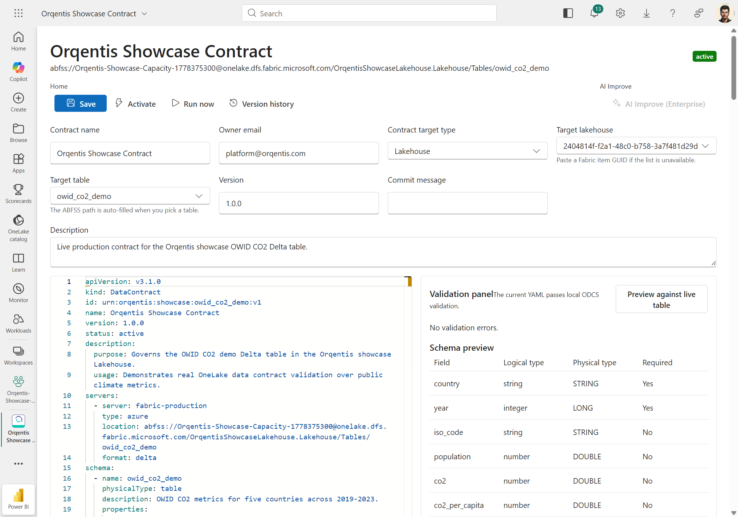
PRODUCT · CONTRACT EDITOR
Author ODCS contracts with AI assistance, not a wiki page.
■ Monaco + ODCS schema. Autocomplete, hover docs, inline lint.
■ AI suggest. GPT-4o reads a sample of the target Delta table and proposes schema, quality, and PII rules.
■ Diff & review. Drift detection vs. the previous active contract version.
■ Multi-target. Lakehouse, Warehouse, Eventhouse, Semantic model, Fabric SQL.
ODCS YAML editor with live JSON-Schema validation and AI suggest
Orqentis | Investor Deck | Confidential
06 / 14

Slide 7
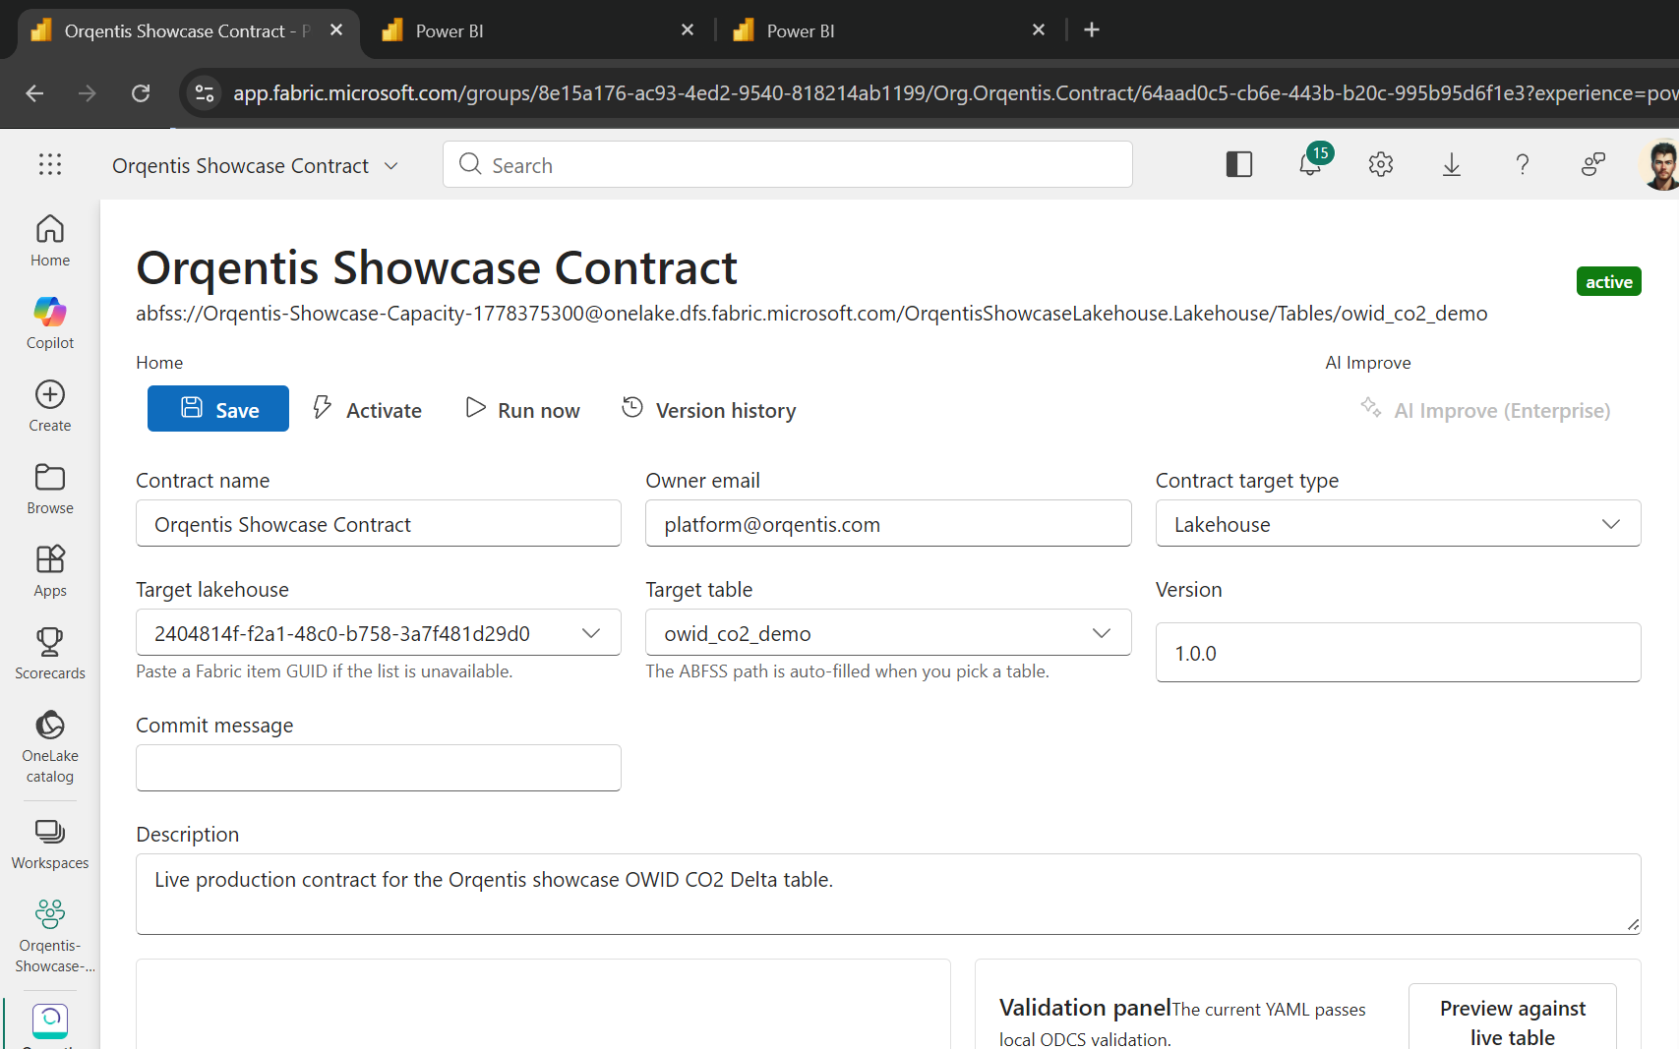
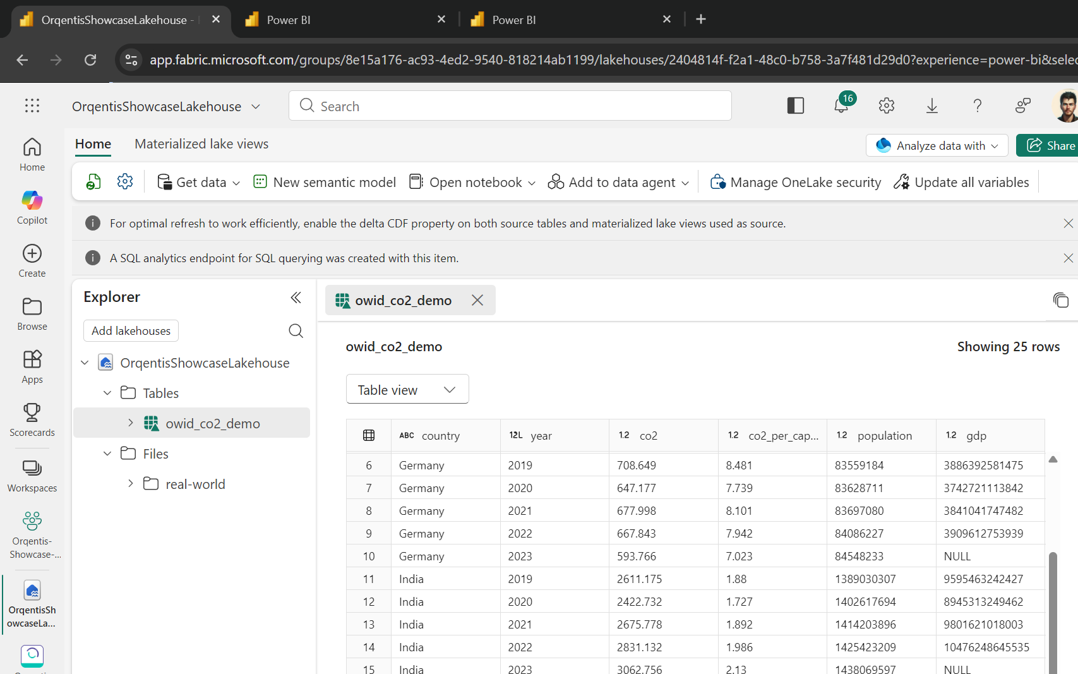
PRODUCT · ENFORCEMENT
Enforcement runs in <60s, with explainable violations.
Run-now: schema, quality, freshness, PII results in one view
Delta table on OneLake — evaluated in-place, no data movement
Orqentis | Investor Deck | Confidential
07 / 14

Slide 8
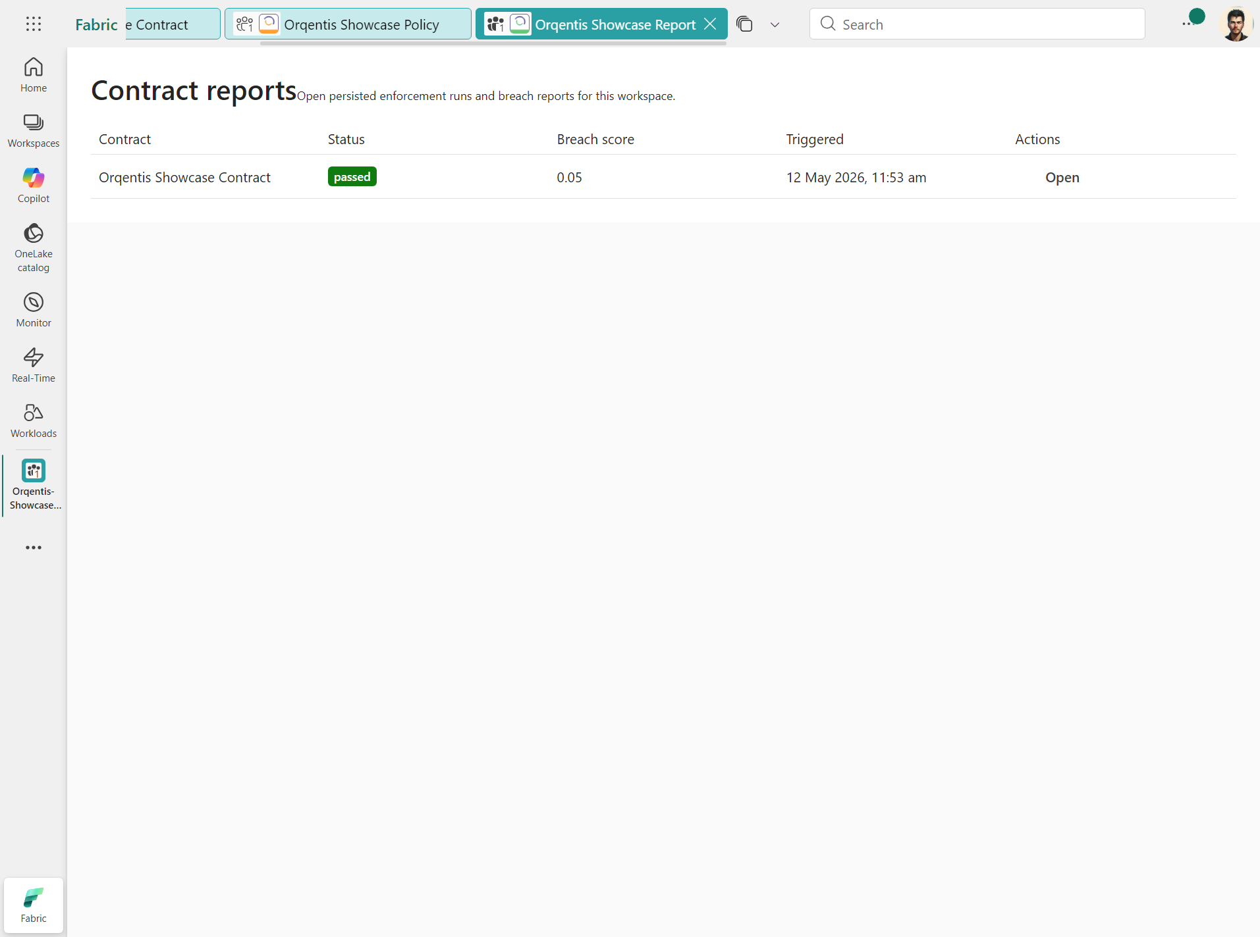
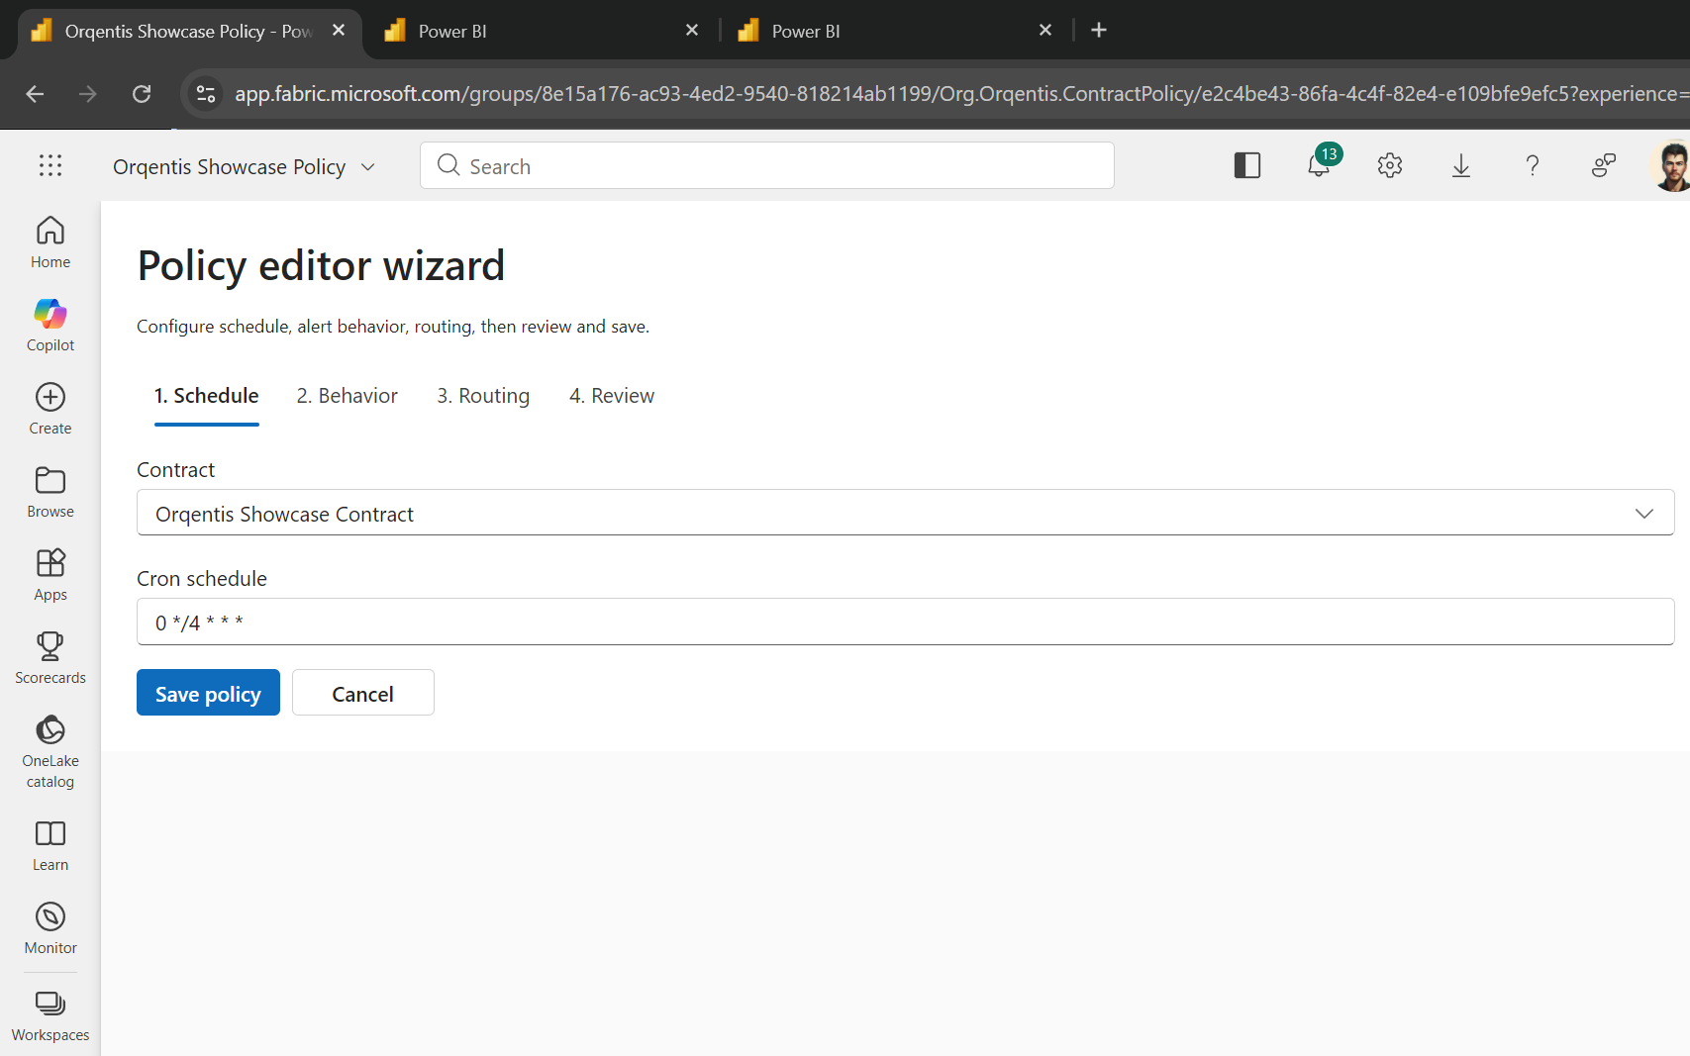
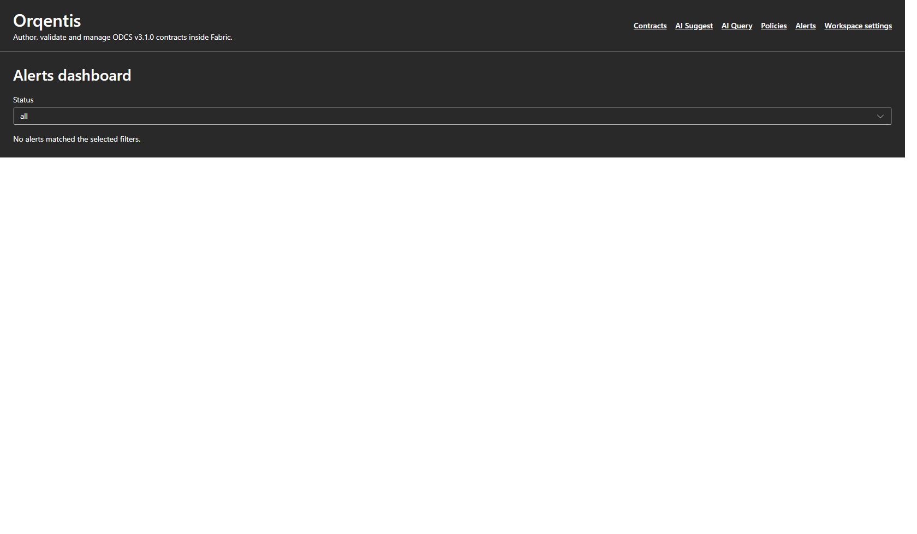
PRODUCT · GOVERNANCE
Policies, reports, and Activator-grade alerts.
Policy wizard — block, warn, or quarantine on violation
Contract report — drill-down by table, rule, run
Alerts dashboard with Activator + Teams + Jira routing
Orqentis | Investor Deck | Confidential
08 / 14

Slide 9
ARCHITECTURE
How it works.
Fabric Portal
Orqentis API
Engine + AI
OneLake (Delta)
Activator + Teams
React 18 · Fluent v9
@ms-fabric/workload-client
.NET 8 · ASP.NET Core
EF Core · Hangfire
ODCS validator
Azure OpenAI GPT-4o
Claude 3.7 fallback
OBO token
Delta log reader
Zero data movement
Webhooks
Jira · ServiceNow
Audit log
Built-in guarantees
■ OBO-only OneLake access — application identity is forbidden on the data plane.
■ Soft-delete + UTC + correlation-id on every API call, log, and webhook.
■ ODCS v3.1.0 JSON-Schema validator is authoritative; nothing persists active without passing.
■ All LLM calls wrapped in 15s timeout + 3-retry Polly + empty-template fallback.
Orqentis | Investor Deck | Confidential
09 / 14

Slide 10
DIFFERENTIATION
Why Orqentis wins where catalogs fail.
Capability
Purview
Collibra
Informatica
Open-source
(Soda, Great Expectations)
Orqentis
Fabric-native (OneLake OBO)
Partial
No
No
No
Yes
ODCS v3.1.0 portable contracts
No
No
No
Partial
Yes
AI suggest from real Delta sample
No
No
No
No
Yes
Block-on-violation enforcement
No
No
Partial
Partial
Yes
Activator + Teams + Jira routing
No
No
No
No
Yes
Time-to-first-contract
Weeks
Weeks
Months
Days
Minutes
Orqentis | Investor Deck | Confidential
10 / 14

Slide 11
MARKET
A $14B governance market, with Fabric as the wedge.
TAM
SAM
SOM (5 yr)
$14.1B
$3.6B
$220M
Global data governance + observability + catalog software, 2027 (IDC, Gartner blend).
Enterprises standardised on Microsoft Fabric / OneLake, 19k+ orgs and growing 60% YoY.
Top 2,000 Fabric tenants at $110k ACV — conservative 6% penetration via Marketplace + MS co-sell.
Go-to-market
Fabric Marketplace
Co-sell with Microsoft
PLG → enterprise
1-click install, transactable, MACC-eligible (Microsoft Azure Consumption Commitment).
Aligned to Fabric ISV motion; Field Engagement program qualified.
Free contract authoring, paid enforcement + AI suggest + audit retention.
Orqentis | Investor Deck | Confidential
11 / 14

Slide 12
TRACTION
Shipped, green, and Marketplace-ready.
263
93.8%
ODCS 3.1.0
Pixel-perfect
backend tests passing
frontend coverage in critical paths
schema-validated, end-to-end
Fluent v9, principal-designer reviewed
Recent milestones
■ UI / UX overhaul Pixel-perfect Fluent UI v9 sweep across every page — Fabric portal indistinguishable.
■ CI green for the first time in months Resolved 7 pre-existing pipeline gates (CSP, lint, dotnet format, trivy, NuGet vulns, coverage, Bicep drift).
■ Data Security for AI Differentiation map vs Purview/Collibra/Informatica; PII classifier wired to AI suggest.
■ Complex scenarios suite ODCS contracts validated end-to-end on real customer-shape data (knowledge graphs, ontologies, multi-table entities).
■ Live Fabric workload Listed in workload hub; OBO-authenticated; contract → run → report flow demoable today.
Orqentis | Investor Deck | Confidential
12 / 14

Slide 13
ROADMAP
Where the next four quarters take us.
Now
Next
Later
GA on Fabric Marketplace
Enterprise scale
Platform
■ ODCS 3.1 enforcement (Lakehouse, Warehouse, SQL)
■ AI suggest + Activator alerts
■ Audit log + RBAC parity with Fabric
■ Co-sell readiness pack
■ Eventhouse / KQL contracts
■ Cross-tenant contract sharing
■ Quarantine + auto-remediate
■ SOC 2 Type II
■ Open contract registry (federated)
■ Contract-as-code GitHub action
■ Multi-cloud (Databricks Unity, Snowflake) via ODCS
■ Agentic remediation copilot
Orqentis | Investor Deck | Confidential
13 / 14

Slide 14
FUNDING
FUNDING
The ask.
The ask.
Seed round
WHY US, WHY NOW
$4M
■ First-mover. The only Fabric-native ODCS enforcer in market.
■ Standards moat. Bitol/ODCS committer access; we shape the spec.
■ Microsoft alignment. Built on the Fabric Extensibility Toolkit since day one.
■ Pixel-perfect product. Live, demoable, principal-designer validated.
18-month runway to Fabric Marketplace GA + 25 paying logos.
■ 40% Engineering — close Eventhouse + remediation copilot.
■ 30% Go-to-market — Microsoft co-sell + Marketplace listing.
■ 20% Security & compliance — SOC 2 Type II.
■ 10% Design partnerships with 3 Fortune-100 Fabric tenants.
Contact
founders@orqentis.io · orqentis.io
Orqentis | Investor Deck | Confidential
14 / 14

