Slide 1
2022-09-05
목적
전문 지식
문제 해결 능력
프로그래밍 능력
관리
의사 소통 (정치)
수업 개요
운영체제
수업 진행 방법
수업 진행
이론/설계
프로그래밍
보고서
수업 요약 보고서
프로그램
팀 구성
3명-4명
평가
보고서 40%
기말 프로젝트 30%
중간 평가 20%
출석 10%

Slide 2
보고서 작성방법
E-class 과제 함에 Upload
보고서
학번_이름.pdf
프로그램
Zip으로 Java Project를 압축하여
학번_이름.zip
과제

Slide 3
운영체제
컴퓨터 구조
CPU
Memory
Storage
IO Devices
Keyboard, Mouse, Monitor, …
Operating System
Resource Manager
Process Management
Memory Management
File System Management
Disk Management
Io Device Management
User Interface Manager
Computer
생각
Storage
Memory
CPU
Programming
Program
Process
Program.exe
IO device
IO device
IO device
IO device

Slide 4
Process Management
Process
Program in execution
Program
Code Segment
Data Segment
Stack Segment
Heap Segment
Storage
File System
Memory
CPU
Program1
Process1
CU
Program2
Process2
ALU
Registers
Monitor

Slide 5
Program
Code Segment
Data Segment
Stack Segment
Heap Segment
Process
Code Segment
Data Segment
Stack Segment
Heap Segment
Program1
Process1
Process1
Data segment =4096
Stack segment =2048
Heap segment =4096
Process1
Data segment =4096
Process1
Data segment =4096
Data segment =4096
Data segment =4096
Code segment
Move @s.4, R1
Move R2, @s.8
Add R1, R2
Move R2, @s.8
Stack segment =2048
Stack segment =2048
Stack segment =2048
Stack segment =2048
Code segment
Move @s.4, R1
Move R2, @s.8
Add R1, R2
Move R2, @s.8
Code segment
Move @s.4, R1
Move R2, @s.8
Add R1, R2
Move R2, @s.8
Code segment
Move @s.4, R1
Move R2, @s.8
Add R1, R2
Move R2, @s.8
Code segment
Move @s.4, R1
Move R2, @s.8
Add R1, R2
Move R2, @s.8

Slide 6
Multi-Tasking
Time-Slice
Context-Switching
CPU >PC = 50000
/
CPU >PC = 50004
Context-Switching
CPU Registers -> Process1.ProcessControlBlock
CPU >PC = 100000
/
Context-Switching
CPU >PC = 200000
/
Context Switching
Process1.ProcessControlBlock -> CPU Registers
PCB
Process1
Data segment =4096
Stack segment =2048
Code segment
Move @s.4, R1
Move R2, @s.8
Add R1, R2
Move R2, @s.8
50000
1
CPU
4
PC
Process1
IR
Data segment =4096
R1
Stack segment =2048
100000
Rn
2
Code segment
Move @s.4, R1
Move R2, @s.8
Add R1, R2
Move R2, @s.8
Process1
Data segment =4096
Stack segment =2048
3
200000
Code segment
Move @s.4, R1
Move R2, @s.8
Add R1, R2
Move R2, @s.8

Slide 7
2022-09-07
진행
Boot up Process
BIOS
Memory
Storage
Keyboard/Mouse
Monitor
OS
UI Command
Process
Memory Layout
CPU
BIOS
Storage
OS
Memory
OS
Application
Program
Loader
Scheduler
Application
Process

Slide 8
Single Process Management
Application Program
Void execute(lineNumber) {
Switch(lineNumber) {
Case 0:
F1();
Case 1:
F2();
}
}
CPU
BIOS
Storage
OS
Memory
OS
Application
Program
Loader
Scheduler
Instruction
Application
Process
10000
Instruction
Instruction
Instruction

Slide 9
2022-09-14
Process Scheduling
CPU
While(PowerOn) {
Execute (PC)
Result = CheckInterrupt();
OS.processInterrupt(Result);
}
Scenario
Process 1: I1 -> I2
Process 2: I1 –> I2
Process 1: I3
Process 2: I3
100
Scheduler
200
Process1
CPU
I1
Ready Queue
I2
Interrupt
200
300
I3
300
Process2
I1
200
I2
I3
300

Slide 10
Context Switching
Time-Slice
Process Control Block (PCB)
Scenario
Process1.PCB -> CPU.Context
Process 1: I1 -> I2
CPU.Context -> Process1.PCB
Process2.PCB -> CPU.Context
Process 2: I1 –> I2
CPU.Context -> Process2.PCB
Process1.PCB -> CPU.Context
Process 1: I3
CPU.Context -> Process1.PCB
Process2.PCB -> CPU.Context
Process 2: I3
CPU.Context -> Process2.PCB
Scheduler
100
CPU
Process1
Interrupt
200
Process Control Block
I1
I2
I3
Process2
300
Process Control Block
I1
I2
I3

Slide 11
프로그램 실행 과정
1. Loader.createProcess
Program -> Process
2. CPU.loadProcess
PCB 에 Context를 생성
Ready Queue에 EnQueue
3. CPU.run
4. Process.execute()
Loader
2.load
1. new
Process1
Process Control Block
CPU
process
I1
4. execute
I2
Interrupt
I3
3.run

Slide 12
2022-09-19
진행
구현
Context Switching
Multi-Task
Scenario
UI
Loader
Load Process1
Scheduler::ReadyQueue.enqueuer(Process1)
Scheduler
While(PowerOn) {
Load CpuContext to processContext
Process = Get Process From RedayQueue
Load processContext to CpuContext
While (interrupt) {
Process.execute
Check Interrupt
}
}
UI
Exe
Loader
Scheduler
p1 | p2
PCB
200
Process1
I1
CPU
I2
I3
300
PCB
Process2
I1
I2
CPU
I3

Slide 13
과제
Context Switching
Scheduler 구현
EA – Class/Sequence Diagram

Slide 14
2022-09-21
진행
Scheduler 구현
역할
User process 실행
User Process 관리
Execute-Terminate
Time-Slice
IO Start-End
Process Queue
Ready Queue
Time Slice
Wait Queue
IO Complete

Slide 15
Scheduler running
eInterrupt = checkInterrupt()
Case based function call
System strart/end/sleep
Io Start/end
Timeout
➔ select Runnning process and Context switching
Memory
CPU
Scheduler
Instruction
p1 | p2 | p3
Ready queue
Interrupt Register
Wait queue
Process1
Timer
Process2
IO Controller
Process3

Slide 16
과제
결과
P1::L0
P1::L1
P2::L0
P2::L1
P3::L0
P3::L1
P1::L2
P1::L3

Slide 17
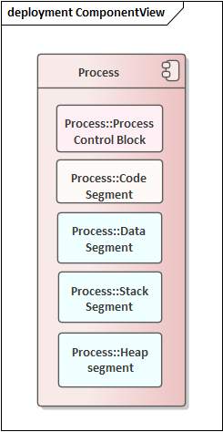
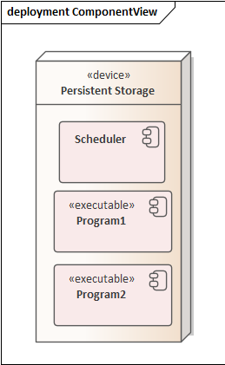
2022-09-26
진행
Multi-Tasking
Process 설계
Suspend
600
CS
0 int x
1 Line1
2 Line1
3 Line1
4 Line1
5 Line1
DS
800
PC
execute
SS
HS

Slide 18
PCB
Process state
The state may be new, ready, running, waiting, halted, and so on.
Program counter.
The address of the next instruction to be executed.
CPU registers.
Accumulators, index registers, stack pointers, and general-purpose registers, plus any condition-code information.
CPU-scheduling information.
A process priority, pointers to scheduling queues, and any other scheduling parameters.
Memory-management information.
The value of the base and limit registers and
the page tables, or the segment tables, depending on the memory system used by the operating system.
Accounting information.
The amount of CPU and real time used, time limits, account numbers, job or process numbers, and so on.
I/O status information.
The list of I/O devices allocated to the process, a list of open files, and so on.

Slide 19
최초 실행
Loader
Program -> Process
Initalize newProcess::PCB – segment Registers
Add newProcess to ReadyQueue
Context Switching
PreCondition
OldProcess Running
TimerOut Interrupt
Context Switching
CPU:Context -> oldProcess:PCB
add oldProcess to ReadQueue
Get newProcess from ReadyQueue
newProcess::PCB -> CPU::Context
Segement Registers
ALU Registers
CU Registers
PC
newPrcess Status Setting
중간/기말 프로젝트
실행
UML
Reverse Engineering
Class Diagram
Sequence Diagram

Slide 20
과제
Process 실행
다음 시간
Loader 설계

Slide 21
2022-09-28
진행
Loader
Executable File -> Process
Executable File
Process 관련 정보
File 관리 정보
기계어 집함
Compiler
Machine Instruction Generation
Compile
Link
Loader
Load

Slide 22
Compile
Lexical Analysis – 단어를 추출
Parsing – 문법적 구조에 맞추러 문장을 구성
Symbol Table
Memory Allocation
Parse Tree
Code – Generation
Obj, Class
Link
Static Lib
Exe
Code size 40
Data size 0
Stack size 4096
Heap size 4096
1. Mv @0, 0
2. Interrupt Read, @4
3. mv @8, 0
4. bgt @8, 10, 7
5. …
6.
7.
Int sum = 0;
Int length = Read();
For (int i=0; i<10; i++) {
sum = sum + I;
}
Print(sum);
sum | int | 0
length | int | 4
I | int | 8
VM
CPU

Slide 23
Loader
Read Exe
Parse Header
Memory Allocation
Memory Layout
Segment Register
PC
Run-Time Library
Link
과제
Program이 Process화 되는 과정 시나리오

Slide 24
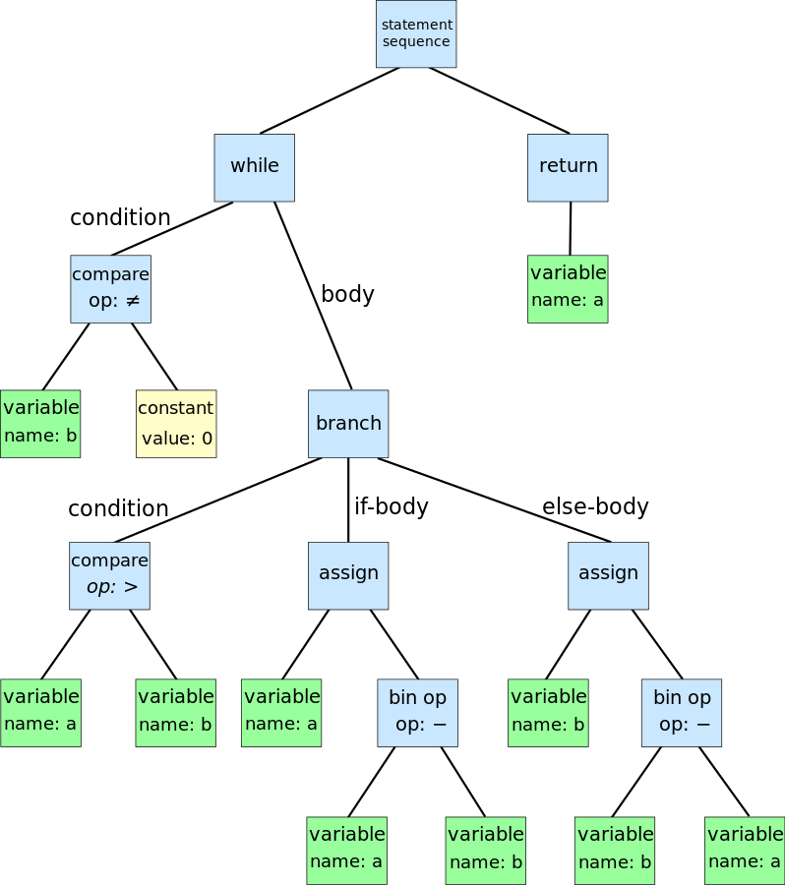
참고
Parse Tress
Abstract Syntax Tree

Slide 25
.program
.data
codeSize 40
dataSize 0
stackSize 4096
heapSize 4096
.code
move @0, 0
interrupt Read
move @4, r0
move @8, 0
.label loop
compare @8, @4
jumpGraterThan loopEnd
add @8, 1
jump label
.label loopEnd
move r0, @4
interrupt write
Halt
.end

Slide 26
2022-10-03
진행
기계어
프로세스
Operator | Operand1 | Operand2

Slide 27
Memory Allocation
Data Segment
Static Variables
Stack Segment
Function Memory
Function call
Heap Segment
Dynamic Allocation
new
PCB
Class C {
Int c, d, e;
void f() {
Int x, y, z
}
}
Int static main() {
C c = new C();
c.f();
}
Loader
Code
Data
c
Stack
x
y
Activation
Record
z
Heap
c
d
e
Process Memory Layout

Slide 28
Machine Code
static void main() {
Int x;
Int y;
Int z;
X = 0;
Y = Read();
Z = 0;
While (x<=y) {
Z++;
}
Write(z);
}
.program
.data
codeSize 40
dataSize 4096
stackSize 4096
heapSize 4096
.code
move @0, 0
interrupt read
move @4, r0
move @8, 0
.label loop
compare @0, @4
jumpGraterThan loopEnd
add @8, 1
jump label
.label loopEnd
move r0, @8
interrupt write
halt
.end
PCB
Code
Data
x
y
z
Stack
Heap

Slide 29
Initial Architecture
CPU
Memory
Loader
File System
Exe
Scheduler
Process
Ready Queue
Process
UI

Slide 30
2022-10-05
진행
구현
Loader
Process
참고)
Java Virtual Machine
Src
Obj
/
Byte Code
Exe
Process
Exe
Compile
Link
Loader
JVM
JVM
Static Lib
System Lib
Windows
Linux
Runtime Lib
HW
HW

Slide 31
프로그램 방식
함수적
객체지향적
참고)
Modularity
Self-Contained
Loader
exe
LMS
Read()
Write()
Process
Student
// Attributes
Int id;
Int address
Read()
Write()
Lecture
// Attributes
Int id;
Int address
Read()
Write()
Loader
Process
exe
File

Slide 32
과제
Scheduler를 한줄 씩 실행
할 일
Scheduler
Instruction Execution
Interrupt Handling
Multi-Tasking
Memory Management

Slide 33
2022-10-10
중간 평가
10/24 수업 시간
면접 평가
코드 제출 : 평가 당일 00:00 까지
평가 내용
Scheduler로 Process 실행
Exe 작성 : 20점
Loading -> Process 만들기 : 30점
Scheduler 실행 : 20점
Ready Queue 10
Wait Queue/ Interrupt 20
기타 추가 기능
기능 당 10점 씩

Slide 34
진행
Scheduler를 한 줄 씩 실행
UI.run
Loader.load()
Scheduler.getReadyQueue.enqueue(process)
Scheudler.run
readyQueue.dequeue()
Scheduler
Loader
Ready Queue
Timer
exe
Process
Process

Slide 35
Interrupt
1) time-out
2) IO Started
3) IO Terminated
CPU
Scheduler
Loader
Process
Process
Process
Scheduler
Process
Interrupt
Timer
Process
Process
Scheduler
Process
Process
Process
3
Process
Process
2
Interrupt
File System

Slide 36
2022-10-12
진행
Thread and Critical Section
Thread1
Thread2
UI
Loader
Scheduler
User
Ready Queue
Process

Slide 37
Thread
Execution Sequence
Thread1
Thread2
Critical section : Data2
O1
f1
f2
O2
f1
f2
O3
f1
f2
data1
data2
data3
Void f2() {
data2 = 23;
}

Slide 38
2022-10-17
구현
Scheduler <계속>
Thread1
Thread2
Thread3
UI
Loader
Scheduler
Interrupt Handler
File System
User
Ready Queue
Process
Interrupt Queue

Slide 39
File Read
File file = new File(“data”);
file.read(x);
Symbolic Name | Address
Sub Directory | 100
Directory
Sub Directory
File

Slide 40
2022-10-19
구현
Scheduler <계속>
중간 평가
10/24 수업 시간
면접 평가
코드 제출 : 평가 당일 00:00 까지
평가 내용
Scheduler로 Process 실행
Exe 작성 : 20점
Loading -> Process 만들기 : 30점
Scheduler 실행 : 20점
Ready Queue 10
Wait Queue/ Interrupt 20
기타 추가 기능
기능 당 10점 씩

Slide 41
Synchronous Queue
If (dequeue == null) wait until enqueued
If (enqueue == full) wait until dequeued
Dequeue
초기
processQueue.semaphore
Dequeue
Blocked if empty semaphore is not available
full
1 | 1 | 1 | 0
empty
0 | 0 | 0 | 0
Loader
Process
Process
Process
Process
Scheduler
enqueue
dequeue
private final Semaphore availableBook = new Semaphore(MAX_PERMIT, true);

Slide 42
2022-10-26
Emulator Architecture
Virtual HW
Virtual OS
UI
Loader
Virtual Machine/OS
CPU
Memory
Storage
Timer
Ready Q
Scheduler
Process
File System
Timer
Wait Q
Exe
Interrupt Handler
Interrupt Q

Slide 43
File IO
File file = new File(“test”);
File::startAddress = @”test”
File::currentAddress = 0;
File.readInt();
File::startAddress = @”test”
File::currentAddress = 4;
과제
기계어 작성
Read count
For (int i=0; i<count; i++) {
sum = sum + i;
}
Write sum;
Interrupt Handler
Device Driver
Buffer
S Add
Size
Storage
File System

Slide 44
2022-10-31
진행
아키텍처
UI
Loader
Virtual Machine/OS
CPU
Memory
Storage
Timer
Ready Q
Scheduler
Process
File System
Timer
Wait Q
exe
Interrupt Handler
Interrupt Q

Slide 45
Program Instructions
CPU
Computational Unit
Arithmetic/Logic
➔ Condition
Control Unit
PC
Memory load/store
IO device
Read memory-address, io-device-address, size
Write io-device-address, memory-address, size
Ex) File System
fetch instruction
Execute instruction
interruptHandler.handle()
Read data();
Mrmory.write();
interruptHandler.Enqueue(interrupt)
1
CPU
Memory
Storage
Instruction
Process
write
Data
read
Data
2
IHS
Interrupt

Slide 46
Sample Program
File Name = “Count”
Count 100
Read/print interrupt
Wait 100ms
Int main() {
File file= new File(“Test”);
Int count = file.readInt();
Int sum = 0;
For (int I =0; i<count; i++) {
sum = sum + I;
}
System.out.println(sum);
}
Read #1
MoveA count, r0
Move sum, 0
Move I, 0
Label For
cmp I, count
Jmp done
Mov r1, sum
Add r1. I
Mov sum, r1
Move r0, i
Print #2
Inc i
Label done
Move r0, sum
Print #2
halt

Slide 47
설계
시나리오
Read #1
MoveA count, r0
Move sum, 0
Move I, 0
Label For
cmp I, count
Jmp done
Mov r1, sum
Add r1. I
Mov sum, r1
Move r0, i
Print #2
Inc i
Label done
Move r0, sum
Print #2
halt
File system
Read #1
MoveA count, r0
Move sum, 0
Move I, 0
Label For
cmp I, count
Jmp done
Mov r1, sum
Add r1. I
Mov sum, r1
Move r0, i
Print #2
Inc i
Label done
Move r0, sum
Print #2
halt
Read data();
Memory.write();
Sleep(100);
interruptHandler.Enqueue(interrupt)
Monitor
Write data();
Sleep(100);
interruptHandler.Enqueue(interrupt)
Scheduler

Slide 48
2022-11-02
설계
시나리오 – 명령 수행
Computational
계산
Control Flow
문장의 수행 순서
UI
Loader
Scheduler
Process
Process
File System
Ready Q
Q
File
Q
Wait Q
Q
IHS
Q
File system Buffer

Slide 49
시나리오 – IO Interrupt Handling
Scheduler
Interrupt::ReadStarted
IO Device.read(offset)
WaitQ.enqueue(RunningProcess)
Interrupt::ReadFinished
waitingProcess = waitQ.dequeuer(PID);
waitingProcess::changeStatus(eReady)
ReadyQueue::enqueue(waitingProcess)
File System
Loop
Read -> writeResult(IOBuffer);
IODevice::New Interrupt(eIOFinished)
HIS::Process
HIS – waitingProcess = waitQ.dequeuer();
Process:: waitingProcess changeStatus()
HIS – Scheduler::ReadyQueue::enqueue(waitingProcess)
read
read
Q
File system Buffer
Write result
eReadFinished
Interrupt Q

Slide 50
2022-11-07
진행
Interrupt Handling
UI
Load process
Process = Loader::createProcess();
Loader::interrupt(eStartProcess, Process);
InterruptHandler::handle(interrupt);
ReadyQueue::enqeue(process);
Scheduler::run()
runningProcess = ReadyQueue::dequeue();
runningProcess.execute();
Loader
Scheduler
File System
RunningProcess
readyQueue
waitQueue
controlQueue
interruptQueue
Interrupt Handler
Terminate process
Process::interrupt(eProcessTerminated, Process)
InterruptHandler::handle(interrupt);
runningProcess.finish();
runningProcess = null;
Timer

Slide 51
UI
Loader
Scheduler
TimeOut
Timer::interrupt(eTimeout);
InterruptHandler::handle(interrupt);
runningProcess = ReadyQueue::dequeue();
ReadyQueue::enqeue(process);
File System
RunningProcess
readyQueue
waitQueue
controlQueue
interruptQueue
Interrupt Handler
Timer

Slide 52
File ReadStart
Process::interrupt(eFileReadStart, Process);
InterruptHandler::handle(interrupt);
waitQueue::enqeue(process);
runningPRocess = ReadyQueue::dequeue();
FileSystem::controlQueue::enqueu();
buffer = FileSystem::Read();
UI
Loader
Scheduler
File System
RunningProcess
readyQueue
waitQueue
FIleIOCommand lQueue
File ReadEnd
Process.data = FileSystem::Read();
FileSystem::Interrupt(eFileReadEnd, process);
InterruptHandler::handle(interrupt);
Process.data = buffer;
waitQueue.enqueue(Process);
interruptQueue
Interrupt Handler
Timer

Slide 53
진행 중
OS 기본 아키텍처 개발
Interrupt Handling
Process Start
Process Terminated
해야 할 일
Interrupt Handling
Timer
File IO
Read/Write
과제
이번 시간 진도 코드 정리 실행

Slide 54
2022-11-09
진행
Process
Parser
Execute Instructions

Slide 55
// int i; @0
// int sum; @1
// int count; @2
// int value; @3
// i = 0;
// sum = 0
// count = readInt();
// while (i < count) {
// value = readInt();
// sum = sum + value;
// i = i + 1;
// }
// writeInt(sum);
.program
.data
codeSize 50
dataSize 10
stackSize 10
heapSize 10
.end
.code
movec r0 0
store 0 r0
store 1 r0
push 2
interrupt readInt
label while
// i
load r0 0
//count
load r1 2
subtract r0 r1
greaterThanEqual whileEnd
push 3
interrupt readInt
load r0 1
load r1 3
add r0 r1
store 1 r0
load r0 0
add r0 1
store 0 r0
jump while
label whileEnd
movec r0 1
interrupt writeInt
Interrupt halt
.end

Slide 56
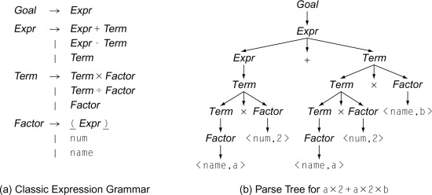
2022-11-14
진행
Instruction Parsing and Execution
a × 2 + a × 2 × b
Main() {
int x;
x = y+4;
…..
}
Lexical Analysis
Main
()
{
Int
X
;
X
=
Y
+4;
…..
}
Parse
Code Generation
Link
Object/
Class
Exe/
Jar

Slide 57
label while
load r0 0
load r1 2
subtract r0 r1
greaterThanEqual whileEnd
push 3
interrupt readInt
load r0 1
load r1 3
add r0 r1
store 1 r0
load r0 0
addc r0 1
store 0 r0
jump while
label whileEnd
push 1
interrupt writeInt
// int i; @0
// int sum; @1
// int count; @2
// int value; @3
// i = 0;
// sum = 0
// count = readInt();
// while (i < count) {
// value = readInt();
// sum = sum + value;
// i = i + 1;
// }
// writeInt(sum);

Slide 58
CPU
I = I + 1
A = 3
A =B;
PC
CU
Registers
0: 5 => 6
1
2
3
ALU
load
store
Memory
Data Segment
0:: (i) 5 => 6
1
2
3
Stack Segment
0
1
2
3
Heap Segment
0
1
2
3

Slide 59
2022-11-16
Memory
진행
Instruction Execution
CPU Instruction
Load/Store
A = B
Move/Add/Subtract
Register to Register
Jump
Conditional/Unconditional
Interrupt
Process
CPU
ALU
R0
MAR
Data Segment
Int I, J;
load
R1
MBR
store
CU
PC
Code Segment
Int I, J;
IR
Fetch
Interrupt handler
DMA
IO Device

Slide 60
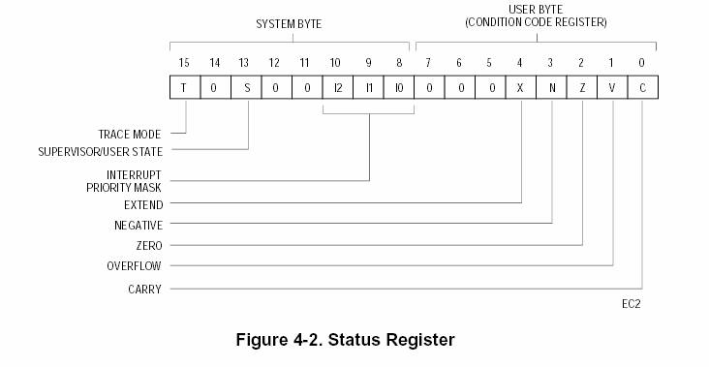
Status Register

Slide 61
2022-11-21
진행
CPU Instruction
Interrupt
Interrupt
HW 함수 호출
함수 이름
반환 타입, 메모리 주소
파라메터
데이터 타입. 메모리 주소
Ex)
File file = new File(“이름“);
Int x = file.Read(파일 이름, 위치)

Slide 62
Read
File System
File Name
File Position
Size
Return Address
Write
File System
File Name
File Position
Size
Memory Address
CPU
Memory
File System
3
read
File A
write
File B
File System Buffer
3
read

Slide 63
2022-11-23
진행
Interrupt
이론
Process/Thread
UI
Interrupt Handler
Scheduler
Process
File System
사용자
Loader
Ready Queue
Running Process
Interrupt Queue
Wait Queue

Slide 64
Functional Call
Activation Record
Void F0() {
int x = F1(1,2,3);
}
Stack
PC +1
//return value
1
2
3
int F1(int x, int y, int z) {
}

Slide 65
2022-11-30
진행
Interrupt
HW
Timer
IO Device Service
SW
Time out
Process Management
IO Device Service
Memory
CPU
Scheduler
User Process
Ready Queue
Instruction
Running Process
Wait Queue
Interrupt Handler
Interrupt Flag
Scheduler

Slide 66
프로그램 설계
Scheduler
File System
Memory
CPU
Ready Queue
User Process
Wait Queue
File Buffer
execute
Interrupt Handler
Interrupt Queue

Slide 67
IO Interrupt
Device Driver
IO Buffer
참고) BIOS
Basic IO System
OS
IO Device
Interrupt Handler
IO Buffer
IO Buffer
Device Driver
Instruction
parameter1
parameter1
Result

Slide 68
Context Switching
Scheduler
Ready queue
P3
P4
P2
Wait queue
P0
read
P1
write

Slide 69
범위
현재 진도 구현
IO Device Interrupt
Context Switching
CPU/Memory 추가
UI

Slide 70
2022-12-05
진행
File IO Interrupt
UI
Scheduler
Interrupt Handler
File System
Ready queue
Wait queue
Interrupt Queue
Loader
Running Process

Slide 71
Fork/Join
Main
UI
Scheduler
File System
Ready queue
Wait queue
Loader
Running Process
Interrupt Queue
fileIOInterrupt Queue

