Slide 1
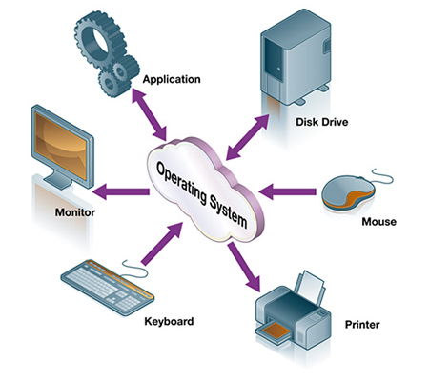
Operating System
Professor, Myongji University
Chair, OMG-Korea
Sungwoon Choi, Ph.D.
choisw@mju.ac.kr

Slide 2
Contents
Operating System
Introduction
Computer Architecture
Process Management
Processes
Threads
Process Synchronization
CPU Scheduling
Deadlocks
Memory Management
Main Memory
Virtual Memory
Storage Management
Mass-Storage Structure
File-System Interface
File-System Implementation
I/O Systems
Protection and Security
Protection
Security
Advanced Topics
Virtual Machines
Distributed Systems

Slide 3
Compile Time

Slide 4
Chapter Objectives Background
Memory Management
Objectives
To provide a detailed description of various ways of organizing memory hardware.
To explore various techniques of allocating memory to processes.
To discuss in detail how paging works in contemporary computer systems.
Background
Basic Hardware
Binding of symbolic memory addresses to actual physical addresses
Distinction between logical and physical addresses
Dynamic linking and shared libraries

Slide 5
Compile Time – Symbol Table
Memory Management
Symbol Table
Int main() {
Object object = new Object();
int result = object.method(3, 4);
System.out.println(result);
}
class Object {
private int ox;
private int oy;
public int method(int x, int y) {
int sum;
this.ox = x;
this.oy = y;
sum = this.ox + this.oy;
return result;
}
}
Data Segment
 | Object object | Data.0
 | int result | Data.4
Heap Segment
 | int ox; | This.0
 | int oy; | This.4
Stack Segment
 | object | AR.0
 | int x | AR.4
 | int y | AR.8
 | DynamicLink | AR.12 | Caller’s Activation Record
 | AccessLink | AR.16 | Enclosing Activation Record
 | ReturnAddress | AR.20
 | Int sum | AR.24
 | Int returnValue | AR.28

Slide 6
Compile Time – Code Generation
Memory Management
Code Segment
object = new Object(); | 0 | Data.0bject = Heap.allocate(sizeof Object))
result=object.method(3, 4); | 1 2 3 4 5 6 7 8 9 | oldAR = AR AR = Stack.top Stack.top = Stack.top + 32 AR.object = Data.0 AR.x = 3 AR.y = 4 AR.dynamicLink = oldAR AR.returnAddress = 10 Jump 15
 | 10 11 12 | Data.result = AR.returnValue Stack.top = AR AR = AR.dynamicLink
System.out.println(result); | 13 14 | Interrupt(“print”, result) Exit()
this.ox = x; | 15 | AR.object.ox = AR.x
this.oy = y; | 16 | AR.object.oy = AR.y
sum = this.ox + this.oy; | 17 | AR.sum = AR. object.0 + AR. object.4
return result; | 18 19 | AR.returnValue = AR.sum Jump AR. returnAddress
Int main() {
Object object = new Object();
int result = object.method(3, 4);
System.out.println(result);
}
class Object {
private int ox;
private int oy;
public int method(int x, int y) {
int sum;
this.ox = x;
this.oy = y;
sum = this.ox + this.oy;
return sum;
}
}

Slide 7
Activation Record

Slide 8
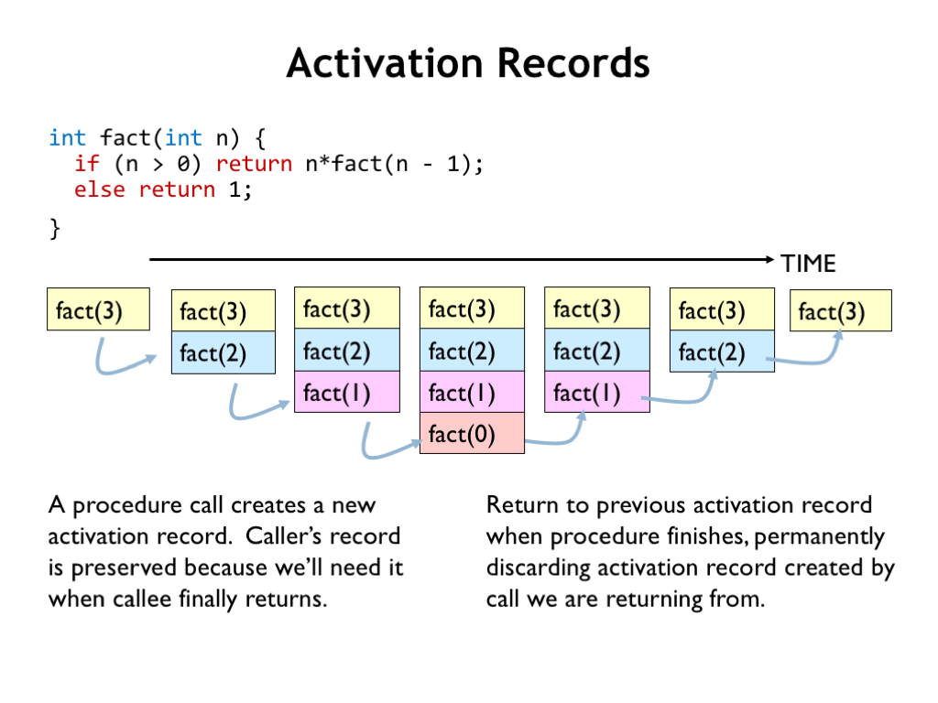
Activation Records
Int factorial(int n) {
int factorial(int n) {
if (n>0) {
return n*factorial(n-1);
} else {
return 1;
}
}

Slide 9
Activation Record
Memory Management
Int main() {
Object object = new Object();
int result = object.f1(3, 4);
System.out.println(result);
}
class Object {
private int x;
private int y;
public int f(int x, int y) {
this.x = x;
this.y = y;
return x+y;
}
}
Stack Frame
…..
Memory
Process Control Block
main
Code Segment
f1
Data Segment
Process
f2
Stack Segment
f3
Heap Segment

