Slide 1
REAL ESTATE ANALYTICS | MACHINE LEARNING | DATA ANALYTICS & VISUALIZATION | EXPLAINABLE AI
Explainable Real Estate Analytics: A Comparative Analysis of Machine Learning Frameworks for House Price Prediction
PROJECT REVIEW – 1
BATCH – 2
Faculty Guide: Dr. K Swapnika Department: Computer Science and Engineering University: KLH University Academic Year: 2026 – 2027
CH. Shalini — 2420030284
M. J. U. Harika — 2420030453
K. Aneesha — 2420030589
1

Slide 2
FOUNDATION
Refined Title & Project Domain
REFINED TITLE
Explainable Real Estate Analytics: A Comparative Analysis of Machine Learning Frameworks for House Price Prediction
Why the title was refined
PROJECT DOMAIN
The title is refined from the initial comparative-analysis topic based on recent research in machine learning-based property valuation. The proposed work retains comparative evaluation and extends it by integrating feature engineering, ensemble learning and Explainable Artificial Intelligence (XAI).
Data Analytics & Visualization
Department: Computer Science and Engineering University: KLH University Faculty Guide: Dr. K Swapnika
Project Review I • House Price Prediction
3

Slide 3
FOUNDATION
Problem Statement
KEY INFLUENCING FACTORS
House prices are influenced by multiple factors, making accurate prediction a complex task. This project presents a comparative machine learning framework using Decision Tree, Random Forest, XGBoost, and CatBoost, with comprehensive EDA, preprocessing, and feature engineering. Model performance is evaluated using MAE, MSE, RMSE, R², and MAPE, while SHAP and LIME provide interpretable insights into the key factors influencing house price predictions.
Location
Property Area
Number of Rooms
Property Age
PROJECT AIM
Quality
To develop an explainable ensemble learning framework that improves house price prediction while identifying the major factors influencing the predicted price.
Amenities
Project Review I • House Price Prediction
4

Slide 4
FOUNDATION
Objectives
1
Data Preparation
2
Model Implementation & Comparison
To preprocess and prepare house-price data using missing-value treatment, categorical encoding, outlier handling and feature engineering techniques.
To implement and compare Linear Regression, Random Forest, XGBoost and CatBoost using K-Fold Cross-Validation and evaluation metrics such as MAE, RMSE and R².
3
Ensemble Development
4
Explainability
To develop a Stacking Regressor by combining the best-performing machine learning models to improve house-price prediction performance.
To apply SHAP-based Explainable Artificial Intelligence to identify and interpret the most influential features contributing to house-price predictions.
Project Review I • House Price Prediction
9

Slide 5
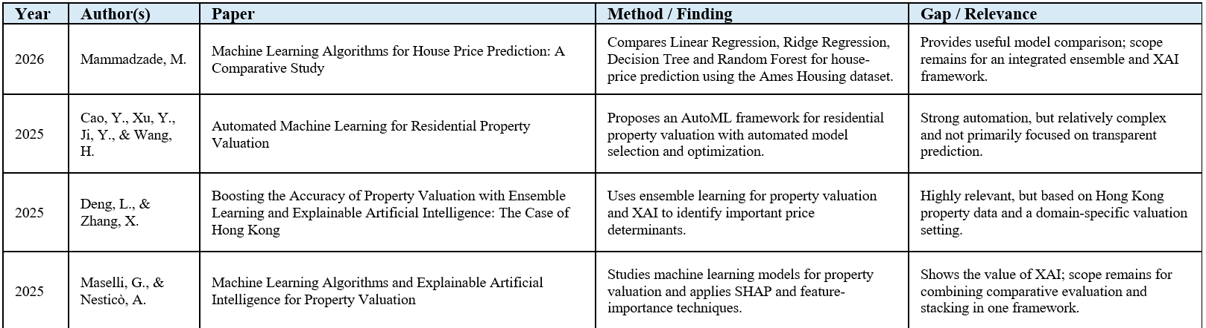
LITERATURE SURVEY
The following recent journal papers were reviewed to understand current machine learning approaches, ensemble methods, explainability techniques and research limitations in house-price prediction and property valuation.

Slide 6
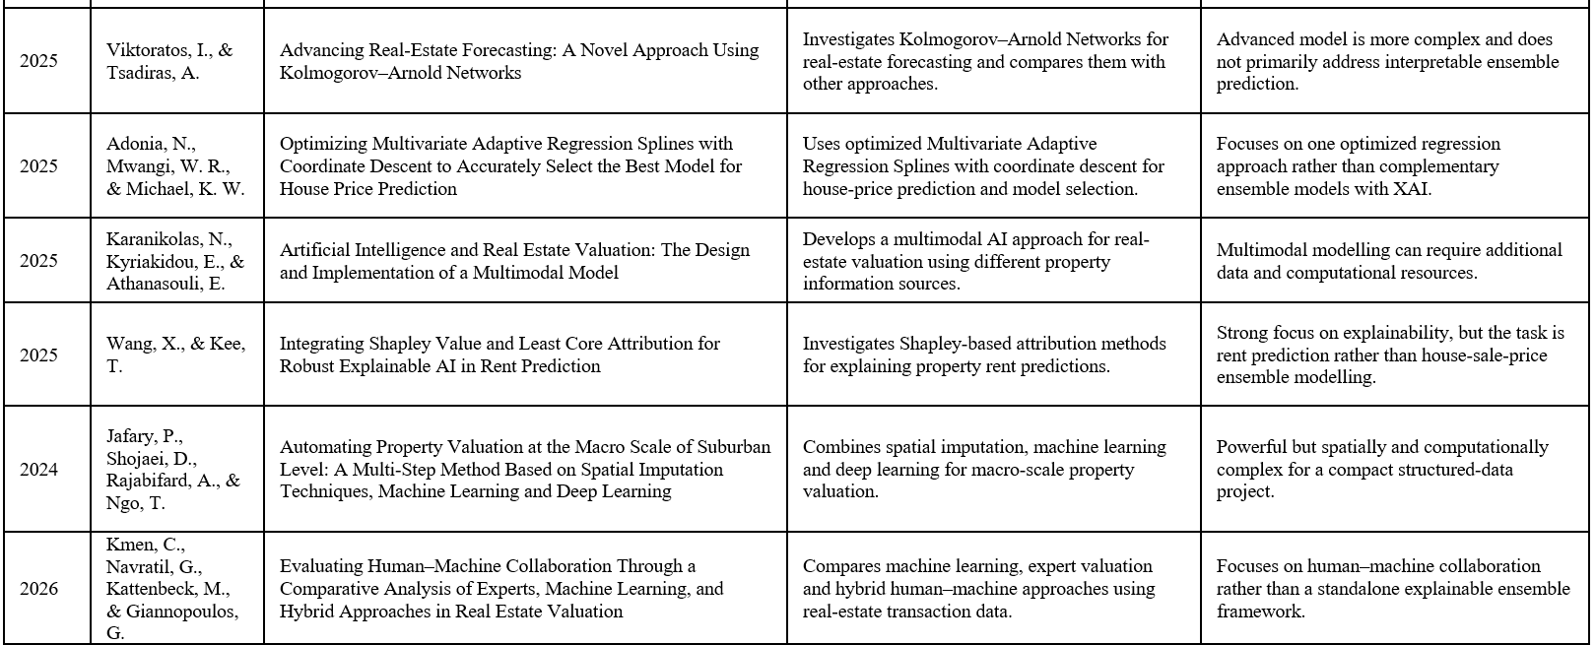

Slide 7
FOUNDATION
Research Gaps Identified
Many studies compare individual machine learning models, but there is scope for integrating complementary high-performing models into a single ensemble framework.
1
Although recent work combines ensemble learning and Explainable AI, several approaches are region-specific, spatially intensive or designed for specialized valuation environments.
2
Advanced AutoML, multimodal and deep-learning approaches can improve prediction but increase implementation and computational complexity.
3
Prediction accuracy is often emphasized more than the interpretability of individual predictions.
4
A practical framework combining feature engineering, model comparison, stacking and SHAP-based explanation remains a suitable research direction for structured house-price data.
5
Project Review I • House Price Prediction
8

Slide 8
FOUNDATION
Novelty / Innovation
The novelty is not the individual use of ensemble learning or SHAP, since these techniques already exist in recent literature. The proposed innovation is their integration into a single practical house-price prediction pipeline.
1
2
Systematic feature engineering and preprocessing before model comparison.
Comparative evaluation of multiple regression models followed by selection of complementary high-performing models.
3
4
Use of a Stacking Regressor to combine selected models instead of relying only on one individual predictor.
Application of SHAP to the final model to provide understandable feature-level explanations for house-price predictions.
Project Review I • House Price Prediction
10

Slide 9
FEASIBILITY STUDY
Feasibility
✓
Technical Feasibility:
Implemented using Python and standard machine learning tools.
Uses open-source libraries such as Scikit-learn, XGBoost, CatBoost, SHAP, and LIME.
Public benchmark housing datasets are available for experimentation.
Can be developed and executed on a standard computer.
✓
Economic Feasibility:
No specialized paid software is required.
Uses freely available datasets, tools, and open-source libraries.
Requires minimal development and implementation costs.
✓
Operational Feasibility:
Suitable for an academic machine learning and data analytics project.
The workflow is structured, simple, and manageable.
Can be completed within the planned project duration.
Requires only standard computing resources.

Slide 10
METHODOLOGY
Proposed Workflow — Data Flow Pipeline
Data
Collection
→
Preprocessing
(Missing/Outlier/Encoding)
→
Feature
Engineering
→
Train-Test
Split (K-Fold)
→
Model Training
(LR, RF, XGB, CB)
→
Stacking
Regressor
→
SHAP
Explainability
→
Comparative
Evaluation
Preprocessed data flows through comparative model training, followed by ensemble stacking of the strongest performers, and finally SHAP-based explanation of the price drivers behind every prediction.
Project Review I • House Price Prediction
13

Slide 11
EXECUTION
Project Plan & Timeline
Phase 1
Foundational groundwork and literature review (planned activity to be detailed as the project progresses).
Phase 2
Feature engineering and exploratory data analysis; prepare relevant features for model development.
Phase 3
Comparative implementation of Linear Regression, Random Forest, XGBoost and CatBoost (planned activity to be detailed as the project progresses).
Phase 4
Develop and evaluate the Stacking Regressor; compare ensemble performance with individual models; perform SHAP-based explainability and feature analysis.
Phase 5
Testing and final evaluation; analyze results; prepare documentation, report and presentation.
Project Review I • House Price Prediction
18

Slide 12
EXECUTION
Team Details
1
2
3
CH. Shalini
M. J. U. Harika
K. Aneesha
Roll No. 2420030284
Roll No. 2420030453
Roll No. 2420030589
Literature Survey, Data Preprocessing & Feature Engineering
ML Model Development, Model Comparison & Ensemble Learning
SHAP Analysis, Result Analysis, Documentation & Presentation
Project Review I • House Price Prediction
19

Slide 13
Thank You
Explainable Real Estate Analytics • Project Review – I

