Slide 1
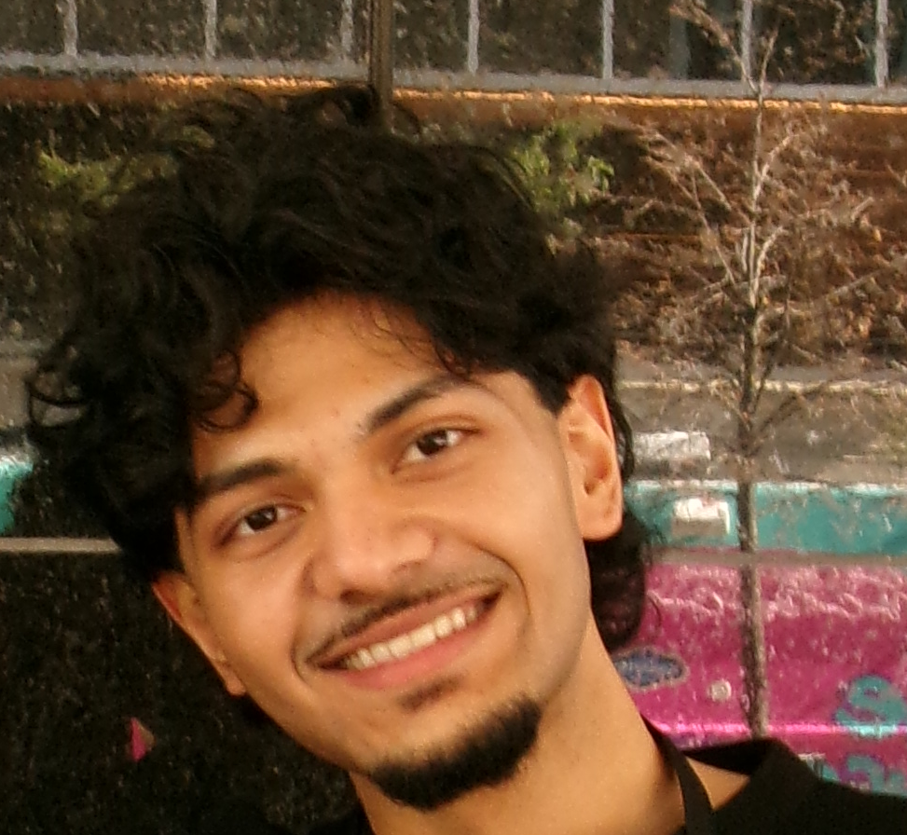
Mohammed Umair Jibran
Engineering for the real world
Computer Engineering · York University
Co-op experience, engineering projects & career direction
01
Notes:
Hi, I’m Mohammed Umair Jibran, a Bachelor of Engineering student in Computer Engineering at York University, expecting to graduate in 2028. My experience includes an eight-month co-op followed by contract roles at U+ Education, a software development internship, and hands-on embedded systems projects. In this presentation, I’ll share what I have worked on, the skills I have developed, and how those experiences are shaping my career goals.
Sources: MohammedUmairJibran_Resume (1).pdf, supplied by the presenter; personal program interests and career direction supplied in conversation. Portrait: original supplied photograph, rotated and cropped only. Event photograph: existing portfolio.

Slide 2
Design, create and understand
Why Computer Engineering
Connect circuits, firmware and software
Build systems and investigate how they work
Apply classroom learning through practical projects
02
Notes:
What I love most about engineering is the ability to design and create, and to understand how things work beneath the surface. Computer Engineering lets me connect circuits, firmware and software instead of seeing them as separate subjects. At York, my coursework includes embedded systems, communication networks, digital logic, operating systems and databases. My projects give me a way to put those ideas into practice. I especially enjoy building something I can test, observing what happens when an input changes, and working out why the system behaves the way it does.
Sources: MohammedUmairJibran_Resume (1).pdf, supplied by the presenter; personal program interests and career direction supplied in conversation. Portrait: original supplied photograph, rotated and cropped only. Event photograph: existing portfolio.

Slide 3
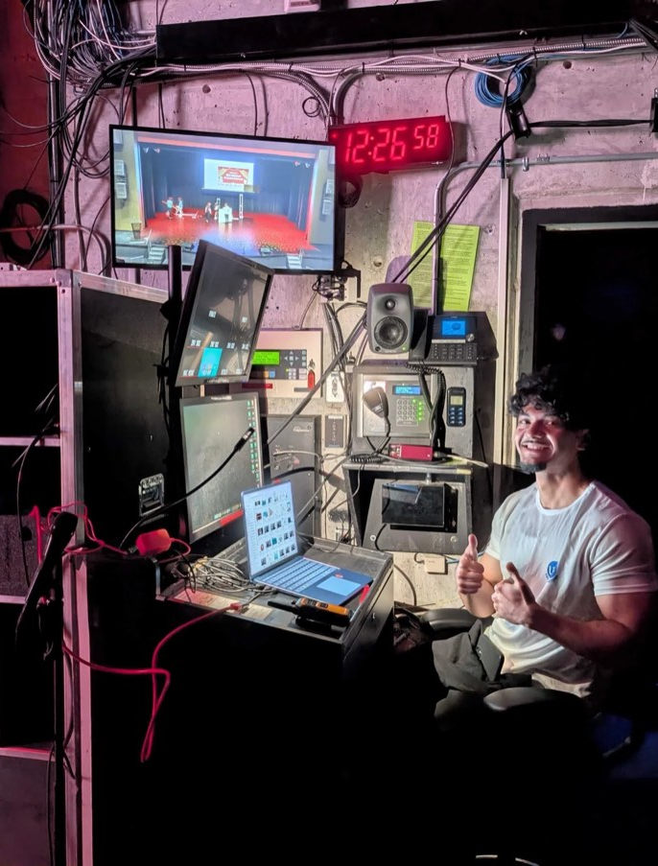
Eight-month co-op followed by contract roles
My learning at U+ Education
Managed an 11-member cross-functional team
Supervised 200+ volunteers
Reviewed features and QA-tested releases
03
Notes:
My most rewarding co-op learning has come from my experience at U+ Education, where I completed an eight-month co-op followed by contract roles. As Technology Manager, I directly managed an eleven-member cross-functional team and supervised more than two hundred volunteers, supporting over three thousand community service hours. I also oversaw high-school co-op students and delivered internal development workshops. On the technical side, I developed and reviewed features for the website, volunteer hub and inventory application, translated stakeholder requests into Jira tickets, and quality-tested GitHub releases. The rewarding part has been helping people turn an unclear request into useful work. It has taught me to explain expectations, give practical feedback and check the result before handing it over.
Sources: MohammedUmairJibran_Resume (1).pdf, supplied by the presenter; personal program interests and career direction supplied in conversation. Portrait: original supplied photograph, rotated and cropped only. Event photograph: existing portfolio.

Slide 4
Software Developer Intern · Riipen internship
A tool adopted by a business
Node.js packing-rule engine
Order JSON + product-dimension CSV
Validated inputs and deterministic instructions
04
Notes:
During my Riipen internship with Islamic Books and Souvenirs, from February to May 2025, I built a Node.js packing-rule engine. It joined Shopify-style order data in JSON with product dimensions stored in CSV files. I validated the inputs and applied deterministic rules to generate packing instructions for more than twenty orders. The business adopted the tool, and the work contributed to an approximately fifteen percent combined improvement in order-to-shipment time and packaging costs. This experience showed me the value of a small, focused tool that fits an existing workflow. It also gave me practical experience with data validation and with turning business requirements into predictable software behaviour.
Sources: MohammedUmairJibran_Resume (1).pdf, supplied by the presenter; personal program interests and career direction supplied in conversation. Portrait: original supplied photograph, rotated and cropped only. Event photograph: existing portfolio.

Slide 5
CAN-FD ECU bench + RF Asset Finder
Testing embedded systems
STM32 / FreeRTOS / C and C++ / Python
Arduino / 433 MHz RF / packet validation
Fault injection, timeouts and recovery
05
Notes:
My CAN-FD test bench connects two STM32 controllers using C, C plus plus and FreeRTOS. The sensor controller sends temperature and RPM data, while the actuator controller checks message identity, integrity and freshness before controlling a fan. I implemented queues, interrupts, timers and buffers, and built a Python harness to capture traffic and inject dropped or delayed frames. In my RF Asset Finder, I developed Arduino firmware and a tag-to-base-station protocol using device IDs, sequence numbers, CRC checks, acknowledgements and retries. Desktop tests cover corrupt frames, invalid packet types, duplicate sequences and timeout behaviour. These projects developed my hardware and software debugging skills and reinforced the importance of checking failure and recovery paths.
Sources: MohammedUmairJibran_Resume (1).pdf, supplied by the presenter; personal program interests and career direction supplied in conversation. Portrait: original supplied photograph, rotated and cropped only. Event photograph: existing portfolio.

Slide 6
SentriCode + MSA donation system
Security and payment workflows
Safe source ingestion and normalized findings
142 automated tests for the SentriCode release
Stripe integration and volunteer training
06
Notes:
In SentriCode, I built a local-first security workbench using Python, FastAPI, Next.js, TypeScript and Docker. It accepts directories, ZIP files and public GitHub repositories, and normalizes findings from several types of security checks. I worked on safe archive extraction, secret redaction, policy gates and scan-history comparisons, and verified the release with one hundred and forty-two automated tests. In my Technology Lead and Executive Director role with the Muslim Student Association at York, I developed the front end and server-side Stripe integration for a donation workflow using WisePOS and BBPOS hardware. I validated terminal data flows and trained volunteers. That system supported more than ten thousand dollars in fundraising at live events.
Sources: MohammedUmairJibran_Resume (1).pdf, supplied by the presenter; personal program interests and career direction supplied in conversation. Portrait: original supplied photograph, rotated and cropped only. Event photograph: existing portfolio.

Slide 7
Embedded systems and hardware–software integration
My next step in engineering
Design and validate reliable connected devices
Build on integration, testing and delivery experience
Grow into leading embedded product projects
07
Notes:
Across these experiences, I have developed skills in system integration, fault injection, test automation and quality assurance, alongside requirements, technical review and team coordination. At U+ Education, I also worked with operational data in Excel and monday.com and guided analyst volunteers through Power BI dashboard development. My career goal is to become an embedded systems engineer focused on hardware and software integration. I want to design firmware, connect sensors and actuators, and validate systems under real constraints. As I gain experience, I would like to lead embedded product development projects while staying involved in design and testing. Thank you for taking the time to explore my portfolio.
Sources: MohammedUmairJibran_Resume (1).pdf, supplied by the presenter; personal program interests and career direction supplied in conversation. Portrait: original supplied photograph, rotated and cropped only. Event photograph: existing portfolio.

