Slide 1
Barriers to Implementing a Just Culture in Software Development
Mikaela June
May 4, 2025
CSD 380 Module 9

Slide 2
Introduction to Just Culture
Just Culture promotes accountability and learning by distinguishing between human error, at-risk behavior, and reckless behavior.
Encourages open reporting of errors, which leads to improved safety and quality.
The goal of just culture is to promote a more learning-oriented workplace environment.

Slide 3
Barriers in Implementing Just Culture

Slide 4
Barrier 1 – Lack of Transparency
Description: Unclear processes for assessing and responding to errors.
Impact: Creates confusion and mistrust among team members.
Example: Developers are unsure how their actions will be evaluated after an incident has occurred.

Slide 5
Barrier 2 – Blame Culture
Description: A tendency to assign blame when outcomes are unfavorable.
Impact: Discourages error reporting and stifles learning based on fear.
Example: Developers may hide mistakes to avoid punishment.

Slide 6
Barrier 3 – Fear of Negative Consequences
Description: Concerns about legal repercussions or damage to reputation.
Impact: Leads to underreporting of errors and near misses.
Example: A developer avoids reporting a bug to prevent potential legal issues.

Slide 7
Barrier 4 – Outcome bias
Description: Judging actions based on the outcome rather than intent or context.
Impact: Leads to inconsistent assessments and unfair consequences.
Example: A minor code change causing a major failure is treated more harshly than a major change with a minor issue.​

Slide 8
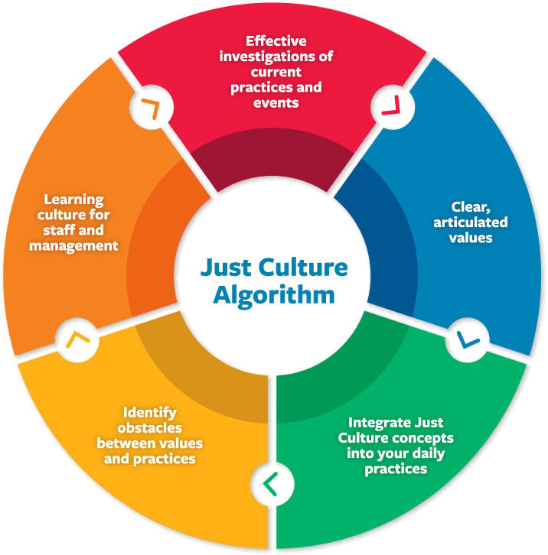
Just Culture Algorithm
The just culture algorithm is a visual representation illustrating how to assess behavior and determine appropriate responses.

Slide 9
Strategies for Overcoming Barriers
Clear Communication: Establish transparent processes and expectations.
Consistent Assessment: Implement standardized methods for evaluating errors.
Training and Education: Provide ongoing learning opportunities for all team members

Slide 10
Conclusion
Implementing a just culture in software development is essential for fostering a learning environment and improving quality. Organizations should assess their current culture and take steps to address identified barriers. A just culture leads to a safer, more innovative, and more productive workplace.

