Slide 1

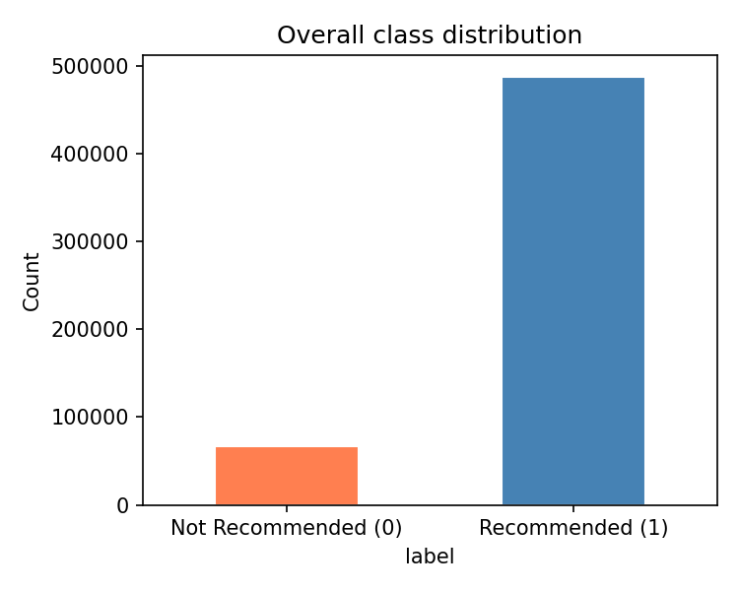
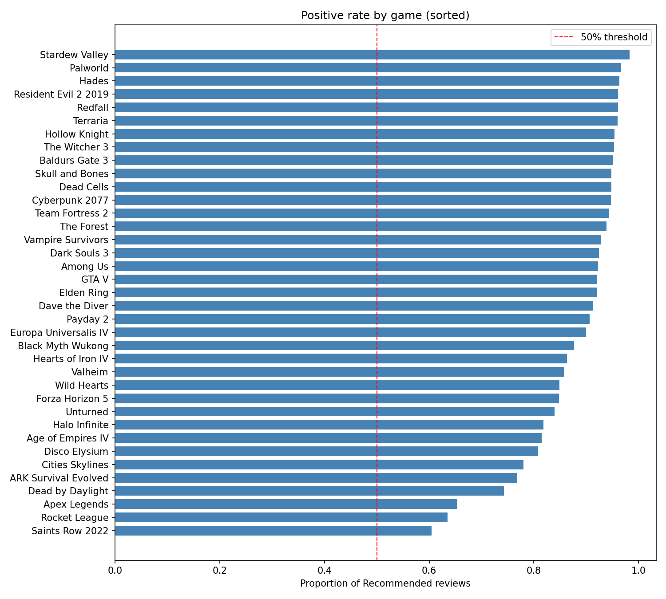
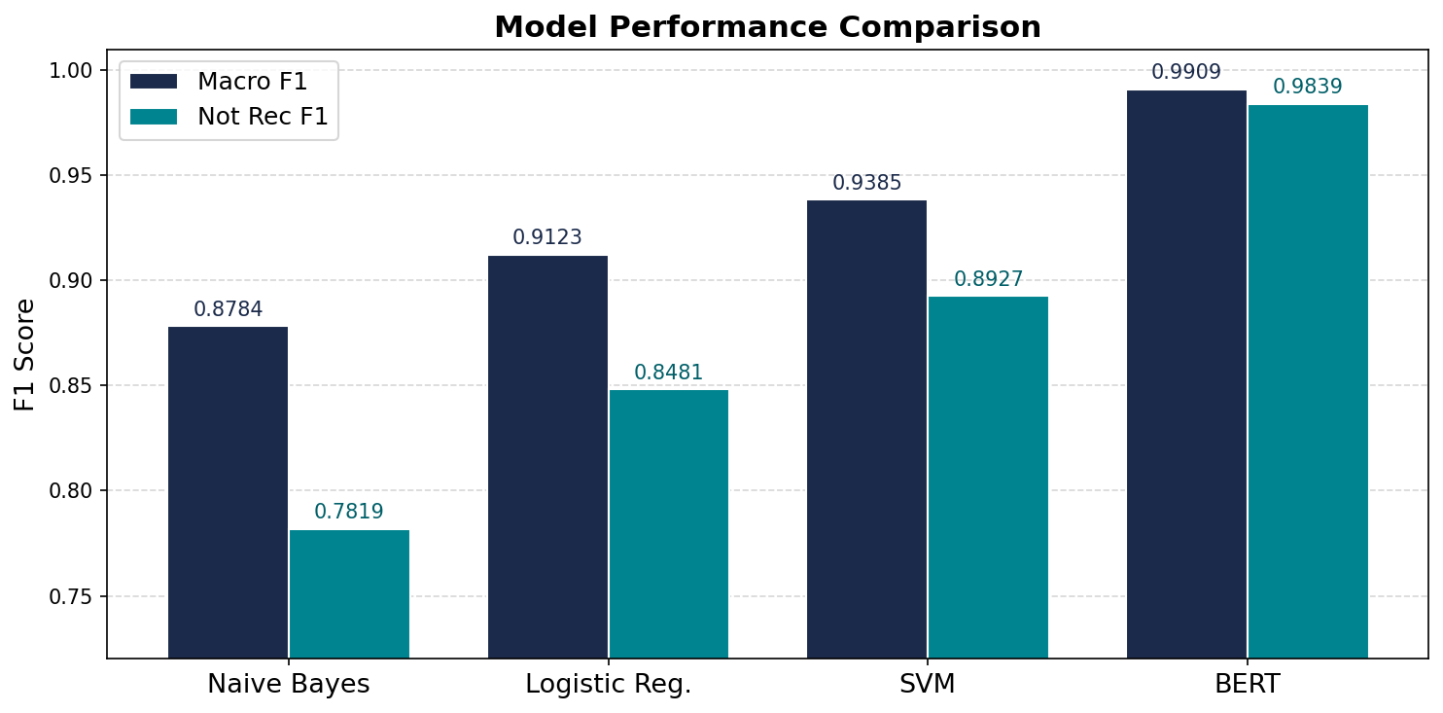
Sentiment Classification of Steam Game Reviews: Comparing Models
CS 759
Natural Language Processing
Task Statement
Methods
Why Steam Reviews?
Steam hosts hundreds of millions of reviews written in informal language, gaming slang, humor, and irony, making sentiment harder than standard benchmarks like IMDB.
Task
Input: raw Steam review text
Output: Recommended / Not Recommended
Research Questions
Do classical models compete with BERT in this domain?
How does 87.9% class imbalance affect minority-class F1?
Does extreme length variability (median 9 words) affect models differently?
Pipeline
Raw Text -> TF-IDF (50K features, unigrams+bigrams) -> NB / LR / SVM
Raw Text -> WordPiece tokenizer (bert-base-uncased) -> BERT fine-tune
Model Details
Naive Bayes Multinomial NB, Laplace a=1.0
Logistic Reg. L2, C=1.0, class_weight='balanced'
SVM: LinearSVC, C=1.0, class_weight='balanced'
BERT: bert-base-uncased, max_length=256, 3 epochs
AdamW lr=2e-5, fp16 mixed precision, RTX 4080 Super
Handling Class Imbalance
Classical: class_weight='balanced' on LR and SVM
BERT: weighted cross-entropy [4.12x Not Rec / 0.57x Rec]
Evaluation: macro F1, weights both classes equally
Dataset
Results
• 555,498 reviews self-scraped via Steam public API
• 37 games: AAA, indie, strategy, horror
• Included mixed-reception titles (Redfall, Saints Row 2022) to reduce positivity bias
87.9% Recommended vs 12.1% Not Recommended
A model always predicting Recommended scores 87.9% accuracy: macro F1 is the only meaningful metric.
Median review: 9 words | ~200K reviews under 5 words | max 1,995 words
Stratified 80 / 10 / 10 split:
443,983 train 55,498 dev 55,498 test
Model | Accuracy | Macro F1 | Not Rec F1 | Rec F1
Naive Bayes | 0.9548 | 0.8784 | 0.7819 | 0.9748
Logistic Reg. | 0.9592 | 0.9123 | 0.8481 | 0.9765
SVM | 0.9724 | 0.9385 | 0.8927 | 0.9842
BERT (fine-tuned) | 0.9961 | 0.9909 | 0.9839 | 0.9978
BERT Macro F1
0.9909 vs SVM 0.9385
+5.2 points
Not Rec F1
0.9839 vs SVM 0.8927
+9.1 pts minority class
Accuracy
BERT 99.6%
vs SVM 97.2%
Challenges
Conclusion
Problem 1: Review Length
~200K reviews under 5 words, almost no signal for any model
TF-IDF sees 'no' in both positive and negative reviews. It can't distinguish sentiment. BERT's attention has nothing to attend to. These one-word reviews are the #1 source of errors across all models.
• SVM is a strong classical baseline, hard to beat without pretraining
• BERT outperforms SVM by +5.2 macro F1, significant on a hard, imbalanced task
• The gap is largest on the minority class: Not Rec F1 0.9839 vs 0.8927 (+9.1 pts)
• Short reviews and sarcasm are the primary sources of misclassification across all models
• Class imbalance handling (weighted loss / balanced weights) is essential for all approaches
Future Work
• Length aware embeddings or separate handling for very short reviews
• Sarcasm / irony detection as a preprocessing step
• Test generalizability on 106K-review Kaggle dataset
Problem 2: Handle Sarcasm
Sarcastic reviews create a mismatch between text and label, establishing noise ceiling that no model can overcome
The voted_up label captures user intent at the time of clicking, not the sentiment of the written text. Since no model can reconcile a label that contradicts its review, this introduces an irreducible ceiling on performance.
Michael Vinciguerra
mjv1044@usnh.edu

