Slide 1

Introduction to Data Analysis and Basic Python Data Structure
Unit-1
1

Slide 2

Outline
What is Data Science?
Why Data Science?
Data Science Components
Data Science Process
Tools for Data Science
Difference between Data Science with BI (Business Intelligence)
Applications of Data Science

Slide 3
What is Data Science?
Data Science is the area of study which involves extracting insights from vast amounts of data using various scientific methods, algorithms, and processes.
It helps you to discover hidden patterns from the raw data.
The term Data Science has emerged because of the evolution of mathematical statistics, data analysis, and big data
Data Science is an interdisciplinary field that allows you to extract knowledge from structured or unstructured data.
Data science enables you to translate a business problem into a research project and then translate it back into a practical solution.

Slide 4
Why Data Science?
Here are significant advantages of using Data Analytics Technology:
Data is very important for today’s world.
With the right tools, technologies, algorithms, we can use data and convert it into a distinct business advantage.
Data Science can help you to detect fraud using advanced machine learning algorithms
It helps you to prevent any significant monetary losses
Allows to build intelligence ability in machines
It enables you to take better and faster decisions

Slide 5
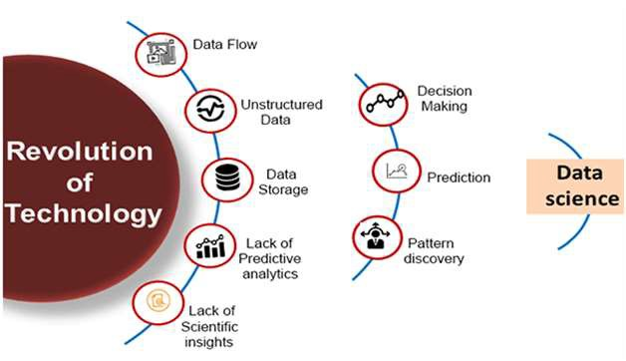
Why Data Science?

Slide 6
Why?
Following are some main reasons for using data science technology:
With the help of data science technology, we can convert the massive amount of raw and unstructured data into meaningful insights.
Data science technology is opting by various companies, whether it is a big brand or a startup.
Google, Amazon, Netflix, etc, which handle the huge amount of data, are using data science algorithms for better customer experience.
Data science is working for automating transportation such as creating a self-driving car, which is the future of transportation.
Data science can help in different predictions such as various survey, elections, flight ticket confirmation, etc.

Slide 7
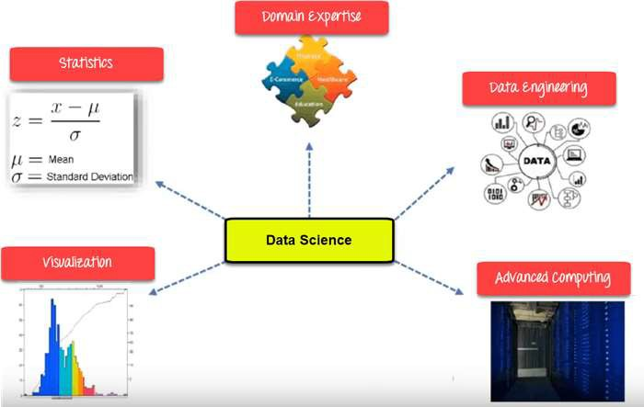
Data Science Components

Slide 8
Data Science Components
Statistics:
Statistics is the most critical unit of Data Science basics, and it is the method or science
of collecting and analyzing numerical data in large quantities to get useful insights.
Visualization:
Visualization technique helps you access huge amounts of data in easy to understand
and digestible visuals.
Machine Learning:
Machine Learning explores the building and study of algorithms that learn to make
predictions about unforeseen/future data.
Deep Learning:
Deep Learning method is new machine learning research where the algorithm selects
the analysis model to follow.

Slide 9
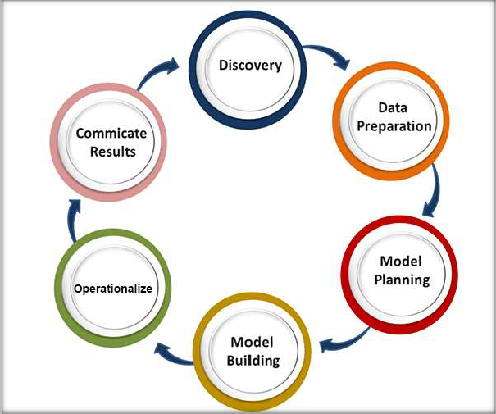
Data Science Process
Now in this Data Science , we will learn the Data Science Process:

Slide 10
Data Science Process
Discovery:
Discovery step involves acquiring data from all the identified internal & external sources, which helps you answer the business question.
The data can be:
Logs from webservers
Data gathered from social media
Census datasets
Data streamed from online sources using APIs
Department of Computer Science & I.T.

Slide 11
Data Science Process
Preparation:
Data can have many inconsistencies like missing values, blank columns, an incorrect data format, which needs to be cleaned.
You need to process, explore, and condition data before modelling.
The cleaner your data, the better are your predictions.
Model Planning:
In this stage, you need to determine the method and technique to draw the relation between input variables.
Planning for a model is performed by using different statistical formulas and visualization tools.
SQL analysis services, R, and SAS/access are some of the tools used for this purpose.

Slide 12
Data Science Process
Model Building:
In this step, the actual model building process starts. Here, Data scientist distributes datasets for training and testing.
Operationalize:
You deliver the final baseline model with reports, code, and technical documents in this stage.
Model is deployed into a real-time production environment.
Communicate Results
In this stage, the key findings are communicated to all team members. This helps you decide if the project results are a success or a failure based on the inputs from the model.

Slide 13
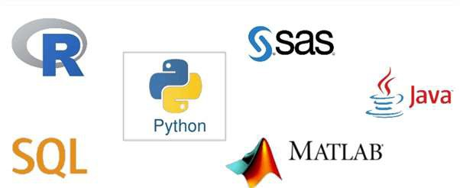
Tools for Data Science
Data Analysis | Data Warehousing | Data Visualization | Machine Learning
R, Spark, Python and SAS | Hadoop, SQL, Hive | R, Tableau, Raw | Spark, Azure ML studio
Department of Computer Science & I.T.

Slide 14
Difference Between Data Science with BI (Business Intelligence)
Parameters | Business Intelligence | Data Science
Perception | Looking Backward | Looking Forward
Data Sources | Structured Data. Mostly SQL, but some time Data Warehouse | Structured and Unstructured data:Like logs, SQL, NoSQL, or text
Approach | Statistics & Visualization | Statistics, Machine Learning, and Graph
Method | Analytical: historical data | Scientific: goes deeper to know the reason for the data report
Emphasis | Past & Present | Analysis & Neuro-linguistic Programming
Tools | Pentaho, Microsoft Bl, QlikView, | R, TensorFlow

Slide 15
Applications of Data Science
Image recognition and speech recognition:
Data science is currently using for Image and speech recognition.
When you upload an image on Facebook and start getting the suggestion to tag to your friends. This automatic tagging suggestion uses image recognition algorithm, which is part of data science.
When you say something using, "Ok Google/Siri“ and these devices respond as per voice control, so this is possible with speech recognition algorithm.
Gaming world:
In the gaming world, the use of Machine learning algorithms is increasing day by day.
EA Sports, Sony, Nintendo, are widely using data science for enhancing user experience.
Internet search:
When we want to search for something on the internet, then we use different types of
search engines such as Google, Yahoo, Bing, Ask, etc.
All these search engines use the data science technology to make the search experience
better, and you can get a search result with a fraction of seconds.

Slide 16
Applications…
Transport:
Transport industries also using data science technology to create self-driving cars. With self-driving
cars, it will be easy to reduce the number of road accidents.
Healthcare:
In the healthcare sector, data science is providing lots of benefits. Data science is being used for
tumor detection, drug discovery, medical image analysis, virtual medical bots, etc.
Recommendation systems:
Most of the companies, such as Amazon, Netflix, Google Play, etc., are using data science
technology for making a better user experience with personalized recommendations.
Risk detection:
Finance industries always had an issue of fraud and risk of losses, but with the help of data
science, this can be rescued.
Most of the finance companies are looking for the data scientist to avoid risk and any type of
losses with an increase in customer satisfaction.

Slide 17
Introduction of Python?
Python is a high-level, interpreted, interactive and object-oriented scripting language.
Python is designed to be highly readable. It uses English keywords frequently where as other languages
use punctuation, and it has fewer syntactical constructions than other languages.
Python is Interpreted: Python is processed at runtime by the interpreter. You do not need to compile your program before executing it. This is similar to PERL and PHP.
Python is Interactive: You can actually sit at a Python prompt and interact with the interpreter directly
to write your programs.
Python is Object-Oriented: Python supports Object-Oriented style or technique of programming that encapsulates code within objects.
Python is a Beginner's Language: Python is a great language for the beginner-level programmers and supports the development of a wide range of applications from simple text processing to WWW browsers to games.

Slide 18
Python…High Level Language
Python is an example of a high-level language; other high-level languages you might have heard of are C++, PHP, Pascal, C#, and Java.
Thus, programs written in a high-level language have to be translated into something more suitable before they can run.
It is much easier to program in a high-level language so programs take less time to write, they are shorter and easier to read, and they are more likely to be correct.
Portable, meaning that they can run on different kinds of computers with few or no modifications.

Slide 19
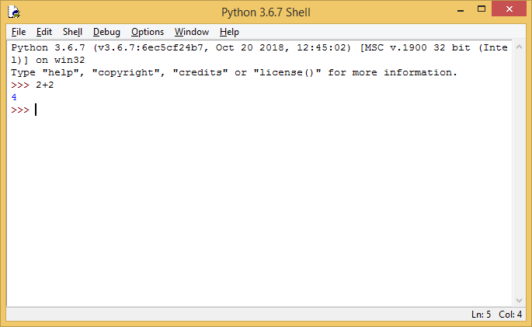
Python…Interpreted Language
The engine that translates and runs Python program is called the Python Interpreter: There are two ways to use it:
immediate mode and script mode. In immediate mode, you type Python expressions into the Python Interpreter window, and the interpreter immediately shows the result:
19

Slide 20
Pyhton…
The >>> is called the Python prompt. The interpreter uses the prompt to indicate that it is ready for instructions.
We typed 2 + 2, and the interpreter evaluated our expression, and replied 4, and on the next line it gave a new prompt, indicating that it is ready for more input.
Alternatively, you can write a program in a file and use the interpreter to execute the contents of the file. Such a file is called a script.
Files have the advantage that they can be saved to disk, printed, and so on.
Working directly in the interpreter is convenient for testing short bits of code because you get immediate output.

Slide 21
Python History
Invented at the National Research Institute for Mathematics and Computer Science in the Netherlands, early 90s by Guido Van Rossum
Python was conceived in the late 1980s and its implementation was started in December 1989
Python is derived from many other languages, including ABC, Modula-3, C, C++, Algol-68, SmallTalk, Unix shell, and other scripting languages.
Open sourced from beginning
Considered a scripting language, but is much more Scalable, object oriented and functional from the beginning
Used by Google from the beginning

Slide 22
History Of Python
Author is Guido Van Rossum
Convinced in Late 1980
Finally released in 1991
Start implementation in December 1989 at CWI in Netherland.
Successor of ABC Programming language.
Name came from BBC’s TV Show – ‘Monty Python’s Flying Circus’

Slide 23
Python Version
Python Version | Released Date
Python 1.0 | January 1994
Python 1.5 | December 31, 1997
Python 1.6 | September 5, 2000
Python 2.0 | October 16, 2000
Python 2.1 | April 17, 2001
Python 2.2 | December 21, 2001
Python 2.3 | July 29, 2003
Python 2.4 | November 30, 2004
Python 2.5 | September 19, 2006
Python Version | Released Date
Python 2.6 | October 1, 2008
Python 2.7 | July 3, 2010
Python 3.0 | December 3, 2008
Python 3.1 | June 27, 2009
Python 3.2 | February 20, 2011
Python 3.3 | September 29, 2012
Python 3.4 | March 16, 2014
Python 3.5 | September 13, 2015
Python 3.6 | December 23, 2016
Python 3.7 | June 27, 2018

Slide 24
Python Features:
Easy-to-learn: Python has few keywords, simple structure, and a clearly defined syntax.
Easy-to-read: Python code is more clearly defined and visible to the eyes.
Easy-to-maintain: Python's source code is fairly easy-to-maintain.
A broad standard library: Python's bulk of the library is very portable and cross- platform compatible on UNIX, Windows, and Macintosh.
Interactive Mode: Python has support for an interactive mode which allows interactive testing and debugging of snippets of code.
Portable: Python can run on a wide variety of hardware platforms and has the same interface on all platforms.

Slide 25
Features…
Extendable: You can add low-level modules to the Python interpreter. These modules enable programmers to add to or customize their tools to be more efficient.
Databases: Python provides interfaces to all major commercial databases.
GUI Programming: Python supports GUI applications that can be created and ported to many system calls, libraries, and windows systems, such as Windows MFC, Macintosh, and the X Window system of UNIX.
Scalable: Python provides a better structure and support for large programs than shell scripting.

Slide 26
Where Python is USED??
Google makes extensive use of Python in its web search system.
Intel, Cisco, HP, Seagate, Qualcomm, and IBM use Python for hardware testing.
ESRI(Environmental Systems Research Institute) uses Python as an popular GIS mapping products.
The YouTube video sharing service is largely written in Python.
Widely used (Google, NASA, Yahoo, Electronic Arts, some UNIX scripts etc.)

Slide 27
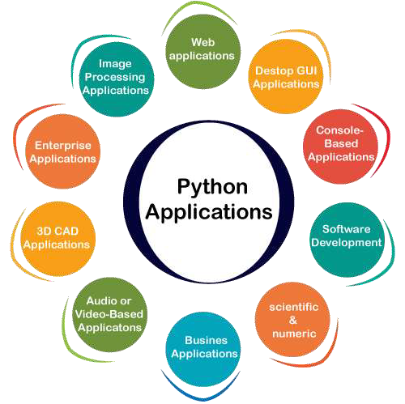
Applications of Python

Slide 28
Installing Python
Python is pre-installed on most Unix systems, including Linux and MAC OS X
But for Windows Operating Systems, user can download from the https://www.python.org/downloads/
Form the above link download latest version of python IDE and install.

Slide 29


Compiling and interpreting
Many languages require you to compile (translate) your program into a form that the machine
understands.
compile
source code
first.c
Object code first.c
execute
output
Python is instead directly interpreted into machine instructions.
interpret
source code
Hello.py
output

Slide 30
Reserved Words
The following list shows the Python keywords. These are reserved words and you cannot use them as constant or variable or any other identifier names.
All the Python keywords contain lowercase letters only.
and | def | If | not | return
break | assert | exec | in | or
try | finally | del | import | pass
for | else | elif | with | print
is | continue | global | except | Raise
from | lambda

Slide 31
Python Identifiers
A Python identifier is a name used to identify a variable, function, class, module or other object.
An identifier starts with a letter A to Z or a to z or an underscore (_) followed by zero or more letters, underscores and digits (0 to 9).
Python does not allow punctuation characters such as @, $, and % within identifiers.
Python is a case sensitive programming language

Slide 32
Basic Syntax
# Python program to print
print("Hello Student")
# Python program to declare variables myNumber = 3
print(myNumber)
myNumber2 = 4.5 print(myNumber2)
myNumber ="helloworld" print(myNumber)
32

Slide 33
Python Variables
Variables are containers for storing data values.
Example x = 10
y = “hello"
print(x) print(y)
x, y, z = “Python", “Java", “Oracle“ x = y = z = “Python"

Slide 34

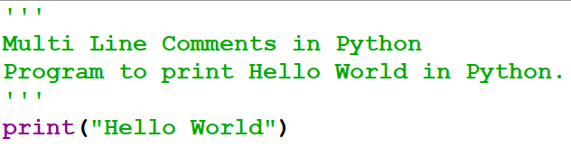
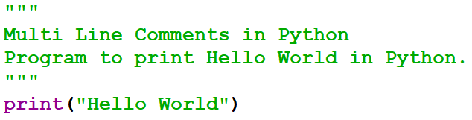
Comments
Single Line Comments
This comments starts with hash symbol(#) and are useful to mention that the entire line till the end should be treated as comments.
Multi Line Comments

Slide 35

Data Types and Operators
Unit-1
1

Slide 36
Indentation
Indentation means adding white space before a statement.
Most of the programming languages like C, C++, Java use braces {
} to define a block of code.
Python use indentation to define a block of code.
Whitespace is used for indentation. All statements with the same distance to the right belong to the same block of code.
If a block has to be more deeply nested, it is simply indented further to the right.

Slide 37
Data types of python
a=10
b="Hi Python"
c = 10.5
print(type(a)) # int
print(type(b)) # str
print(type(c)) # float

Slide 38

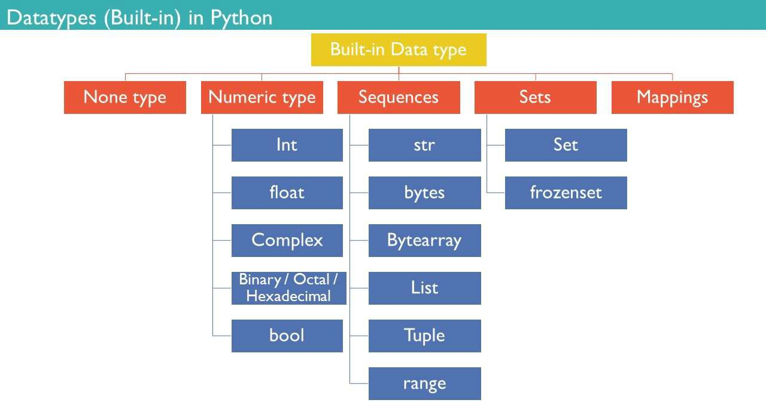
Python Data Types

Slide 39
Data types in Python
Numbers (int and float)
int (signed integers Ex. 10)
long (long integers, they can also be represented in octal and hexa Ex. 0122L)
float (floating point real values Ex. 15.20)
complex (complex numbers Ex. 3e+26J)
Sequence Data Type : String (char and string) , List, Tuple
Dictionary
Set
Boolean

Slide 40
Integer Number
positive or negative whole numbers without decimal point.
no limit to how long an integer value.

Slide 41
Float Number
real numbers.
decimal point dividing the integer and fractional parts.
scientific notation
E or e indicating the power of 10

Slide 42
Complex
Complex numbers are written with a "j" as the imaginary part:
x=5+7j
print(x)
print(x.real)
print(x.imag)
Output:
(5+7j)
5.0
7.0

Slide 43
Literals in Python
String literals :: "hello" , '12345'
Int literals :: 0,1,2,-1,-2
Long literals
Float literals
:: 89675L
:: 3.14
Complex literals
Boolean literals
:: 12j
:: True or False
Special literals :: None

Slide 44
Representing Binary, Octal and Hexadecimal Numbers
A binary number should be written by prefixing 0b or 0B before the value. For example,
0b100011
0B10100010
Hexadecimal numbers are written by prefixing 0x or 0X before the value. For example,
0xA180
0X11fb
Similarly, Octal numbers are indicated by prefix 0o or 0O before the value. For example,
0O145
0o773

Slide 45
Boolean
Booleans represent one of two values: True or False.
The bool() function allows you to evaluate any value, and give you True or False in return.
Example
Evaluate a string and a number:
True
print(bool("Hello")) print(bool(15))

Slide 46
Sequence Type : String
A string is a sequence of characters.
A character is simply a symbol. For example, the English language has 26 characters.
Computers do not deal with characters, they deal with numbers (binary).
This conversion of character to a number is called encoding, and the reverse process is decoding.
ASCII and Unicode are some of the popular encoding used.
In Python, string is a sequence of Unicode characters.
Unicode was introduced to include every character in all languages and bring uniformity in encoding.

Slide 47
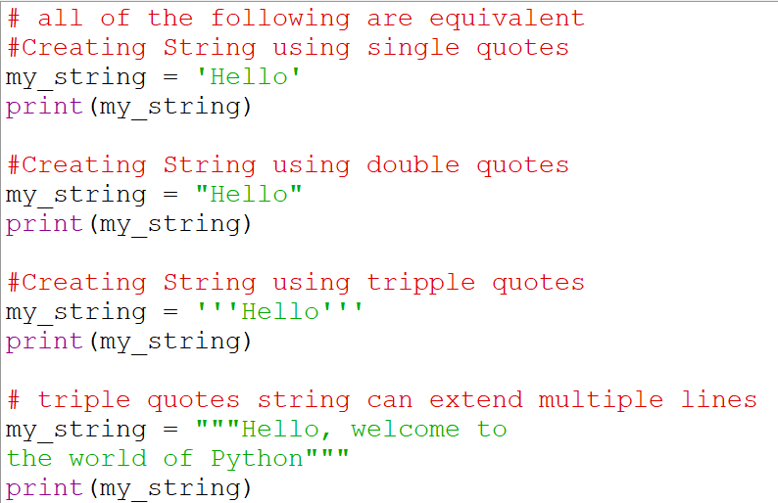
Sequence Type (String, List, Tuple): String
The string can be defined as the sequence of characters represented in the quotation
marks. In Python, we can use single, double, or triple quotes to define a string.

Slide 48
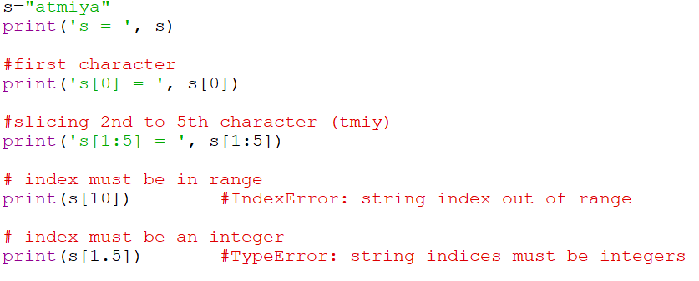
How to access characters in a String?
We can access individual characters using indexing and a range of characters using slicing.
Index starts from 0.
Trying to access a character out of index range will raise an IndexError.
The index must be an integer. We can't use float or other types, this will result into TypeError.

Slide 49
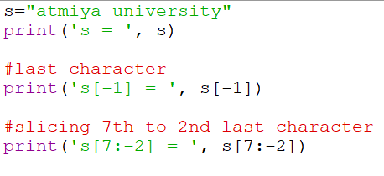
How to access characters in a String?
Python allows negative indexing for its sequences.
The index of -1 refers to the last item, -2 to the second last item and so on.
We can access a range of items in a string by using the slicing operator (colon).

Slide 50
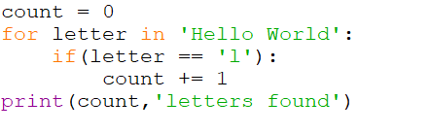
Iterating through a string
Using a for loop we can iterate through a string.
For example, count number of ‘l’ in to the string.

Slide 51
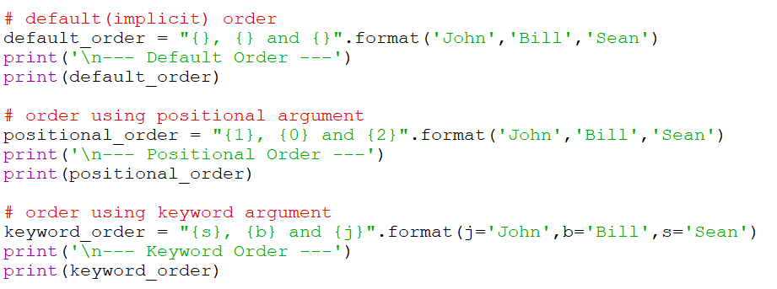
String Formatting
The format() method that is available with the string object is very versatile and powerful in formatting strings.
Format strings contain curly braces
{} as placeholders or replacement fields which get replaced.
We can use positional arguments or keyword arguments to specify the order.

Slide 52
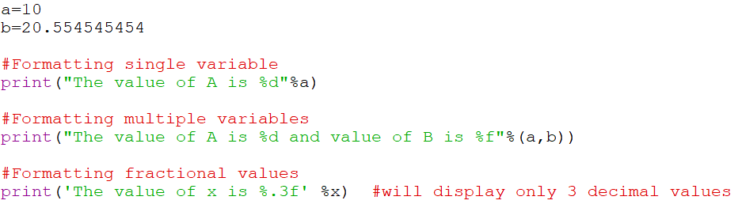
Formatting....
We can even format strings like the old style used in the C programming language. We use the % operator to accomplish this.

Slide 53
Reversing Strings Through Slicing
To slice a string, you can use the following syntax:
a_string[start:stop:step]
All the offsets are optional, and they have the following default values:
Offset Default Value start 0 stop len(a_string) step 1
Here, start represents the index of the first character in the slice, while stop holds the index that stops the slicing operation. The third offset, step, allows you to decide how many characters the slicing will jump through on each iteration.

Slide 54
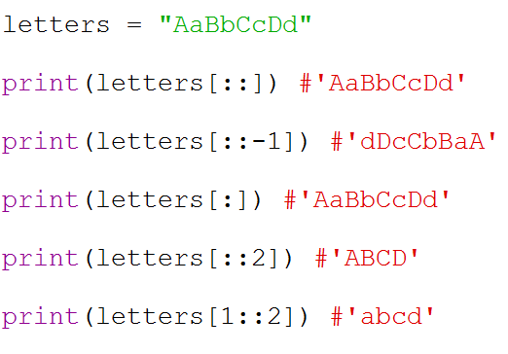
Example…

Slide 55
Sequence Type (String, List, Tuple): String
str1 = ‘Hello Students' #string str1 str2 = ' how are you' #string str2
print (str1[0:2]) #printing first two character using slice operator print (str1[4]) #printing 4th character of the string
print (str1*2) #printing the string twice
print (str1 + str2) #printing the concatenation of str1 and str2

Slide 56
Sequence Type: List
Lists are used to store multiple items in a single variable.
Lists are one of 4 built-in data types in Python used to store collections of data.
In Python programming, a list is created by placing all the items (elements) inside a square bracket [ ], separated by commas.
It can have any number of items and they may be of different types (integer, float, string etc.).
List items are ordered, changeable, and allow duplicate values.

Slide 57
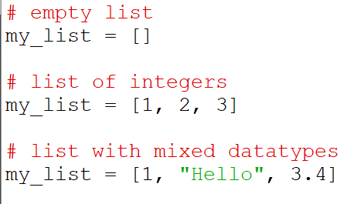
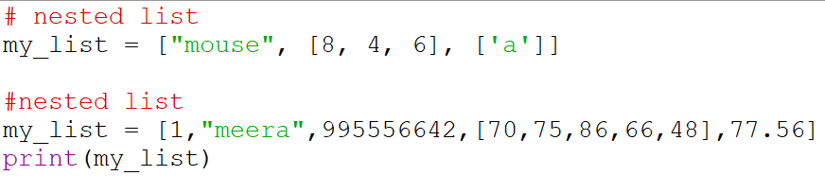
Creation of LIST

Slide 58
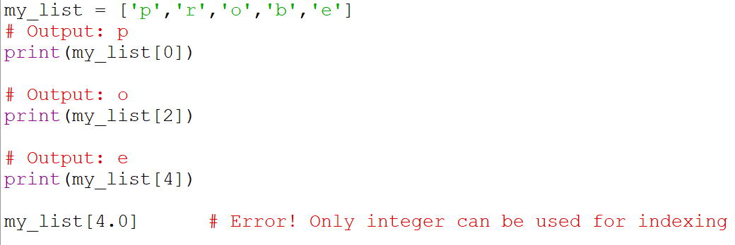
How to access elements from a List? Indexing

Slide 59
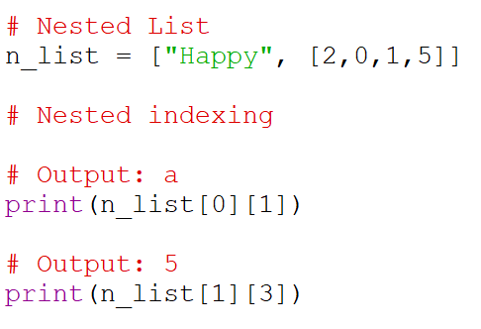
Indexing with nested list…

Slide 60
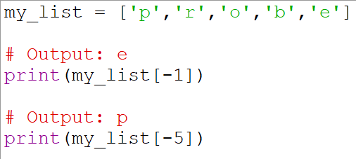
Negative Indexing…

Slide 61
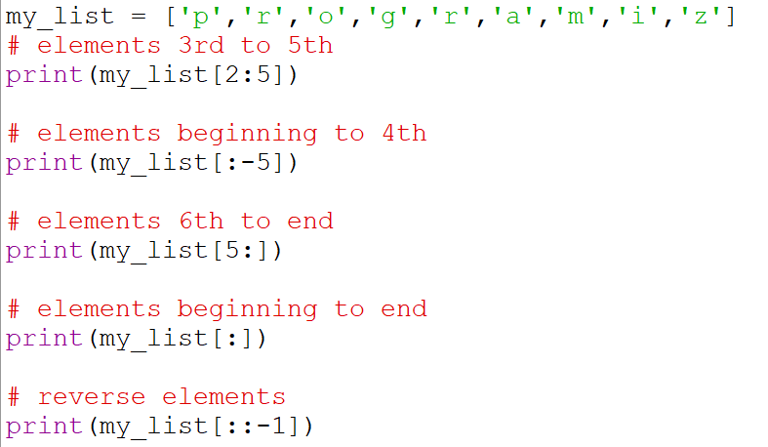
How to slice lists in python?

Slide 62
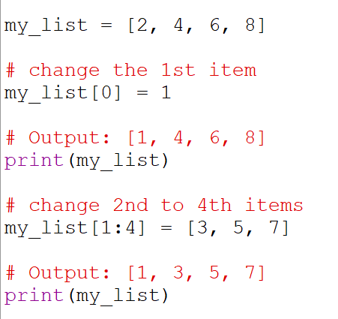
How to change or add elements to a List?
Lists are mutable, meaning their elements can be changed unlike string or tuple.
We can use assignment operator (=) to change an item or a range of items.

Slide 63
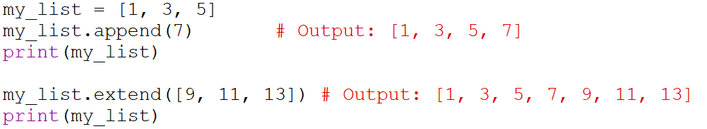
Append and Extend method of list
We can add one item to a list using the append() method or add several items using extend() method.

Slide 64
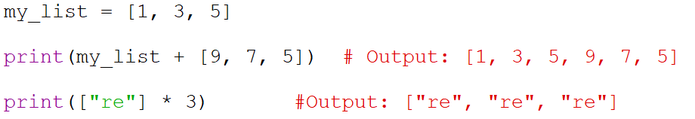
+ and * operators with list
We can also use + operator to combine two lists. This is also called concatenation.
The * operator repeats a list for the given number of times.

Slide 65
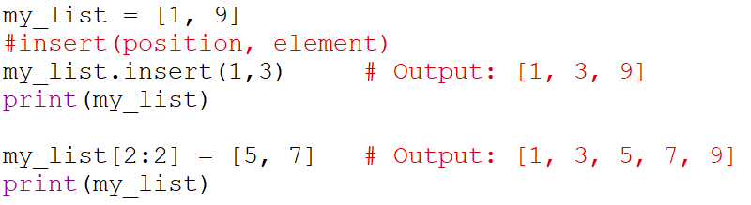
insert( ) with List
we can insert one item at a desired location by using the method insert() or insert
multiple items by squeezing it into an empty slice of a list.

Slide 66
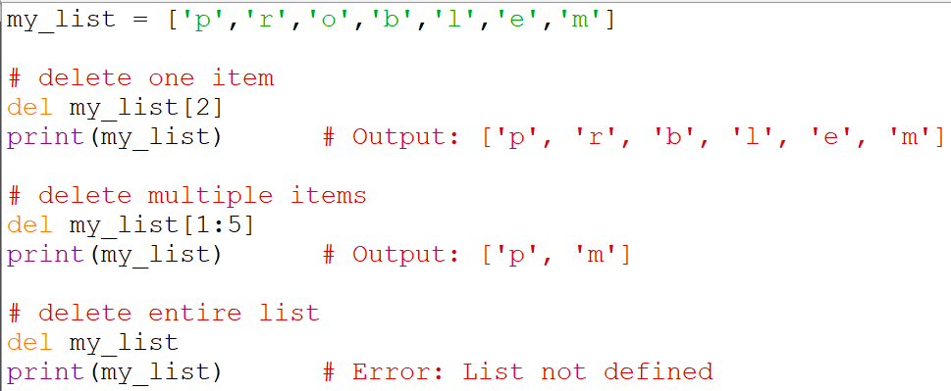
How to delete or remove elements from a List?
We can delete one or more items from a list using the keyword del. It can even delete the list entirely.

Slide 67
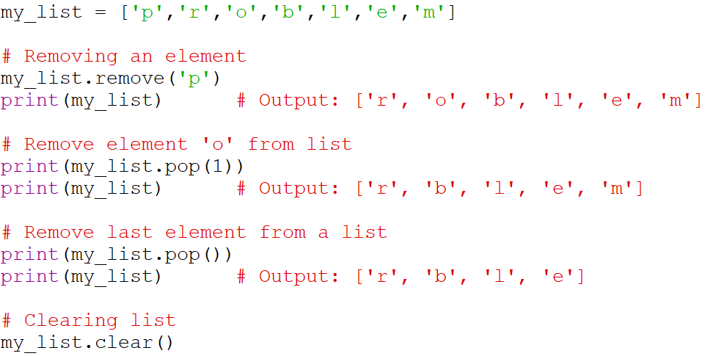
remove, pop and clear methods
We can use remove() method to remove the given item or pop() method to remove an item at the given index.
The pop() method removes and returns the last item if index is not provided. This helps us implement lists as stacks (first in, last out data structure).
We can also use the clear()
method to empty a list.

Slide 68
List Length
To determine how many items a list has, use the len() function:
Example
Print the number of items in the list:
thislist = ["apple", "banana", "cherry"]
print(len(thislist))
Output: 3
Department of Computer Science & I.T.

Slide 69
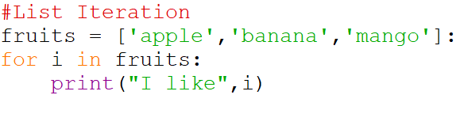
Iteration of List

Slide 70
List Methods
Method | Description
append() | Add an element to the end of the list
extend() | Add all elements of a list to the another list
insert() | Insert an item at the defined index
remove() | Removes an item from the list
pop() | Removes and returns an element at the given index
clear() | Removes all items from the list
index() | Returns the index of the first matched item
count() | Returns the count of number of items passed as an argument

Slide 71
Methods…
Method | Description
sort() | Sort items in a list in ascending order
reverse() | Reverse the order of items in the list
copy() | Returns a shallow copy of the list
len() | Return the length (the number of items) in the list.
list() | Convert a collection (tuple, string, set, dictionary) to a list.
max() | Return the largest item in the list.
min() | Return the smallest item in the list
sum() | Return the sum of all elements in the list.

Slide 72
Tuple
A tuple is a collection which is ordered, unchangeable and allows duplicate values.
Tuples are used to store multiple items of any type like int, float and string in a single variable.
Tuples are written with round brackets.
Example :Create a Tuple
thistuple = ("apple", "banana", "cherry")
print(thistuple)
Output :- ('apple', 'banana', 'cherry')

Slide 73
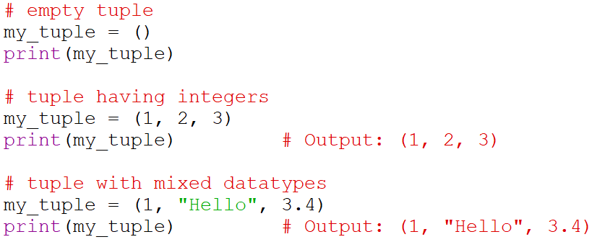
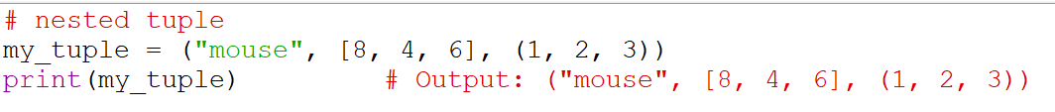
Tuple…

Slide 74
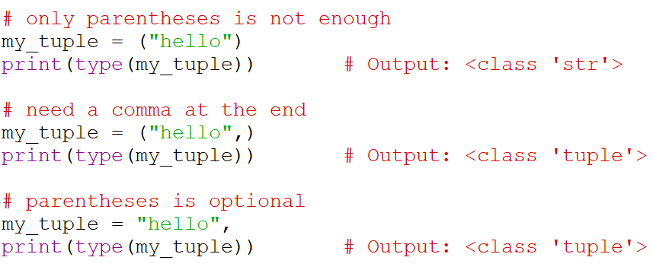
Tuple…

Slide 75
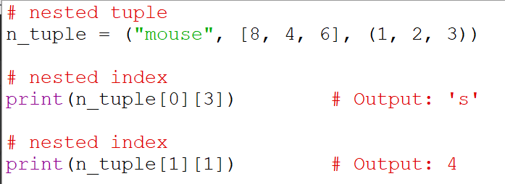
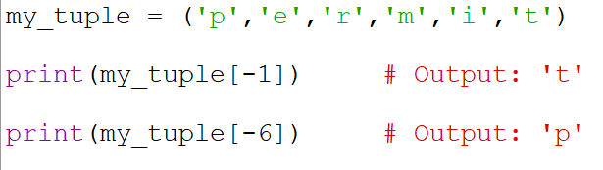
Tuple…

Slide 76
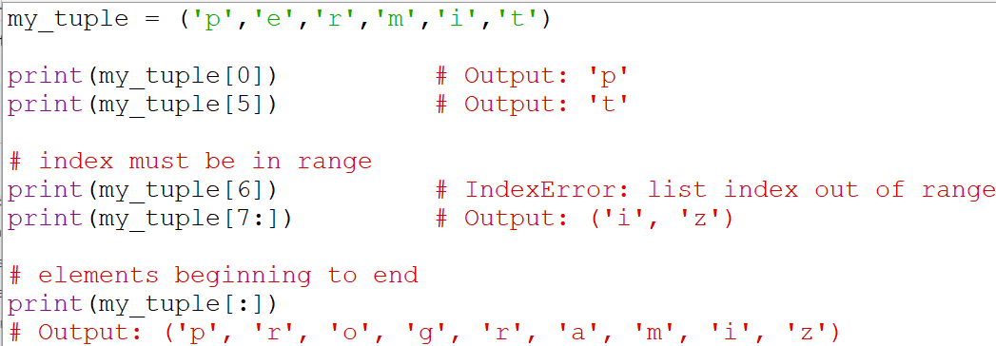
Indexing and Slicing

Slide 77
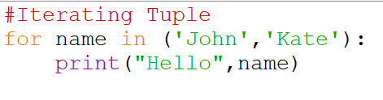
Iterating through Tuple

Slide 78
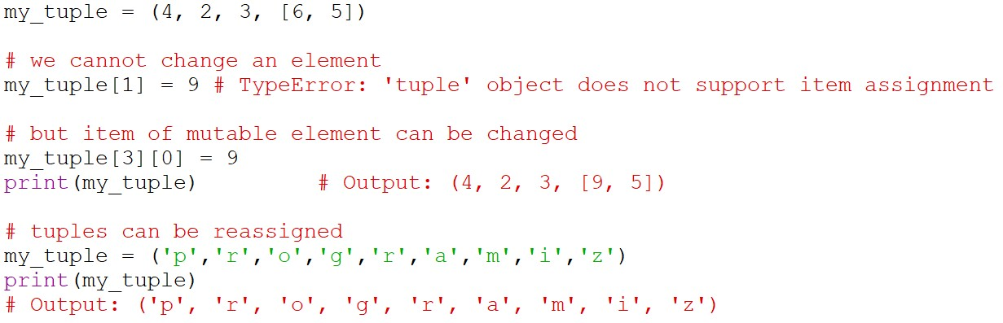
Tuples are immutable
This means that elements of a tuple cannot be changed once it has been assigned.
We can also assign a tuple to different values (reassignment).

Slide 79
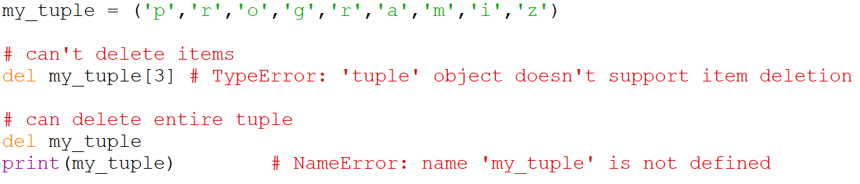
Deleting a tuple
As discussed above, we cannot change the elements in a tuple. That also means we cannot delete or remove items from a tuple.
But deleting a tuple entirely is possible using the keyword del.

Slide 80
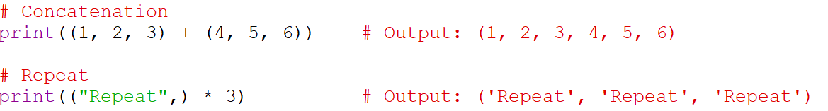
Use of + and * with tuple
We can use + operator to combine two tuples (concatenation).
We can also repeat the elements in a tuple for a given number of times using the
* operator.
Both + and * operations result into a new tuple.

Slide 81
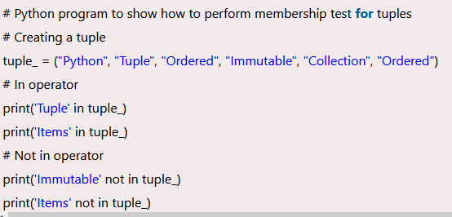
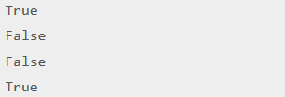
Tuple Membership Test : IN and NOT IN

Slide 82
Methods of Tuple
Method | Description
index(x) | Return index of first item that is equal to x
count(x) | Return the number of items that is equal to x
len() | Return the length (the number of items) in the tuple.
tuple() | Convert an iterable (list, string, set, dictionary) to a tuple.
max() | Return the largest item in the tuple.
min() | Return the smallest item in the tuple
sum() | Return the sum of all elements in the tuple.

Slide 83
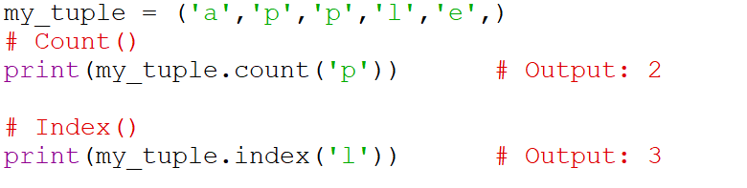
Methods…

Slide 84
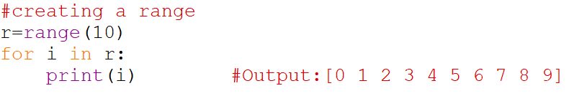
Range
The range data type represents a sequence of numbers.
The numbers in the range are not modifiable.
Generally, range is used for repeating a for loop for a specific number of times.

Slide 85
Range…
The range () has three arguments:
range(start, stop, step)
Start : it is an optional argument that represents the starting value of range. Default value is 0
Stop : represents the ending value of range ( excluding).
Stepsize : it is an optional argument that represents the increment between each number in a range. Default value is 1.you can provide negative stepsize to reverse a range.

Slide 86
Set
A set is an unordered collection of elements much like sets in Mathematics.
The order of elements is not maintained in the sets.
It means the elements may not appear in the same order as they are entered into the set.
Moreover, a set does not accept duplicate elements
There are two subtypes in sets:
set
frozenset

Slide 87
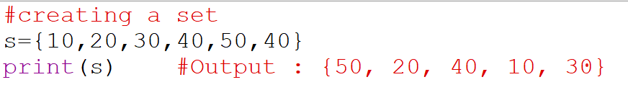
Set....
To create a set, we should enter the elements separated by commas inside curly braces { }.
Since sets are unordered, we cannot retrieve the elements using indexing and slicing operations.

Slide 88
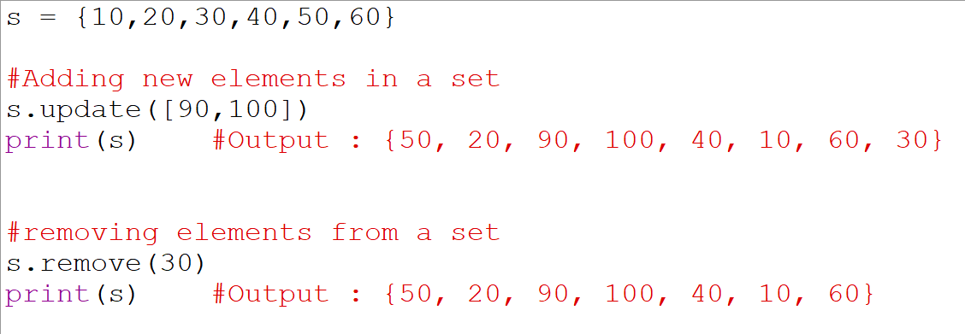
Update and Remove method with Set
The update() method is used to add elements to a set.
The remove() method is used to remove any particular element from a set.

Slide 89
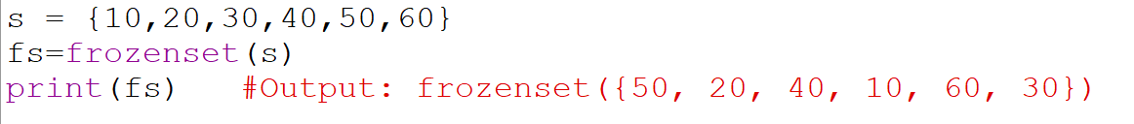
frozenset Datatype
The frozenset datatype is the same as the set datatype.
The main difference is that the elements in the set can be modified; whereas, the elements of the frozenset cannot be modified.
We can create a frozenset by passing a set to frozenset().

Slide 90
Dictionary
The data is stored as key-value pairs using a Python dictionary is called Mapping
This data structure is mutable
The components of dictionary were made using keys and values.
Keys must only have one component.
Values can be of any type, including integer, list, and tuple.
The key and its value should be separated by a colon (:) and every
pair should be separated by a comma.
All the elements should be enclosed inside curly brackets { }.

Slide 91

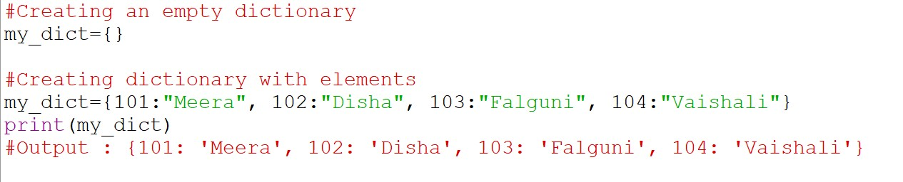

Dictionary

Slide 92
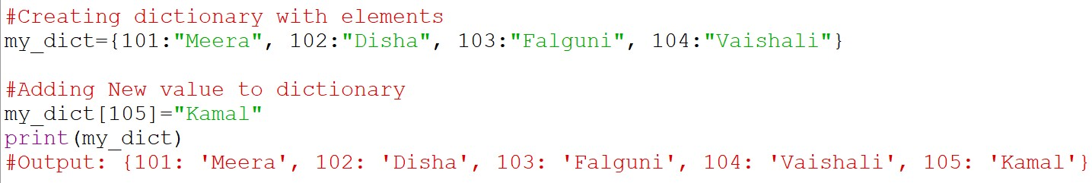
Add new element to dictionary

Slide 93
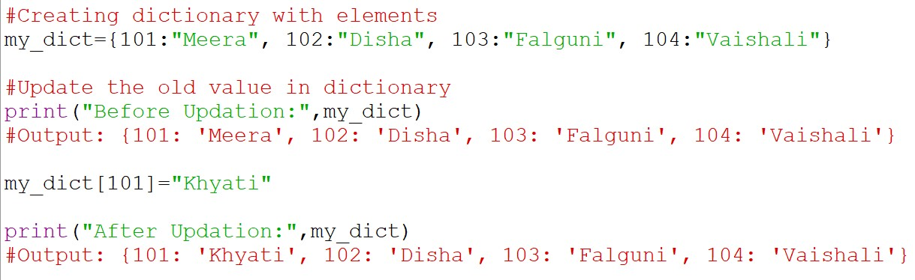
Change the value in to the dictionary

Slide 94
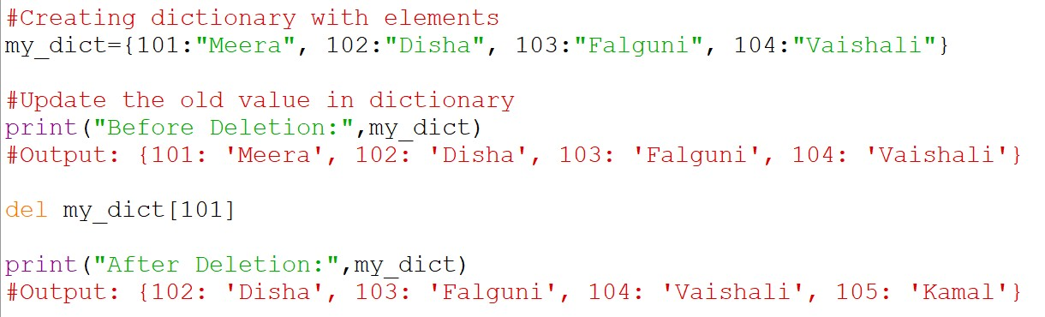
Delete the element from Dictionary

Slide 95
Setting Data Type
x = int(20)
x = float(20.5)
x = complex(1j)
x = list(("apple", "banana", "cherry"))
x = tuple(("apple", "banana", "cherry"))
x = dict(name="John", age=36)
x = set(("apple", "banana", "cherry"))
x = bool(5)

Slide 96
Python Data Types
Here are four collection data types in the Python programming language:
List is a collection which is ordered, changeable and allows duplicate members.
Tuple is a collection which is ordered, unchangeable and allows duplicate members.
Set is a collection which is unordered, unchangeable, unindexed and
No duplicate members.
Dictionary is a collection which is ordered and changeable and No duplicate members.

Slide 97
Simple Output – print()
Print() -Output data to the standard output device (screen).
Example:
print(“Atmiya University-Rajkot”) Output:- Atmiya University-Rajkot

Slide 98
print() Example
a = 5
print('The value of a is', a) x=12.34574
Output:-The value of a 5
print('The value of x is %3.2f‘,x) Output: The value of x is 12.35 print('The value of x is %3.4f‘,x) Output: The value of x is 12.3457

Slide 99
input function
input():- to allow take the input from the user at run-time.
Syntax of input(): input([prompt])
Example:
num = input('Enter a number: ')
print(“Number is:”,num)
Output: Enter a number:10
Number is:10

Slide 100
input()….
# two input 2 no and calculate sum
a=int(input("enter first no..."))
print(a)
b=int(input("enter second no..."))
print(b)
c=a+b
print("sum is",c)

Slide 101
Operators
An operator is a symbol that performs an operation.
An Operator acts on some variables called operands.
If an operator acts on a single variable it is called a unary operator.
if an operator acts on two variables, it is called a binary operator.
If an operator acts on three variables, then it is called ternary operator.

Slide 102
Python Basic Operators
Types of Operator
Arithmetic Operators
Assignment Operators
Relational Operators
Logical Operators
Boolean Operators
Bitwise Operators
Identity Operator
Membership Operator

Slide 103
Arithmetic Operators
Assume variable a holds 13 and variable b holds 5, then
Operator | Description | Example
+ Addition | Addition of number | a + b = 18
- Subtraction | Subtracts of number | a – b = 8
* Multiplication | Multiplication of number | a * b = 65
/ Division | Division of number | b/a = 2.6
% Modulus | Found the modulus | b % a =3
// Floor Division | Perform the division and return answer in integer | b//a= 2
** Exponent | Calculates exponential power value. | a**b=371293

Slide 104
Assignment Operators
Operator | Example
= | c = a + b
+= | c += a (c = c + a)
-= | c -= a (c = c - a)
*= | c *= a (c = c * a)
/= | c /= a (c = c / a)
**= | c**=a (c=c**a)
//= | c//=a (c=c//a)

Slide 105
Relational Operators
For ex: a=10 and b= 20
Operator | Example
== | (a == b) is not true
!= | (a != b) is true
> | (a > b) is not true
< | (a < b) is true
>= | (a >= b) is not true
<= | (a <= b) is true

Slide 106
Logical Operators
For ex: a=10 and b= 20
Operator | Example
and | (a and b) is true.
or | (a or b) is true
not | not(a and b) is false.

Slide 107
Bitwise Operators
Operator | Name | Description | Syntax
& | Bitwise AND | Result bit 1,if both operand bits are 1;otherwise results bit 0. | x & y
| | Bitwise OR | Result bit 1,if any of the operand bit is 1; otherwise results bit 0. | x | y
~ | Bitwise NOT | inverts individual bits | ~x
^ | Bitwise XOR | Results bit 1,if any of the operand bit is 1 but not both, otherwise results bit 0. | x ^ y
>> | Bitwise right shift | The left operand’s value is moved toward the right by the number of bits specified by the right operand. | x>>
<< | Bitwise left shift | The left operand’s value is moved toward the left by the number of bits specified by the right operand. | x<<

Slide 108
Python Identity Operators
Identity operators compare the memory locations of two objects. There are two Identity operators explained below
Operator | Description | Example
is | Evaluates to true if the variables on either side of the operator point to the same object and false otherwise. | x is y, here is results in 1 if id(x) equals id(y).
is not | Evaluates to false if the variables on either side of the operator point to the same object and true otherwise | x is not y, here is not results in 1 if id(x) is not equal to id(y).

Slide 109
Python Membership Operators
Python’s membership operators test for membership in a sequence, such as strings, lists, or tuples. There are two membership operators as explained below
Operator | Description | Example
in | Evaluates to true if it finds a variable in the specified sequence and false otherwise.. | x in y, here in results in a 1 if x is a member of sequence y.
not in | Evaluates to true if it does not finds a variable in the specified sequence and false otherwise. | x not in y, here not in results in a 1 if x is not a member of sequence y.

