Slide 1
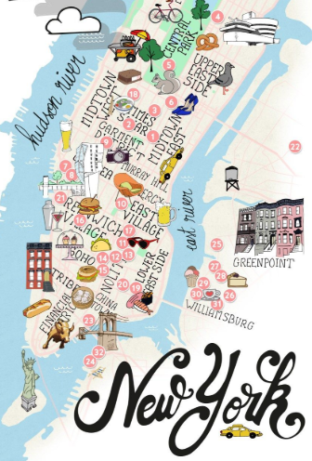
AIRBNB HOT SPOTS Project 1 1/12/19
ERIC LIEU
MJ VILLACRESES
FRANCIS IMPERIAL
AMANDA WISHNIE

Slide 2
RESEARCH QUESTIONS TO ANSWER
PRIMARY QUESTION What affects AirBnB prices?
ADDITIONAL QUESTIONS Does the time of the year affect prices? Do crime rates affect prices? Does median household income affect prices? Do demographics (i.e. ethnicity) affect prices?
MOTIVATIONS:
UNDERSTAND WHAT EXTERNAL FACTORS AFFECT AIRBNB PRICES
WHERE:
AIRBNB OPEN SOURCE
US CENSUS BUREAU DATA
HOW:
EXCEL
PYTHON
API’s
ADD EVERYONES SOURCES

Slide 3
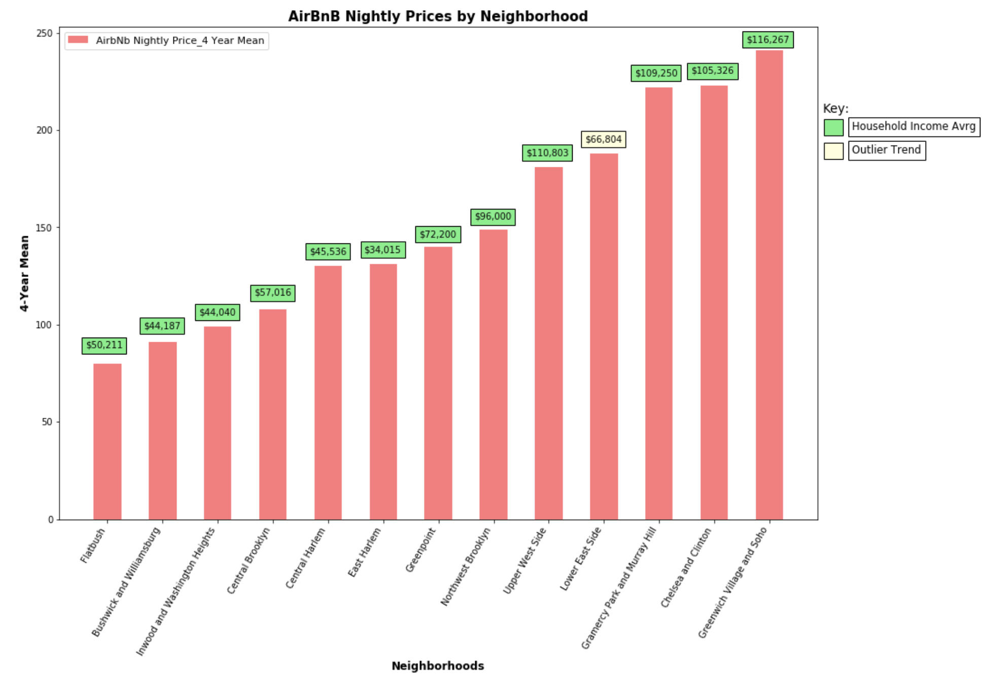
hh Income & Price by neighborhood
Lower Income = Lower Price
Outlier Trend = Lower East Side
Source: 2013-2017 American Community Survey 5-Year Estimates & AirBnB

Slide 4
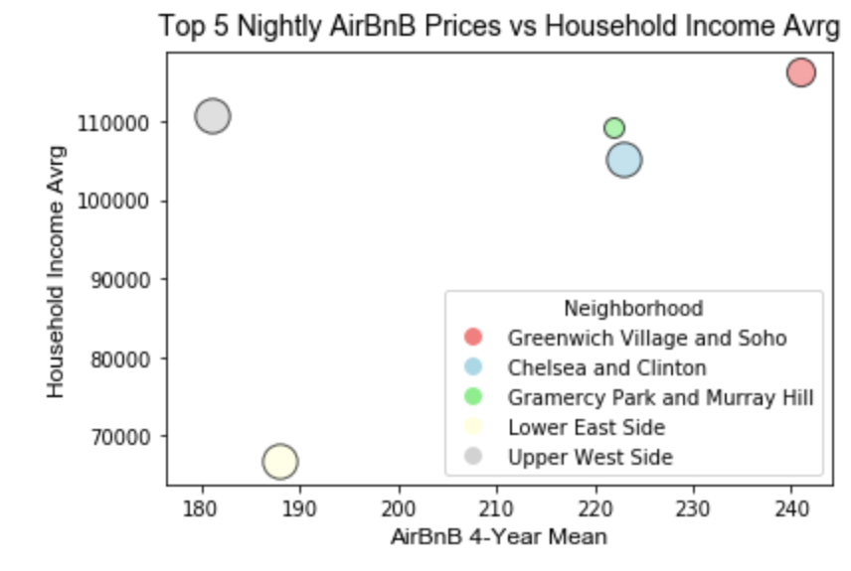
Lower east side
Amongst the Top 5 AirBnB Prices
$34K average Household Income
Source: 2013-2017 American Community Survey 5-Year Estimates & AirBnB

Slide 5
AIRBNB HOT SPOT CONCLUSIONS
TIME OF THE YEAR:
ADD YOUR ANALYSIS HERE
Apt Owner
Time of Year
HH Income
Demographics
Crime Rates
CRIME RATES:
ADD YOUR ANALYSIS HERE
HH INCOME:
HH INCOME DIRECTLY CORRELATES WITH AIRBNB PRICES
AIRBNB PRICES THAT AREN’T INLINE WITH HH INCOME SUGGESTS THERE MAY BE EXTERNAL AFFECTING THE AIRBNB PRICES
DEMOGRAPHICS:
ADD YOUR ANALYSIS HERE

Slide 6
Add a Slide Title - 5

