Slide 1
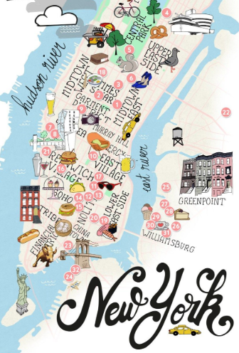
AIRBNB HOT SPOTS Project 1 1/12/19
ERIC LIEU
MJ VILLACRESES
FRANCIS IMPERIAL
AMANDA WISHNIE

Slide 2
RESEARCH QUESTIONS TO ANSWER
PRIMARY QUESTION What affects AirBnB prices?
ADDITIONAL QUESTIONS Does the time of the year affect prices? Do crime rates affect prices? Does median household income affect prices? Do demographics (i.e. ethnicity) affect prices?
MOTIVATIONS:
UNDERSTAND WHAT EXTERNAL FACTORS AFFECT AIRBNB PRICES
WHERE:
AIRBNB OPEN SOURCE
US CENSUS BUREAU DATA
HOW:
EXCEL
PYTHON
API’s
ADD EVERYONES SOURCES

Slide 3






Does the time of the year affect prices?
MJ VILLACRESES

Slide 4
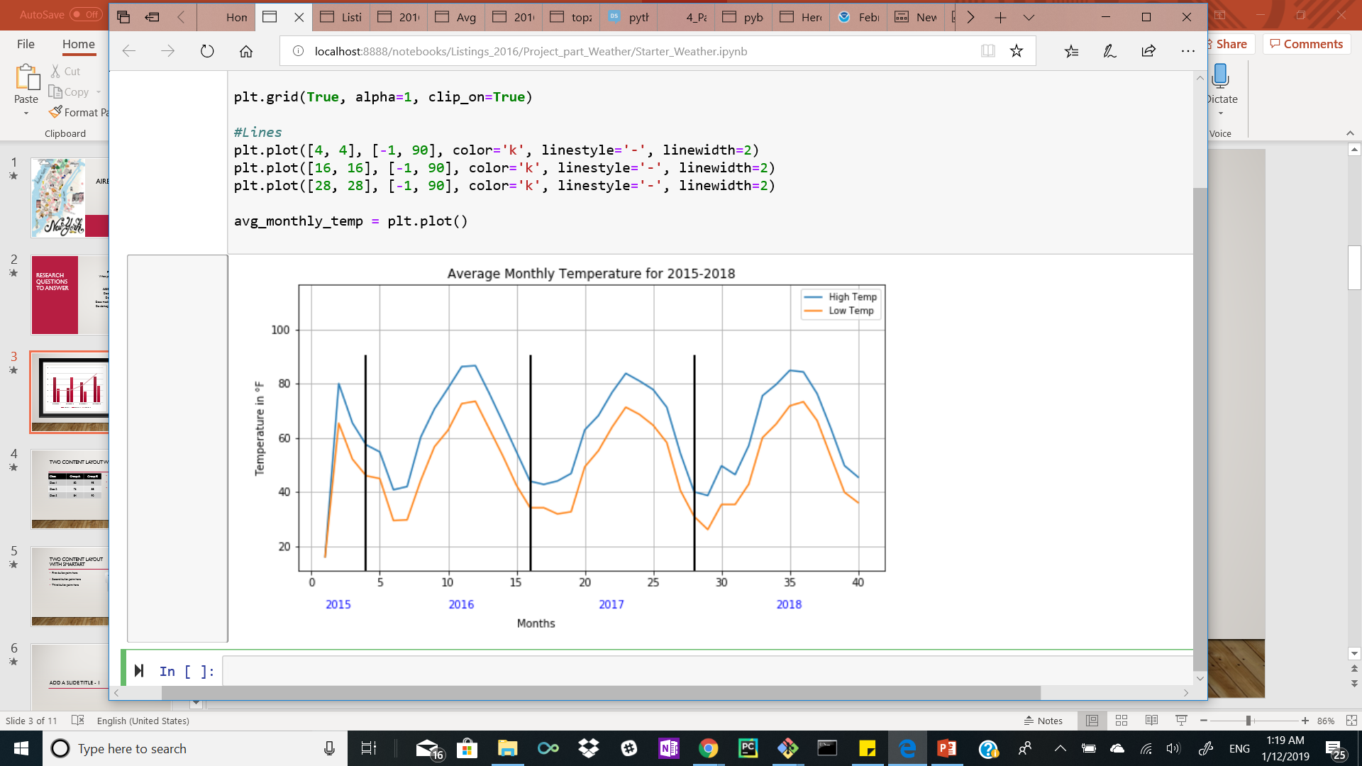
Trend for average monthly temperature
As it is expected, temperature fluctuates according to the seasons
Lowest temperatures in NYC show up in January and February 2018, then 2016 and lastly 2017.
Highest temperature remain relatively the same throughout all summers with one discrepancy during 2015, when avg temp remained just below the 80° mark.

Slide 5
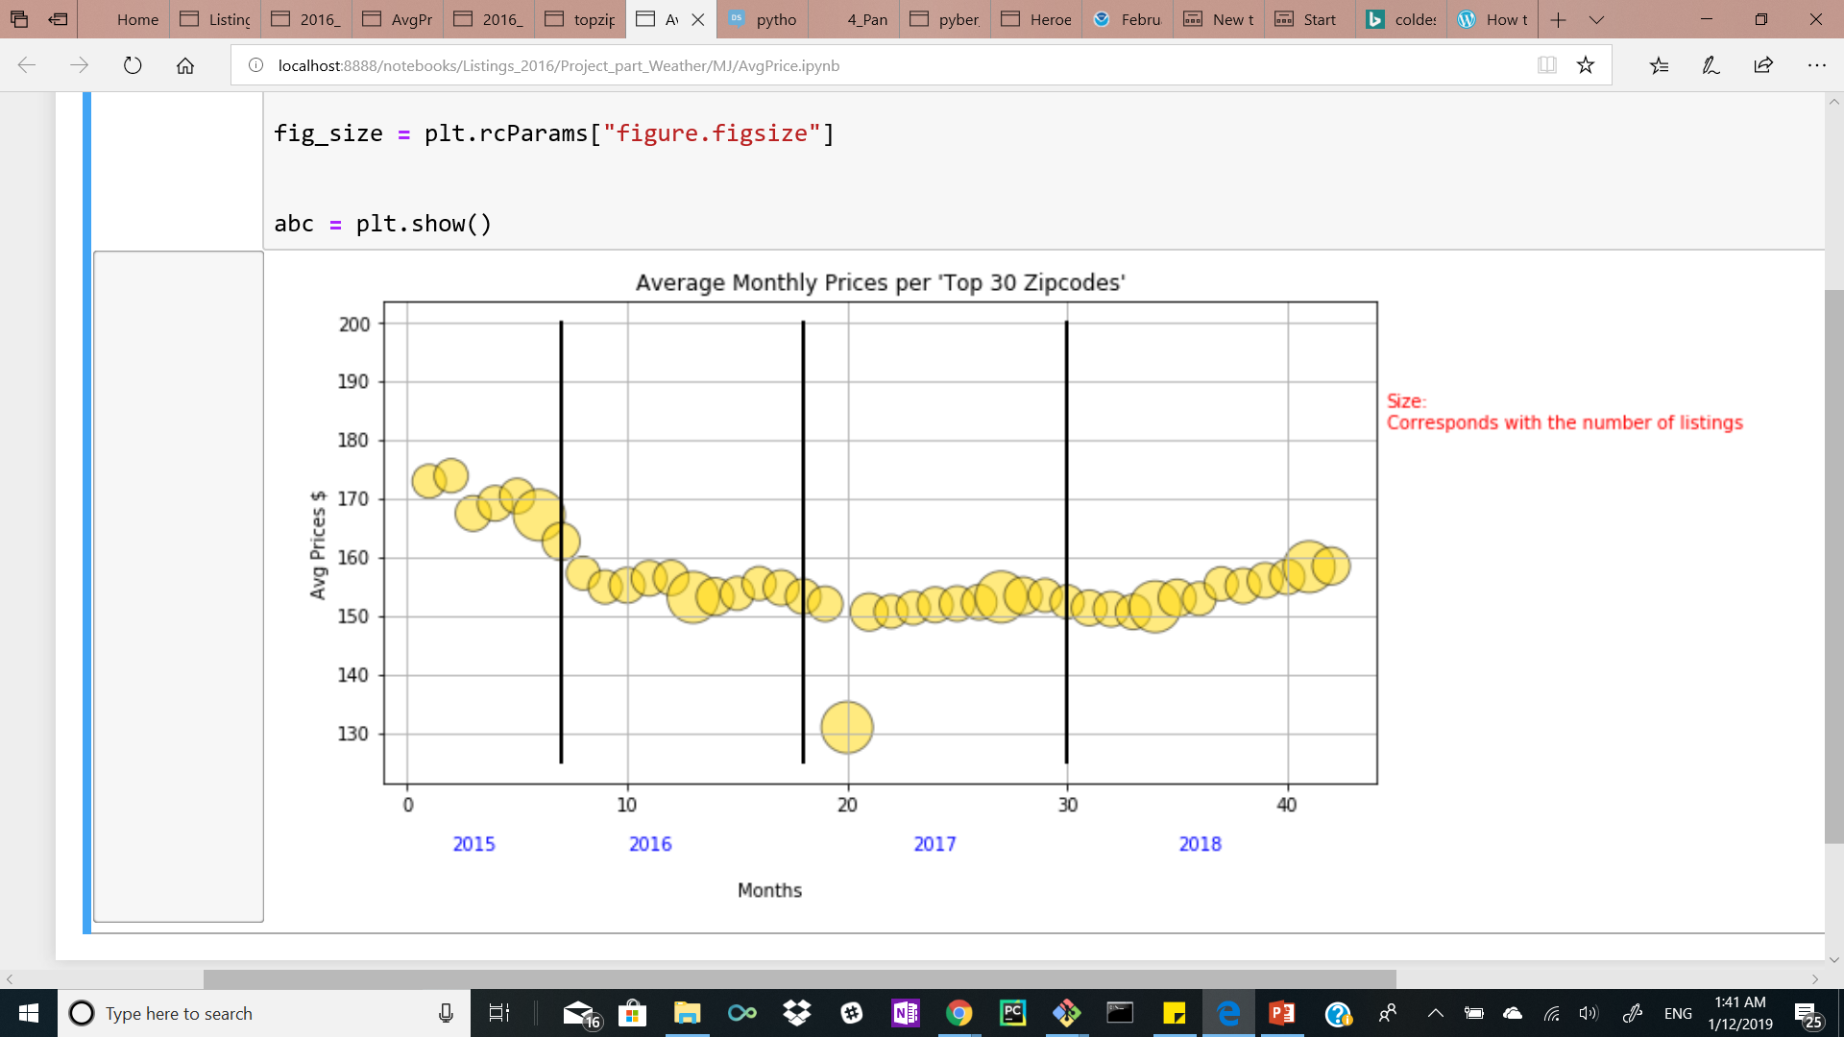
Average AirBnB monthly Price per night from 2015-2018
Number of listings has no correlation with current temperature
Avg. Price has decreased over the years, slight increase over the summer.
Feb 9, 2017 – major pitfall in Avg. Price.

Slide 6





Do crime rates affect prices?
ERIC LIEU

Slide 7
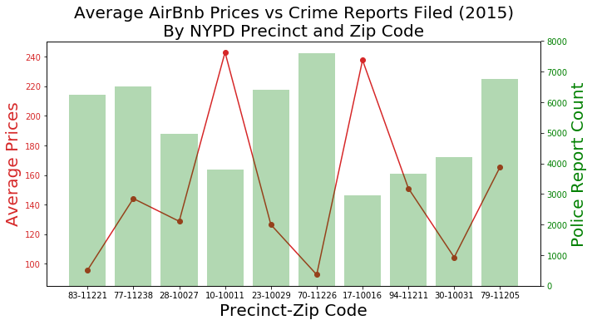
Does the amount of crime in the area affect Airbnb prices?

Slide 8
Average Airbnb prices & number of complaints filed at nypd precinct
AirBnB Data (CSV):
Yearly average prices for selected list of zip codes
NYC OPEN DATA (API JSON):
Queried and returned number of police reports (e.g. violations, misdemeanors, felonies) filed for each select precinct for entire year
Precincts were chosen based on the selected list of selected list of zip codes

Slide 9
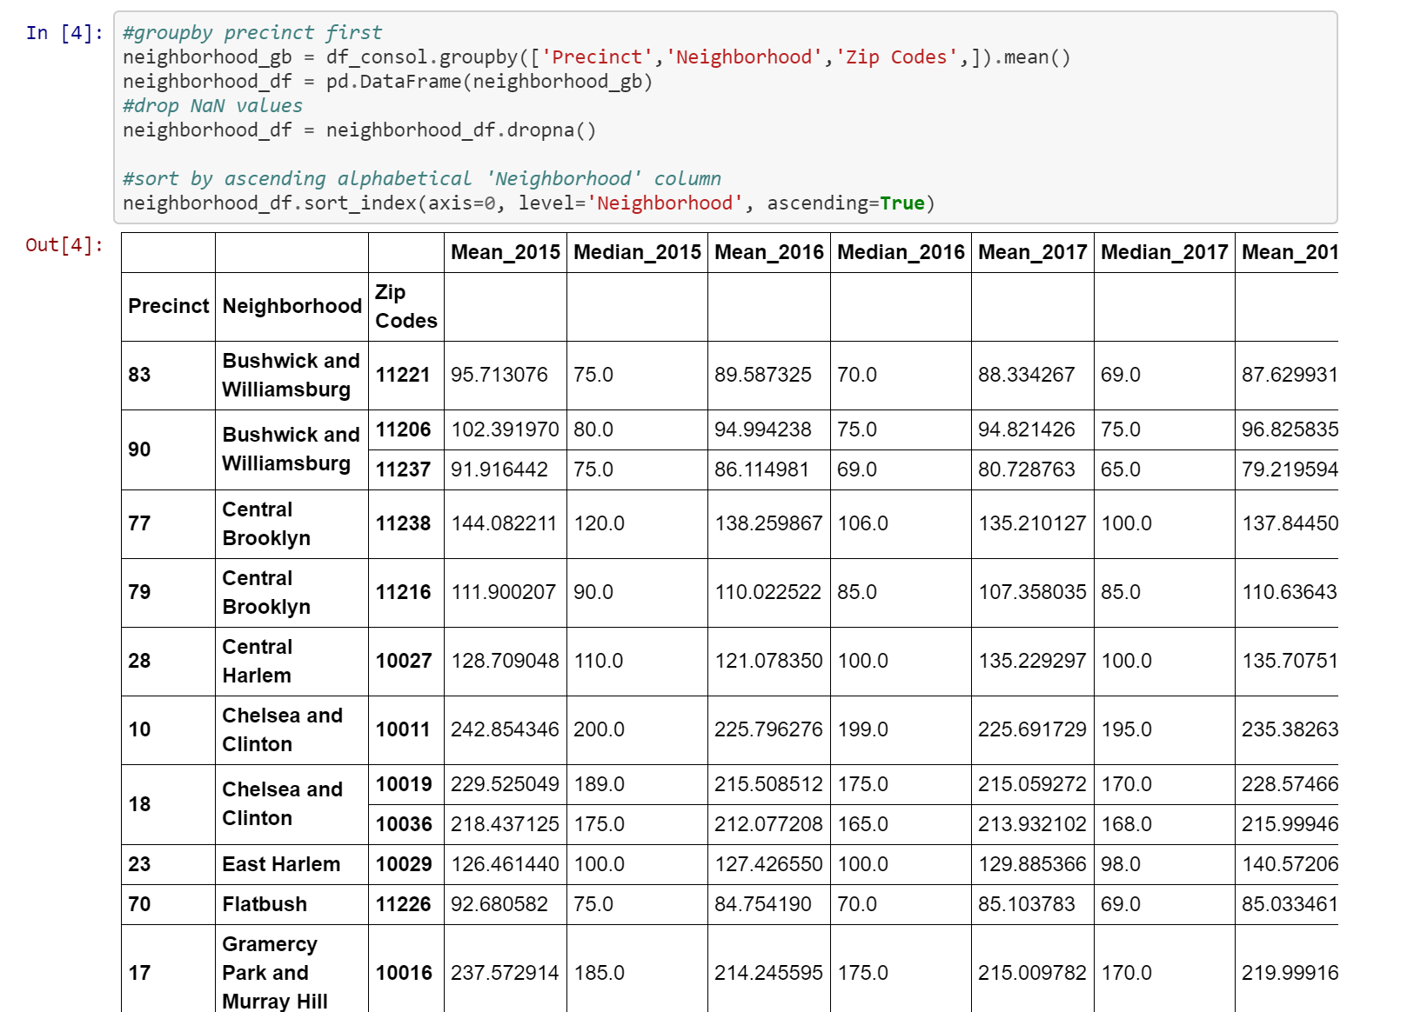
Brief overview of code input and output

Slide 10
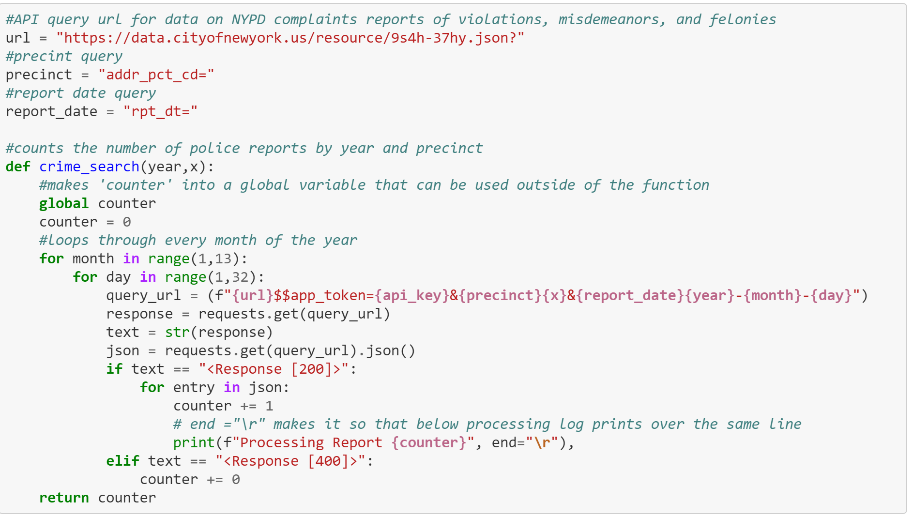
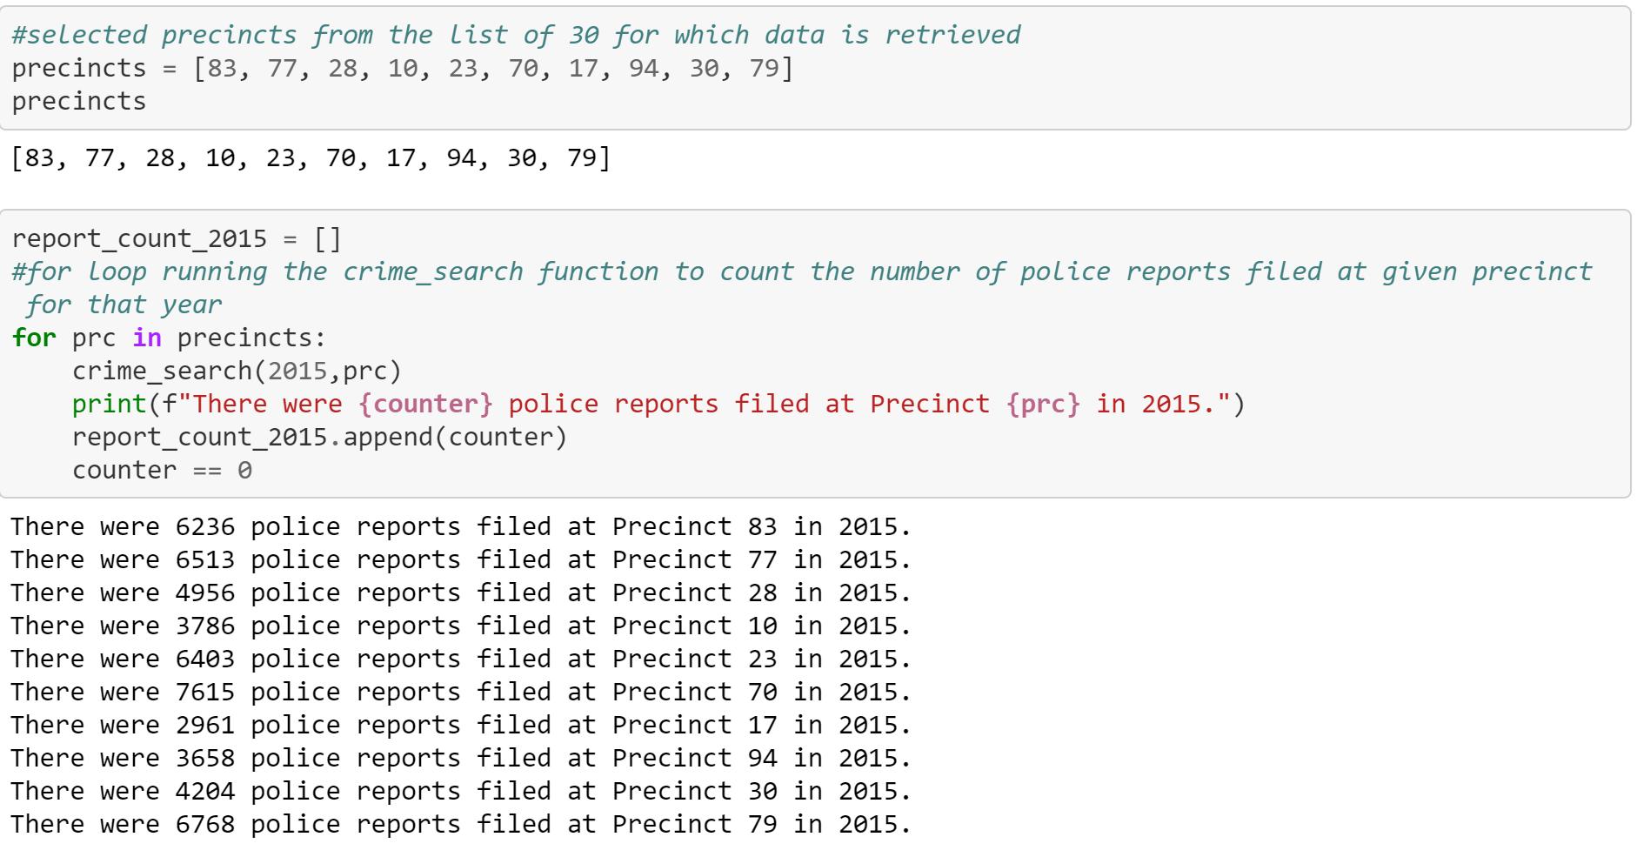
Brief overview of code input and output

Slide 11
gss
Chelsea and Clinton
Gramercy Park and Murray Hill
Northwest Brooklyn
Washington Heights
Bushwick and Williamsburg
Flatbush

Slide 12
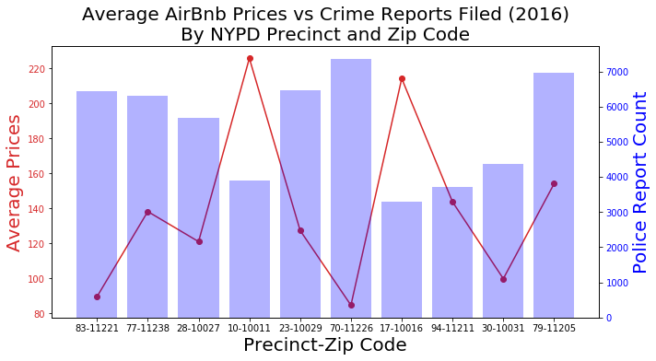

Slide 13
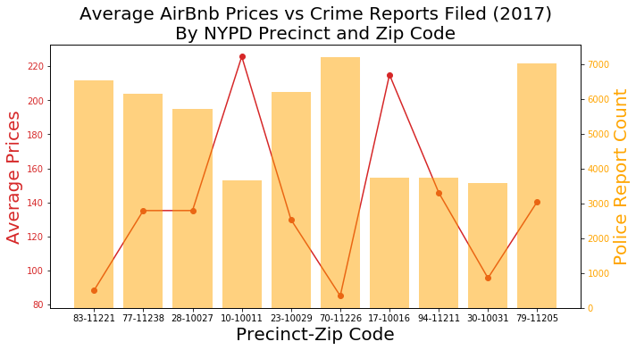

Slide 14





Does median household income affect prices?
AMANDA WISHNIE

Slide 15
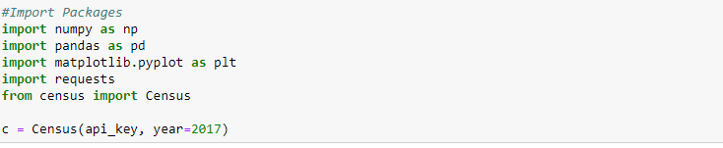
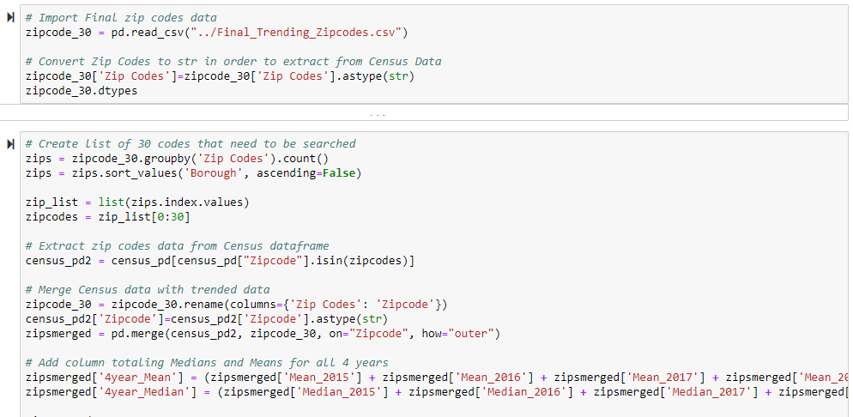
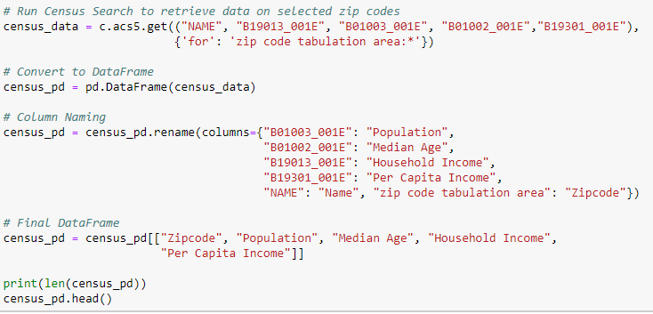
INS & OUTS
CENSUS DATA
ZIPCODES & CENSUS DATA

Slide 16
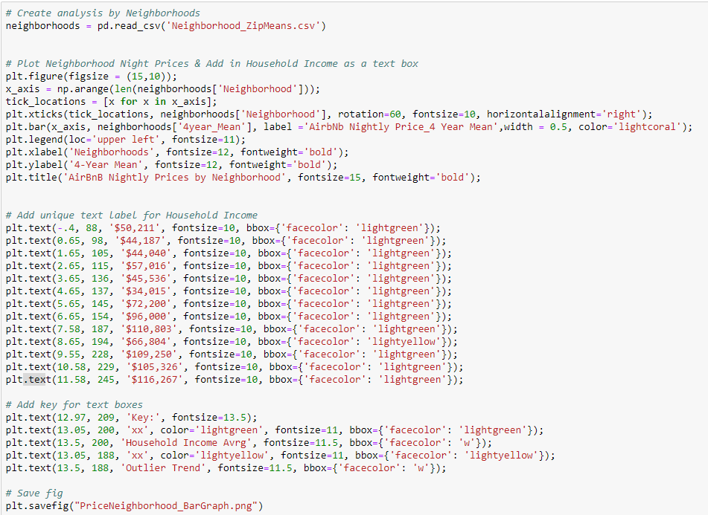
BAR GRAPH
DataFrame grouped by Neighborhood
Calculated the 4 year Mean for AirBnB Prices
Compare Prices & HH Income (2013 – 2017)

Slide 17
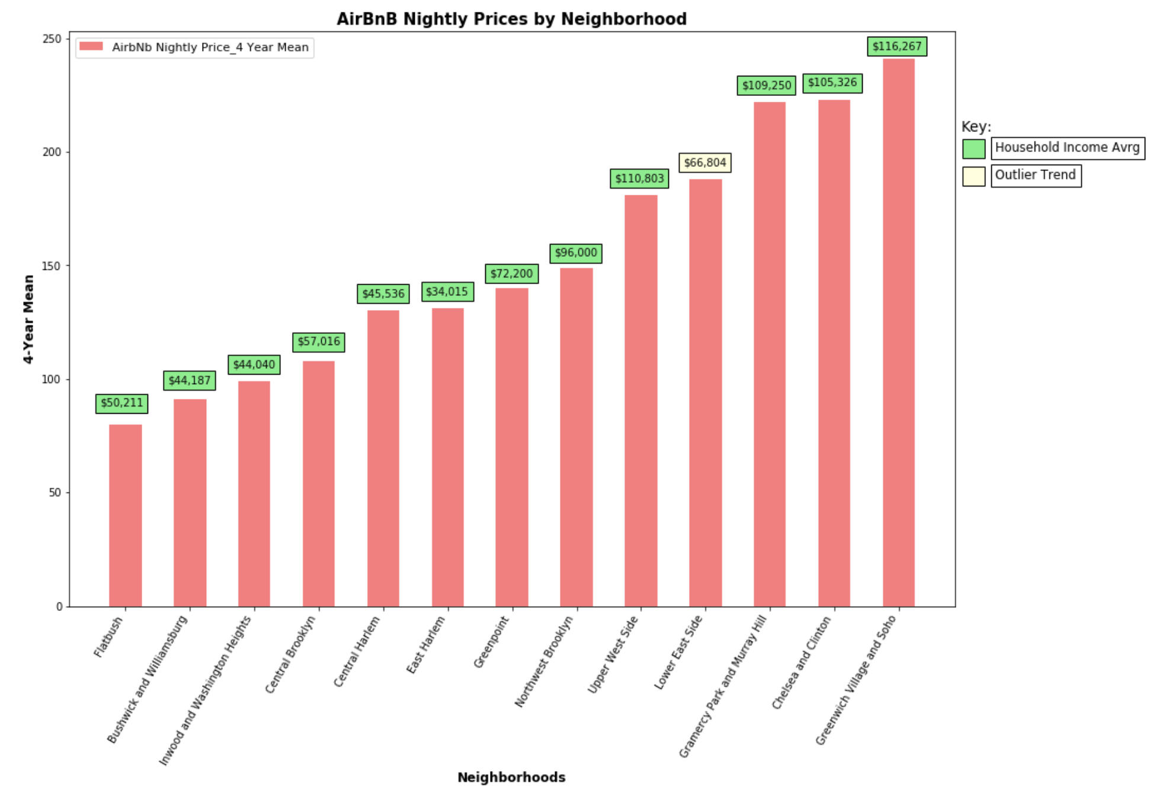
hh Income & Price by neighborhood
Lower Income = Lower AirBnB Prices
Outlier Trend = Lower East Side
Source: 2013-2017 American Community Survey 5-Year Estimates & AirBnB

Slide 18
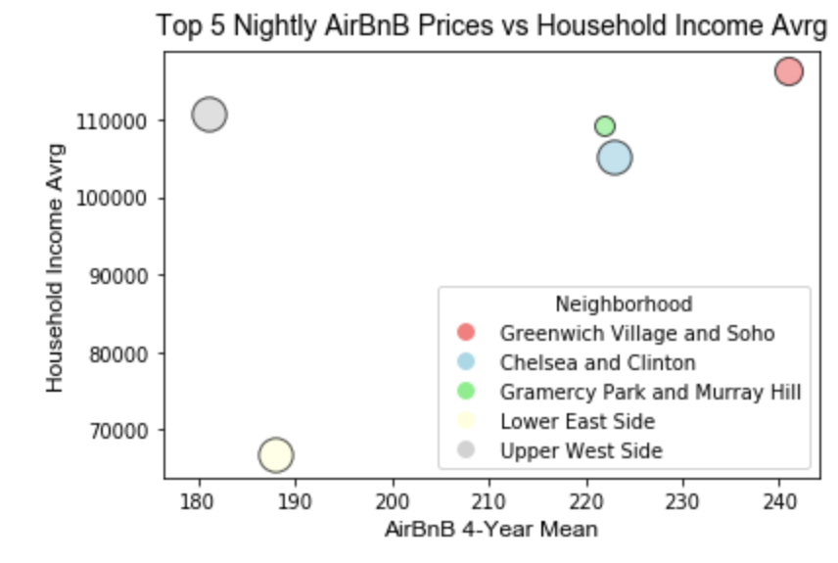
OUTLIER TREND:
Lower east side
Amongst the Top 5 AirBnB Prices
$34K average Household Income
Neighborhood | AirBnB Avrg Price | HH Income Avrg
Greenwich Village & Soho | $241 | $116,267
Chelsea & Clinton | $223 | $105,326
Gramercy Park & Murray Hill | $222 | $109,250
Lower East Side | $188 | $66,804
Upper West Side | $181 | $110,803
TOP 5 AVRG | $211 | $101,690
$101,690 - $66,804 = $34,886
Source: 2013-2017 American Community Survey 5-Year Estimates & AirBnB

Slide 19




Do demographics (i.e. ethnicity) affect prices?
FRANCIS IMPERIAL

Slide 20
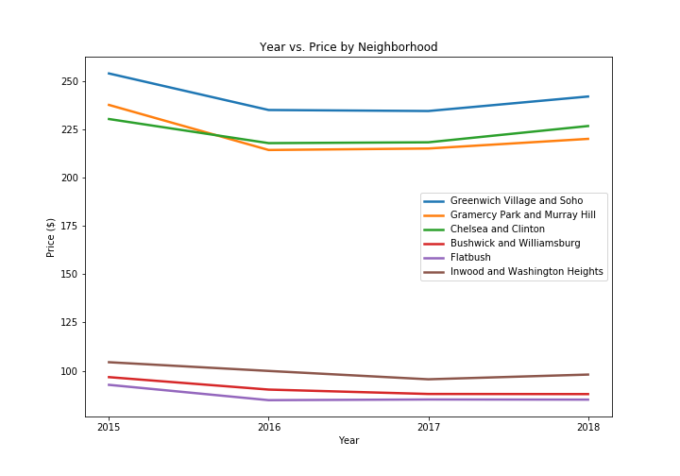
Year vs. Price by neighborhood

Slide 21
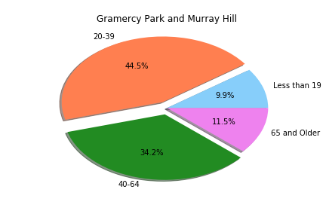
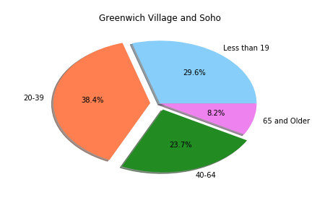
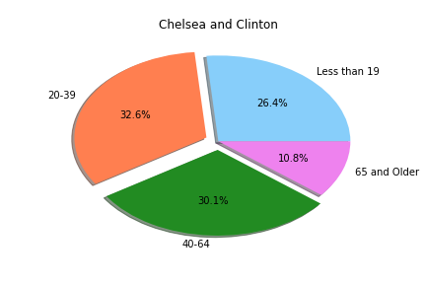
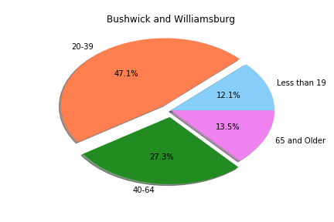
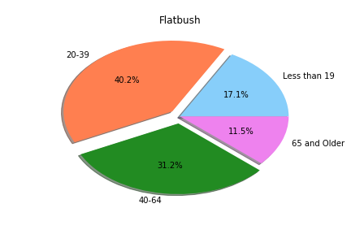
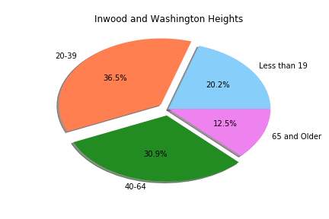
Demographics by age
High
Low

Slide 22
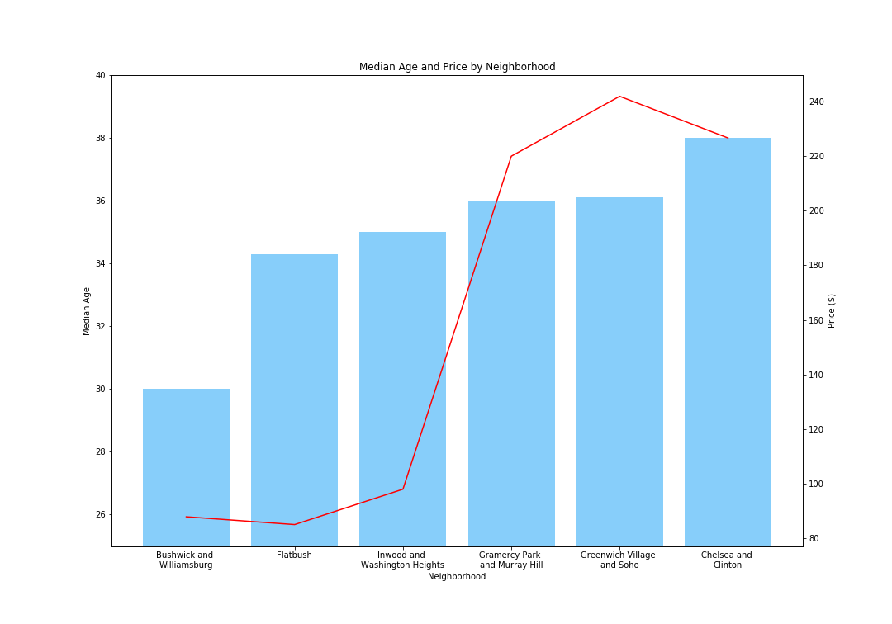
Median age and price by neighborhood

Slide 23
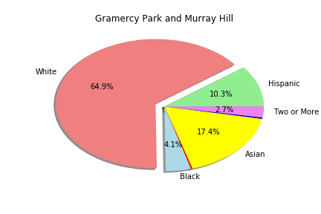
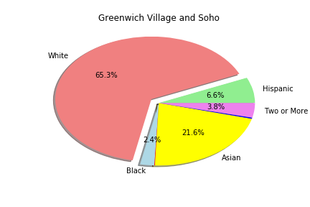
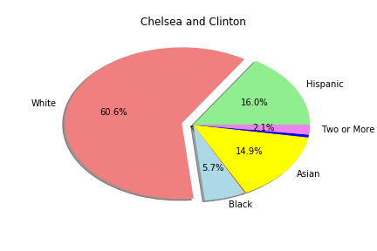
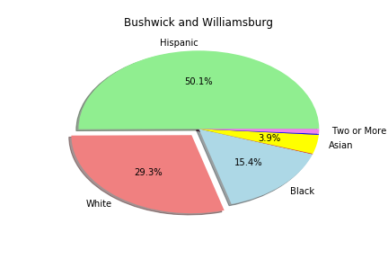
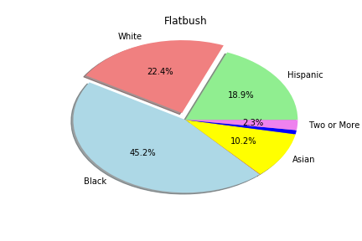
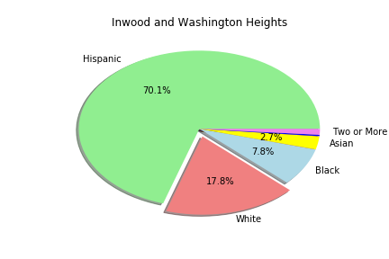
Demographics by Race
High
Low

Slide 24
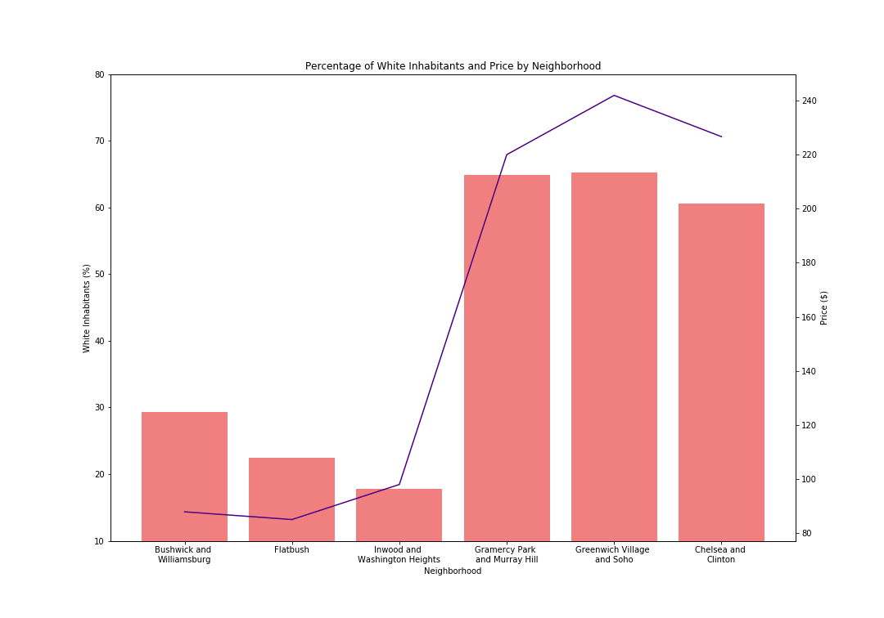
Percentage of white inhabitants and price by neighborhood

Slide 25
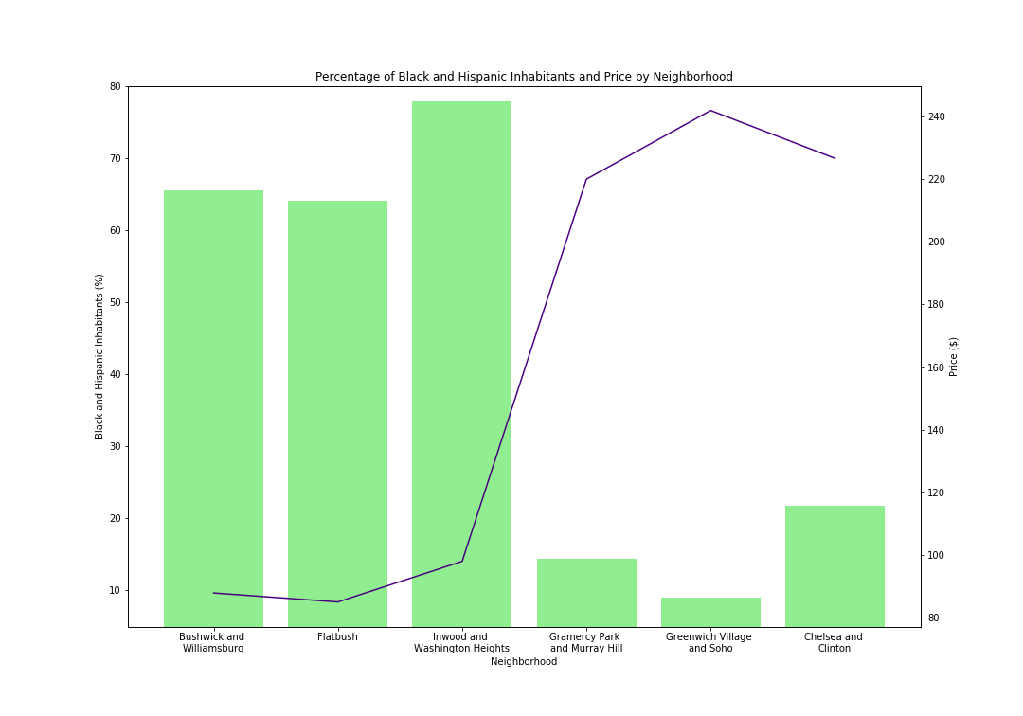
Percentage of black and Hispanic inhabitants and price by neighborhood

Slide 26
AIRBNB HOT SPOT CONCLUSIONS
TIME OF THE YEAR:
ADD YOUR ANALYSIS HERE
Apt Owner
Time of Year
HH Income
Demographics
Crime Rates
CRIME RATES:
ADD YOUR ANALYSIS HERE
HH INCOME:
HH INCOME DIRECTLY CORRELATES WITH AIRBNB PRICES
AIRBNB PRICES THAT AREN’T INLINE WITH HH INCOME SUGGESTS THERE MAY BE EXTERNAL AFFECTING THE AIRBNB PRICES
DEMOGRAPHICS:
ADD YOUR ANALYSIS HERE

