Slide 1
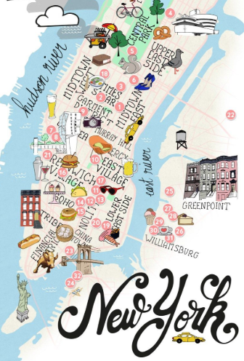
AIRBNB HOT SPOTS Project 1 1/12/19
ERIC LIEU
MJ VILLACRESES
FRANCIS IMPERIAL
AMANDA WISHNIE

Slide 2
RESEARCH QUESTIONS TO ANSWER
PRIMARY QUESTION What affects AirBnB prices? ADDITIONAL QUESTIONS Does the time of the year affect prices? Do crime rates affect prices? Does median household income affect prices? Do demographics (i.e. ethnicity) affect prices?

Slide 3
Title and Content Layout with Chart

Slide 4
Two Content Layout with Table
Class | Group A | Group B
Class 1 | 82 | 95
Class 2 | 76 | 88
Class 3 | 84 | 90
First bullet point here
Second bullet point here
Third bullet point here

Slide 5
Two Content Layout with SmartArt
First bullet point here
Second bullet point here
Third bullet point here
Group A
Task 1
Group B
Task 1
Group C
Task 2
Task 2
Task 1
Task 2

Slide 6
Add a Slide Title - 1

Slide 7
Add a Slide Title - 2

Slide 8
Add a Slide Title - 3

Slide 10
Add a Slide Title - 4

Slide 11
Add a Slide Title - 5

