Slide 1

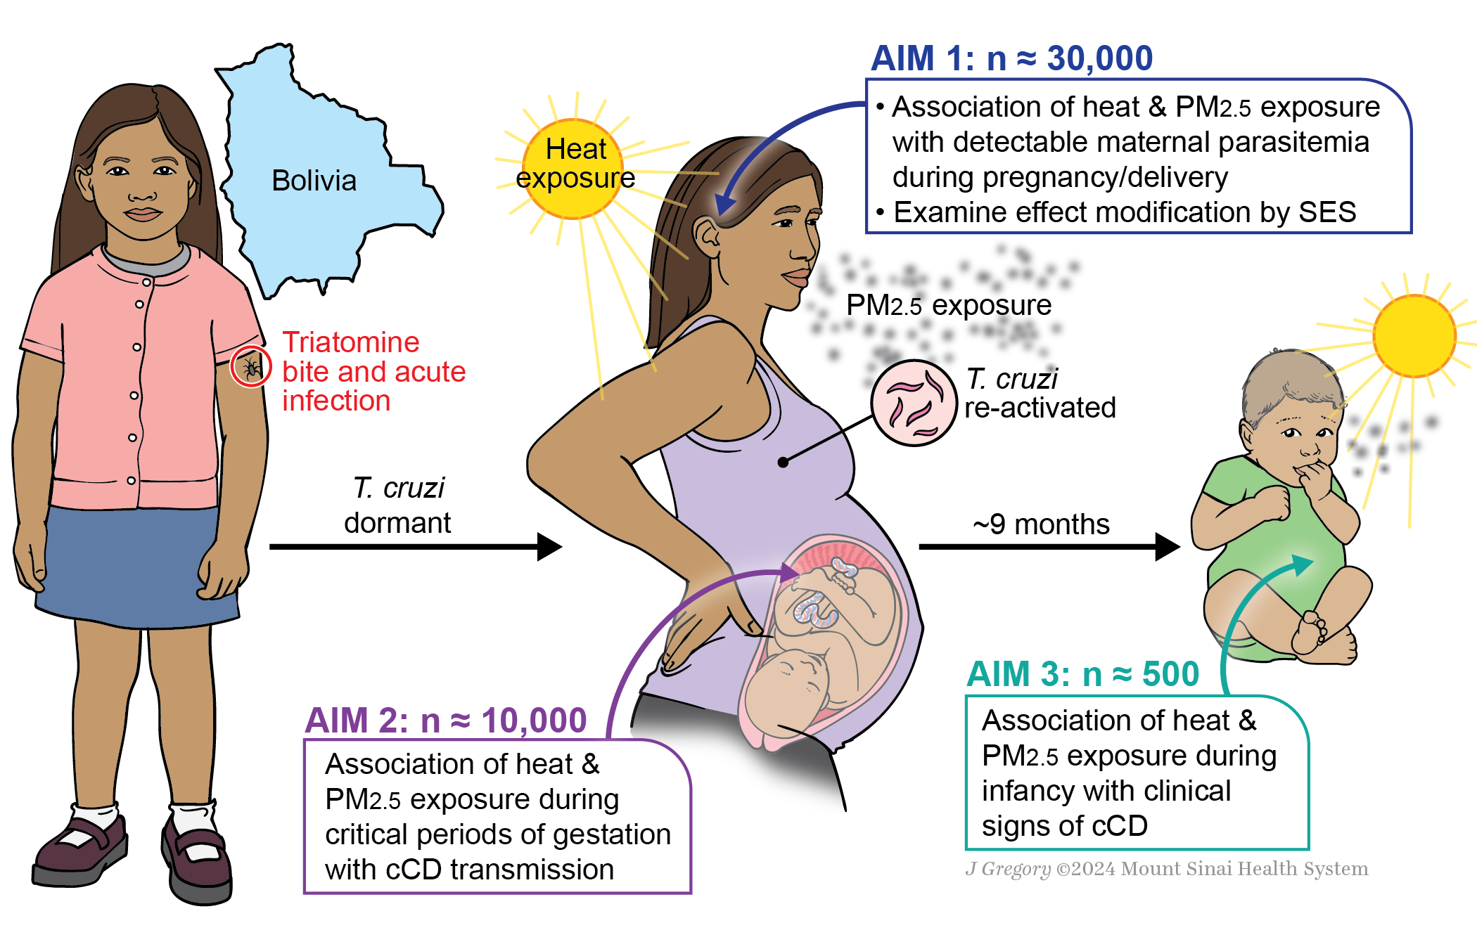
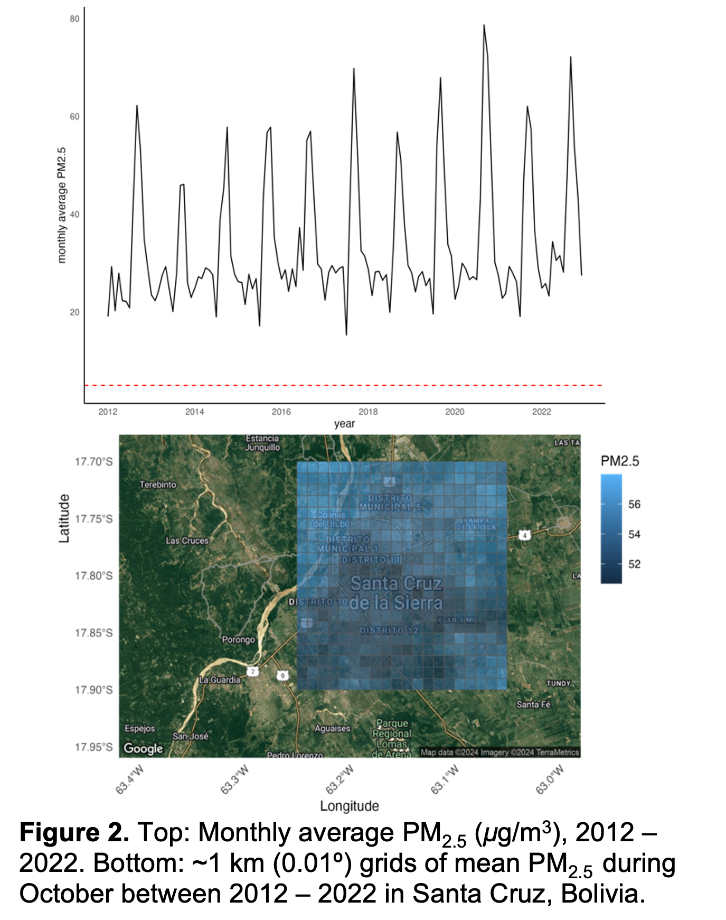


The effects of adverse environmental exposures on risk for congenital Chagas transmission and adverse birth outcomes in Santa Cruz, Bolivia.
Abstract: 7442
Matthew J. Ward¹, Natalie M. Bowman², Heather H. Burris³, Chris Gennings¹, Robert H. Gilman⁴, Nicholas B. DeFelice¹. matthew.ward@mssm.edu
¹Environmental Medicine and Climate Science, Icahn School of Medicine at Mount Sinai, New York, New York 10029. ²Department of Medicine, Division of Infectious Diseases, UNC School of Medicine, Chapel Hill, North Carolina 27599. ³Department of Pediatrics, Division of Neonatology, Perelman School of Medicine at the University of Pennsylvania, Philadelphia, Pennsylvania 19104. ⁴Department of International Health, Johns Hopkins Bloomberg School of Public Health, Baltimore, Maryland 21205.
CONCLUSIONS & CLINICAL RELEVANCE
As global temperatures continue to rise and exposures to ambient air-pollution continue, the potential association between gestational PM2.5 and heat stressors and rates of congenital Chagas transmission need to be investigated further. The outcome of this study will aid physicians in advising women infected with T. cruzi on risk reduction during pregnancy. Results will shed light on the association of air pollution and heat exposures during pregnancy with adverse birth outcomes and congenital Chagas transmission in Santa Cruz, Bolivia. Additionally, the findings could have implications for other infections with similar mechanisms of congenital transmission as T. cruzi.
BACKGROUND
Methods
Little is known about the relationship between environmental stressors and congenital transmission of Trypanosoma cruzi, the etiologic agent of Chagas disease.
Up to 30% of develop cardiac, digestive, and/or neurologic disease, resulting in significant morbidity and mortality.¹
6 – 8 million people are infected globally.
> half in the Southern - Cone region of Latin America and over 90% of new cases in this region occurring in Bolivia.^{2, 3, 4}
Adverse birth outcomes in infants born to infected mothers and can result in delayed childhood development.³
Congenital transmission occurs in 5 - 10%
It is thought T. cruzi evades the immune system to establish congenital infection through a complex interaction between parasite, placenta, and inflammatory and oxidative stressors that weaken the placental barrier from repeated activation of the innate immune system.^{5, 6}
Repeated gestational exposure to ambient PM2.5 also results in adverse birth outcomes due to oxidative and inflammatory stress and PM2.5 can cross the placental barrier and result in placental maladaptation with further deleterious effects on fetal development.^{7,8}
Studies indicate that a 1°C increase in temperature correlates to double the risk for both pre-term and stillbirths.⁹ Santa Cruz, Bolivia has highs in the 40 ºC range with summer PM2.5 exceeding the WHO’s recommendation by as much as five - fold.
Aim 1. Regression models will quantify associations of heat and PM_{2.5} exposure during pregnancy with detectable parasitemia at multiple time points. Effect measure modification by SES will be assessed. Hypothesis: High levels of heat and PM_{2.5} exposure will be associated with parasitemia in pregnancy and associations will be stronger among individuals of low SES.
Aim 2. Distributed lag models will characterize association of time-varying exposures with cCD transmission. Hypothesis: Pregnancies with high levels of heat and PM_{2.5} during critical periods of gestation will have increased rates cCD transmission.
Aim 3. We will analyze associations of heat and PM_{2.5} exposure with symptoms of cCD with a focus on neurodevelopmental delays. Hypothesis: Infants with cCD exposed to higher levels of heat and PM_{2.5} will have lower APGAR scores and delays assessed by physical exam.
Figure 1. Study overview.
Table 1. Currently identified data sources for environment and socioeconomic status in Santa Cruz, Bolivia.
Variable | Platform | Source | Spatial Resolution | Temporal Resolution
Surface Temp | CHC-CMIP6 | Climate Hazards Center¹⁸ | 0.05 º | Daily, 1981 - present
Wet Bulb Temp
Precipitation
Humidity
Surface PM2.5 | ACAG | Atmospheric Composition Analysis Group¹⁹ | ~ 1 km | Monthly, 1998 - present
Health, Demographic & SES Data | Cohort | Questionnaire* | Dyad - Neighborhood | Enrolment
*Includes data on housing size, type, and occupancy, as well as household education levels and occupations.
AIMS
Aim 1: Quantify associations of heat and PM_{2.5} exposure with detectable maternal parasitemia during pregnancy and at delivery and examine effect modification by SES.
Aim 2: Quantify associations of heat and PM_{2.5} exposure during critical periods of gestation with congenital Chagas transmission.
Aim 3: Quantify associations of heat and PM_{2.5} exposures during infancy with clinical signs of congenital Chagas disease.
Funding & Collaborators
References
T32HD049311, NIEHS P30603202403, NIEHS P30ES02351,
NICHD K25HD109509-01
Please see attached flyer or scan the QR code.
American Society of Tropical Medicine & Hygiene, Annual Meeting. New Orleans, November 15, 2024.

