Slide 1


D.C. Resuscitation Collaborative: The State of Cardiac Arrest Performance in the District of Columbia
Marshall Washick MS, NRP
CQI Manager
Office of the Medical Director
D.C. Fire and EMS
July 29th, 2021

Slide 2
Goals
Show the state of cardiac arrest outcomes in the District of Columbia
Foster motivation to drive change that leads to improvement
Develop an appreciation for the complexity of the system(s)

Slide 3
Objectives
Present clear data on cardiac arrest performance from the years 2016 through 2021
Show where the challenges/barriers lie to improving cardiac arrest outcomes
Promote dialogue

Slide 4
Before we begin…
Every system is perfectly designed to produce the results you get
Management of a system requires knowledge of the interrelationships between all of the components within the system and of everybody that works in it.
Learning is not compulsory… neither is survival.
-W. Edwards Deming
Notes:
A reminder to keep in mind that we are talking about a system, and the outcomes of that system
In order to effectively understand/manage/improve this system – we much all know how we all work, and our relationships to that work; as well know/understand all the folks that are responsible for the system
Serves as a primer that we much all use data to learn from and drive improvement

Slide 5
So, when we talk about cardiac arrest – what do we mean?
We are talking about:
Adults 18 years of age and older
Have a “Presumed Cardiac”, “Respiratory/Asphyxia”, and “Drug Overdose” etiologies… essentially Non-Traumatic Cardiac Arrests
And patients that were treated by D.C. Fire and EMS and other system partners
What we are not talking about:
Special populations
Traumatic cardiac arrest
Patients who are deceased, and no resuscitation attempted

Slide 6
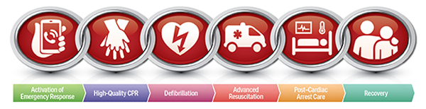
The American Heart Association, Out of Hospital Cardiac Arrest “Chain of Survival”
Image: https://cpr.heart.org/-/media/cpr-images/resources/cpr-facts-stats/adult_ohca_cos_600x415_72dpi_cropped_optimized.jpg?la=en&hash=BE12202D68A21FE49CF614588D91D0BD14042616
Notes:
The chain of survival is a set of interrelated processes and interventions…. In effect, it is a conceptual framework of a system of care

Slide 7
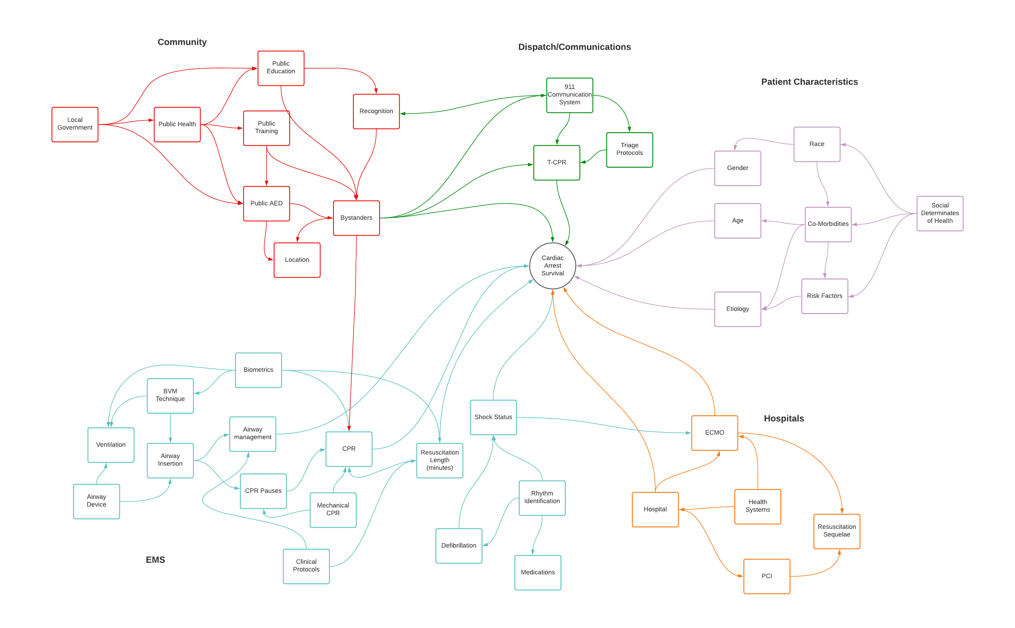
Notes:
When you drill down into that system… it starts to become more complicated.
We begin to see the interrelationships between components
Each box, in and of them selves could be expanded…

Slide 8
Data about ‘The System’
Data used for analysis were extracted out of the Cardiac Arrest Registry to Enhance Survival, aka CARES dataset for the District of Columbia
Total number of cases: N=4,656
Removing trauma related cases: n=4,352
A difference of n=304; or ~6.5% of the data not included

Slide 9
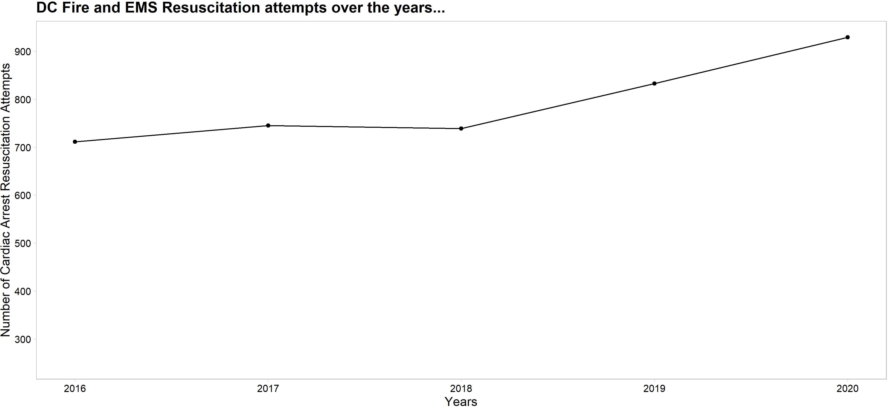
The state of cardiac arrests…
Notes:
2021 is not included because it is not complete – and not adding a forecasting/estimate line

Slide 10
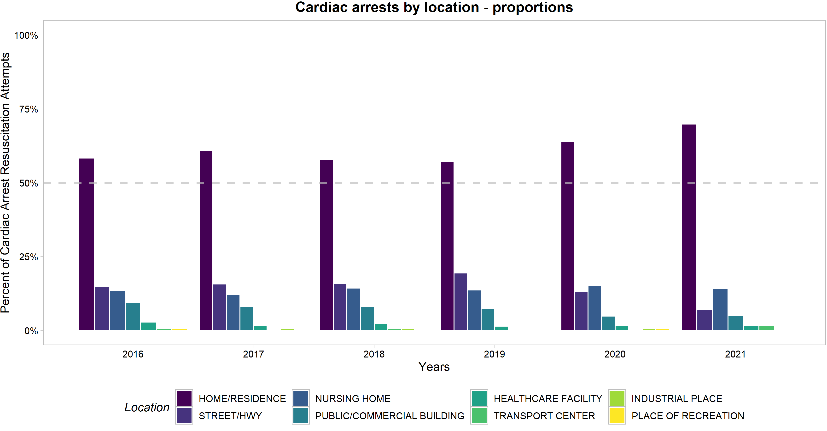
Where do cardiac arrests occur?
Notes:
Again – overwhelmingly at home.
Then public places… and really nursing homes.

Slide 11
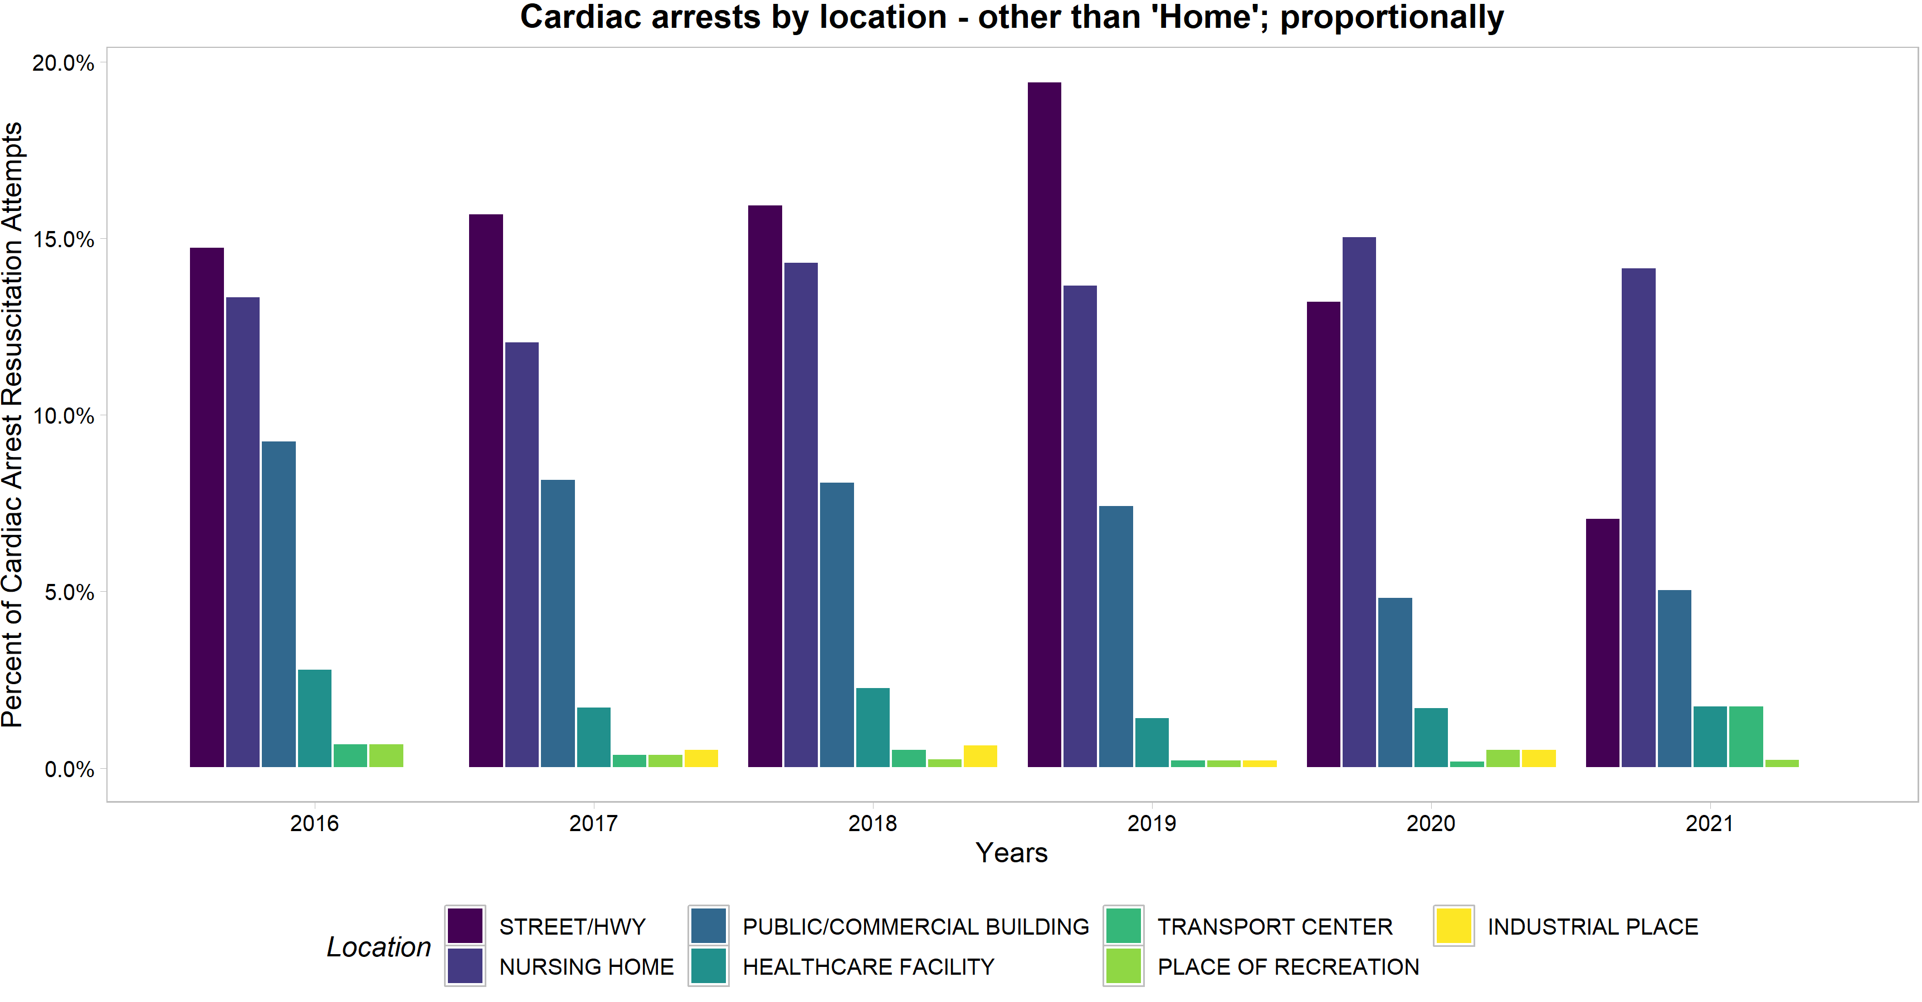
Drilling down beyond “Home”

Slide 12
There are 3 factors that affect survival
Was it a witnessed and recognized cardiac arrest?
Was early (immediate) CPR initiated?
Was an AED applied; and if applicable, early defibrillation?
Notes:
See the first thee links in the chain of survival

Slide 13
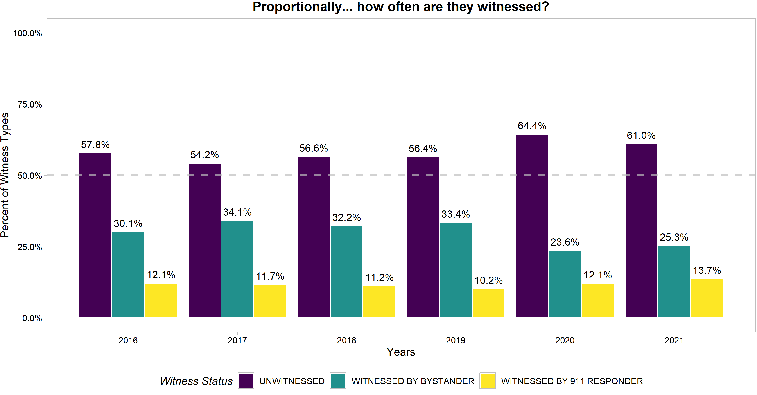
So how often are cardiac arrests ‘witnessed’?

Slide 14
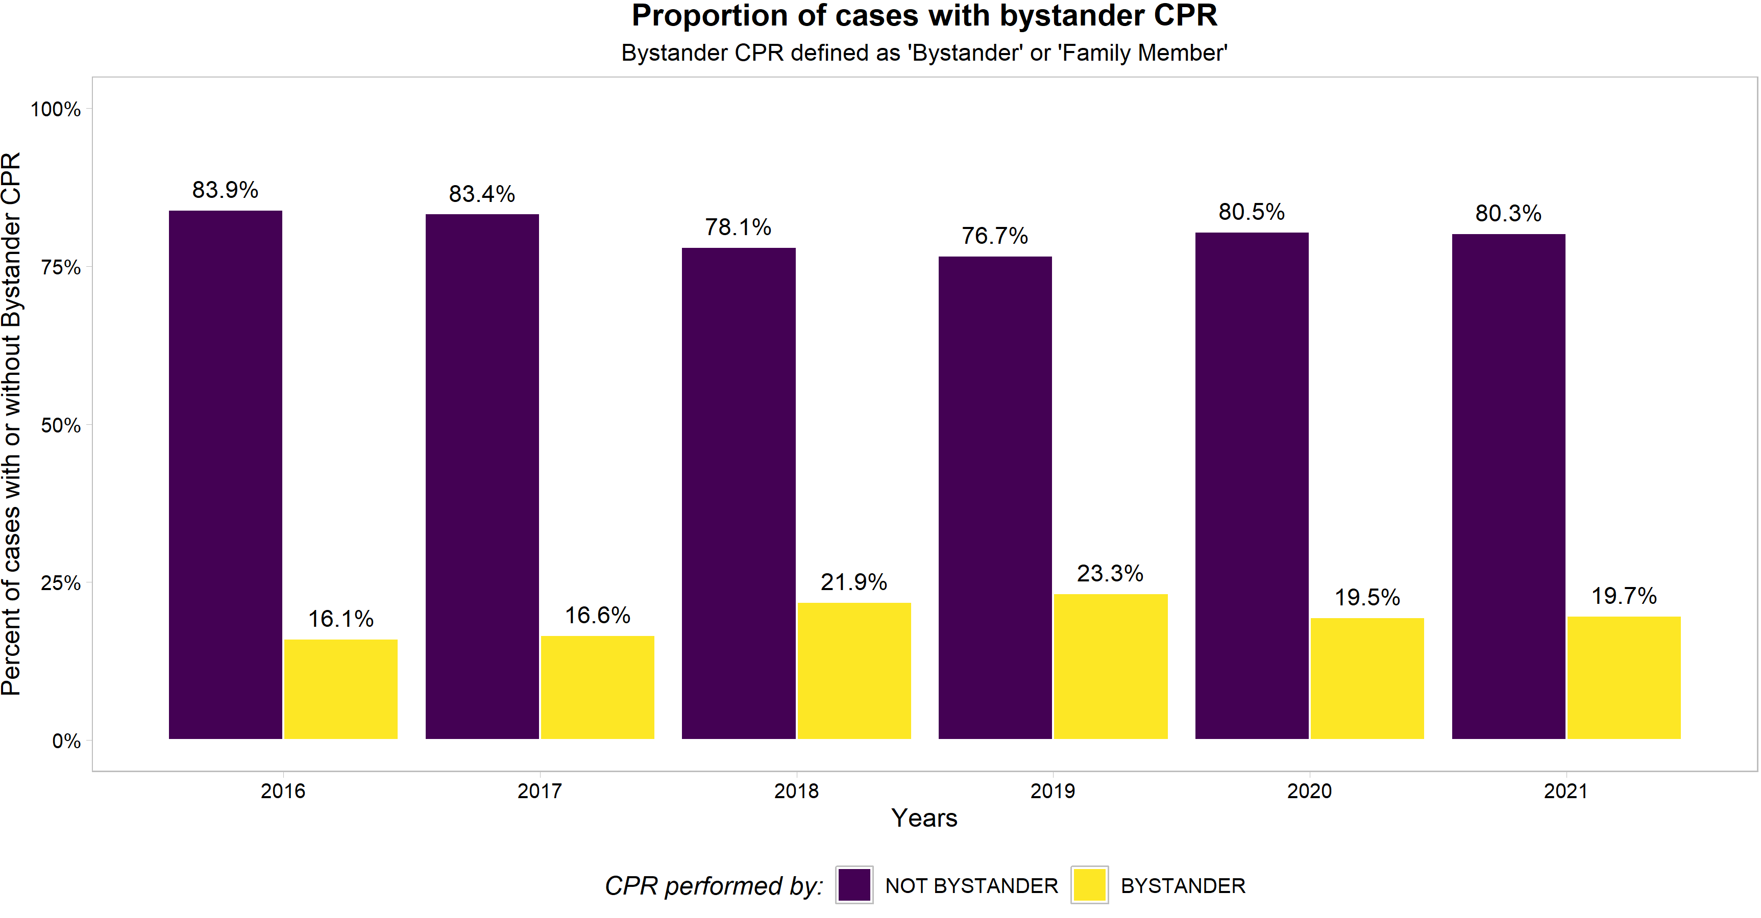
And bystander CPR initiated?
Notes:
Again – bystander CPR rates remain low across all years. The highest we’ve achieved is ~25% in 2019
We also see that there is a gap between bystander witnessed and bystander CPR… We should strive to understand why.

Slide 15
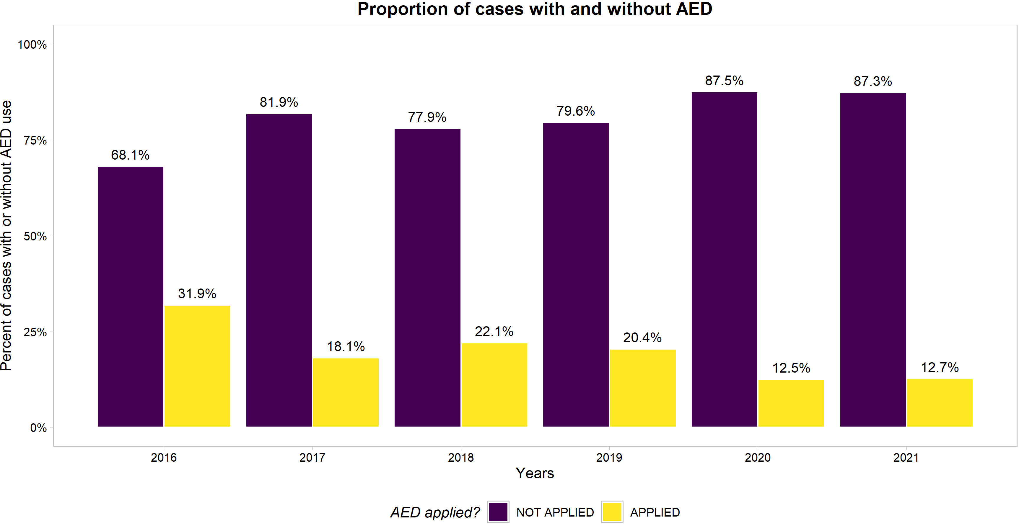
And AED use…

Slide 16
So when someone got all three elements
 | Discharged - Yes | Discharged - No
Survival Bundle - Yes | 39 | 60
Survival Bundle - No | 297 | 3956
Odds of being Discharged from Hospital if Witnessed + Bystander CPR + AED application: 8.65
Translation: 8.65x’s more likely to be discharged compared to not having all 3 elements
Notes:
Additional information:
With Bundle : 39/99 = .394; or 39.4%
Without Bundel: 297/4253 = .07; or 7%

Slide 17
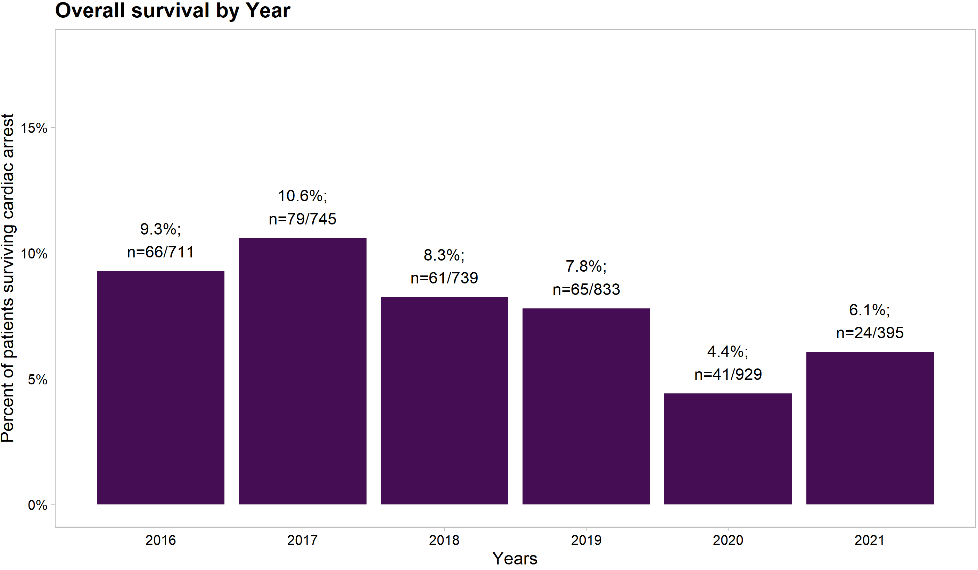
How many patients are surviving?

Slide 18
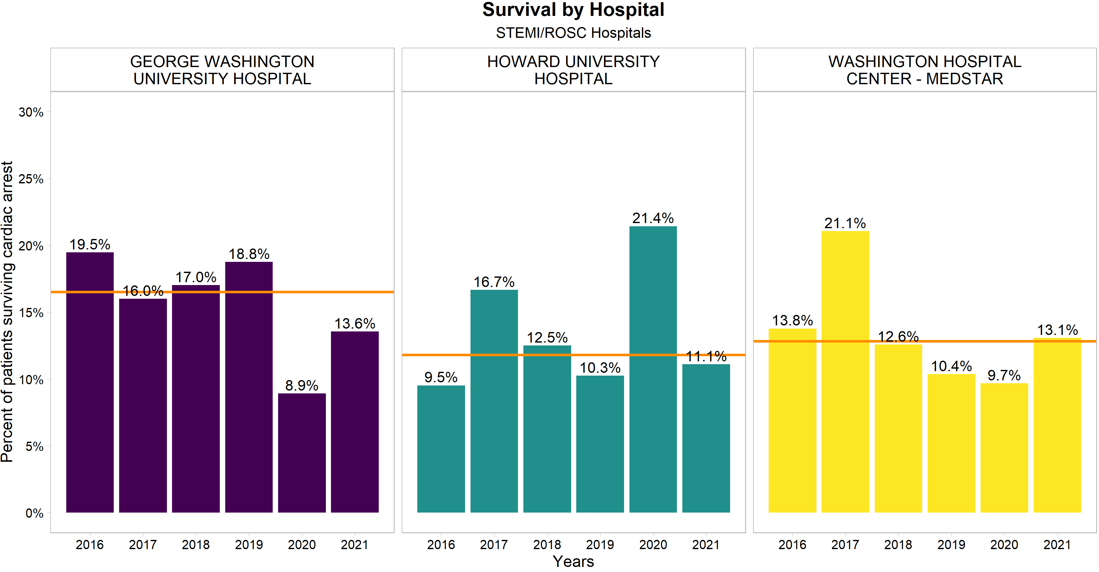
Hospital A
Hospital B
Hospital C
Notes:
Survival includes all patients transported to respective hospitals:

Slide 19
To recap what we’ve seen so far…
Majority of cardiac arrests occur in the home
More than half all of cardiac arrests are unwitnessed
Low rates of cardiac arrest Bystander or Family Member CPR
Low rates of AED use
COVID-19 has had a detrimental impact

Slide 20
An important question we are left with is…
Which groups in our community suffer more negative impacts from cardiac arrest than others?

Slide 21
What we know about the District
The 2019 1-Year American Community Survey population estimate of the District of Columbia is ~705,000
45.4% Black/African-American, alone (n~320,000)
42.5% White, alone (n~300,000)
4.3% Asian (n~30,000)
Ethnically – 11.3% Hispanic/Latino
2019 1- Year Data Estimates: ACS DEMOGRAPHIC AND HOUSING ESTIMATES: https://data.census.gov/cedsci/table?g=0400000US11&tid=ACSDP1Y2019.DP05

Slide 22
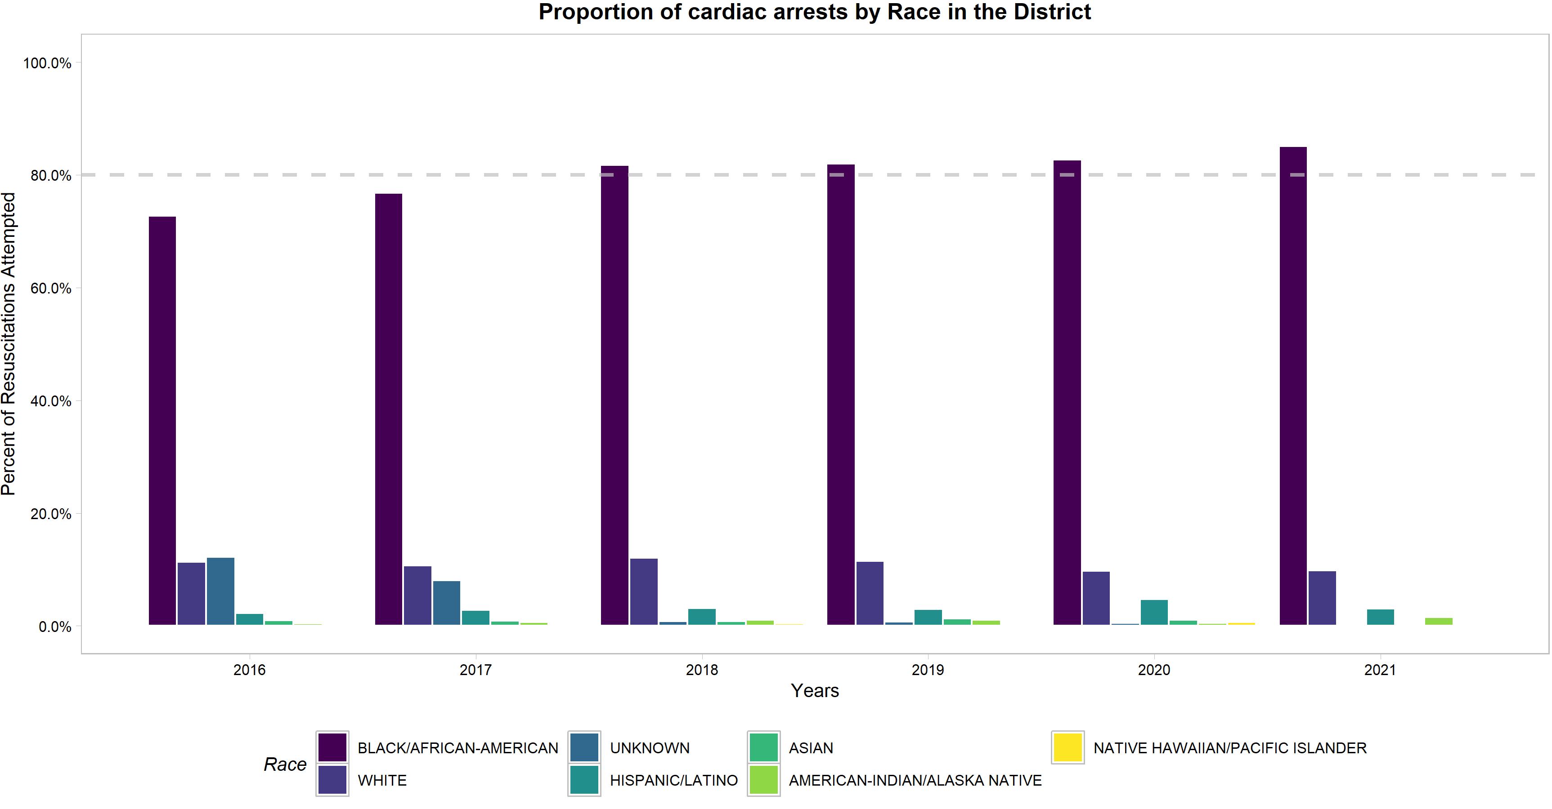
Proportionally…
Notes:
The percent of Black and African Americans suffering cardiac arrest is growing –
17 out of every 20 cardiac arrest is a Black or African American patient

Slide 23
Black and African Americans make up ~45% of the Districts population, and account for over 80% of all cardiac arrests
Estimates based on the 2019 ACS Data…
Black/African-Americans: 16 cardiac arrests per 10,000
Whites: 2.7 cardiac arrests per 10,000
Black/African-American Residents suffered cardiac arrests at 5.9x’s the rate of White residents in 2019
Notes:
Data are based on 2019 1-Year ACS statistics and 2019 CARES data.
While these rates may fluctuate year to year; proportions of cardiac arrest rates remain grossly disparate

Slide 24
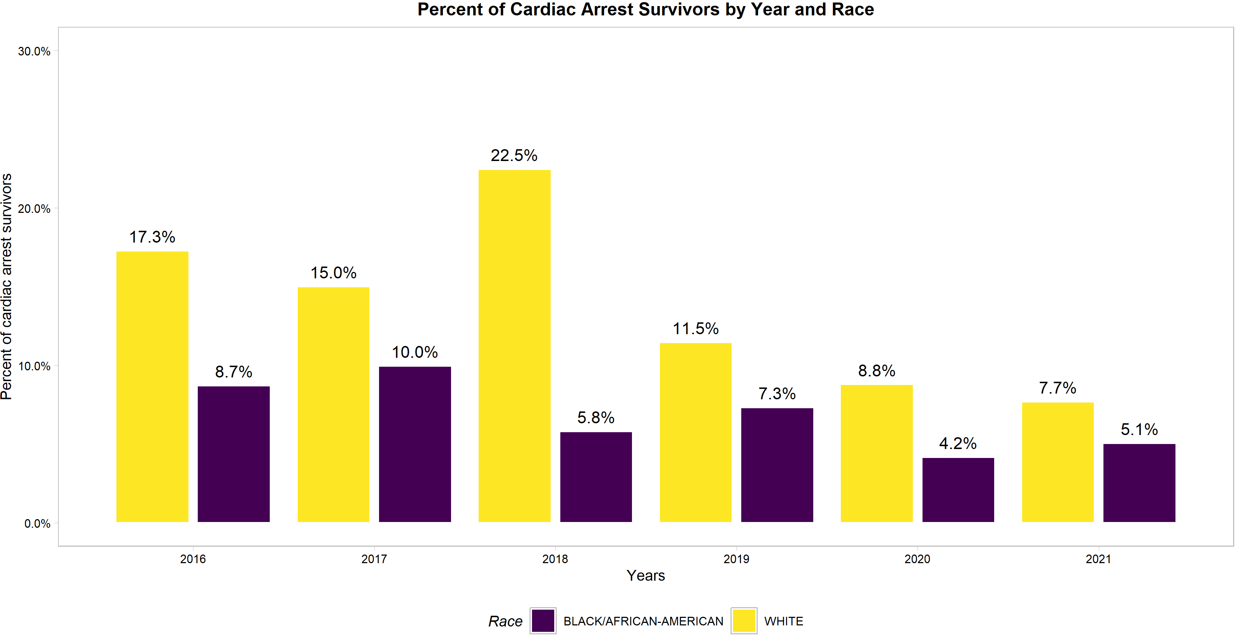
When we break down survival…

Slide 25
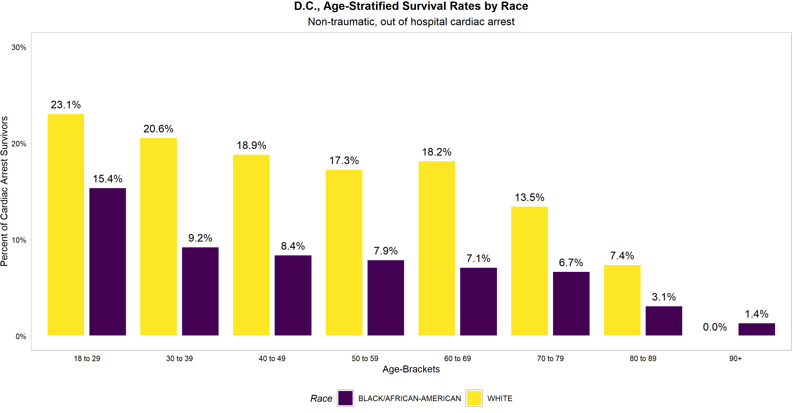
And when we stratify by age

Slide 26
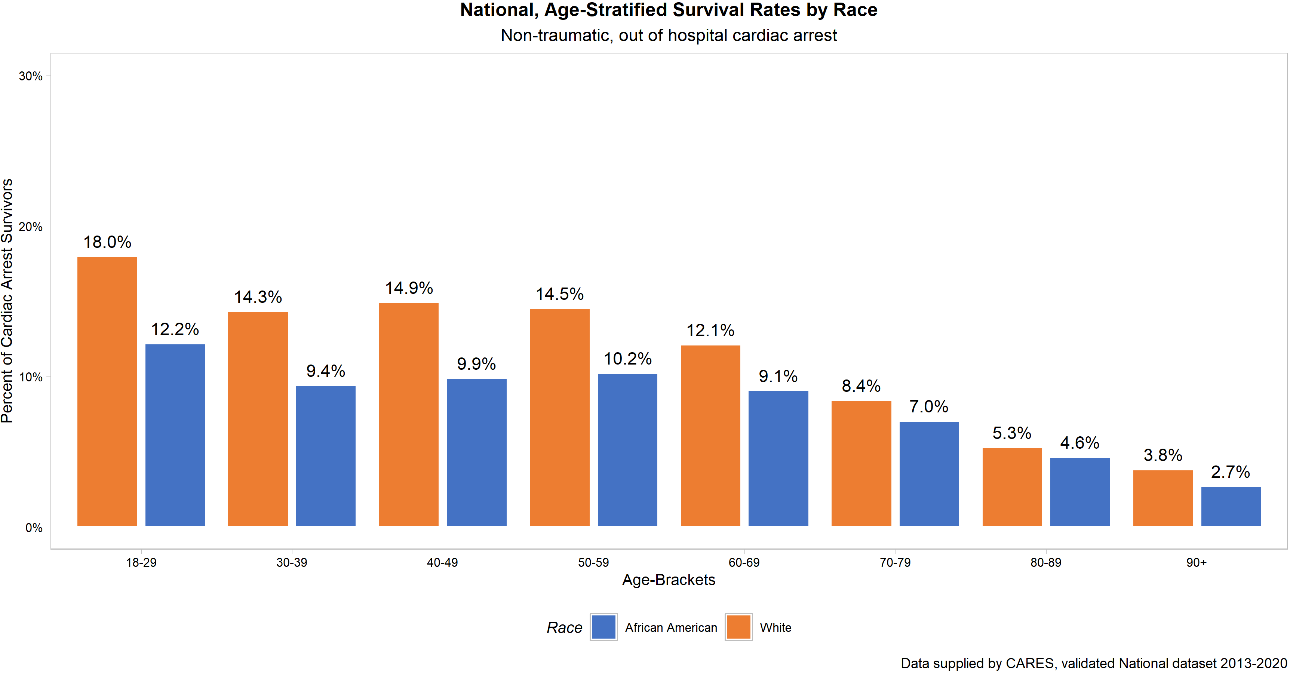
National, Age-Stratified Survival Rate

Slide 27
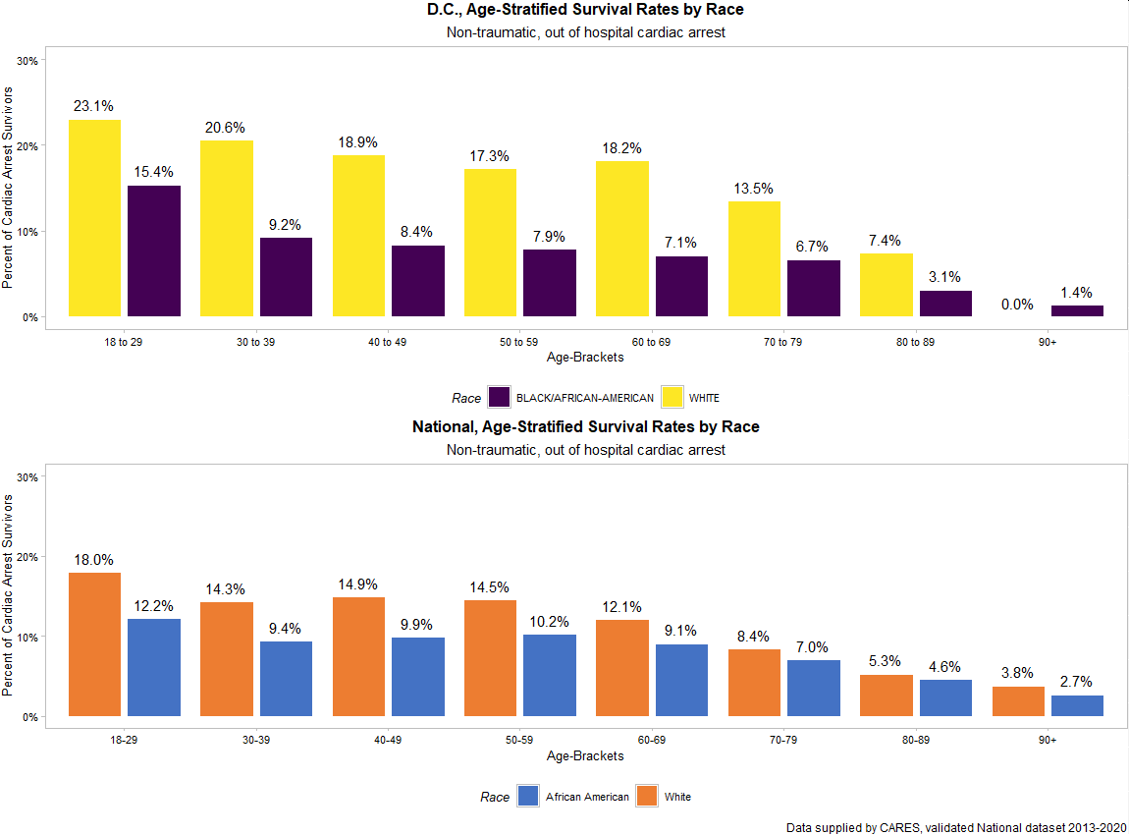

Slide 28
Key Points:
1) Black/African-American residents are disproportionately suffering from cardiac arrest
2) Black/African-American residents are disproportionately dying from cardiac arrest (not surviving)

Slide 29
Other significant contributing factors…
Compared to White patients, Black/African-American patients were:
48.7% less likely to have a “Witnessed” arrest
37.3% less likely to have “Bystander” CPR
38.8% less likely to have an AED applied

Slide 30
Survival bundle… by Race
 | Black/African-American | White
Survival Bundle - Yes | 52 | 36
Survival Bundle - No | 3428 | 440
Odds of being Black/African-American and having a witnessed cardiac arrest + bystander CPR + AED; OR: 0.185
Translation: Black/African-American patients were 81.5% less likely to have all three elements, compared to White patients
Notes:
Additional information:
With Bundle : 39/99 = .394; or 39.4%
Without Bundel: 297/4253 = .07; or 7%

Slide 31
Hospital Survival
Three hospitals in the District of Columbia receive over 70% of all cardiac arrests. Outcomes for these three hospitals are presented.
To protect their identities, they have been denoted as Hospital A, Hospital B, and Hospital C.

Slide 32
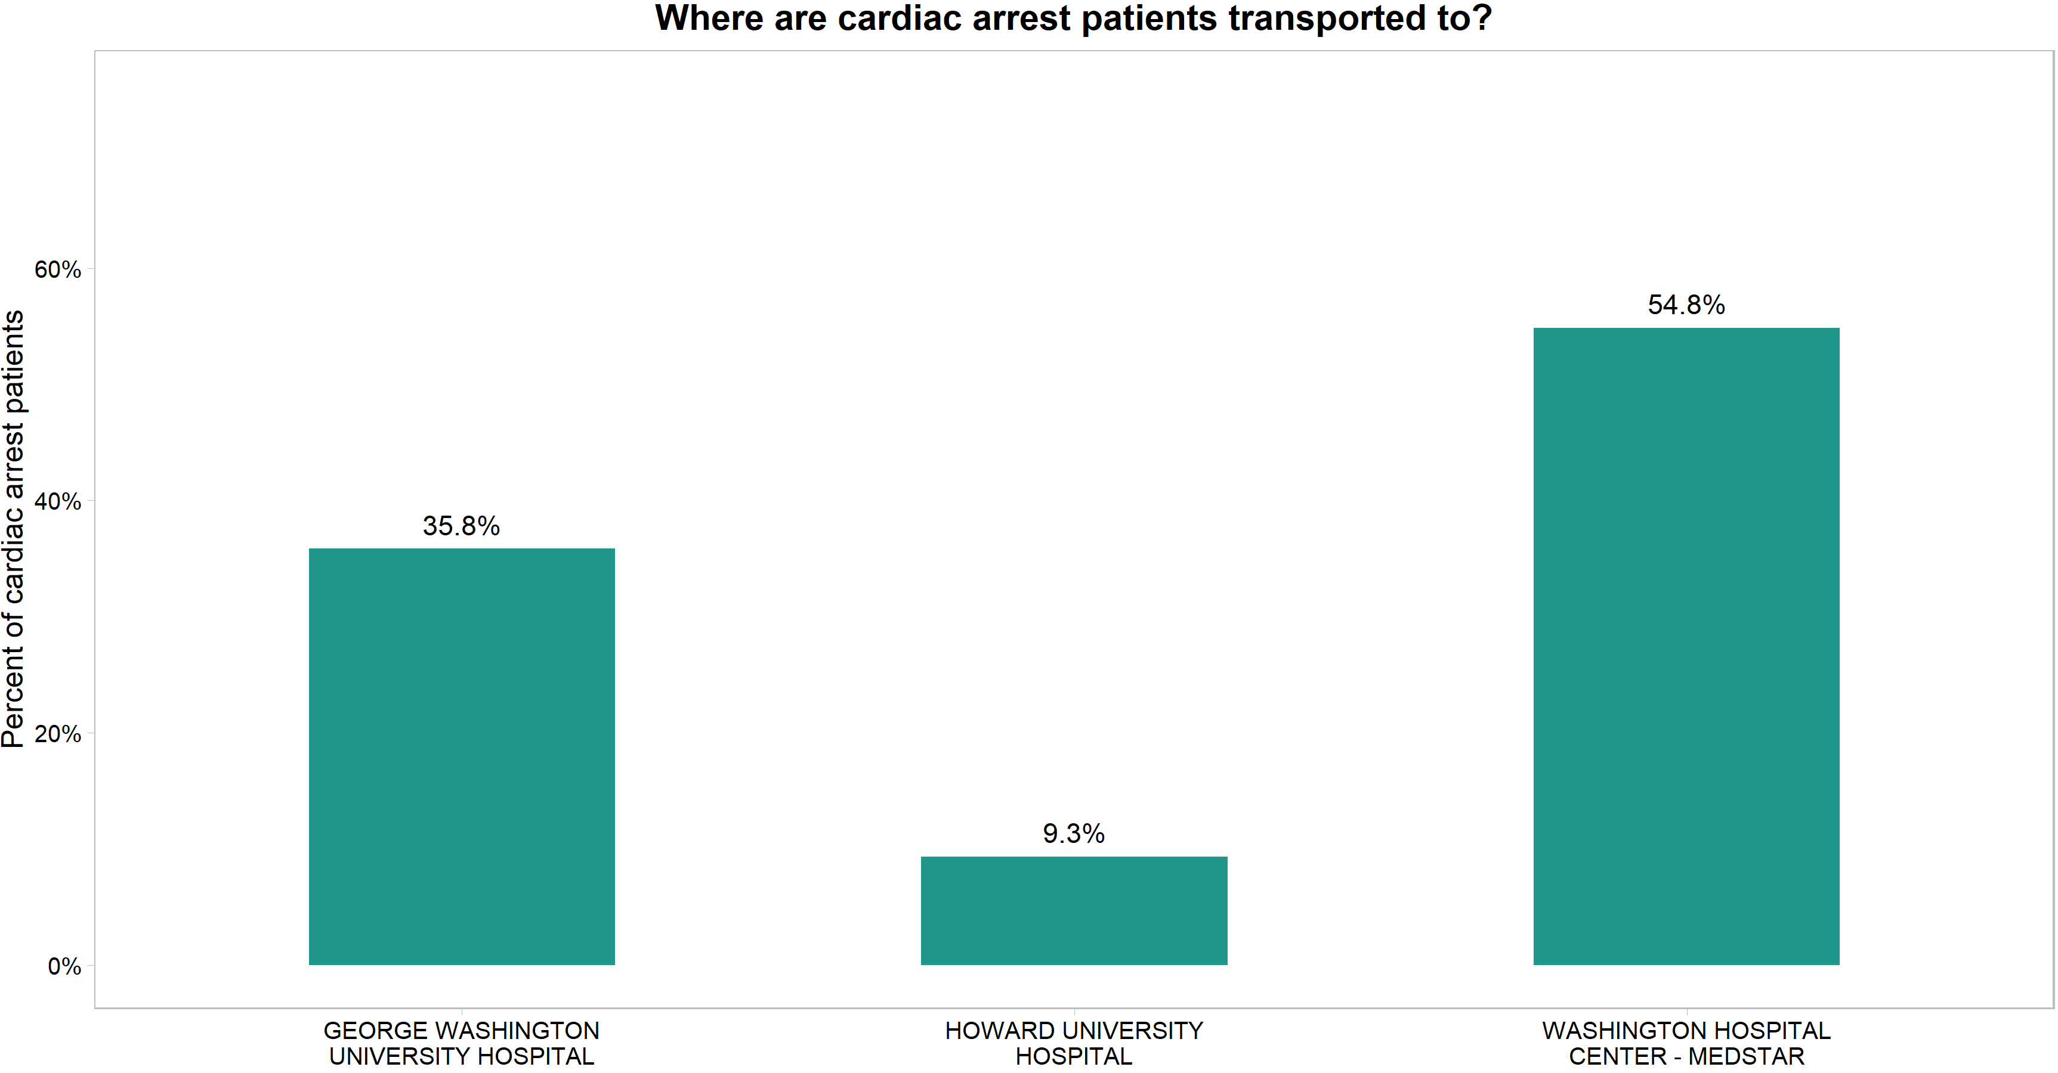
Hospital A
Hospital B
Hospital C
Notes:
These three hospitals make up 70% of hospitals we transport cardiac arrest patients to

Slide 33
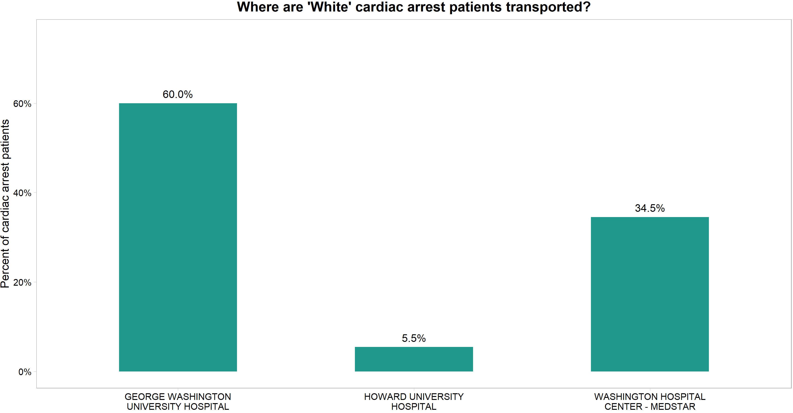
Hospital A
Hospital B
Hospital C

Slide 34
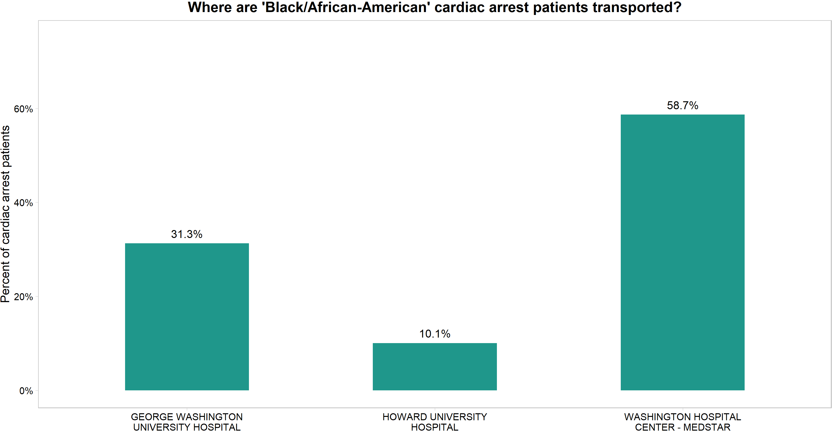
Hospital A
Hospital B
Hospital C

Slide 35
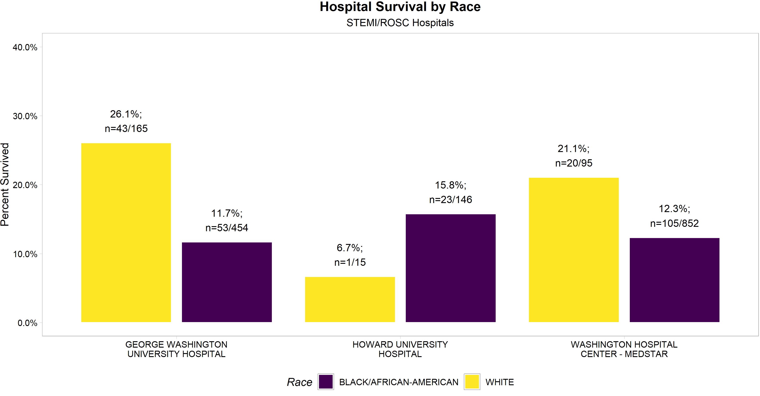
What about survival by hospital?
Hospital A
Hospital C
Hospital C
Notes:
WHC = 947; 55%
HUH = 161; 9%
GWU = 619; 36%
Total = 1727
destination_hospital race_ethnicity NO YES total survival
<chr> <chr> <int> <int> <int> <dbl>
1 GEORGE WASHINGTON UNIVERSITY HOSPITAL BLACK/AFRICAN-AMERICAN 401 53 454 0.117
2 GEORGE WASHINGTON UNIVERSITY HOSPITAL WHITE 122 43 165 0.261
3 HOWARD UNIVERSITY HOSPITAL BLACK/AFRICAN-AMERICAN 123 23 146 0.158
4 HOWARD UNIVERSITY HOSPITAL WHITE 14 1 15 0.0667
5 WASHINGTON HOSPITAL CENTER - MEDSTAR BLACK/AFRICAN-AMERICAN 747 105 852 0.123
6 WASHINGTON HOSPITAL CENTER - MEDSTAR WHITE 75 20 95 0.211
N=1727
GWU = 619; 36%
HUH = 161; 9%
WHC = 947; 55%
White(N) = 275
Race:
GWU = 165 60%
HUH = 15; 5.5%
WHC = 95; 34.5%
Black(N) = 1452
Race:
GWU = 454; 31.3%
HUH = 146; 10.1%
WHC = 852; 58.7%

Slide 36
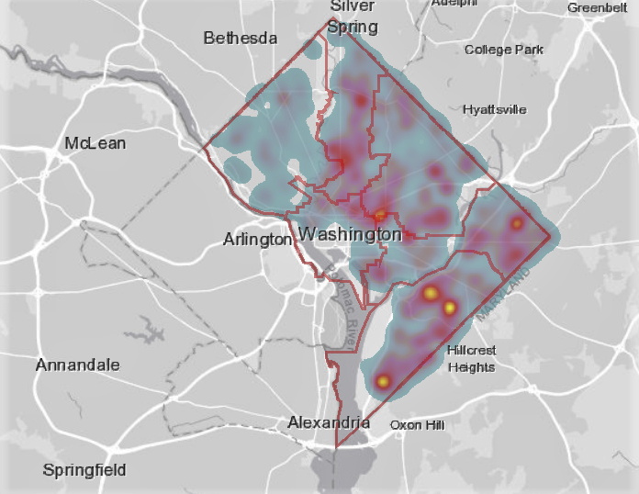
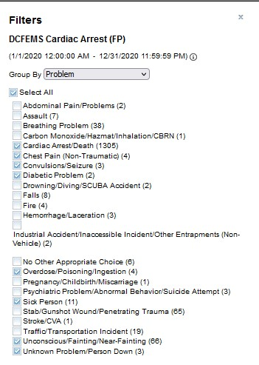
Notes:
Data from FirstWatch website, 2020 data

Slide 37
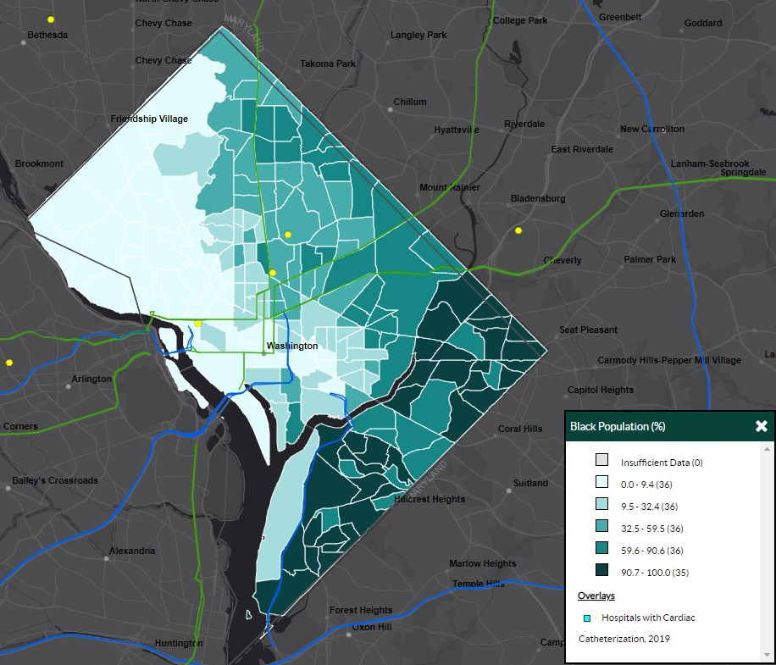
Notes:
Data from the CDC Interactive Map website: https://nccd.cdc.gov/dhdspatlas/
Each yellow dot represents a hospital with “Cardiac Intensive Care”

Slide 38
In summary…
Cardiac arrest cases appear to be increasing in the District of Columbia
We have low rates of witnessed cardiac arrests, low rates of bystander CPR, and low rates of AED application
Overall survival rates have declined, and remain low so far
Black/African-American residents disproportionately suffer from cardiac arrest, and the negative consequences from it
There is disparity in across our three STEMI/PCI hospitals

Slide 39
Knowing what we now know… consider:
If every system is perfectly designed to get the results you get… then what do these outcomes tell us about our system?
Are there immediate steps we can take to address gaps in care/outcomes?
What else do we need to consider as it relates to these outcomes?

Slide 40
Look around the room and ask yourself…
Who isn’t here, that should be?
What is my role in the system of cardiac arrest prevention, treatment and recovery?
How can I help or contribute to other elements/parts of the system of prevention, treatment and recovery?
Notes:
Who else do we need at the table? How do we get them here?
Consider individual and organizational role
Consider what the individual can do themselves?

